Slide 1
PySpark - Day 1 Training
Introduction, Architecture, RDD & DataFrame Basics

Slide 2
Day 1 Agenda
Introduction to Big Data & Apache Spark
Spark vs Hadoop
Spark Architecture & Execution Flow
RDD Basics & Hands-On
DataFrames Basics & Hands-On

Slide 3
Introduction to Big Data
Explosion of data in Volume, Variety, Velocity, Veracity
Traditional systems (RDBMS) fail with scale
Need for distributed processing frameworks
Hadoop was first solution → Spark is faster alternative

Slide 4
Why Apache Spark?
Open-source distributed processing engine
In-memory computation → up to 100x faster than Hadoop MapReduce
Unified platform: Batch, Streaming, ML, Graph
APIs in Python (PySpark), Scala, Java, R

Slide 5
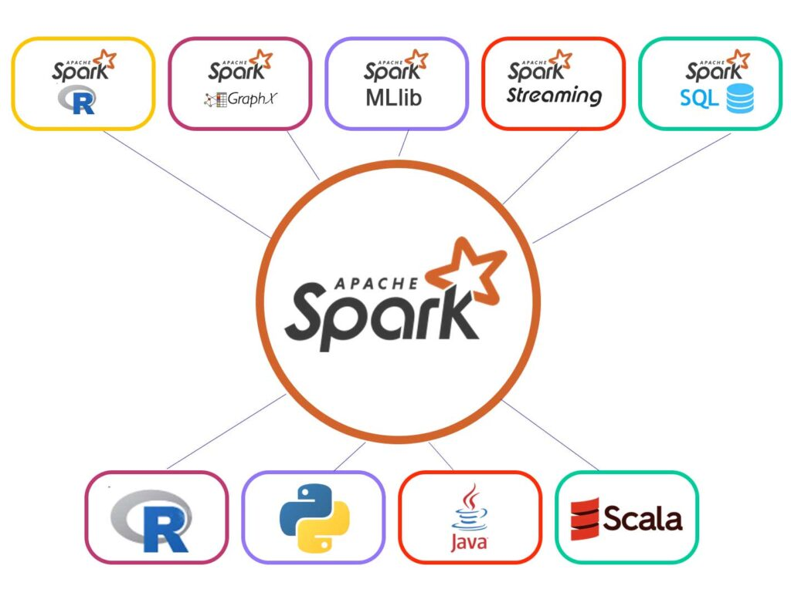
Why Apache Spark?

Slide 6
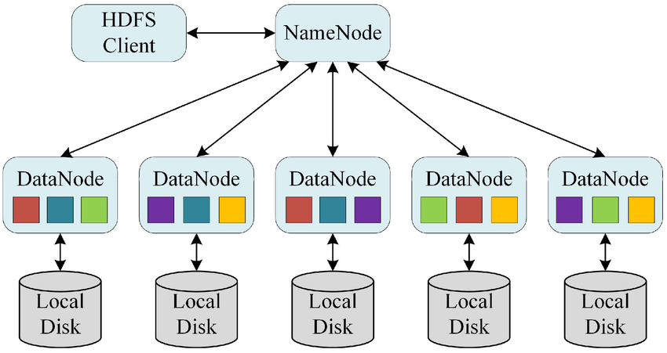
HDFS

Slide 7
Apache Spark vs Hadoop MapReduce
Spark: In-memory, real-time + batch, interactive
Hadoop MapReduce: Disk-based, batch only, slower
Spark supports advanced analytics → MLlib, GraphX, Streaming
Hadoop strong in storage (HDFS) + batch jobs

Slide 8
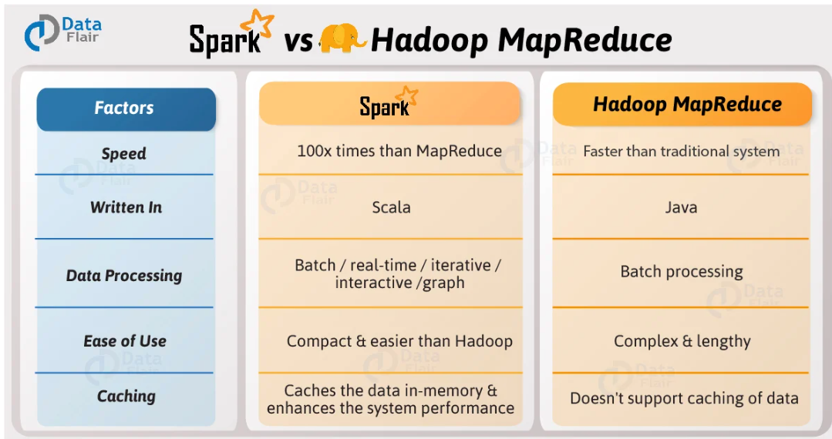
Apache Spark vs Hadoop MapReduce

Slide 9
Spark Architecture Components
Driver Program: Controls execution of tasks
Cluster Manager: Allocates resources (Standalone, YARN, Kubernetes)
Executors: Run tasks, process data, store results

Slide 10

Spark Architecture Components

Slide 11
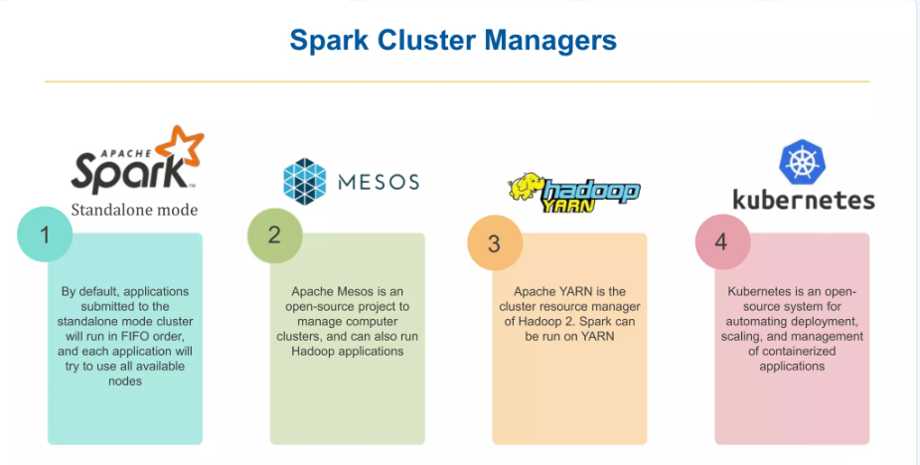
Spark Architecture Components

Slide 12
Spark Job Execution Flow
Step 1: Driver submits job to Cluster Manager
Step 2: Job divided into stages
Step 3: Each stage → multiple tasks
Step 4: Executors run tasks in parallel
Step 5: Results returned to Driver

Slide 13
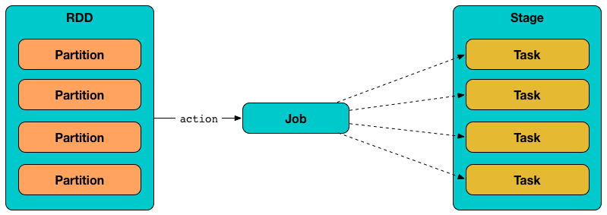
Spark Job Execution Flow

Slide 14
Lazy Evaluation in Spark
Transformations are not executed immediately
Execution triggered only by actions (e.g., collect, count)
Optimizes the execution plan before running

Slide 15
Resilient Distributed Datasets (RDD)
Fundamental data structure in Spark
Immutable, partitioned, fault-tolerant
Supports two operations: Transformations & Actions
Examples: map, filter, reduce, collect

Slide 16
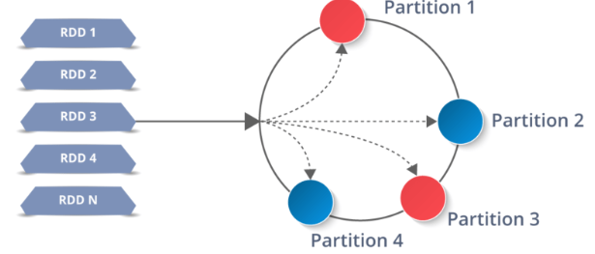
Resilient Distributed Datasets (RDD)

Slide 17
Hands-On: RDD Example
from pyspark.sql import SparkSession
spark = SparkSession.builder.appName('RDD Example').getOrCreate()
rdd = spark.sparkContext.parallelize([1,2,3,4,5])
rdd2 = rdd.map(lambda x: x*2).collect()
print(rdd2) # Output: [2,4,6,8,10]

Slide 18
DataFrames in Spark
Distributed collection of data organized into columns
Similar to SQL tables / Pandas DataFrames
Optimized by Catalyst Optimizer
APIs: select, filter, groupBy, agg

Slide 19
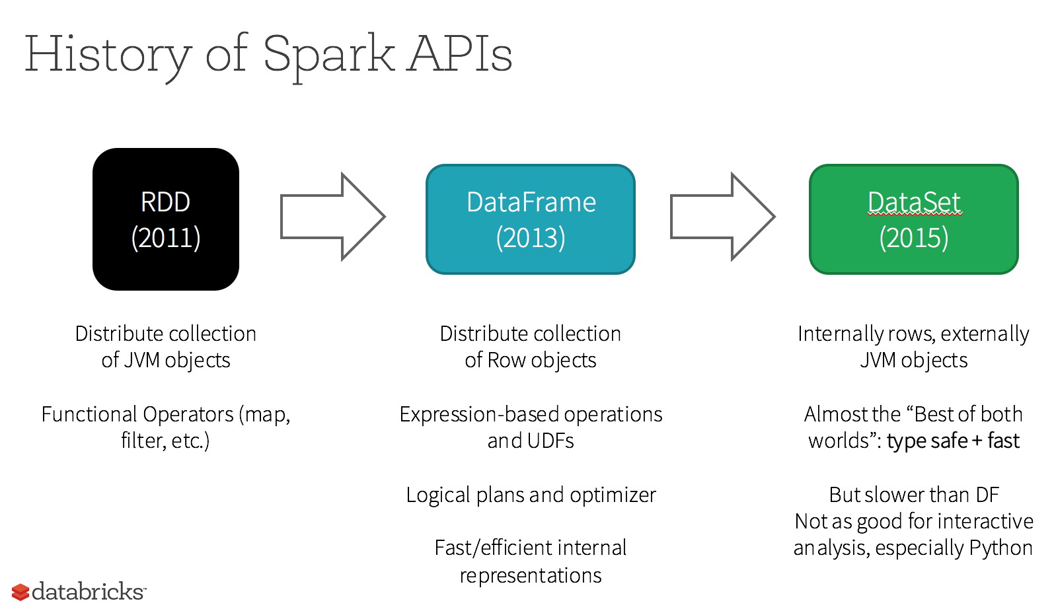
DataFrames

Slide 20
Hands-On: DataFrame Example
data = [(1, 'Alice', 20), (2, 'Bob', 25)]
df = spark.createDataFrame(data, ['id', 'name', 'age'])
df.show()
df.filter(df.age > 21).show()

