Slide 1
Automatic Image Registration
Digital Image Processing - Mini Project

Slide 2
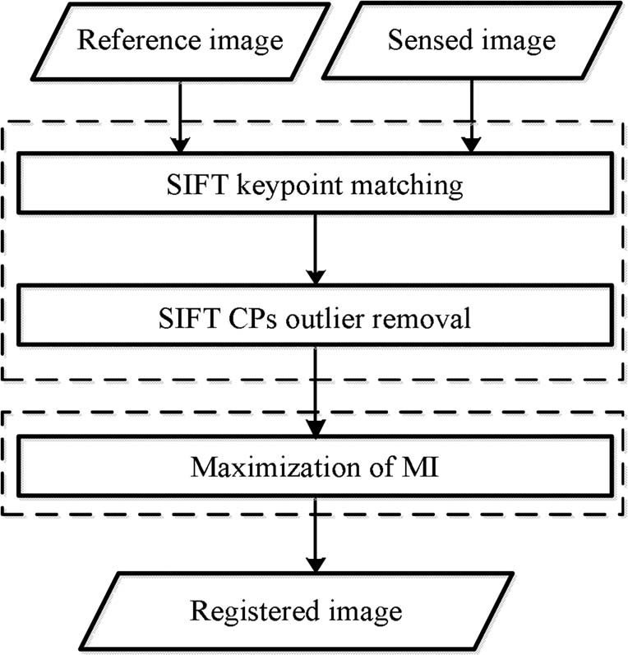
Objective
Implement Coarse-to-Fine Scheme for Automatic Image Registration Based on SIFT feature matching and mutual information leaving the optimisation step.
Test the performance from the test images of the referenced publications.

Slide 3
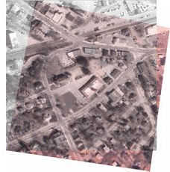
Image Registration
Image Registration is a critical approach to determine the most
accurate match between two photographs of the same scene taken
at different times, with different sensors, and from
different viewpoints. The reference and sensed
images are geometrically aligned during this
process.

Slide 4


SIFT - Scale Invariant Function Transform
SIFT feature descriptor is invariant to uniform scaling, orientation, illumination changes, and partially invariant to affine distortion.
Scale-Space Extrema Detection
Keypoint Localisation
Orientation Assignment
Keypoint Descriptor
Keypoint Matching

Slide 5
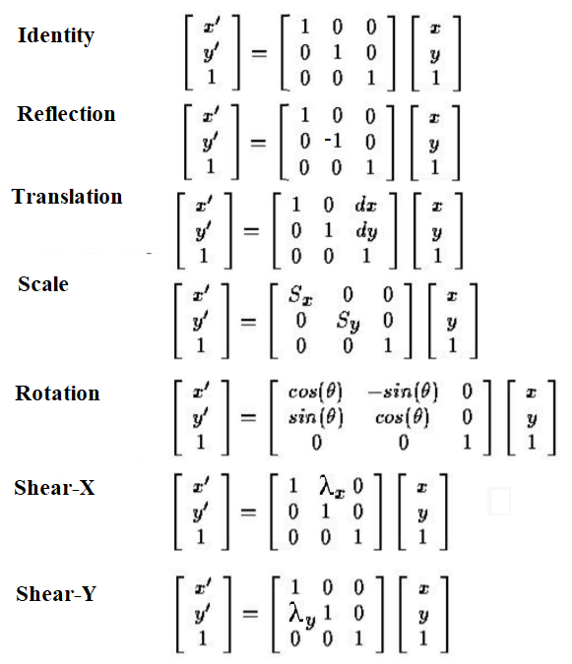
Affine Transformation
Any transformation that retains collinearity (i.e., all points lying on a line initially still lie on a line after transformation) and distance ratios (e.g., the midpoint of a line segment remains the midpoint after transformation) is called an affine transformation.

Slide 6
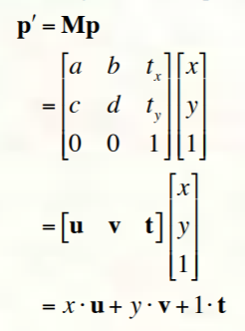
Change of frame is known as the affine transformation and it is incorporated using u,v and t (basis and origin) as a frame for an affine space.
Matrix as well as vector representation of affine transformation is shown:

Slide 7
Algorithm
Find nearest matching of SIFT features using knnMatch()
Ratio Test b/w best match and second best match to select points with ratio < 0.6
Outlier Removal using histogram of ratio of dist. between keypoints
Affine Matrix estimation using least square method
Performing Affine Transform and aligning with reference image

Slide 8
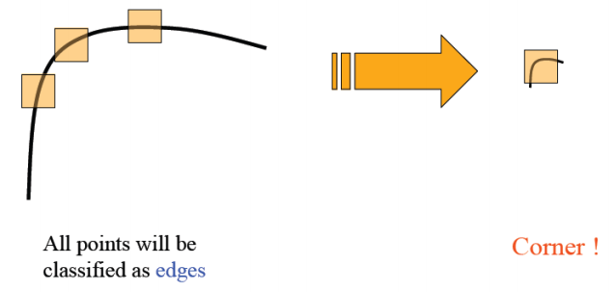
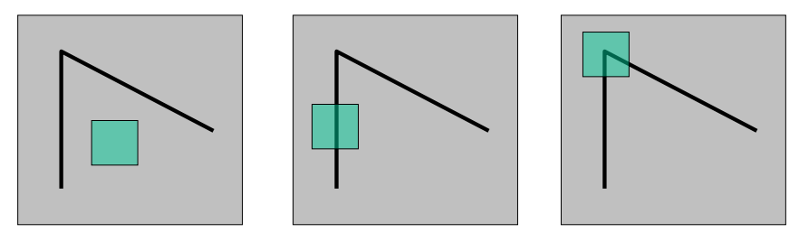
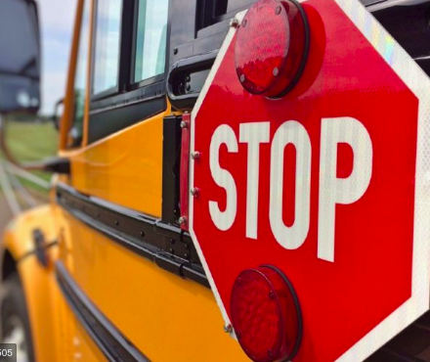
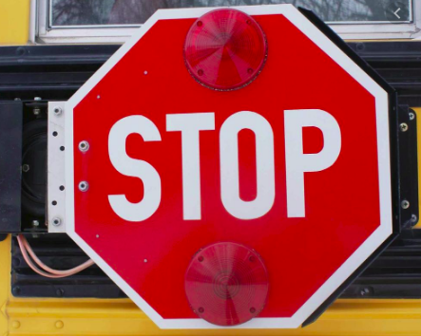
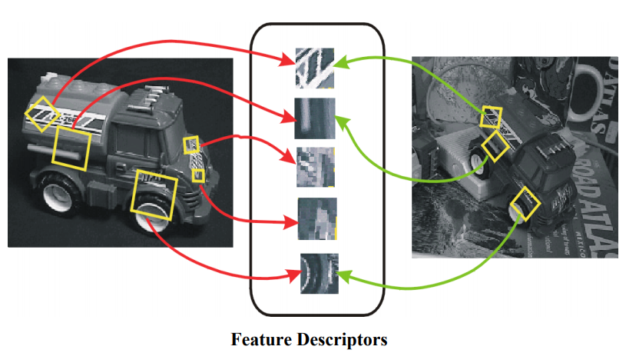
SIFT feature detection:
We see that how 2 dimensional difference are enough to identify a feature, but what about scale?
How can a point in an image can be selected as good feature ?
So, scale imposes 3rd dimension, now what about change in perspective?
Considering all the factor, 128 dimensional descriptor for each feature.

Slide 9
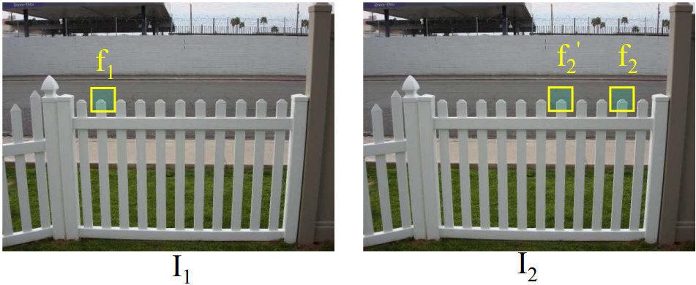
Feature Matching:
Given a feature in I1, how to find the best match in I2 ?
Use SSD (Sum of square differences).
Suppose f2 is the best match of f1 and f2’ is second best match found using KNN.
Problem: How to eliminate bad matches.
Better approach: ratio distance = SSD(f1, f2) / SSD(f1, f2’)
An bad match will have ratio close to 1
Look for unique matches which have low ratio (This will be threshold value)

Slide 10
Outlier Removal:
Even after the removal of false initial matches through a ratio threshold, some incorrect matches may still exist. Therefore, a reliable outlier removal process is necessary.
Suppose after the ratio threshold we find m matched keypoints {Ri } and {Si } belonging to the reference and sensed images, respectively, let RiRj be the distance between keypoints Ri and Rj and Si Sj be the distance between keypoints Si and Sj . A distance ratio Dij is defined as:
Dij = RiRj/SiSj
Now we form a scale histogram based upon Dij and remove all the match pair which does not belong to the maximum density bin of the formed histogram. Which is basically the true scale difference between the images.

Slide 11
Affine matrix estimation.
Once we have minimum of 3 match point pair in the images, we estimate the Affine matrix that will convert the sensed image into reference image plane (i.e sensed image being source and reference image being destination).
This is performed using least square method and we used cv.estimateAffinePartial2D() function to do so. Final Registration:
Once we have our affine matrix, we calculate the bounds of coordinates of sensed image after transformation.
Based upon this bounds we calculate the padding required for destination image, as well as the translation of sensed image so that after transformation it doesn't get clipped.
At last we just superimpose padded reference image with the transformed sensed image.

Slide 12
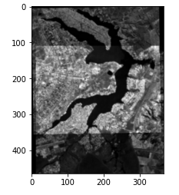
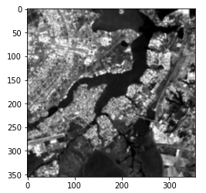
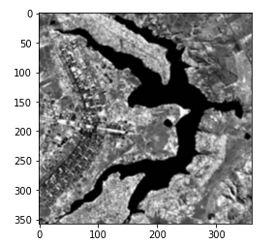
Results - I
Reference Image
Sensed Image
Output Registered Image

Slide 13
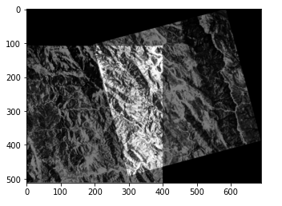
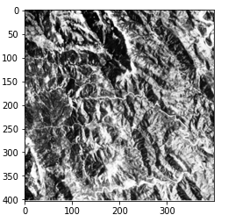
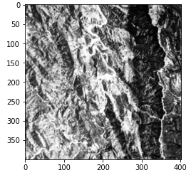
Results - II
Reference Image
Sensed Image
Output Registered Image

Slide 14
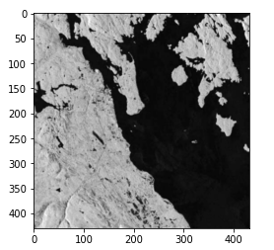
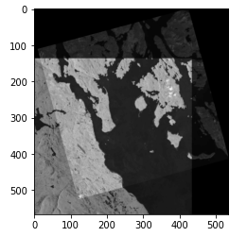
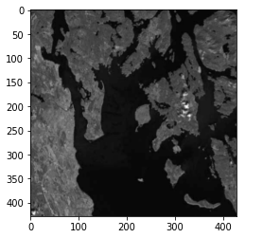
Results - III
Reference Image
Sensed Image
Output Registered Image

Slide 15
Thank You
This work has been done by
Anand Jhunjhunwala (17EC35032)
Parakh Agarwal(17EC35016)
Under the guidance of
SK Nehra
Prof. Saumik Bhattacharya
Please contact us at anandjhunjhunwala913@gmail.com or parakh.iitkgp@gmail.com incase of any queries,

