Slide 1
SPSS DATA ANALYTICS
NAME:-
Anand Jha

Slide 2
ANALYZE A DATA GIVEN OF STUDENTS OF A CLASS
GIVEN:
1.AGE
2.HEIGHT
3.WEIGHT
4.NAME

Slide 3
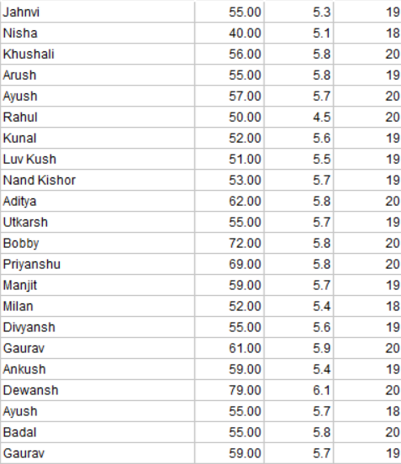
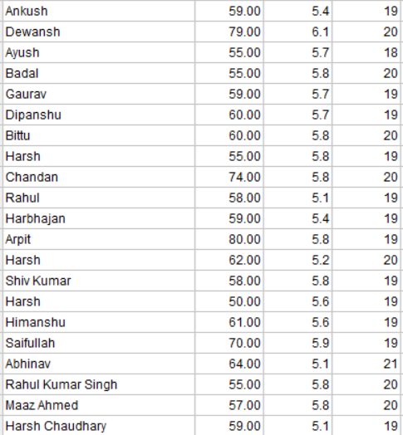
THE DATA OF THE STUDENTS IS TAKEN FROM A CLASS OF 48 STUDENTS

Slide 4
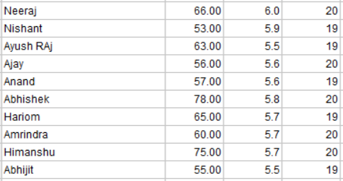
NOW THIS IS THE COMPLETE DATA PROVIDED AND NOW WE HAVE TO ANALYSE AND GENERATE SOME DATA LIKE MODE, MEDIAN, ETC.

Slide 5
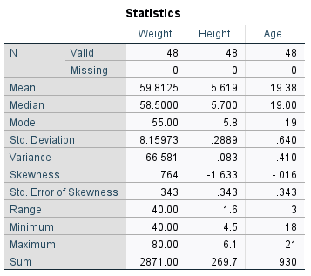
NOW HERE IS A ANALYTICS REPORT THAT WE HAVE CREATED USING THE SPSS SOFTWARE BY THE IBM

Slide 6
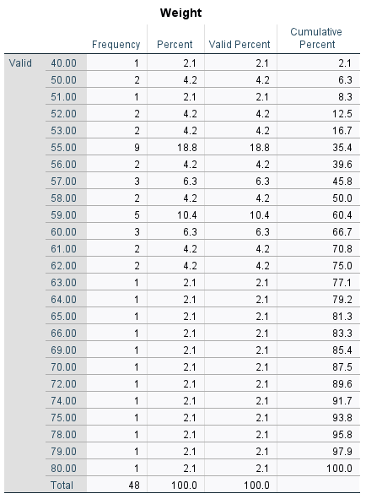
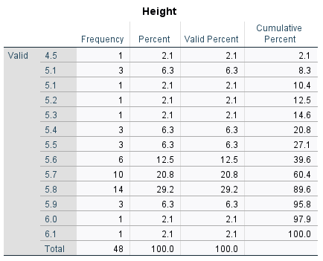
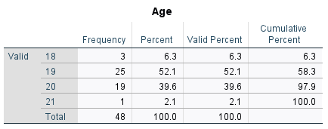
Frequency Tables

Slide 7
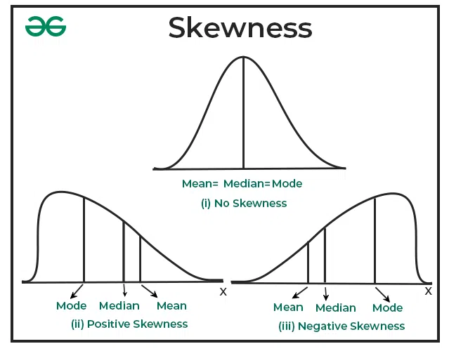
SKEWNESS:
IN STATISTICS AND PROBABILITY THEORY, SKEWNESS IS A MEASURE OF HOW ASYMMETRIC A DISTRIBUTION IS AROUND ITS MEAN. IT CAN BE POSITIVE, NEGATIVE, ZERO, OR UNDEFINED

Slide 8
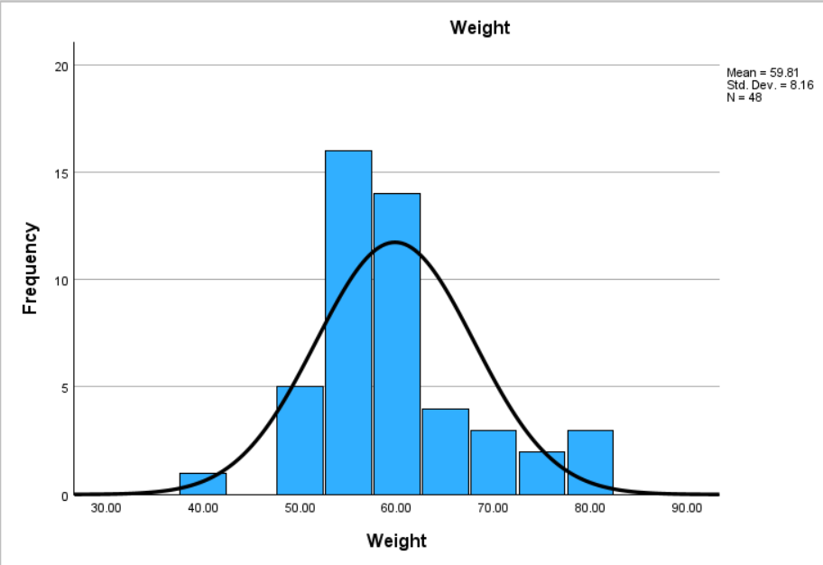
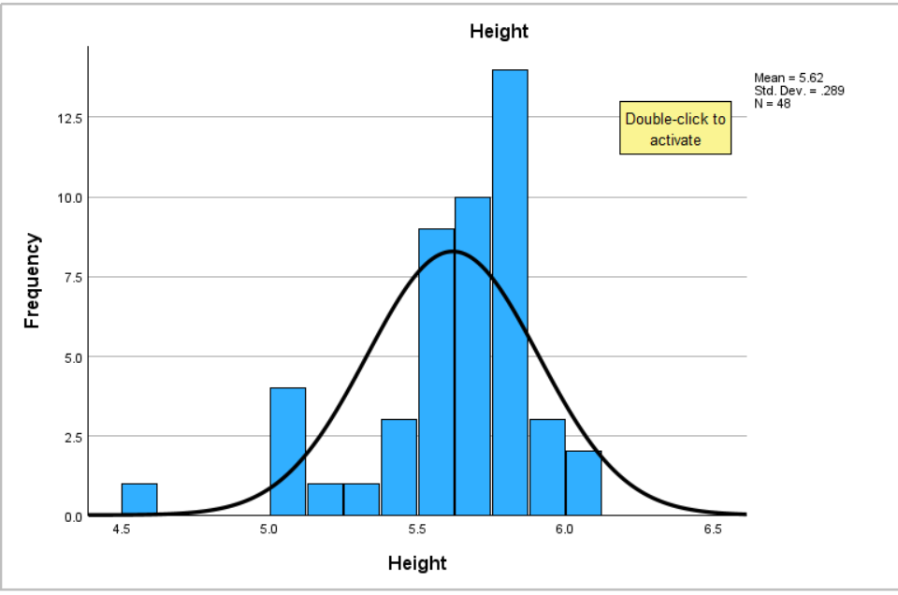

Slide 9
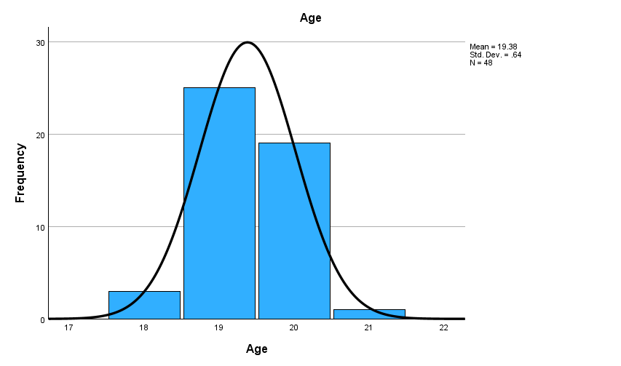

Slide 10
As you have seen in the holograms that all the three entities have the same and especially a “normal curve” or you can say there is no skewness in the graphs and hence it is one of the best data.
Summary
Data Analysis
All three entities exhibit a normal curve
No skewness in the graphs
Data quality is high

