Slide 1
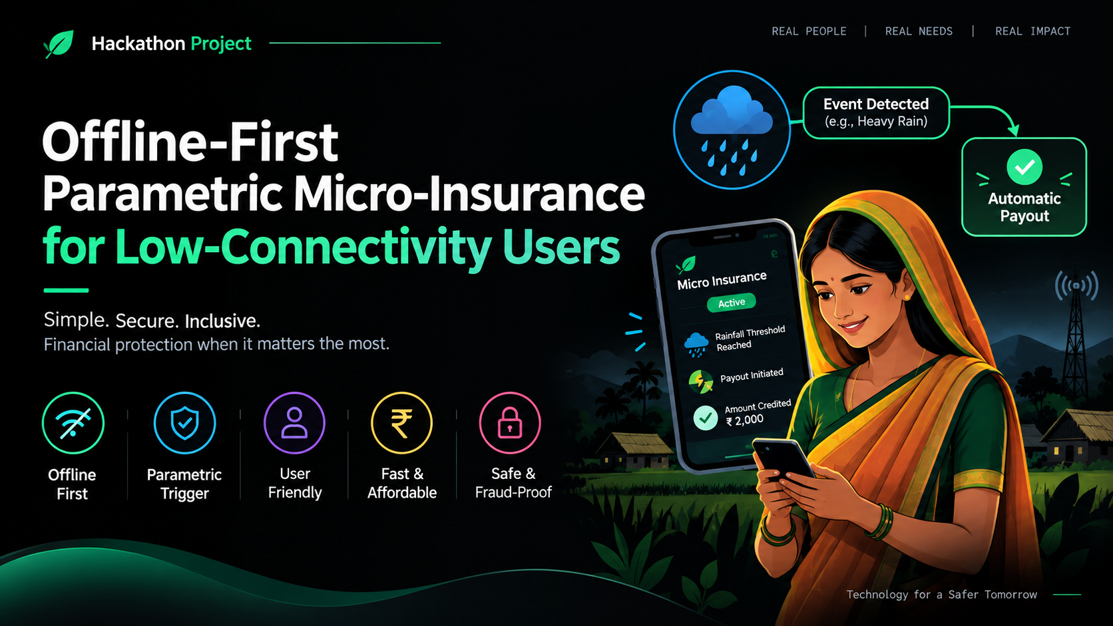

Slide 2
1. Problem Statement
The challenge
What we need to build
People in low-connectivity areas may need financial protection, but traditional insurance often depends on internet access, paperwork, claim forms and physical inspections.
An insurance system that can work with very limited connectivity, automatically trigger eligible payouts from measurable events, and keep the process simple and understandable.
2

Slide 3
2. Why Current Insurance Can Fail
Limited internet access makes online claims difficult.
Manual claim forms and inspections can delay financial support.
Users may have low digital literacy or limited ability to read long documents.
Small-value insurance needs a low-cost, low-friction process.
Fraud prevention is important when payouts happen automatically.
3

Slide 4
3. Proposed Solution
1. Simple policy
2. Offline-first app
3. Event trigger
User selects a small, affordable coverage plan.
Policy data and actions remain available without continuous internet.
External data confirms whether a predefined event threshold is reached.
4. Verification
5. Automatic payout
System checks policy validity, event evidence and duplicate/fraud signals.
Eligible users receive the payout without a conventional claim inspection.
4

Slide 5
4. How the System Works
Example: rainfall-triggered micro-insurance
USER
OFFLINE APP
EVENT DATA
RULE ENGINE
VERIFY
PAYOUT
Buys policy
→
Stores policy locally
→
Rainfall / disaster signal
→
Checks threshold
→
Policy + event + fraud checks
→
Trigger payment
Example rule: if verified rainfall exceeds the policy threshold for the covered location and period,
the system automatically initiates the predefined payout.
5

Slide 6
5. Key Features
Offline-first
Parametric triggers
Simple UX
Core policy view, claim status and queued actions remain usable with intermittent connectivity.
Payout is based on objective measurable conditions rather than lengthy manual claims.
Large actions, local-language support and voice/audio guidance can reduce complexity.
Fraud controls
Sync when online
Transparent status
Validate policy status, event evidence, timestamps and duplicate payout attempts.
Queued transactions synchronize securely when a network connection returns.
Users can see policy, trigger condition, payout status and reason.
6

Slide 7
7. Example User Journey
A
Ravi selects a ₹50 micro-insurance plan.
B
The policy is saved on the phone for offline access.
C
A covered rainfall threshold is reached in the insured area.
D
When connectivity is available, event evidence is synchronized and verified.
E
The policy rule is satisfied and the predefined payout is initiated.
F
Ravi receives a simple confirmation and can view the payout status.
8

Slide 8
8. Innovation & Social Impact
Innovation
Social impact
Scalability
Combines parametric insurance with offline-first design, automated rules and resilient synchronization.
Can improve access to rapid financial protection for users who face unreliable connectivity and limited access to conventional insurance processes.
The same framework can support rainfall, flood, heat, crop, travel or other measurable event-based insurance products.
9

Slide 9
9. Hackathon MVP
User registration + simple policy selection
Offline policy storage and offline status screen
Parametric rule engine with simulated event data
Event verification and basic fraud/duplicate checks
Automatic payout simulation with transaction history
Simple dashboard for insurer/admin monitoring
Optional: local-language and voice-guided interface
10

Slide 10
Thank You
Protecting people should not depend on having a perfect internet connection.
Offline-first • Parametric • Inclusive • Fast
12

