Slide 1
SDN Based Threat Vector And Security Solutions
(Research)
SPRINT
Anand Kumar
Amogh Eshappa Setra
Nandan Goudar
Sachin Uplaonkar

Slide 2
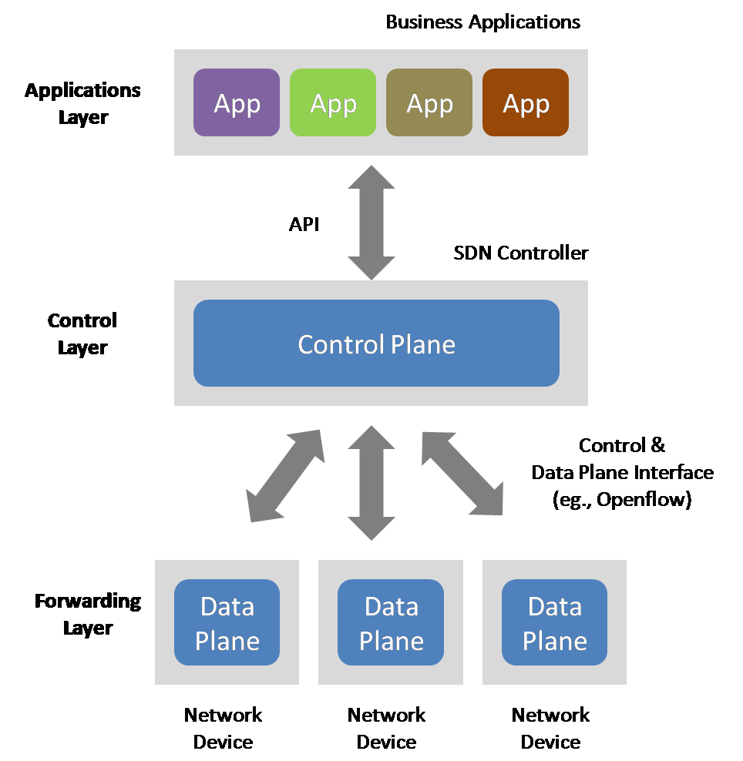
What is SDN?
Three layer architecture
Centralized intelligence

Slide 3
Two Key Definitions
Data Plane: processing and delivery of packets
– Based on state in routers and endpoints
– E.g., IP, TCP, Ethernet, etc.
– Fast timescales (per-packet)
Control Plane: establishing the state in routers
– Determines how and where packets are forwarded
– Routing, traffic engineering, firewall state, …
– Slow time-scales (per control event)

Slide 4
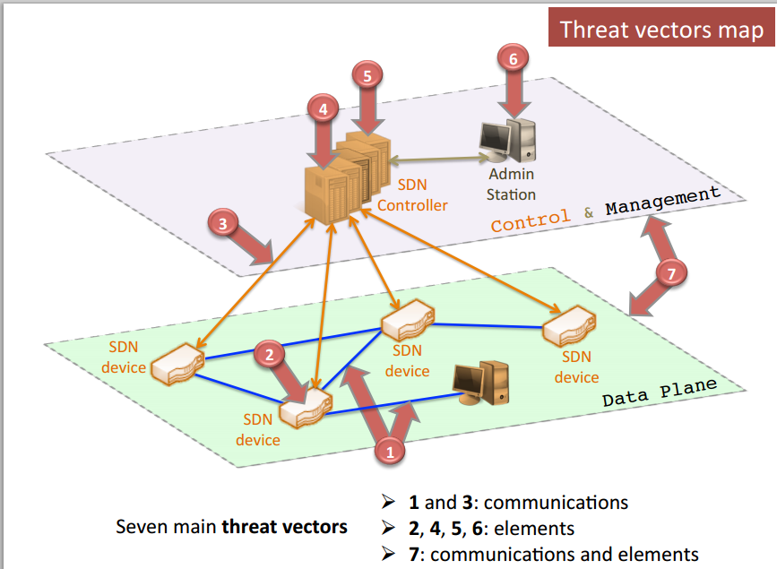
SDN Threat Vectors

Slide 5
Threat vectors
Forged or Faked traffic flow communication between data plane devices.
Vulnerability exploitation in forwarding devices(switches).
Attack on control communications between controller and switches
Exploiting vulnerabilities on Controllers
Trust in administrative rights and control

Slide 6
Examples
Host Hijacking
- Controller maintains a Host Profile for each host. It either creates a new Host profile or Updates existing profile whenever it receives a PacketIn Message.
- No Authentication
- Verify the Legitimacy of Host Migration
Link Fabrication Attack
- To learn the about links between the switches.
- The integrity/origin of LLDP packets must be ensured during the Link Discovery procedure
- The propagation path of LLDP packets can only contain OpenFlow-enabled switches

Slide 7
Continued..
Security standards implementation in overflow communication has not been defined and product developer are implementing their proprietary methods.
The programmable aspect of Software Defined Networks also make them more vulnerable to a number of malicious code exploits and attacks.

Slide 8
Present Security Solutions
Enforce TLS standard
Network partitioning
Cluster of controllers
Verify applications
Trust between devices and controllers
Diverse controllers can avoid common vulnerabilities
Notes:
Replication.
Diversity
Self-healing Systems
Dynamic Device Association
Trust between devices and controllers.

Slide 9
How is DDOS performed
Attacker constructs an attack network.
They wait for specific time to start the attack. Either by remotely activating the hack to wakeup simultaneously or program in advance.
Victim’s system is flooded with useless load and exhausts its resources.

Slide 10
Early detection of DDOS attack
The term early is subjected to tolerance level and traffic being handled by the controller
Results in controlling flooding of malicious packets significantly.
The early detection mechanism must be of light weight and should have high response.
The high response time helps the controller in regaining the control during DDOS.
Detecting the ENTROPY variation in the destination address

Slide 11
Simulation of DDOS
Mininet
- Created a tree topology with n switches
Pox
Scapy

Slide 12
Simulation Results

Slide 13
Prevention

Slide 14
Demo

Slide 15
References
http://conferences.sigcomm.org/sigcomm/2013/papers/hotsdn/p165.pdf
Poisoning Network Visibility in Software-Defined Networks: New Attacks and Countermeasures
Early detection of DDoS attacks against SDN controllers
Handling intrusion and DDoS attacks in Software Defined Networks using machine learning techniques

