Slide 1


Anand kumar
16th December 2025

Slide 2

Outline
Executive Summary
Introduction
Methodology
Results
Conclusion
Appendix

Slide 3
Executive Summary
Summary of methodologies
Summary of all results

Slide 4
Introduction
In this We are going to use the skills learned throughout the specialization on the single project
Encountered various difficulty with data cleaning, data imputation
Made interactive plots with Folium and Web app with plotly dash
Used Machine Learning to predict the landing outcome of a payload

Slide 5

Section 1

Slide 6
Methodology
Executive Summary
Data collection methodology:
  Describe how data was collected
Perform data wrangling
  Describe how data was processed
Perform exploratory data analysis (EDA) using visualization and SQL
Perform interactive visual analytics using Folium and Plotly Dash
Perform predictive analysis using classification models
  How to build, tune, evaluate classification models

Slide 7
Data Collection – SpaceX API
Data Source Wikipedia wikipedia data source
GitHub: https://github.com/Anandkumar267/Data-Science/blob/main/jupyter-labs-spacex-data-collection-api-v2.ipynb

Slide 8
Data Collection - Scraping
1. Used BeautifulSoup to traverse the web page and construct the dataset
2. Made custom function to extract each column
3. Made a Dataframe in pandas for web scrapped data
4. Exported to CSV File

Slide 9
Data Wrangling
1. Collected data from wikipedia
2. Applied custom function to clean the values and remove unwanted hyperlinks and references
3. Made a final DataFrame in Pandas
4. Converted date column to Datatime dtype
5. Numerical column to float

Slide 10
EDA with Data Visualization
GitHUB: https://github.com/Anandkumar267/Data-Science/blob/main/jupyter-labs-eda-sql-coursera_sqllite.ipynb

Slide 11
EDA with SQL
SQL IS VERY HANDY IN EDA INVOLVING SMALL TO LARGE DATABASES
Columns of data are
Name
Date
Time (UTC)
Booster_Version
Launch_Site
Payload
PAYLOAD_MASS__KG_
Orbit, Customer, Mission_Outcome, Landing_Outcome

Slide 12
Build an Interactive Map with Folium
Graphs are best way to visualize the location based data
Easy to understand and can identify factors like distance between location
Folium is python package enables to visualize map

Slide 13
Build a Dashboard with Plotly Dash
Sucess rate is more than 70% for all of them individually
Background color and Font color is changed for graphs for better visibility
GitHub: https://github.com/Anandkumar267/Data-Science/blob/main/plotly_spacex.py

Slide 14
Predictive Analysis (Classification)
KNN is best performing model in my test with highest test accuracy over LogisticRegression, DecisionTreeClassifier, SVC,
GitHub URL :
https://github.com/Anandkumar267/Data-Science/blob/main/SpaceX_Machine%20Learning%20Prediction_Part_5.ipynb

Slide 15
Results
There is some decrease in Success Rate in 2018 of SpaceX
Success is more in number than failure
With upcoming the success rate is increasing

Slide 16

Section 2

Slide 17
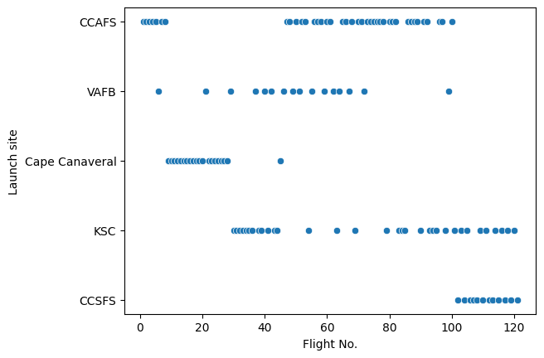
Flight Number vs. Launch Site
Show a scatter plot of Flight Number vs. Launch Site
Show the screenshot of the scatter plot with explanations
This shows CCSFS only launch with Flight No. 100 to 120 and Cape Canaveral Flight No. 0 to 50 Rest are evenly distributed.

Slide 18
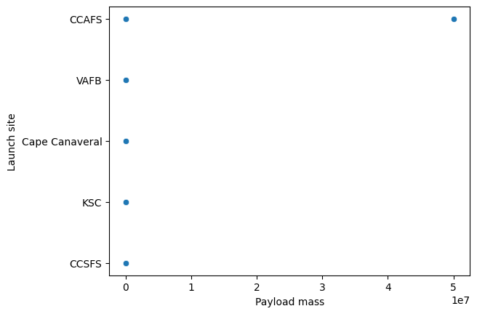
Payload vs. Launch Site
Show a scatter plot of Payload vs. Launch Site
Show the screenshot of the scatter plot with explanations
Payload mass 0 to 14000 kg maximum but for CCAFS there is anomly of 50000000kg

Slide 19
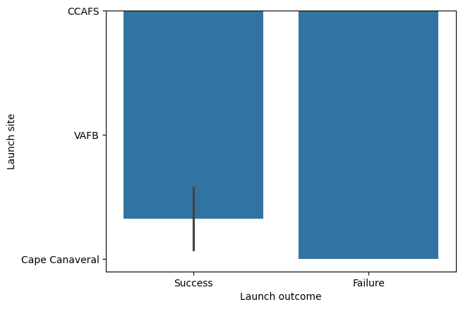
Success Rate vs. Orbit Type
Show a bar chart for the success rate of each orbit type
Show the screenshot of the scatter plot with explanations

Slide 20
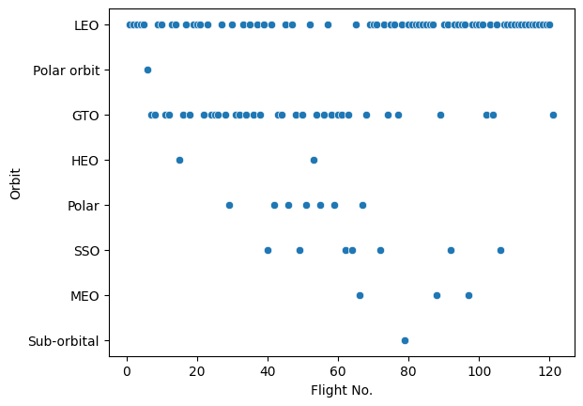
Flight Number vs. Orbit Type
Show a scatter point of Flight number vs. Orbit type
Show the screenshot of the scatter plot with explanations
1. In Sub orbital only Flght No. 80 operate
2. Approximatly all Flight No. operate in LEO and GTO

Slide 21
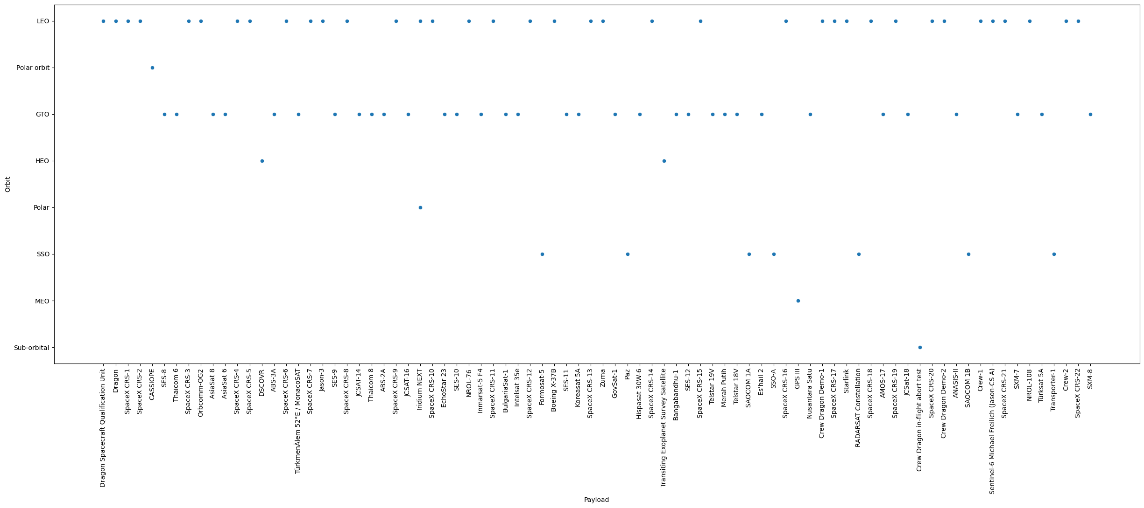
Payload vs. Orbit Type
Show a scatter point of payload vs. orbit type
Show the screenshot of the scatter plot with explanations
Only LEO and GTO are orbit which all payload operate

Slide 22
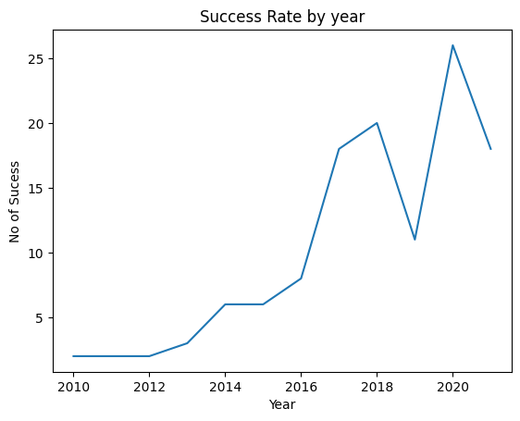
Launch Success Yearly Trend
Show a line chart of yearly average success rate
Show the screenshot of the scatter plot with explanations
There is decrease in success rate in 2019
Reason for decrease After 2020 is covid-19

Slide 23
All Launch Site Names
Find the names of the unique launch sites
Present your query result with a short explanation here
SELECT DISTINCT LAUNCH_SITE FROM SPACEXTABLE
THIS PRINT UNIQUE LAUNCH_SITE

Slide 24
Launch Site Names Begin with 'CCA'
Find 5 records where launch sites begin with `CCA`
Present your query result with a short explanation here
SELECT * FROM SPACEXTABLE WHERE Launch_Site LIKE "CCA%" LIMIT 5
“CCA%” search for string begins with CCA ends with anything

Slide 25
Total Payload Mass
Calculate the total payload carried by boosters from NASA
Present your query result with a short explanation here
SELECT SUM(PAYLOAD_MASS__KG_) FROM SPACEXTABLE WHERE Customer="NASA (CRS)"
OUTPUT: 45596

Slide 26
Average Payload Mass by F9 v1.1
Calculate the average payload mass carried by booster version F9 v1.1
Present your query result with a short explanation here
SELECT AVG(PAYLOAD_MASS__KG_) FROM SPACEXTABLE WHERE Booster_Version ="F9 v1.1"
OUTPUT = 2928.4kg

Slide 27
First Successful Ground Landing Date
Find the dates of the first successful landing outcome on ground pad
Present your query result with a short explanation here
SELECT Date FROM SPACEXTABLE WHERE Landing_Outcome="Success (ground pad)"

Slide 28
Successful Drone Ship Landing with Payload between 4000 and 6000
List the names of boosters which have successfully landed on drone ship and had payload mass greater than 4000 but less than 6000
Present your query result with a short explanation here
SELECT Booster_Version FROM SPACEXTABLE WHERE Landing_Outcome="Success (drone ship)" AND PAYLOAD_MASS__KG_ >=4000 AND PAYLOAD_MASS__KG_ < 6000

Slide 29
Total Number of Successful and Failure Mission Outcomes
Calculate the total number of successful and failure mission outcomes
Present your query result with a short explanation here
SELECT Landing_Outcome, COUNT(*) FROM SPACEXTABLE GROUP BY Landing_Outcome HAVING Landing_Outcome LIKE "Success%" OR "Failure%"

Slide 30
Boosters Carried Maximum Payload
List the names of the booster which have carried the maximum payload mass
Present your query result with a short explanation here
SELECT Booster_Version, PAYLOAD_MASS__KG_ FROM SPACEXTABLE WHERE PAYLOAD_MASS__KG_ = (SELECT MAX(PAYLOAD_MASS__KG_) FROM SPACEXTABLE)

Slide 31
2015 Launch Records
List the failed landing_outcomes in drone ship, their booster versions, and launch site names for in year 2015
Present your query result with a short explanation here
SELECT substr(Date, 6,8) AS MONTH, Landing_Outcome, Booster_Version, Launch_Site FROM SPACEXTABLE WHERE substr(Date, 0,5)='2015' AND Landing_Outcome LIKE "Failure%"

Slide 32
Rank Landing Outcomes Between 2010-06-04 and 2017-03-20
Rank the count of landing outcomes (such as Failure (drone ship) or Success (ground pad)) between the date 2010-06-04 and 2017-03-20, in descending order
Present your query result with a short explanation here
SELECT Landing_Outcome, COUNT(*) AS count FROM SPACEXTABLE WHERE Date BETWEEN '2010-06-04' AND '2017-03-20' GROUP BY Landing_Outcome ORDER BY count DESC

Slide 33

Section 3

Slide 34
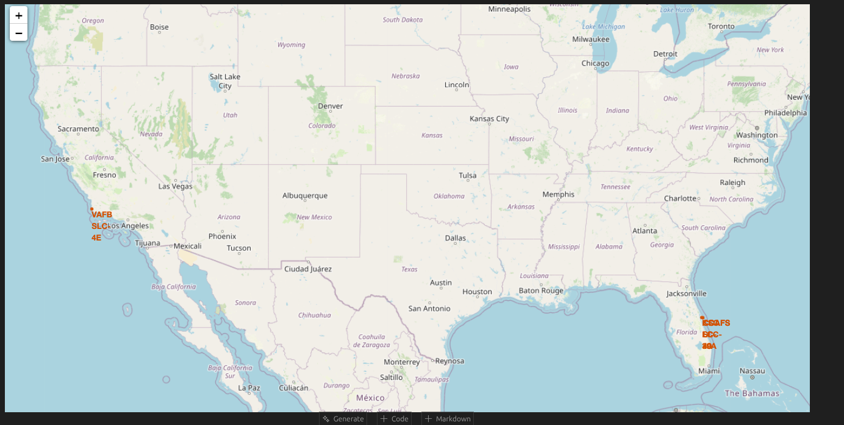
<Folium Map Screenshot 1>
Replace <Folium map screenshot 1> title with an appropriate title
Explore the generated folium map and make a proper screenshot to include all launch sites’ location markers on a global map
Explain the important elements and findings on the screenshot

Slide 35
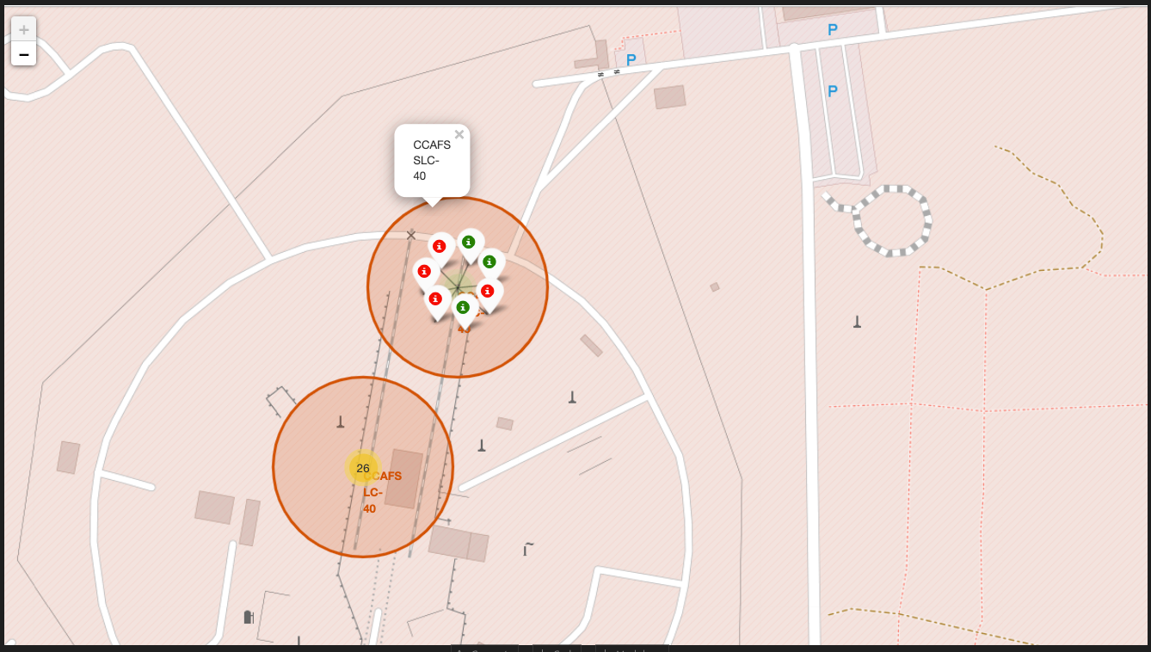
<Folium Map Screenshot 2>
Replace <Folium map screenshot 2> title with an appropriate title
Explore the folium map and make a proper screenshot to show the color-labeled launch outcomes on the map
Explain the important elements and findings on the screenshot

Slide 36
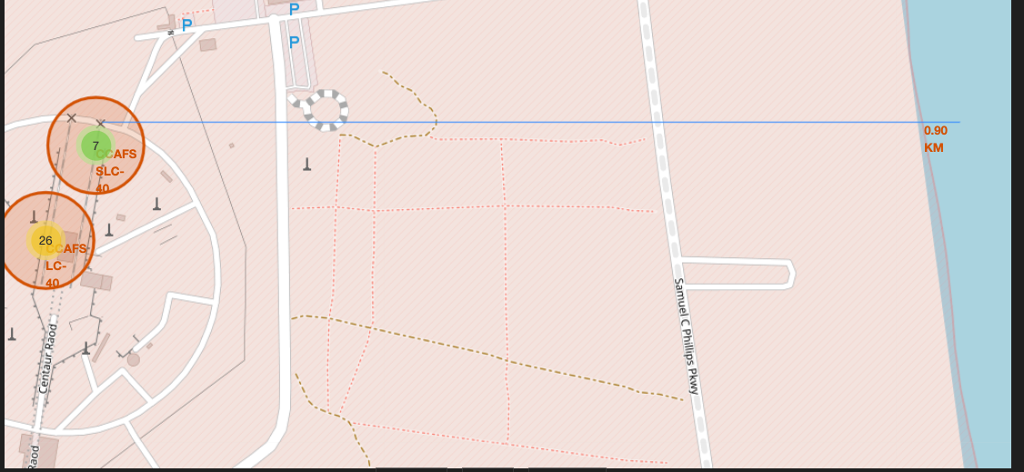
<Folium Map Screenshot 3>
Replace <Folium map screenshot 3> title with an appropriate title
Explore the generated folium map and show the screenshot of a selected launch site to its proximities such as railway, highway, coastline, with distance calculated and displayed
Explain the important elements and findings on the screenshot

Slide 37

Section 4

Slide 38
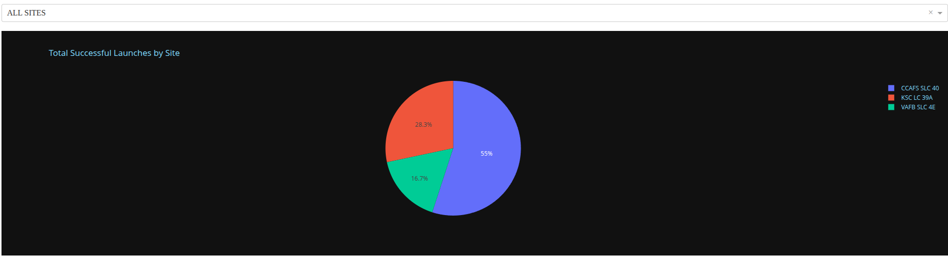
<Dashboard Screenshot 1>
Replace <Dashboard screenshot 1> title with an appropriate title
Show the screenshot of launch success count for all sites, in a piechart
Explain the important elements and findings on the screenshot

Slide 39
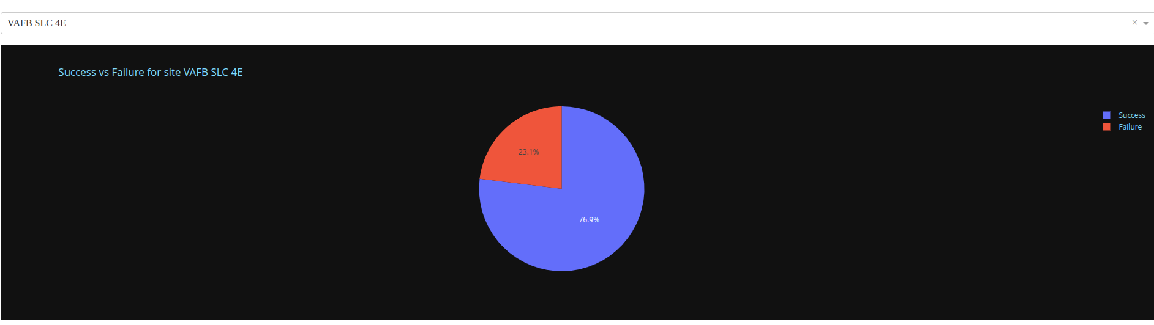
<Dashboard Screenshot 2>
Replace <Dashboard screenshot 2> title with an appropriate title
Show the screenshot of the piechart for the launch site with highest launch success ratio
Explain the important elements and findings on the screenshot

Slide 40
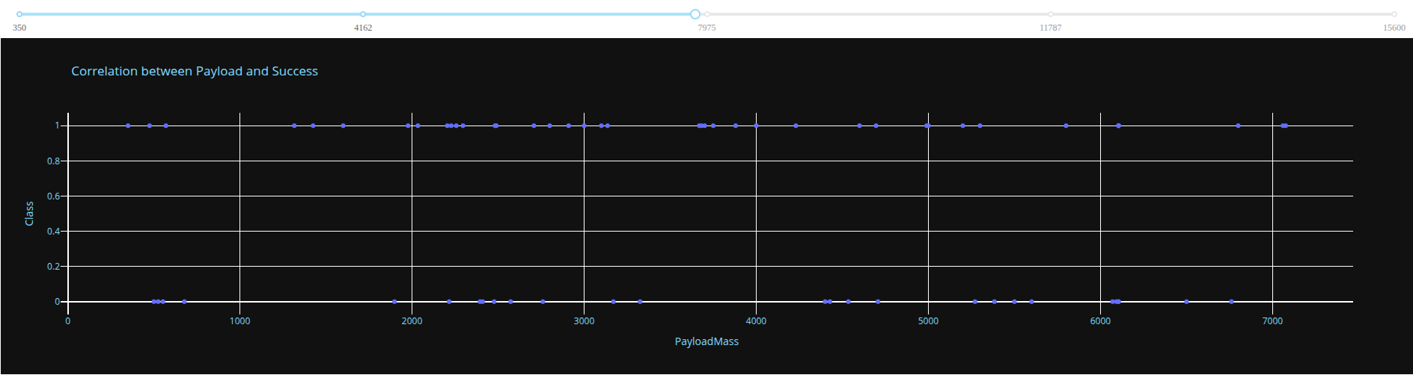
<Dashboard Screenshot 3>
Replace <Dashboard screenshot 3> title with an appropriate title
Show screenshots of Payload vs. Launch Outcome scatter plot for all sites, with different payload selected in the range slider
Explain the important elements and findings on the screenshot, such as which payload range or booster version have the largest success rate, etc.

Slide 41

Section 5

Slide 42
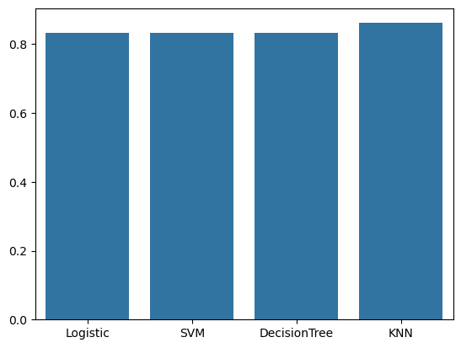
Classification Accuracy
Visualize the built model accuracy for all built classification models, in a bar chart
Find which model has the highest classification accuracy
KNN has highest Test Accuracy

Slide 43
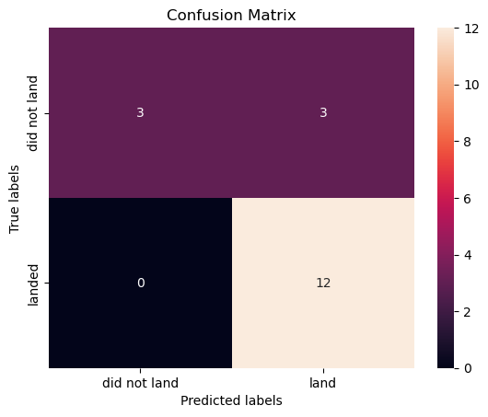
Confusion Matrix
Very Good Confusion Matrix Score

Slide 44
Conclusions
- Classification Model can predict failure or success to a high degree
- KNN is best classifier out of four used in prediction
- Higher Accuracy can be achieved by tuning the hyperparameters
- Feature Engineering can greatly increase model ability to identify patterns and in turn higher accuracy

Slide 45
Appendix
Include any relevant assets like Python code snippets, SQL queries, charts, Notebook outputs, or data sets that you may have created during this project

Slide 46


