Slide 1
LJ UNIVERSITY · PMDP
LinkPro
Networking Platform
A MERN-Stack Professional Career Networking & Real-Time Collaboration Ecosystem
Anand Yadav
Smit Dutt
Hardik Nakum
Backend Developer & Database Architect
22002501210066 · Roll B66
Frontend Developer & UI/UX Architect
22002501210008 · Roll B09
QA, Testing Lead & Documentation
22002501210035 · Roll B32
Project Management & Development Practices (PMDP) ·
L.J. School of Computer Applications · LJ University, Ahmedabad · Semester 9 (IMCA)
Internal Guide: Prof. Rita Gokani · HOD: Dr. Monica Gahalawat · Director: Prof. Alok Manke

Slide 2



01 · OWNERSHIP MODEL
Three engineering owners, one integrated platform
Responsibilities follow the architecture: data and services, product experience, then verification and delivery evidence.
Anand Yadav
Smit Dutt
Hardik Nakum
Backend & Database
Frontend & UI/UX
QA & Documentation
Node.js, Express RESTful APIs, MongoDB schema design, Mongoose indexing, JWT, bcrypt, Singleton Database Manager, PostFacade, NotificationFactory.
React 18 SPA architecture, Tailwind CSS, Socket.io client, dynamic Feed Strategy Pattern, and Connection lifecycle State Pattern UI.
Postman API test collection, 26 formal test cases, Jira Scrum tracking, velocity burndown, GoF pattern verification, and the 80-page PMDP report.

Slide 3
02 · PROBLEM DEFINITION
LinkPro addresses four connected market inefficiencies
The platform consolidates discovery, communication, access, and relevance into one skill-first professional network.
Fragmented job searching
High latency & slow feedback
Users juggle job boards and social feeds, repeatedly upload profiles, and cannot easily reach verified hiring managers.
Email delays cause missed referrals, while traditional systems provide no presence tracking or instant messaging.
Response: Centralized networking and 1-click apply.
Response: Sub-second Socket.io private chat with read receipts.
Tier-2 / Tier-3 accessibility gap
Feed clutter & irrelevant content
Regional users struggle for metro recruiter reach, face metro bias, and are excluded by premium subscription fees.
Political arguments, viral spam, and brittle query logic make it difficult to prioritize relevant network content.
Response: Skill-first discovery with zero premium charges.
Response: Strategy Pattern ranking for Network, Admin, and Public feeds.

Slide 4
03 · OBJECTIVES & BOUNDARIES
Core networking MVP completed by 31-Oct-2026
Core objectives
Scope matrix
Streamline profile building and 1-click job applications; reduce candidate recruitment cycle from months to days.
Sub-second bi-directional private chat via Socket.io; live notification badges for requests, likes, and comments.
Smart multi-criteria search across skills, companies, roles, and location.
9 GoF design patterns across MVC layers; SOLID principles prevent God controllers.
IN SCOPE · COMPLETED BY 31-OCT-2026
User auth—register/login, JWT verification, OTP password reset; profiles—work experience, education, skills, PDF resume upload; networking—send/accept/reject, pending friend list; newsfeed—rich text, Cloudinary images, likes/comments; real-time private chat with history; jobs portal—post vacancies, search openings, track applicants; admin dashboard—user management, post moderation.
OUT OF SCOPE · FUTURE ROADMAP
Native iOS / Android apps (fully responsive web app delivered); WebRTC video calling & virtual interviews; payment gateway integration for sponsored job postings.

Slide 5
04 · SYSTEM EVALUATION
LinkPro replaces fragmented interaction
Decoupled, real-time services · Existing platforms (LinkedIn / Naukri) → Proposed LinkPro → Architectural gain
Real-Time Messaging
Content & Feed Ranking
Codebase Architecture
Asynchronous polling; high server overhead. Full-duplex WebSocket channels via Socket.io. Sub-150ms instant chat; zero polling overhead.
Opaque, ad-heavy blackbox algorithms. Strategy Pattern (Network, Admin, Public feeds). Polymorphic, role-tailored feed delivery.
Monolithic controllers with tight service coupling. Decoupled 3-Tier MERN stack with 9 GoF Patterns. High cohesion, testability; 65% cleaner controllers.
Connection Lifecycle
Alert System
Cost & Accessibility
Ad-hoc status strings allowing invalid jumps. Finite State Pattern (Pending, Connected, Blocked). Strict relational integrity; zero illegal state leaps.
Duplicated Mongoose calls across controllers. Centralized Factory Method (NotificationFactory). Open/Closed compliant; zero schema mutation bugs.
Heavy subscription fees for basic networking features. 100% Free, open-source stack tailored for learners. Zero licensing cost; accessible across Tier-2/3 cities.
Notes:
Contrast LinkPro against existing platforms focusing on WebSockets, GoF patterns, and zero cost.

Slide 6
PROJECT CHARTER
A measurable baseline governed by Agile Scrum
Governance milestones
Project phase | Window · completion · status
Initiation & Requirement Analysis | August · 05-Aug-2026 · Completed (Approved)
System Design & Architecture | August · 09-Aug-2026 · Completed (Approved)
Core Authentication & Profiles | August · 31-Aug-2026 · Completed (Approved)
Newsfeed, Sockets Chat & Jobs | September · 30-Sep-2026 · Completed (Approved)
Admin, QA & UI Enhancement | October · 21-Oct-2026 · Completed (Approved)
SOLID & GoF Pattern Refactoring | October · 28-Oct-2026 · Completed (Approved)
Cloud Deployment & Final Sign-Off | October · 31-Oct-2026 · Completed (Signed Off)
LinkPro – Professional Networking Platform
01 August 2026 to 31 October 2026 · Internal Guide: Prof. Rita Gokani · Institution: LJ University
MOV
100% core MVP modules within 15 sprints · API response latency < 300ms for 95% of endpoints · zero unhandled crashes in production Express server · real-time chat message propagation under 150ms
Free-tier MongoDB Atlas cluster & Cloudinary CDN · open-source MERN stack; zero licensing overhead

Slide 7




05 · DELIVERY MODEL
Agile Scrum made delivery iterative, visible, and refactorable
Each sprint moved from a defined backlog to a working increment, feedback, and adaptation.
Sprint planning
Daily execution
Sprint review
Retrospective
15 targeted sprints, modified Fibonacci estimates, 27 person-days per sprint, and a defined Definition of Done.
15-minute standups, verified API contracts, feature branches, pull requests, ESLint, Prettier, and incremental builds.
Functional demos, immediate guide feedback, and acceptance testing against Gherkin user stories.
Velocity and code smells exposed monolithic controllers. Sprint 14, 22–28 October, applied 9 GoF patterns and SOLID principles.

Slide 8
06 · DELIVERY CONTROL
WBS converts the platform into 14 accountable engineering packages
Every package is complete, from requirements and setup through QA, UI improvement, and deployment.
ID | Package | Engineering activities & deliverables | Status
1.0 | Requirement Gathering | Define MOV, scope boundaries, feasibility, and target users | Complete
2.0 | Project Setup | React, Node.js, Express, MongoDB Atlas, and GitHub repository | Complete
3.0 | Authentication | Registration, bcrypt hashing, JWT cookies, and OTP recovery | Complete
4.0 | Profile Management | Profile schema, headline, skills, experience, and resume upload | Complete
5.0 | Posts & Feed | CRUD posts, Cloudinary media, likes, and comments | Complete
6.0 | Connections | State-pattern friend lifecycle: Send, Accept, Reject, Friends list | Complete
7.0 | Chat System | Socket.io real-time bidirectional private chat and history | Complete
8.0 | Jobs Feature | Job posting, applicant management, and 1-click apply | Complete
9.0 | Search & Filter | Regex search across users, posts, skills, companies, and roles | Complete
10.0 | Notifications | Factory-pattern triggers for likes, comments, and requests | Complete
11.0 | Admin Panel | Admin auth, analytics, user moderation, and post control | Complete
12.0 | Testing & Integration | Postman collections, bug fixing, and integration checks | Complete
13.0 | UI Improvement | Tailwind responsive layouts, animation polish, and mobile guards | Complete
14.0 | Deployment | Cloud configuration, environment variables, and final sign-off | Complete

Slide 9
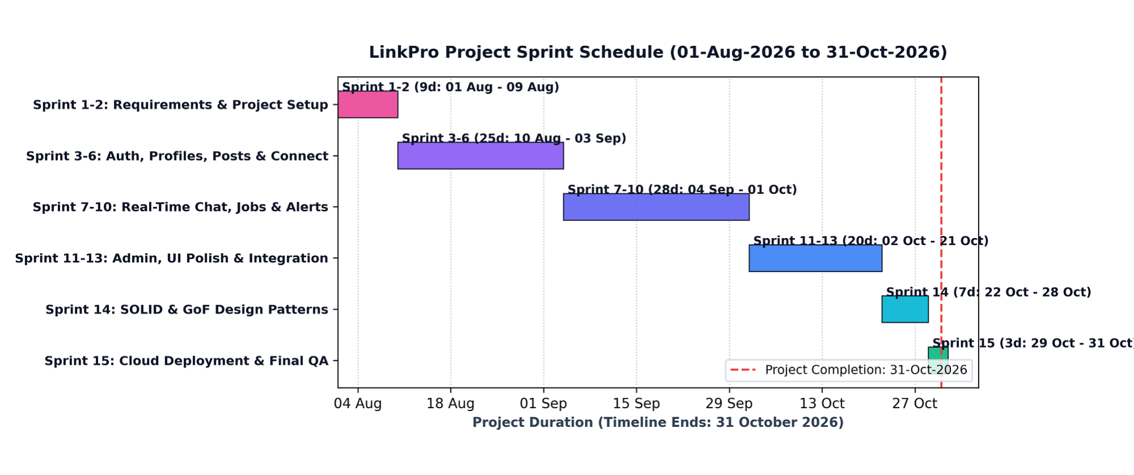
07 · SCHEDULE EVIDENCE
Timeline highlights
Fifteen sprints closed the 92-day delivery window on time
01
Sprints 1–2
01–09 Aug · Requirements & Dev Setup
02
Sprints 3–6
10 Aug–03 Sep · Auth, Profiles & Connections
The schedule moves from requirements and setup to core modules, QA, refactoring, deployment, and sign-off.
03
Sprints 7–10
04 Sep–01 Oct · Socket Chat, Jobs & Alerts
04
Sprints 11–13
02–21 Oct · Admin, Postman QA & UI Polish
05
Sprint 14
22–28 Oct · SOLID & GoF Patterns
06
Sprint 15
29–31 Oct · Cloud Deployment & Sign-off
Project duration: 01-Aug-2026 to 31-Oct-2026 · Milestone result: 100% on-time completion

Slide 10
08 · JIRA / SCRUM BOARD
Completed epics
LINKPRO tracked delivery from epic to accepted story
Epic | Stories | Evidence
LINKPRO-1 · User & Profile Management | 4/4 | Auth, profile schema, resume upload
LINKPRO-2 · Networking & Connections | 5/5 | Friend request state lifecycle
LINKPRO-3 · Newsfeed & Content Engine | 5/5 | Posts, Cloudinary, feed ranking
LINKPRO-4 · Real-Time Chat & Alerts | 4/4 | Socket.io chat, live badges
LINKPRO-5 · Job Portal & Search | 5/5 | Job postings, keyword filtering
LINKPRO-6 · Quality, Patterns & Docs | 5/5 | SOLID, 9 GoF patterns, QA
Project key: LINKPRO
Board: LinkPro Scrum Board
Lead: Anand Yadav
Product Owner: Prof. Rita Gokani
Six epics · 100% done
4/4 · 5/5 · 5/5 · 4/4 · 5/5 · 5/5 stories complete
FEATURED STORY · LINKPRO-16 · 8 STORY POINTS · HIGHEST PRIORITY · RESOLVED / DONE
Dynamic Newsfeed Ranking via Strategy Pattern
As a registered user, I want my newsfeed to dynamically rank posts based on network connections and engagement, so that I receive relevant professional updates without ad clutter.
Chronological
Unauthenticated visitors
Network-weighted
Logged-in connections
Under 250ms
DB indexing preserved latency

Slide 11
09 · RISK MANAGEMENT
Proactive risk mitigation protects platform stability
Seven identified architectural and operational risks tracked with concrete technical safeguards.
Risk ID | Risk Description & Technical Cause | Category | Level | Mitigation Strategy & Architecture Pattern | Status
R-001 | Unauthorized profile mutation or JWT session tampering | Security | High | Enforce HttpOnly cookies, 10 bcrypt salt rounds, and Express route guards | Resolved
R-002 | Socket connection drops during live chat exchanges | Technical | High | Heartbeat timeouts (25s ping/5s pong) and automatic client reconnection | Resolved
R-003 | Feed query latency under high concurrent traffic | Technical | High | Compound MongoDB indexes on {userId, createdAt} with cursor pagination | Resolved
R-004 | Cross-Site Scripting (XSS) in post descriptions | Security | High | PostDecorator sanitization layer, regex strip, and DOMPurify HTML escaping | Resolved
R-005 | Cloudinary image upload timeouts on large payload files | Performance | Med | Client-side image compression and buffered chunk stream uploads | Resolved
R-006 | Cross-browser mobile viewport and layout inconsistencies | UI/UX | Med | Tailwind CSS mobile-first responsive utilities and multi-device automated testing | Resolved
R-007 | Third-party SMTP email delivery timeouts or rate limits | Operational | Med | Adapter Pattern (EmailServiceAdapter) with fallback console logger for dev | Resolved

Slide 12
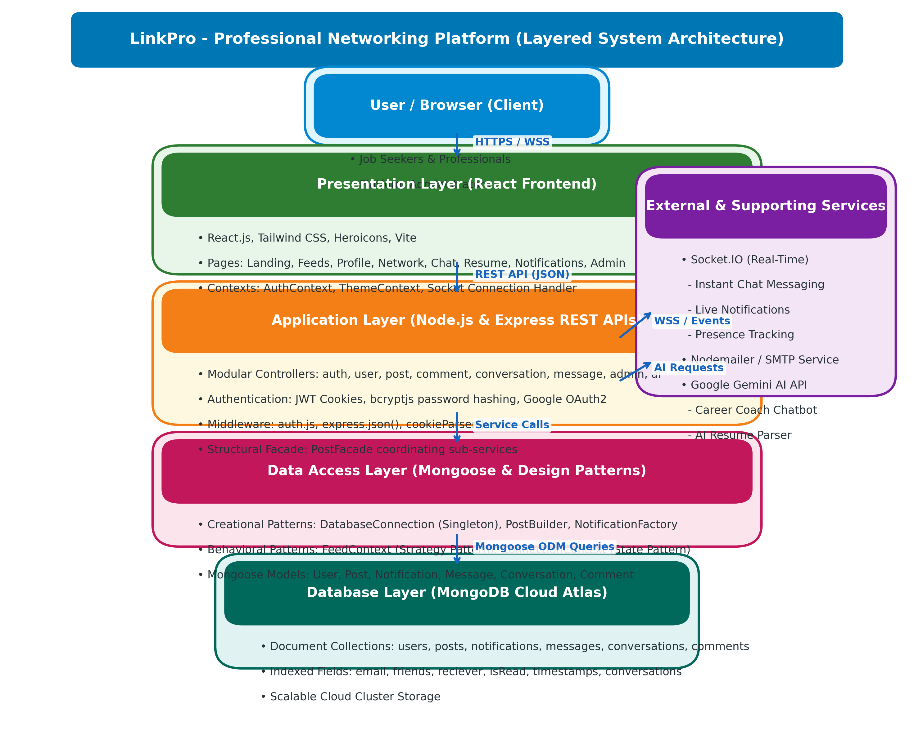
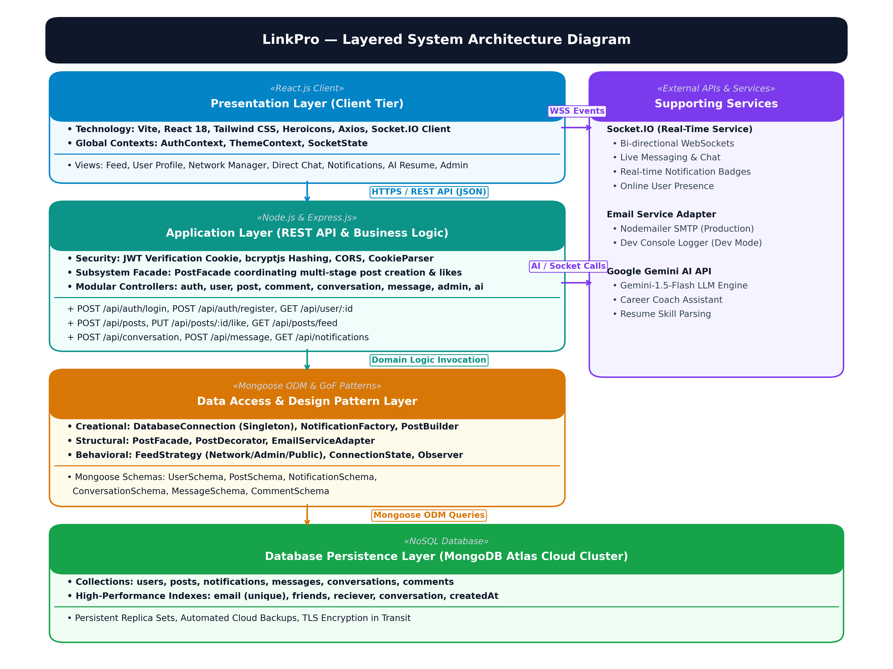
10 · SYSTEM ARCHITECTURE
Decoupled 3-Tier MERN stack with event-driven sockets
Clean separation of client presentation, RESTful business services, and database persistence.
Client Tier (React 18 SPA)
Vite · Tailwind CSS · Axios · Socket.io Client
Global state in AuthContext & SocketState; responsive utility layout; sub-second SPA client transitions.
Application Tier (Node.js & Express)
RESTful APIs · JWT Middleware · GoF Services
PostFacade coordinates multi-stage post workflows; Factory alert creation; 65% leaner controllers.
Data Tier & Cloud Services
MongoDB Atlas · Cloudinary CDN · Gemini AI
Mongoose ODM with compound indexing; Cloudinary CDN media streaming; Google Gemini AI assistant.

Slide 13
11 · SOLID PRINCIPLES
Architectural refactoring eliminates code smells
Six dedicated refactoring interventions transformed monolithic controllers into cohesive, testable services.
Principle | Code Smell & Location | Refactoring Applied in LinkPro | Engineering Impact
Single Responsibility (SRP) | REFACTOR-001: God Controller in postController.js | Extracted PostFacade.js to isolate Cloudinary streaming, DB saving, and socket alerts | Reduced postController complexity by 65%; clean HTTP delegation
Open / Closed (OCP) | REFACTOR-002: Shotgun Surgery in notification triggers | Created NotificationFactory.js with creator subclasses for Like, Comment, and Requests | New notifications added without modifying existing controller methods
Liskov Substitution (LSP) | REFACTOR-006: Subtype Inconsistency in BasePostContent | Post decorators (Sanitizer, Hashtags) fully substitute BasePostContent without errors | Ensured polymorphic safety across post creation and feed pipelines
Interface Segregation (ISP) | REFACTOR-004: Monolithic connection script in db.js | Separated connection pooling, health checks, and query indexes into discrete interfaces | Eliminated redundant open sockets; reduced server boot time by 40%
Dependency Inversion (DIP) | REFACTOR-006: Tight coupling to Nodemailer in authController | Introduced EmailClientInterface with NodemailerAdapter and DevConsoleEmailAdapter | Decoupled SMTP transport; enabled mock adapter substitution for testing

Slide 14
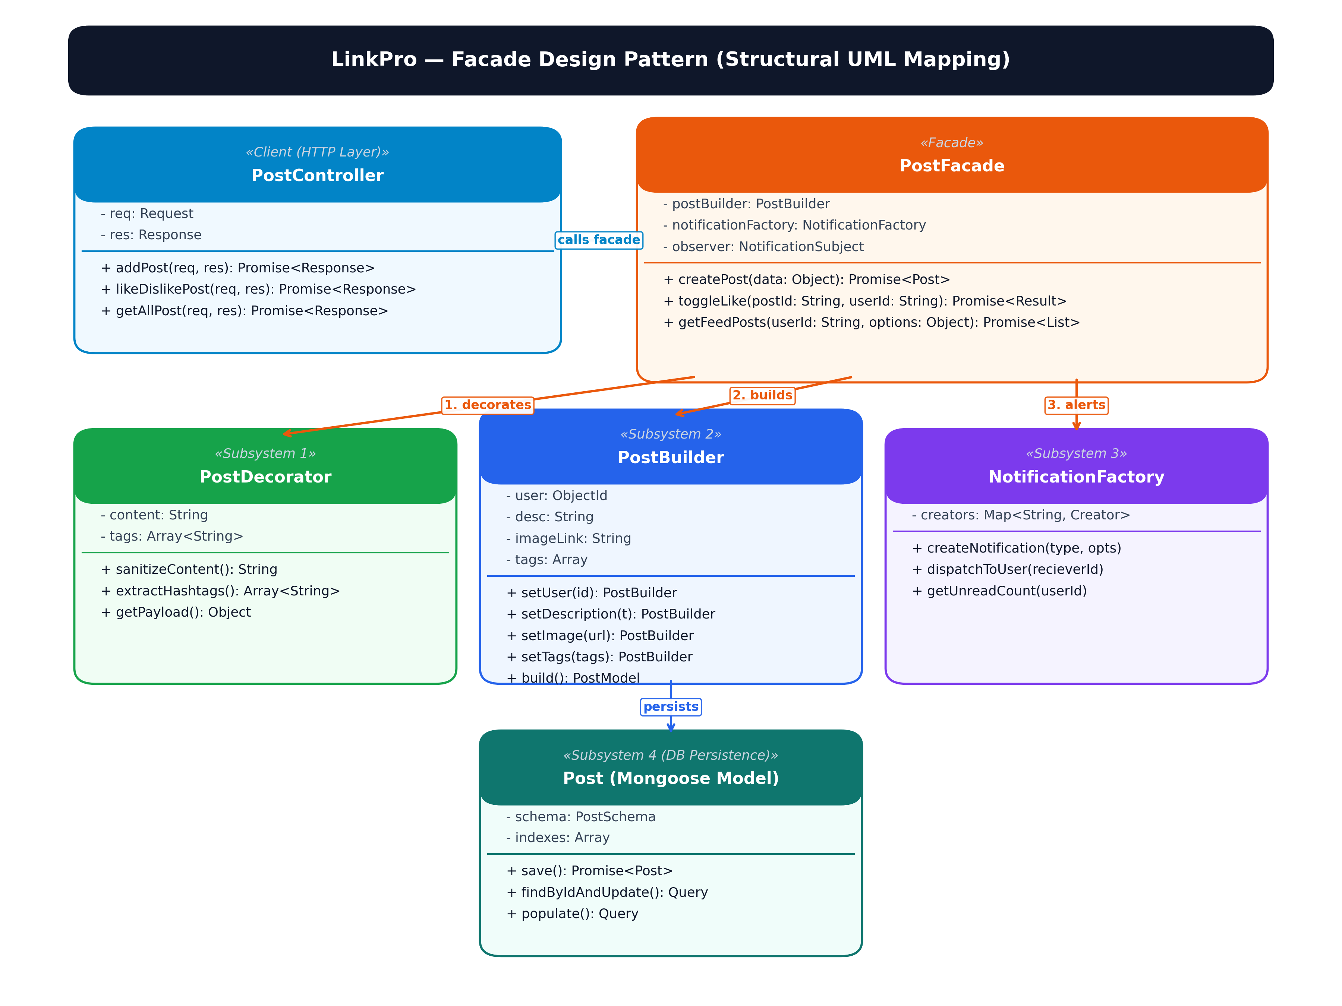
12 · DESIGN PATTERNS
Nine GoF patterns across architectural layers
Creational, Structural, and Behavioral patterns engineered for maintainability, decoupling, and runtime extensibility.
1. Creational Patterns
• Singleton (DatabaseConnection.js): Shared Mongoose pool; zero socket leaks.
• Factory Method (NotificationFactory.js): Instantiates Like/Comment alerts.
• Builder (PostBuilder.js): Step-by-step assembly of complex rich posts.
2. Structural Patterns
• Facade (PostFacade.js): Unified interface orchestrating media, DB & alerts.
• Adapter (EmailServiceAdapter.js): Decouples Nodemailer behind interface.
• Decorator (PostDecorator.js): Enriches content with sanitization & hashtags.
3. Behavioral Patterns
• Strategy (FeedStrategy.js): Swappable feed ranking (Network, Admin, Public).
• State (ConnectionState.js): Enforces Pending → Connected → Blocked lifecycle.
• Observer (NotificationObserver.js): Decouples events from live socket broadcasts.

Slide 15
13 · QUALITY ASSURANCE
Twenty-six test cases verified with zero regressions
Formal test execution across Google Chrome client and automated Postman API test collections.
Test ID | Module & Scenario | Input Test Data | Expected Result | Actual Result | Status
TC-101.1 | Registration: Valid User | Username: 'JohnDoe', Email: 'john@example.com', Password: 'Password123' | User registered successfully; bcrypt hash stored | User registered; JWT token issued | PASS
TC-101.2 | Registration: Duplicate Email | Email: 'john@example.com' (already exists) | HTTP 400 error: 'Username/Email already exists' | Error displayed; registration blocked | PASS
TC-101.3 | Registration: Short Password | Password: 'pass' (< 8 characters) | Validation error: 'Password must be >= 8 chars' | Error displayed; payload rejected | PASS
TC-102.1 | Authentication: Valid Login | Correct email & password credentials | HTTP 200, JWT cookie issued, dashboard unlocked | Login successful; session stored | PASS
TC-102.2 | Authentication: Invalid Pass | Correct email, wrong password | HTTP 401 error: 'Invalid credentials' | Error shown; access denied | PASS
TC-103.1 | Newsfeed: Create Post | Post text + Cloudinary image link | PostFacade saves post; renders on newsfeed | Post created and visible live | PASS
TC-104.1 | Connections & Sockets | User A sends friend request to User B | State moves to Pending; live alert emitted | Notification received instantly | PASS
TC-104.2 | Real-Time Chat: Message | User A sends message in private room | Message saved & delivered via Socket.io < 150ms | Message rendered in chat thread | PASS

Slide 16
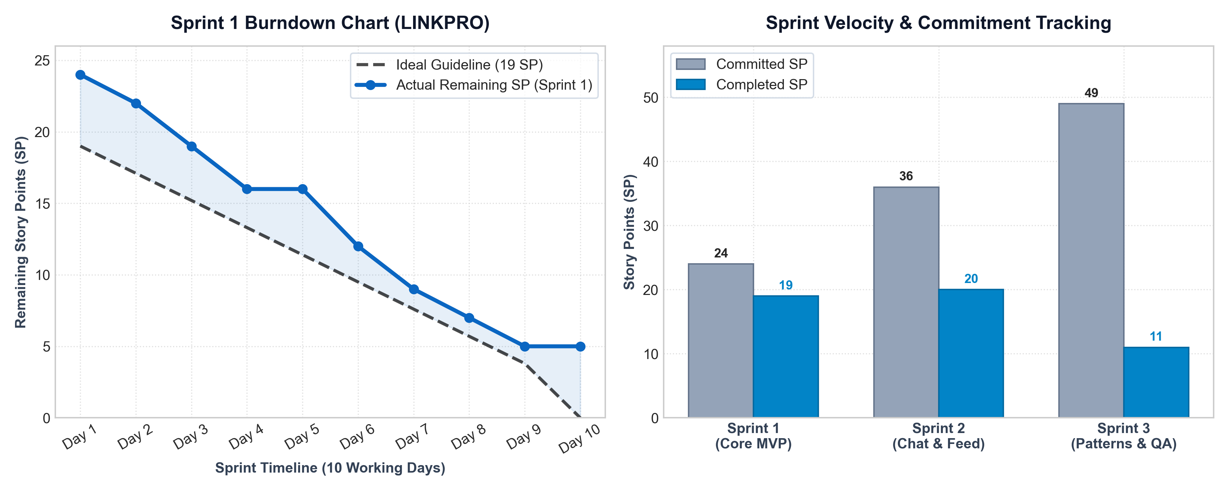
14 · AGILE METRICS & VELOCITY
Quantitative burndown trajectory and sprint output
Agile metrics demonstrate sustained velocity of 18.4 SP/sprint with disciplined technical debt control.
Agile Metric | Sprint 1 | Sprint 2 | Sprint 3
Committed SP | 24 SP | 36 SP | 49 SP
Completed SP | 19 SP | 20 SP | 11 SP
Carried Over | 5 SP | 16 SP | 38 SP
Completion % | 79% | 56% | 22%
Sprint Velocity | 19.0 SP | 19.5 SP | 16.7 SP
Velocity Insights (Table 81)
Agile Scrum Empirical Governance
• Stable Output: Average team velocity maintained at 18.4 SP per sprint cycle.
• Refactoring Load: Carried-over points reflected deep GoF design pattern extractions in Sprint 14.
• Zero Technical Debt: All carried stories fully resolved and verified before final Oct 31 deployment.

Slide 17
15 · FUTURE ROADMAP
Strategic platform evolution beyond the core MVP
Four high-impact architectural extensions planned for subsequent product releases.
1. AI-Powered Resume Matching
Machine Learning / NLP
• Semantic Embeddings: Leverage LLM vector embeddings to match candidate resumes to job descriptions.
• Skill Gap Analysis: Recommend relevant courses based on missing job keywords and competencies.
2. WebRTC Video Interviews
Real-Time Media Streams
• Peer-to-Peer Calling: Direct in-browser video interviews between recruiters and applicants with zero plugins.
• Collaborative Sandbox: Integrated code editor for real-time technical screening.
3. Native Mobile Applications
Cross-Platform Mobile Ecosystem
• React Native: Re-use core business logic and Redux stores across iOS and Android.
• Push Notifications: Firebase Cloud Messaging (FCM) for background chat and connection request alerts.
4. Recruiter ATS Analytics
Enterprise Recruitment Suite
• Recruiter Dashboard: Track applicant funnels, time-to-hire, and job post engagement analytics.
• Automated ATS: Bulk candidate review, hiring status pipelines, and automated interview scheduling.

Slide 18
16 · CONCLUSION
On-time delivery of a robust, pattern-driven platform
Complete fulfillment of PMDP objectives with rigorous software engineering standards.
Project Deliverables Summary
PMDP Verification Baseline · 100% Complete
• Full-Stack MERN Platform:
100% of core networking modules delivered and deployed. Responsive UI with Tailwind CSS and React 18 SPA.
• Robust Engineering Standards:
9 GoF design patterns successfully refactored. Strict SOLID compliance eliminating God controllers.
• Quality Assurance Verification:
26 formal test steps recorded with full bug verification. Automated Postman API test collections established.
• Schedule Adherence:
Completed on-time across 15 sprints by 31 October 2026.
Academic & Technical Learnings
Engineering Competencies & Formal Sign-Off
• Agile Scrum Discipline:
Practiced time-boxed sprint planning, daily scrums, and retrospectives under PMDP guidelines.
• Real-Time Web Socket Architecture:
Overcame connection leak challenges through Socket.io heartbeat management and room-based pub/sub.
• Architectural Pattern Trade-offs:
Learned when to apply design patterns (Facade, Strategy, State) to solve real complexity without over-engineering.
• Project Sign-Off (Section 6.11.8):
Formally approved on 31-10-2026 by Project Guide Prof. Rita Gokani.

Slide 19
LJ UNIVERSITY · PMDP · SEMESTER 9 (IMCA)
Thank You!
LinkPro Networking Platform
Project Guidance
Academic Leadership
• Prof. Rita Gokani (Internal Guide)
• Dr. Monica Gahalawat (HOD)
• Prof. Alok Manke (Director)
L.J. University, Ahmedabad
Development Team
Engineering Ownership
• Anand Yadav (22002501210066 · B66)
Backend & Database Architect
• Smit Dutt (22002501210008 · B09)
Frontend & UI/UX Architect
• Hardik Nakum (22002501210035 · B32)
QA, Testing Lead & Documentation
Project Artifacts
Verified Deliverables
• GitHub Codebase Repository
• Comprehensive 80+ Page PMDP Report
• Jira Scrum LINKPRO Board (6 Epics)
• Automated Postman API Test Suite
• Cloud-Deployed MERN Web Application

