Slide 1
Retail Sales Dashboard – Day 4 Internship Task
Created using Power BI Desktop
[ANAND KUMAR M]
Date: April 11, 2025

Slide 2
Key Metrics and Insights
- Tracked Total Sales, Quantity, and Profit using Card visuals.
- Enabled interactivity with slicers for Product Category and Gender.
- Included time-series line chart for Sales over Months.
- Applied consistent theme and clean layout for better readability.

Slide 3
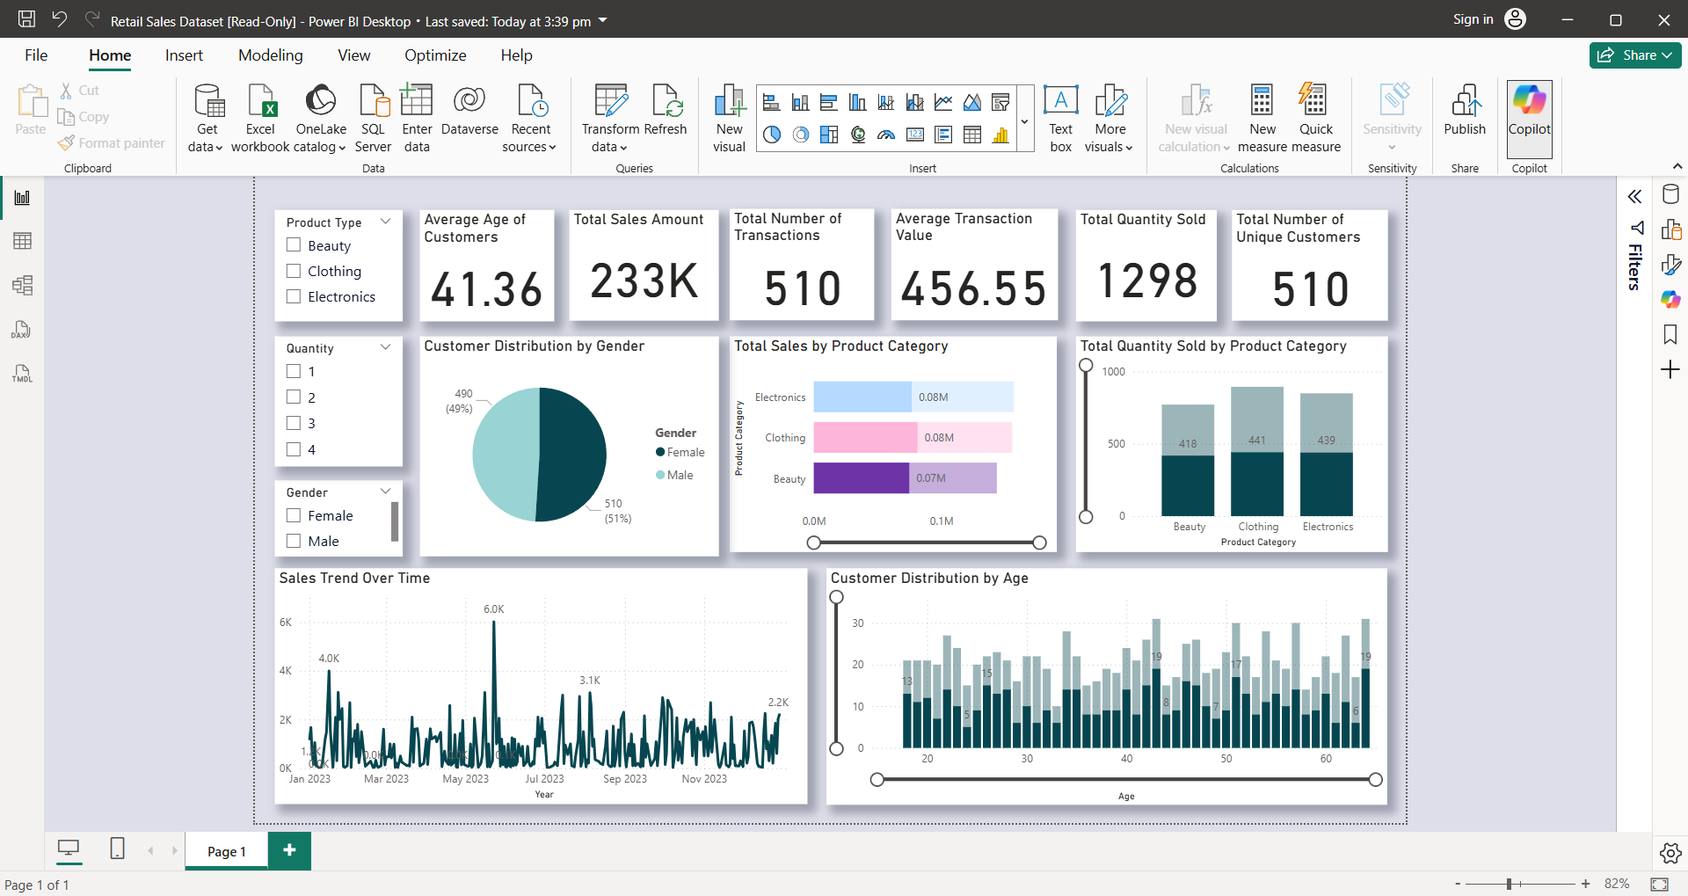
Power BI Dashboard Screenshot

Slide 4
Learnings from Day 4 Task
- Learned to create interactive dashboards using slicers and cards.
- Practiced visual storytelling using Power BI.
- Understood the importance of clean design and KPI tracking.

