Slide 1
CORE JAVA
BASICS

Slide 2
What is Java
Java is a programming language and a platform.
Java is a high level, robust, secured and object-oriented programming language.
Platform: Any hardware or software environment in which a program runs, is known as a platform. Since Java has its own runtime environment (JRE) and API, it is called platform.
Where it is used
Desktop Applications such as acrobat reader, media player, antivirus etc.
Web Applications such as irctc.co.in, javatpoint.com etc.
Enterprise Applications such as banking applications.
Mobile
Embedded System
Smart Card
Robotics & Games etc.

Slide 3
Java Platforms / Editions
Java SE (Java Standard Edition)
Java EE (Java Enterprise Edition)
It is built on the top of Java SE platform. It includes topics like Servlet, JSP, Web Services, EJB, JPA etc.
3) Java ME (Java Micro Edition)
It is a micro platform which is mainly used to develop mobile applications.
4) JavaFx
It is used to develop rich internet applications. It uses light-weight user interface API.
Prerequisite
To learn Java, you must have the basic knowledge of C/C++ programming language.

Slide 4
Types of Java Applications
Standalone Application
Web Application
Enterprise Application
4) Mobile Application

Slide 5
Java Version History
There are many java versions that has been released. Current stable release of Java is Java SE 10.
JDK Alpha and Beta (1995)
JDK 1.0 (23rd Jan, 1996)
JDK 1.1 (19th Feb, 1997)
J2SE 1.2 (8th Dec, 1998)
J2SE 1.3 (8th May, 2000)
J2SE 1.4 (6th Feb, 2002)
J2SE 5.0 (30th Sep, 2004)
Java SE 6 (11th Dec, 2006)
Java SE 7 (28th July, 2011)
Java SE 8 (18th March, 2014)
Java SE 9 (21st Sep, 2017)
Java SE 10 (20th March, 2018)
Java SE 11 (LTS) (September 2018)
Java SE 12 March 2019

Slide 6
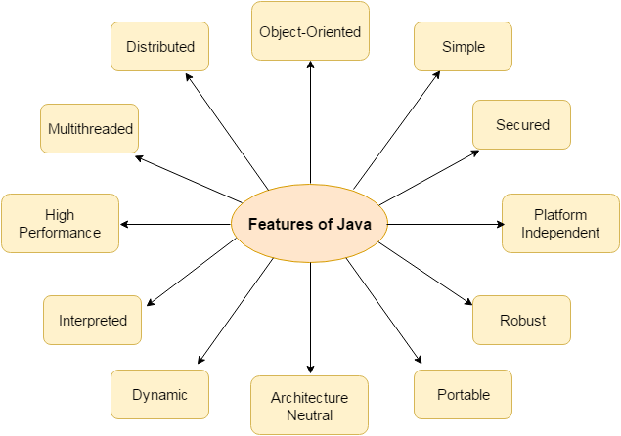
Features of Java

Slide 7
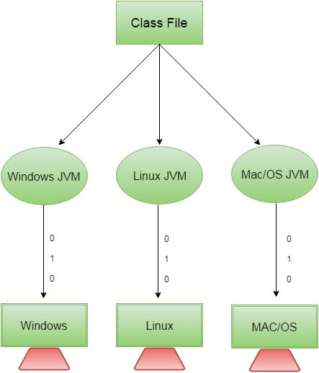

Slide 8
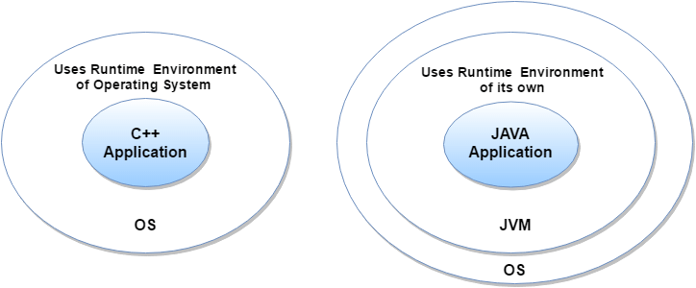

Slide 9
C++ vs Java
Comparison Index | C++ | Java
Platform-independent | C++ is platform-dependent. | Java is platform-independent.
Mainly used for | C++ is mainly used for system programming. | Java is mainly used for application programming. It is widely used in window, web-based, enterprise and mobile applications.
Goto | C++ supports goto statement. | Java doesn't support goto statement.
Multiple inheritance | C++ supports multiple inheritance. | Java doesn't support multiple inheritance through class. It can be achieved by interfaces in java.
Operator Overloading | C++ supports operator overloading. | Java doesn't support operator overloading.
Pointers | C++ supports pointers. You can write pointer program in C++. | Java supports pointer internally. But you can't write the pointer program in java. It means java has restricted pointer support in java.
Compiler and Interpreter | C++ uses compiler only. | Java uses compiler and interpreter both.
Call by Value and Call by reference | C++ supports both call by value and call by reference. | Java supports call by value only. There is no call by reference in java.

Slide 10
C++ vs Java
Comparison Index | C++ | Java
Structure and Union | C++ supports structures and unions. | Java doesn't support structures and unions.
Thread Support | C++ doesn't have built-in support for threads. It relies on third-party libraries for thread support. | Java has built-in thread support.
Documentation comment | C++ doesn't support documentation comment. | Java supports documentation comment (/** ... */) to create documentation for java source code.
Virtual Keyword | C++ supports virtual keyword so that we can decide whether or not override a function. | Java has no virtual keyword. We can override all non-static methods by default. In other words, non-static methods are virtual by default.
unsigned right shift >>> | C++ doesn't support >>> operator. | Java supports unsigned right shift >>> operator that fills zero at the top for the negative numbers. For positive numbers, it works same like >> operator.
Inheritance Tree | C++ creates a new inheritance tree always. | Java uses single inheritance tree always because all classes are the child of Object class in java. Object class is the root of inheritance tree in java.

Slide 11
Simple Program of Java
1. Creating hello java example
    class Simple{
    public static void main(String args[]){
    System.out.println("Hello Java");
    }
    }
2. save this file as Simple.java
3. To compile:javac Simple.java
4. To execute:java Simple
Output:Hello Java

Slide 12
Parameters used in first java program
class keyword
public keyword is an access modifier which represents visibility
static is a keyword, if we declare any method as static, it is known as static method. The core advantage of static method is that there is no need to create object to invoke the static method. The main method is executed by the JVM, so it doesn't require to create object to invoke the main method. So it saves memory.
void is the return type of the method.
main represents the starting point of the program.
String[] args is used for command line argument.
System.out.println() is used print statement.

Slide 13
static public void main(String args[])
public static void main(String[] args)
public static void main(String []args)
public static void main(String args[])
public static void main(String... args)
class A{
static public void main(String... args){
System.out.println("hello java4");
}
};

Slide 14
Valid java main method signature
public static void main(String[] args)
public static void main(String []args)
public static void main(String args[])
public static void main(String... args)
static public void main(String[] args)
public static final void main(String[] args)
final public static void main(String[] args)
final strictfp public static void main(String[] args)
Invalid java main method signature
public void main(String[] args)
static void main(String[] args)
public void static main(String[] args)
abstract public static void main(String[] args)

Slide 15
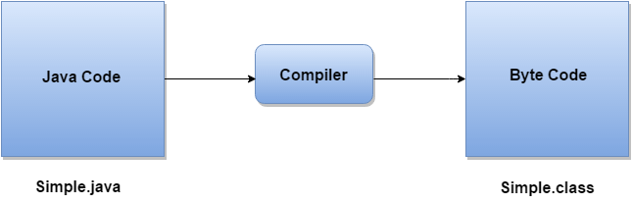
What happens at compile time?
At compile time, java file is compiled by Java Compiler (It does not interact with OS) and converts the java code into bytecode.

Slide 16
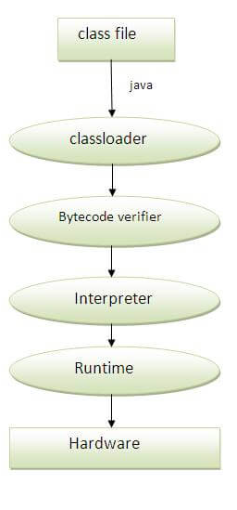
What happens at runtime?
Classloader: is the subsystem of JVM that is used to load class files.
Bytecode Verifier: checks the code fragments for illegal code that can violate access right to objects.
Interpreter: read bytecode stream then execute the instructions.

Slide 17
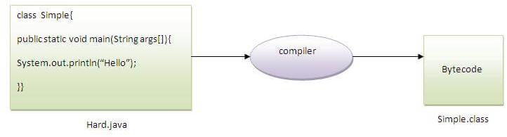
Q)Can you save a java source file by other name than the class name?
Yes, if the class is not public. It is explained in the figure given below:
To compile:javac Hard.java
To execute:java Simple

Slide 18
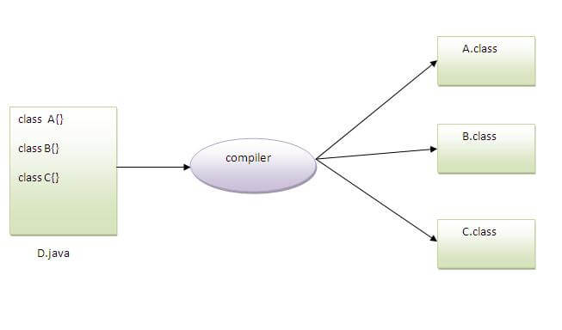
Q)Can you have multiple classes in a java source file?
Yes, like the figure given below illustrates:

Slide 19
How to set path in Java
The path is required to be set for using tools such as javac, java etc.
If you are saving the java source file inside the jdk/bin directory, path is not required to be set because all the tools will be available in the current directory.
But If you are having your java file outside the jdk/bin folder, it is necessary to set path of JDK.
There are 2 ways to set java path:
1. temporary
2. permanent

Slide 20
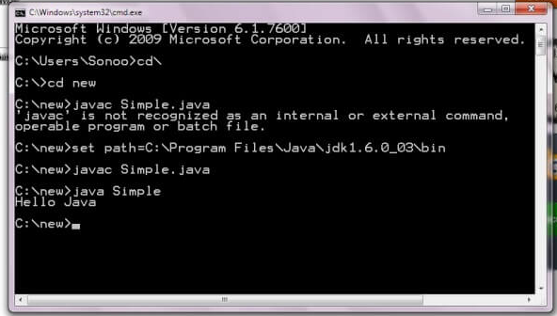
1) How to set Temporary Path of JDK in Windows
To set the temporary path of JDK, you need to follow following steps:
Open command prompt
Copy the path of jdk/bin directory
Write in command prompt: set path=copied_path
  Eg:
  set path=C:\Program Files\Java\jdk1.6.0_23\bin

Slide 21
Difference between JDK, JRE and JVM
JVM
JVM (Java Virtual Machine) is an abstract machine. It is a specification that provides runtime environment in which java bytecode can be executed.
JVMs are available for many hardware and software platforms. JVM, JRE and JDK are platform dependent because configuration of each OS differs. But, Java is platform independent. There are three notions of the JVM: specification, implementation, and instance.
The JVM performs following main tasks:
  Loads code
  Verifies code
  Executes code
  Provides runtime environment

Slide 22
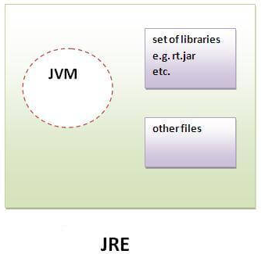
JRE
JRE is an acronym for Java Runtime Environment. It is used to provide runtime environment. It is the implementation of JVM. It physically exists. It contains set of libraries + other files that JVM uses at runtime.

Slide 23
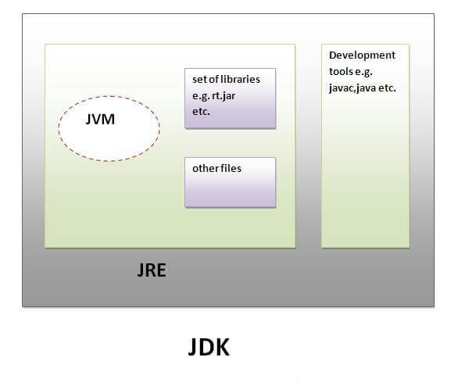
JDK
JDK is an acronym for Java Development Kit. It physically exists. It contains JRE + development tools.

Slide 24
Variables and Data Types in Java
A variable is a container which holds the value while the java program is executed. A variable is assigned with a datatype.
Variable is a name of memory location.
Variable is name of reserved area allocated in memory. In other words, it is a name of memory location. It is a combination of "vary + able" that means its value can be changed.
int data=50;//Here data is variable

Slide 25
JAVA VARIABLE TYPES
In Java there are four types of variables:
Non-static fields - A non-static field is a variable that belongs to an object. Objects keep their internal state in non-static fields. Non-static fields are also called instance variables, because they belong to instances (objects) of a class.
Static fields - A static field is a variable that belongs to a class. A static field has the same value for all objects that access it. Static fields are also called class variables.
Local variables - A local variable is a variable declared inside a method. A local variable is only accessible inside the method that declared it
Parameters - A parameter is a variable that is passed to a method when the method is called. Parameters are also only accessible inside the method that declares them.

Slide 26
1) Local Variable
A variable declared inside the method is called local variable.
2) Instance Variable
A variable declared inside the class but outside the method, is called instance variable . It is not declared as static.
3) Static variable
A variable which is declared as static is called static variable. It cannot be local.

Slide 27
Example to understand the types of variables in java
class A{
int data=50;//instance variable
static int m=100;//static variable
void method(){
int n=90;//local variable
}
}//end of class

Slide 28
DATA TYPE
A data type, in programming, is a classification that specifies,
    Which type of value a variable has
    And what type of mathematical, relational or logical operations can be applied to it without causing an error.
A string, for example, is a data type that is used to classify text and an integer is a data type used to classify whole numbers.
The data type defines which operations can safely be performed to create, transform and use the variable in another computation.
Data Type | Used for | Example
String | Alphanumeric characters | hello world, Alice, Bob123
Integer | Whole numbers | 7, 12, 999
Float (floating point) | Number with a decimal point | 3.15, 9.06, 00.13
Character | Encoding text numerically | 97 (in ASCII, 97 is a lower case 'a')
Boolean | Representing logical values | TRUE, FALSE

Slide 29
STRONGLY TYPED AND WEAKLY TYPED
Strongly Typed :
Variable must be declared with a data type.
A variable cannot start off life without knowing the range of values it can hold, and once it is declared, the data type of the variable cannot change.
A strongly typed language requires an explicit conversion (by using the cast operator) between related types
Java is a strongly typed programming language
Weakly Typed :
Variables are not associated to specific datatype
Weakly typed languages place no restrictions on how data types can be mixed.
Conversions between unrelated types are implicitly allowed.
Example : Perl

Slide 30
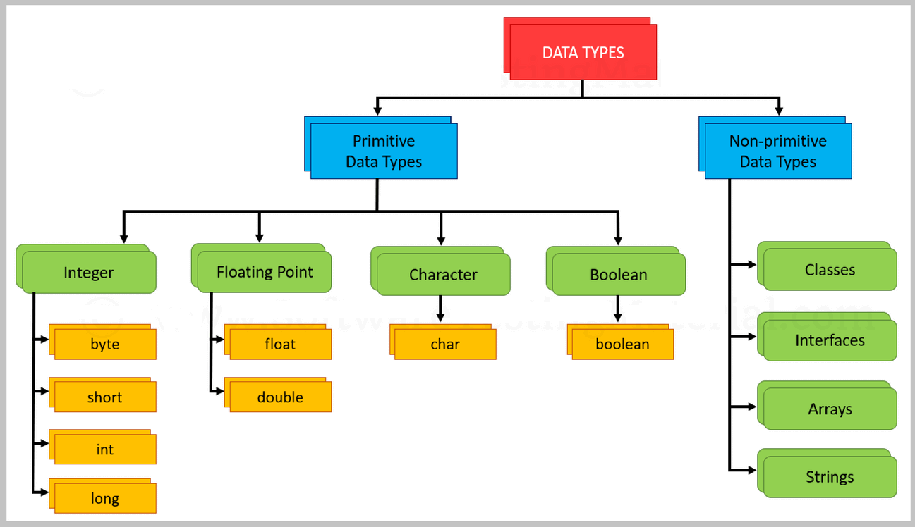

Slide 31
JAVA - DATA TYPES AND THEIR RANGE
Data Type | Default Value | Default size | Range
boolean | false | 1 bit | true or false
char | '\u0000' | 2 byte | 0 to 65535
byte | 0 | 1 byte | -128 to 127
short | 0 | 2 byte | -32,768 to 32,767
int | 0 | 4 byte | -2³¹ to 2³¹-1
long | 0L | 8 byte | -2⁶³ to 2⁶³-1
float | 0.0f | 4 byte | 1.4e-324 to 3.4e+038
double | 0.0d | 8 byte | 4.9e-324 to 1.8e+308

Slide 32
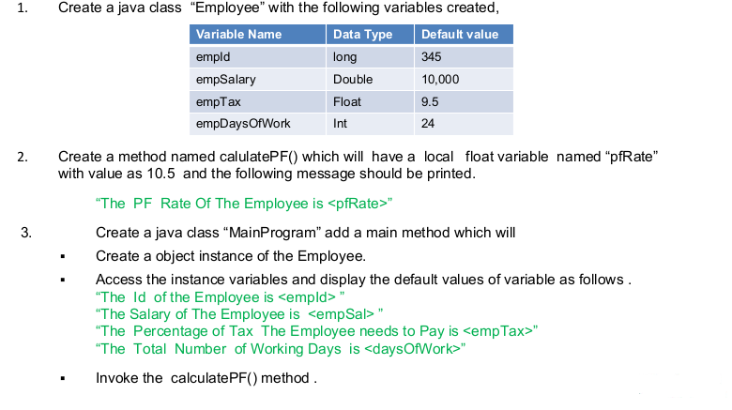

Slide 33
Q) Why char uses 2 byte in java and what is \u0000 ?
It is because java uses Unicode system not ASCII code system.
The \u0000 is the lowest range of Unicode system.

Slide 34
Java Variable Example:
Add Two Numbers
class Simple{
public static void main(String[] args){
int a=10;
int b=10;
int c=a+b;
System.out.println(c);
}
}
Output:
20

Slide 35
Java Variable Example:
Widening
class Simple{
public static void main(String[] args){
int a=10;
float f=a;
System.out.println(a);
System.out.println(f);
}
}
Output:
10
10.0

Slide 36
Java Variable Example:
Narrowing (Typecasting)
class Simple{
public static void main(String[] args){
float f=10.5f;
//int a=f;//Compile time error
int a=(int)f;
System.out.println(f);
System.out.println(a);
}
}
Output:
10.5
10

Slide 37
Java Variable Example:
Overflow
class Simple{
public static void main(String[] args){
//Overflow
int a=130;
byte b=(byte)a;
System.out.println(a);
System.out.println(b);
}
}
Output:
130
-126

Slide 38
Java Variable Example:
Adding Lower Type
class Simple{
public static void main(String[] args){
byte a=10;
byte b=10;
//byte c=a+b;//Compile Time Error: because a+b=20 will be int
byte c=(byte)(a+b);
System.out.println(c);
}
}
Output:
20

Slide 39
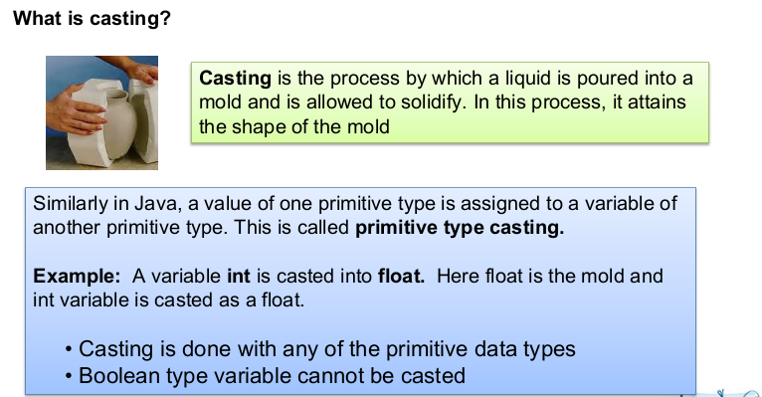

Slide 40
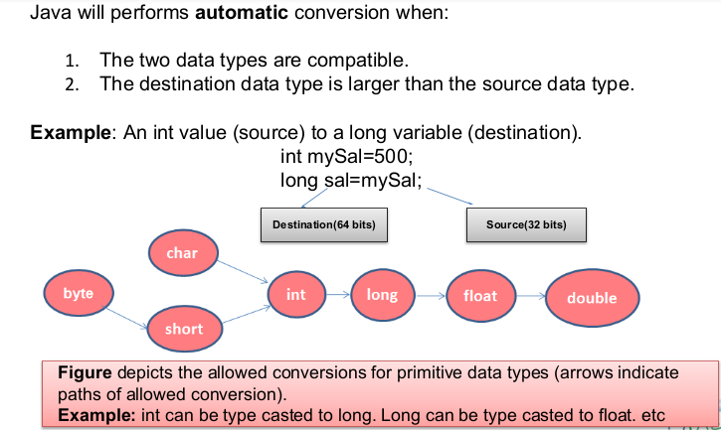
AUTOMATIC/IMPLICIT CASTING

Slide 41
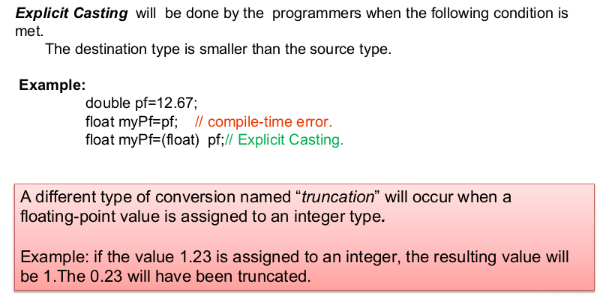

Slide 42
Unicode System
Unicode is a universal international standard character encoding that is capable of representing most of the world's written languages.
Why java uses Unicode System?
Before Unicode, there were many language standards: ASCII (American Standard Code for Information Interchange) for the United States.
ISO 8859-1 for Western European Language.
KOI-8 for Russian.
GB18030 and BIG-5 for chinese, and so on.
Solution:
lowest value:\u0000
highest value:\uFFFF

Slide 43
Operators in java
There are many types of operators in java which are given below:
Unary Operator,
Arithmetic Operator,
Shift Operator,
Relational Operator,
Bitwise Operator,
Logical Operator,
Ternary Operator and
Assignment Operator.

Slide 44
Java Operator Precedence
Operator Type | Category | Precedence
Unary | postfix | expr++ expr--
 | prefix | ++expr --expr +expr -expr ~ !
Arithmetic | multiplicative | * / %
 | additive | + -
Shift | shift | << >> >>>
Relational | comparison | < > <= >= instanceof
 | equality | == !=
Bitwise | bitwise AND | &
 | bitwise exclusive OR | ^
 | bitwise inclusive OR | |
Logical | logical AND | &&
 | logical OR | ||
Ternary | ternary | ? :
Assignment | assignment | = += -= *= /= %= &= ^= |= <<= >>= >>>=

Slide 45
Java Unary Operator
Java Unary Operator Example: ++ and --
class OperatorExample{
public static void main(String args[]){
int x=10;
System.out.println(x++);
System.out.println(++x);
System.out.println(x--);
System.out.println(--x);
}
}
Output:
10 12 12 10

Slide 46
Java Unary Operator Example 2: ++ and --
class OperatorExample{
public static void main(String args[]){
int a=10;
int b=10;
System.out.println(a++ + ++a);
System.out.println(b++ + b++);
}
}
Output:
22 21

Slide 47
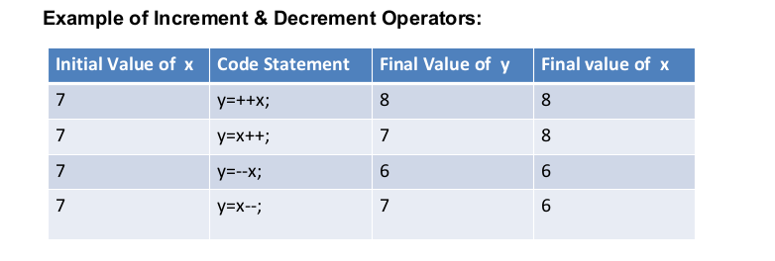
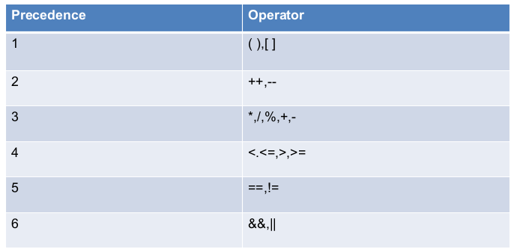

Slide 48
Java Unary Operator Example: ~ and !
class OperatorExample{
public static void main(String args[]){
int a=10;
int b=-10;
boolean c=true;
boolean d=false;
System.out.println(~a);//-11 (minus of total positive value which starts from 1)
System.out.println(~b);//9 (positive of total minus, positive starts from 0)
System.out.println(!c);
System.out.println(!d);
}}
Output:
-11 9 false true

Slide 49
Java Arithmetic Operator Example
class OperatorExample{
public static void main(String args[]){
int a=10;
int b=5;
System.out.println(a+b);
System.out.println(a-b);
System.out.println(a*b);
System.out.println(a/b);
System.out.println(a%b);
}}
Output:
15 5 50 2 0

Slide 50
Java Arithmetic Operator Example: Expression
class OperatorExample{
public static void main(String args[]){
System.out.println(10*10/5+3-1*4/2);
}}
Output:
21

Slide 51
Java Left Shift Operator Example
class OperatorExample{
public static void main(String args[]){
System.out.println(10<<2);//10*2^2=10*4=40
System.out.println(10<<3);
System.out.println(20<<2);
System.out.println(15<<4);
}}
Output:
40
80
80
240

Slide 52
Java Right Shift Operator Example
class OperatorExample{
public static void main(String args[]){
System.out.println(10>>2);//10/2^2=10/4=2
System.out.println(20>>2);
System.out.println(20>>3);
}}
Output:
2
5
2

Slide 53
Java Shift Operator Example: >> vs >>>
class OperatorExample{
public static void main(String args[]){
//For positive number, >> and >>> works same
System.out.println(20>>2);
System.out.println(20>>>2);
//For negative number, >>> changes parity bit (MSB) to 0
System.out.println(-20>>2);
System.out.println(-20>>>2);
}}
Output:
5
5
-5
1073741819

Slide 54
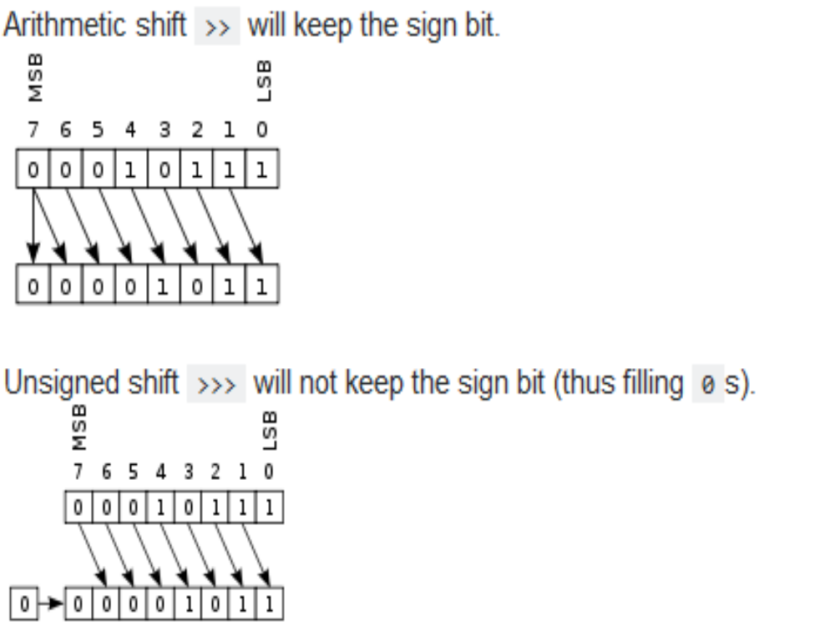

Slide 55
Java AND Operator Example:
Logical && and Bitwise &
The logical && operator doesn't check second condition if first condition is false. It checks second condition only if first one is true.
The bitwise & operator always checks both conditions whether first condition is true or false.
class OperatorExample{
public static void main(String args[]){
int a=10;
int b=5;
int c=20;
System.out.println(a<b&&a<c);
System.out.println(a<b&a<c);
}}
Output:
false
false

Slide 56
Java AND Operator Example:
Logical && vs Bitwise &
class OperatorExample{
public static void main(String args[]){
int a=10;
int b=5;
int c=20;
System.out.println(a<b&&a++<c);
System.out.println(a);
System.out.println(a<b&a++<c);
System.out.println(a);
}}
Output:
false
10
false
11

Slide 57
Java OR Operator Example:
Logical || and Bitwise |
The logical || operator doesn't check second condition if first condition is true. It checks second condition only if first one is false.
The bitwise | operator always checks both conditions whether first condition is true or false.
class OperatorExample{
public static void main(String args[]){
int a=10;
int b=5;
int c=20;
System.out.println(a>b||a<c);
System.out.println(a>b|a<c);
System.out.println(a>b||a++<c);//true || true = true
System.out.println(a);//10 because second condition is not checked
System.out.println(a>b|a++<c);//true | true = true
System.out.println(a);//11 because second condition is checked
}}
Output:
true true true 10 true 11

Slide 58
Java Ternary Operator
Java Ternary operator is used as one liner replacement for if-then-else statement and used a lot in java programming. it is the only conditional operator which takes three operands.
Java Ternary Operator Example
class OperatorExample{
public static void main(String args[]){
int a=2;
int b=5;
int min=(a<b)?a:b;
System.out.println(min);
}
}
Output:
2

Slide 59
Another Example:
class OperatorExample{
public static void main(String args[]){
int a=10;
int b=5;
int min=(a<b)?a:b;
System.out.println(min);
}
}
Output:
5

Slide 60
Java Assignment Operator Example
class OperatorExample{
public static void main(String args[]){
int a=10;
int b=20;
a+=4;
b-=4;
System.out.println(a);
System.out.println(b);
}}
Output:
14
16

Slide 61
Java Assignment Operator Example
class OperatorExample{
public static void main(String[] args){
int a=10;
a+=3;
System.out.println(a);
a-=4;
System.out.println(a);
a*=2;
System.out.println(a);
a/=2;
System.out.println(a);
}}
Output:
13 9 18 9

Slide 62
Java Assignment Operator Example:
Adding short
class OperatorExample{
public static void main(String args[]){
short a=10;
short b=10;
a=a+b;
System.out.println(a);
}}
Output:
Compile time error

Slide 63
After type cast:
class OperatorExample{
public static void main(String args[]){
short a=10;
short b=10;
a=(short)(a+b);
System.out.println(a);
}}
Output:
20

Slide 64
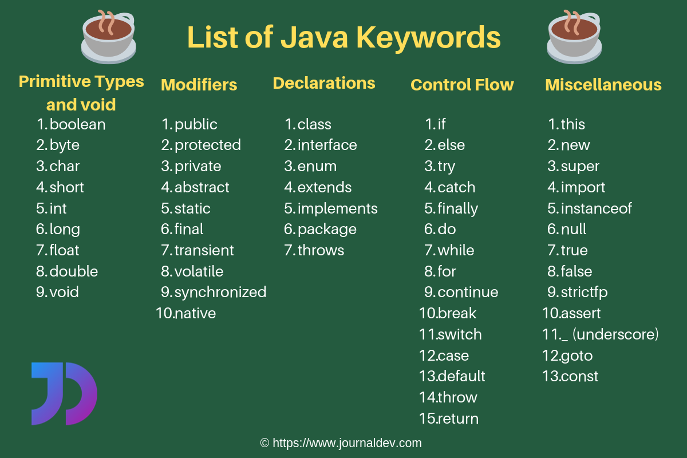
JAVA KEYWORDS
keywords are also known as reserved words.
so it cannot be used as a variable or object name.

Slide 65
WRAPPER CLASS
The wrapper class in Java provides the mechanism to convert primitive into object and object into primitive.
Primitive Type | Wrapper class
boolean | Boolean
char | Character
byte | Byte
short | Short
int | Integer
long | Long
float | Float
double | Double

Slide 66
JAVA IF-ELSE STATEMENT
The Java if statement is used to test the condition. It checks boolean condition: true or false. There are various types of if statement in java.
if statement
if-else statement
if-else-if ladder
nested if statement

Slide 67
JAVA IF STATEMENT
The Java if statement tests the condition. It executes the if block if condition is true.
Syntax:
    if(condition){
    //code to be executed
    }
public class IfExample {
public static void main(String[] args) {
int age=20;
if(age>18){
System.out.print("Age is greater than 18");
}
}
}

Slide 68
JAVA IF-ELSE STATEMENT
The Java if-else statement also tests the condition. It executes the if block if condition is true otherwise else block is executed.
Syntax:
if(condition){
//code if condition is true
}else{
//code if condition is false
}
public class IfElseExample {
public static void main(String[] args) {
int number=13;
if(number%2==0){
System.out.println("even number");
}
else{
System.out.println("odd number");
}
}
}

Slide 69
JAVA IF-ELSE-IF LADDER STATEMENT
public class IfElseIfExample {
public static void main(String[] args) {
int marks=65;
if(marks<50){
System.out.println("fail");
}
else if(marks>=50 && marks<70){
System.out.println(“C grade");
}
else if(marks>=70 && marks<90){
System.out.println(“B grade");
}
else if(marks>=90 && marks<100){
System.out.println(“A grade");
}
else{
System.out.println("Invalid!");
} } }
The if-else-if ladder statement executes one condition from multiple statements.
Syntax:
if(condition1){
//code to be executed if condition1 is true
}else if(condition2){
//code to be executed if condition2 is true
}
else if(condition3){
//code to be executed if condition3 is true
}
...
else{
//code to be executed if all the
conditions are false
}

Slide 70
JAVA SWITCH STATEMENT
The Java switch statement executes one statement from multiple conditions. It is like if-else-if ladder statement.
Syntax:
switch(expression){
case value1:
//code to be executed;
break; //optional
case value2:
//code to be executed;
break; //optional
......
default:
code to be executed if all cases
are not matched;
}
public class SwitchExample {
public static void main(String[] args) {
int number=20;
switch(number){
case 10: System.out.println("10");break;
case 20: System.out.println("20");break;
case 30: System.out.println("30");break;
default:System.out.println("Not in 10, 20 or 30"); } } }

Slide 71
RULES APPLY TO A SWITCH STATEMENT
The variable used in a switch statement can only be a byte, short, int, or char.
You can have any number of case statements within a switch. Each case is followed by the value to be compared to and a colon.
The value for a case must be the same data type as the variable in the switch, and it must be a constant or a literal.
When the variable being switched on is equal to a case, the statements following that case will execute until a break statement is reached.
When a break statement is reached, the switch terminates, and the flow of control jumps to the next line following the switch statement.
Not every case needs to contain a break. If no break appears, the flow of control will fall through to subsequent cases until a break is reached.
A switch statement can have an optional default case, which must appear at the end of the switch. The default case can be used for performing a task when none of the cases is true. No break is needed in the default case.

Slide 72
Points to Remember
There can be one or N number of case values for a switch expression.
The case value must be of switch expression type only. The case value must be literal or constant. It doesn't allow variables.
The case values must be unique. In case of duplicate value, it renders compile-time error.
The Java switch expression must be of byte, short, int, long (with its Wrapper type), enums and string.
Each case statement can have a break statement which is optional. When control reaches to the break statement, it jumps the control after the switch expression. If a break statement is not found, it executes the next case.
The case value can have a default label which is optional.

Slide 73
PREDICT THE OUTPUT
public class SwitchExample2 {
public static void main(String[] args) {
int number=20;
switch(number){
case 10: System.out.println("10");
case 20: System.out.println("20");
case 30: System.out.println("30");
default:System.out.println("Not in 10, 20 or 30");
}
}
}

Slide 74
LOOPS IN JAVA
In programming languages, loops are used to execute a set of instructions/functions repeatedly when some conditions become true. There are three types of loops in java.
  for loop
  while loop
  do-while loop
Java For Loop
The Java for loop is used to iterate a part of the program several times. If the number of iteration is fixed, it is recommended to use for loop.
There are three types of for loops in java.
  Simple For Loop
  For-each or Enhanced For Loop
  Labeled For Loop

Slide 75
JAVA SIMPLE FOR LOOP
The simple for loop is same as C/C++. We can initialize variable, check condition and increment/decrement value.
Syntax:
for(initialization;condition;incr/decr){
//code to be executed
}
public class ForExample {
public static void main(String[] args) {
for(int i=1;i<=10;i++){
System.out.println(i);
}
}
}

Slide 76
JAVA FOR-EACH LOOP
The for-each loop is used to traverse array or collection in java. It is easier to use than simple for loop because we don't need to increment value and use subscript notation.
It works on elements basis not index. It returns element one by one in the defined variable.
Syntax:
for(Type var:array){
//code to be executed
}
public class ForEachExample {
public static void main(String[] args) {
int arr[]={12,23,44,56,78};
for(int i:arr){
System.out.println(i);
}
}
}

Slide 77
JAVA LABELED FOR LOOP
We can have name of each for loop. To do so, we use label before the for loop. It is useful if we have nested for loop so that we can break/continue specific for loop.
Normally, break and continue keywords breaks/continues the inner most for loop only.
Syntax:
labelname:
for(initialization;condition;incr/decr){
//code to be executed
}

Slide 78
PREDICT THE OUTPUT
public class LabeledForExample {
public static void main(String[] args) {
aa:
for(int i=1;i<=3;i++){
bb:
for(int j=1;j<=3;j++){
if(i==2&&j==2){
break aa;
}
System.out.println(i+" "+j);
}
}
}
}

Slide 79
PREDICT THE OUTPUT
public class LabeledForExample2 {
public static void main(String[] args) {
aa:
for(int i=1;i<=3;i++){
bb:
for(int j=1;j<=3;j++){
if(i==2&&j==2){
break bb;
}
System.out.println(i+" "+j);
}
}
}
}

Slide 80
JAVA WHILE LOOP
The Java while loop is used to iterate a part of the program several times. If the number of iteration is not fixed, it is recommended to use while loop.
Syntax:
while(condition){
//code to be executed
}
public class WhileExample {
public static void main(String[] args) {
int i=1;
while(i<=10){
System.out.println(i);
i++;
}
}
}
public class WhileExample2 {
public static void main(String[] args) {
while(true){
System.out.println(“Special while loop");
}
}
}

Slide 81
JAVA DO-WHILE LOOP
The Java do-while loop is used to iterate a part of the program several times. If the number of iteration is not fixed and you must have to execute the loop at least once, it is recommended to use do-while loop.
The Java do-while loop is executed at least once because condition is checked after loop body.
Syntax:
do{
//code to be executed
}while(condition);
public class DoWhileExample {
public static void main(String[] args) {
int i=1;
do{
System.out.println(i);
i++;
}while(i<=10);
}
}

Slide 82
JAVA BREAK STATEMENT
When a break statement is encountered inside a loop, the loop is immediately terminated and the program control resumes at the next statement following the loop.
The Java break is used to break loop or switch statement. It breaks the current flow of the program at specified condition. In case of inner loop, it breaks only inner loop.
Syntax:
jump-statement;
break;
public class BreakExample {
public static void main(String[] args) {
for(int i=1;i<=10;i++){
if(i==5){
break;
}
System.out.println(i);
}
}
}

Slide 83
JAVA CONTINUE STATEMENT
The continue statement is used in loop control structure when you need to immediately jump to the next iteration of the loop. It can be used with for loop or while loop.
The Java continue statement is used to continue loop. It continues the current flow of the program and skips the remaining code at specified condition. In case of inner loop, it continues only inner loop.
Syntax:
jump-statement;
continue;
public class ContinueExample {
public static void main(String[] args) {
for(int i=1;i<=10;i++){
if(i==5){
continue;
}
System.out.println(i);
}
} }

Slide 84
PREDICT THE OUTPUT
public class BreakExample2 {
public static void main(String[] args) {
for(int i=1;i<=3;i++){
for(int j=1;j<=3;j++){
if(i==2&&j==2){
break;
}
System.out.println(i+" "+j);
}
}
}
}

Slide 85
PREDICT THE OUTPUT
public class ContinueExample2 {
public static void main(String[] args) {
for(int i=1;i<=3;i++){
for(int j=1;j<=3;j++){
if(i==2&&j==2){
continue;
}
System.out.println(i+" "+j);
}
}
}
}

Slide 86
MCQS
1. Consider the following program written in Java.
class Test{
public static void main(String args[]){
int x=7;
if(x==2);
System.out.print("NumberSeven");
System.out.println("NotSeven");
}
}
What would the output of the program be?
A. NumberSeven NotSeven
B. NumberSeven
C. NotSeven
D. Error
E. 7

Slide 87
2. public class HelloWorld{
public static void main(String []args)
{
float x = 0.1f;
if ( x == 0.1 )
System.out.print("IF");
else if (x == 0.1f)
System.out.print("ELSE IF");
else
System.out.print("ELSE");
}
}
(A) ELSE IF
(B) IF
(C) ELSE
d. none of these

Slide 88
3. What will be the value of y after execution of switch statement?
public class Test{
public static void main(String[] args){
int x = 3, y = 4;
switch(x + 3){
case 6: y = 0;
case 7: y = 1;
default: y += 1;
}
}
}
A. 1
B. 2
C. 3
D. 4
E. 0

Slide 89
4. public void test(int x)
{
int odd = 1;
if(odd)
{
System.out.println("odd");
}
else
{
System.out.println("even");
}
}
Which statement is true?
A. Compilation fails.
B. "odd" will always be output.
C. "even" will always be output.
D. "odd" will be output for odd values of x, and "even" for even values.

Slide 90
5. Which of these selection statements test only for equality?
a) if
b) switch
c) if & switch
d) none of the mentioned
6. Which of this statement is incorrect?
a) switch statement is more efficient than a set of nested ifs
b) two case constants in the same switch can have identical values
c) switch statement can only test for equality, whereas if statement can evaluate any type of boolean expression
d) it is possible to create a nested switch statements

Slide 91
7. What is the output of this program?
1. class selection_statements
2. {
3. public static void main(String args[])
4. {
5. int var1 = 5;
6. int var2 = 6;
7. if ((var2 = 1) == var1)
8. System.out.print(var2);
9. else
10. System.out.print(++var2);
} }
Options:
a)1
b)2
c)6
d)7

Slide 92
8. What would be the output of the following codesnippet if variable a=10?
if(a<=0)
{
if(a==0)
{
System.out.println("1 ");
}
else
{
System.out.println("2 ");
}
}
System.out.println("3 ");
a) 1 2
b) 2 3
c) 1 3
d) 3

Slide 93
1. a
2. a
3. b
4. a
5.b
6. b
7. b
8. d

Slide 94
NESTED LOOPS. WHAT DO THESE PRINT?
for (int i = 1; i < 4; i++)
for (int j = 1; j < i; j++)
System.out.println(i + “ “ + j);
for (int i = 0; i < 4; i++)
  for (int j = 1; j < i; j++)
System.out.println(i + “ “ + j);
for (int i = 1; i < 4; i++)
for (int j = 1; j < i; j++)
System.out.println(i + “ “ + j);
System.out.println(“******”);
int T = 0;
for (int i = 1; i < 4; i++) {
for (int j = 1; j < 2*i; j += 2)
T += j * i;
System.out.println(“T = “ + T);
}

Slide 95
MCQS
1. . Determine output:
public class Test{
public static void main(String args[]){
int i, j;
for(i=1, j=0;i<10;i++) j += i;
System.out.println(i);
}
}
A. 10
B. 11
C. 9
D. 20
E. None of these

Slide 96
2. How many times will the following code print "Welcome to Eon"?
int count = 0;
do {
System.out.println("Welcome to Eon!");
count++;
} while (count < 10);
A. 8
B. 9
C. 10
D. 11
E. 0

Slide 97
3. Choose the correct statement in context of the following program code.
public class Test{
public static void main(String[] args){
double sum = 0;
for(double d = 0; d < 10;){
d += 0.1;
sum += sum + d;
}
}
}
A. The program has a compile error because the adjustment is missing in the for loop.
B. The program has a compile error because the control variable in the for loop cannot be of the double type.
C. The program runs in an infinite loop because d<10 would always be true.
D. The program compiles and runs fine.

Slide 98
4. . Which of the following for loops will be an infinite loop?
A. for(; ;)
B. for(i=0 ; i<1; i--)
C. for(i=0; ; i++)
D. All of the above
5. What is the value of a[1] after the following code is executed?
int[] a = {0, 2, 4, 1, 3};
for(int i = 0; i < a.length; i++)
a[i] = a[(a[i] + 3) % a.length];
A. 0
B. 1
C. 2
D. 3
E. 4

Slide 99
6. What will be the result?
1. int i = 10;
2. while(i++ <= 10){
3. i++;
4. }
5. System.out.print(i);
A. 10
B. 11
C. 12
D. 13
E. Line 5 will be never reached.

Slide 100
7. public class While
{
public void loop()
{
int x= 0;
while ( 1 ) /* Line 6 */
{
System.out.print("x plus one is " + (x + 1)); /* Line 8 */
}
}
}
Which statement is true?
A. There is a syntax error on line 1.
B. There are syntax errors on lines 1 and 6.
C. There are syntax errors on lines 1, 6, and 8.
D. There is a syntax error on line 6.

Slide 101
8. What is the output of this program?
class comma_operator
{
public static void main(String args[])
{
int sum = 0;
for (int i = 0, j = 0; i < 5 & j < 5; ++i, j = i + 1)
sum += i;
System.out.println(sum);
}
}
a) 5
b) 6
c) 14
d) Compilation error

Slide 102
9. What is the output of this program?
class jump_statments
{
public static void main(String args[])
{
int x = 2;
int y = 0;
for ( ; y < 10; ++y)
{
if (y % x == 0)
continue;
else if (y == 8)
break;
else
System.out.print(y + " ");
}
}
}
a) 1 3 5 7
b) 2 4 6 8
c) 1 3 5 7 9
d) 1 2 3 4 5 6 7 8 9

Slide 103
1. a
2. c
3. d
4. d
5. b
6. d
7. d
8. b
9. c

Slide 104
JAVA COMMENTS
The java comments are statements that are not executed by the compiler and interpreter. The comments can be used to provide information or explanation about the variable, method, class or any statement. It can also be used to hide program code for specific time.
Types of Java Comments
There are 3 types of comments in java.
  Single Line Comment
  Multi Line Comment
  Documentation Comment
1) Java Single Line Comment
The single line comment is used to comment only one line.
Syntax:
//This is single line comment

Slide 105
2) Java Multi Line Comment
The multi line comment is used to comment multiple lines of code.
Syntax:
/* This is
multi line
comment */
3) Java Documentation Comment
The documentation comment is used to create documentation API. To create documentation API, you need to use javadoc tool.
Syntax:
/** This is
documentation
Comment */

Slide 106
OBJECTS AND CLASSES
An object has three characteristics:
State
Behavior
Identity
Object Definitions:
An object is a real-world entity.
An object is a runtime entity.
The object is an entity which has state and behavior.
The object is an instance of a class.

Slide 107
METHOD
method is a way to perform some task.
is a block of code grouped together to perform a certain task or operation.
types of methods
method declaration
how to call a method in Java.
Advantages
easy modification
readability of code

Slide 108
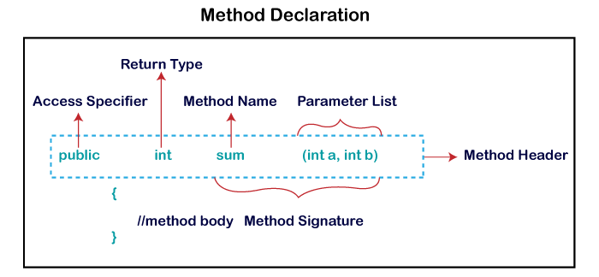

Slide 109
Types of Method
There are two types of methods in Java:
Predefined Method
length(), equals(), compareTo(), sqrt()
User-defined Method
How to Call or Invoke a User-defined Method
add(a, b);

Slide 110
Static Method
Instance Method(non static method)
  There are two types of instance method:
    Accessor Method
    Mutator Method
Abstract Method
Factory method
Recursive Method

Slide 111
ACCESS MODIFIERS
A Java access modifier specifies which classes can access a given class and its fields, constructors and methods.
Access modifiers can be specified separately for a class, its constructors, fields and methods.
private
default (package)
protected
public

Slide 112
Access Modifier | within class | within package | outside package by subclass only | outside package
Private | Y | N | N | N
Default | Y | Y | N | N
Protected | Y | Y | Y | N
Public | Y | Y | Y | Y
 | private | default | protected | public
Class | No | Yes | No | Yes
Nested Class | Yes | Yes | Yes | Yes
Constructor | Yes | Yes | Yes | Yes
Method | Yes | Yes | Yes | Yes
Field | Yes | Yes | Yes | Yes

Slide 113
CONSTRUCTORS IN JAVA

Slide 114
AGENDA
Types of constructors
  Default Constructor
  Parameterized Constructor
Constructor Overloading
Does constructor return any value?
Copying the values of one object into another
Does constructor perform other tasks instead of the initialization

Slide 115
Rules for creating Java constructor
There are two rules defined for the constructor.
Constructor name must be the same as its class name
A Constructor must have no explicit return type
A Java constructor cannot be abstract, static, final, and synchronized

Slide 116
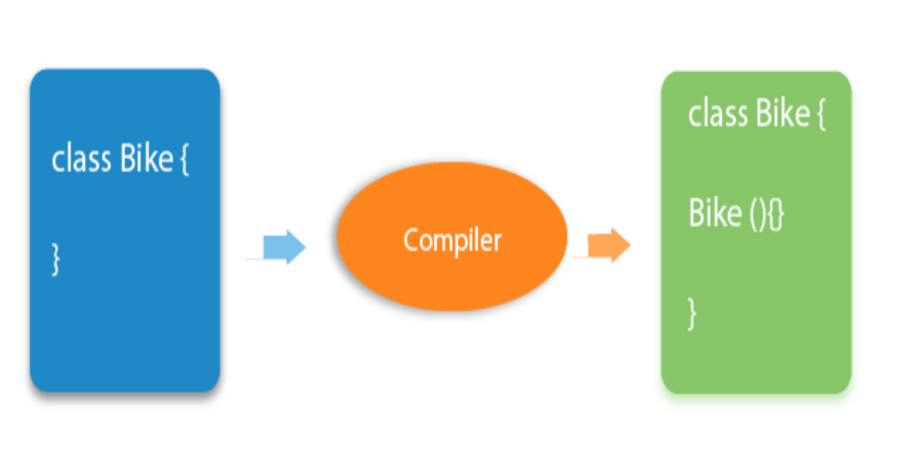
JAVA DEFAULT CONSTRUCTOR
What is the purpose of a default constructor?
The default constructor is used to provide the default values to the object like 0, null, etc., depending on the type.

Slide 117
NO ARG CONSTRUCTOR
class Bike1{
//creating a default constructor
Bike1()
{
System.out.println("Bike is created");
}
public static void main(String args[]){
Bike1 b=new Bike1();
}
}

Slide 118
JAVA PARAMETERIZED CONSTRUCTOR
A constructor which has a specific number of parameters is called a parameterized constructor.
Why use the parameterized constructor?
The parameterized constructor is used to provide different values to distinct objects. However, you can provide the same values also.

Slide 119
class Student4{
int id;
String name;
//creating a parameterized constructor
Student4(int i,String n){
id = i;
name = n;
}
//method to display the values
void display(){System.out.println(id+" "+name);}
public static void main(String args[]){
//creating objects and passing values
Student4 s1 = new Student4(111,"Karan");
Student4 s2 = new Student4(222,"Aryan");
//calling method to display the values of object
s1.display();
s2.display();
}
}

Slide 120
Difference between constructor and method in Java
Java Constructor | Java Method
A constructor is used to initialize the state of an object. | A method is used to expose the behavior of an object.
A constructor must not have a return type. | A method must have a return type.
The constructor is invoked implicitly. | The method is invoked explicitly.
The Java compiler provides a default constructor if you don't have any constructor in a class. | The method is not provided by the compiler in any case.
The constructor name must be same as the class name. | The method name may or may not be same as the class name.

Slide 121
JAVA COPY CONSTRUCTOR
There is no copy constructor in Java. However, we can copy the values from one object to another like copy constructor in C++.
There are many ways to copy the values of one object into another in Java. They are:
By constructor
By assigning the values of one object into another
By clone() method of Object class

Slide 122
//Java program to initialize the values from one object to another object.
class Student6{
int id;
String name;
//constructor to initialize integer and string
Student6(int i,String n){
id = i;
name = n;
}
//constructor to initialize another object
Student6(Student6 s){
id = s.id;
name =s.name;
}
void display(){System.out.println(id+" "+name);}
public static void main(String args[]){
Student6 s1 = new Student6(111,"Karan");
Student6 s2 = new Student6(s1);
s1.display();
s2.display();
}
}

Slide 123
COPYING VALUES WITHOUT CONSTRUCTOR
We can copy the values of one object into another by assigning the objects values to another object. In this case, there is no need to create the constructor.

Slide 124
Does constructor return any value?
Yes, it is the current class instance (You cannot use return type yet it returns a value).
Can constructor perform other tasks instead of initialization?
Yes, like object creation, starting a thread, calling a method, etc. You can perform any operation in the constructor as you perform in the method.
Is there Constructor class in Java?
Yes.
What is the purpose of Constructor class?
Java provides a Constructor class which can be used to get the internal information of a constructor in the class. It is found in the java.lang.reflect package.

Slide 125
THIS KEYWORD IN JAVA
In java, this is a reference variable that refers to the current object.
Usage of java this keyword
this can be used to refer current class instance variable.
this can be used to invoke current class method (implicitly)
this() can be used to invoke current class constructor.
this can be passed as an argument in the method call.
this can be passed as argument in the constructor call.
this can be used to return the current class instance from the method.

Slide 126
class Student{
int rollno;
String name;
float fee;
Student(int rollno,String name,float fee){
rollno=rollno;
name=name;
fee=fee;
}
void display(){System.out.println(rollno+" "+name+" "+fee);}
}
class TestThis1{
public static void main(String args[]){
Student s1=new Student(111,"ankit",5000f);
Student s2=new Student(112,"sumit",6000f);
s1.display();
s2.display();
}}

Slide 127
Program where this keyword is not required
class Student{
int rollno;
String name;
float fee;
Student(int r,String n,float f){
rollno=r;
name=n;
fee=f;
}
void display(){System.out.println(rollno+" "+name+" "+fee);}
}
class TestThis3{
public static void main(String args[]){
Student s1=new Student(111,"ankit",5000f);
Student s2=new Student(112,"sumit",6000f);
s1.display();
s2.display();
}}

Slide 128
this: to invoke current class method
class A{
void m(){System.out.println("hello m");}
void n(){
System.out.println("hello n");
//m();//same as this.m()
this.m();
}
}
class TestThis4{
public static void main(String args[]){
A a=new A();
a.n();
}}

Slide 129
THIS() : TO INVOKE CURRENT CLASS CONSTRUCTOR
class A{
A(){System.out.println("hello a");}
A(int x){
this();
System.out.println(x);
}
}
class TestThis5{
public static void main(String args[]){
A a=new A(10);
}}

Slide 130
Calling parameterized constructor from default constructor:
class A{
A(){
this(5);
System.out.println("hello a");
}
A(int x){
System.out.println(x);
}
}
class TestThis6{
public static void main(String args[]){
A a=new A();
}}

Slide 131
Real usage of this() constructor call
The this() constructor call should be used to reuse the constructor from the constructor. It maintains the chain between the constructors i.e. it is used for constructor chaining.

Slide 132
this: to pass as an argument in the method
The this keyword can also be passed as an argument in the method. It is mainly used in the event handling. Let's see the example:
class S2{
void m(S2 obj){
System.out.println("method is invoked");
}
void p(){
m(this);
}
public static void main(String args[]){
S2 s1 = new S2();
s1.p();
}
}

Slide 133
this: to pass as argument in the constructor call
We can pass the this keyword in the constructor also. It is useful if we have to use one object in multiple classes.
class B{
A4 obj;
B(A4 obj){
this.obj=obj;
}
void display(){
System.out.println(obj.data);//using data member of A4 class
}
}
class A4{
int data=10;
A4(){
B b=new B(this);
b.display();
}
public static void main(String args[]){
A4 a=new A4();
}
}

Slide 134
this keyword can be used to return current class instance
We can return this keyword as an statement from the method. In such case, return type of the method must be the class type (non-primitive). Let's see the example:
Syntax of this that can be returned as a statement
return_type method_name(){
return this;
}

Slide 135
class A{
A getA(){
return this;
}
void msg(){System.out.println("Hello java");}
}
class Test1{
public static void main(String args[]){
new A().getA().msg();
}
}

Slide 136
JAVA - STRINGS

Slide 137
STRINGS IN JAVA
Generally, String is a sequence of characters
An object that represents sequence of char values.
An array of characters works same as Java string.
For example:
char[] ch={‘S’,‘M',‘A',‘R',‘T'};
String s=new String(ch);
is same as:
String s=“SMART";

Slide 138
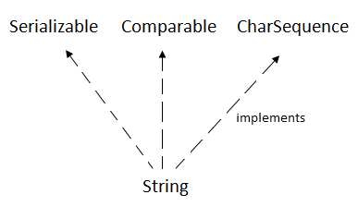
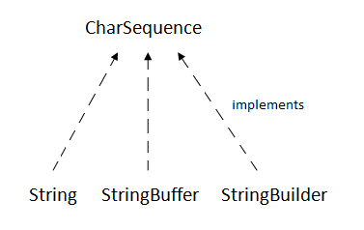
CHARSEQUENCE INTERFACE
The java.lang.String class implements Serializable, Comparable and CharSequence interfaces.
The CharSequence interface is used to represent the sequence of characters.
String, StringBuffer and StringBuilder classes implement it.

Slide 139
HOW TO CREATE A STRING OBJECT?
There are two ways to create String object:
  By string literal
  By new keyword
Using String Literal
    String s="welcome";
  It doesn’t create a new instance if the string already exist in the string constant pool
    String s1="Welcome";
    String s2="Welcome";//It doesn't create a new instance

Slide 140
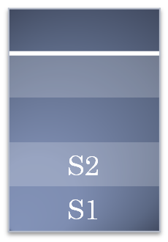
WELCOME
String Constant pool
Object Stack
HEAP
“This makes Java more memory efficient”

Slide 141
2. BY NEW KEYWORD
  String s=new String("Welcome");//creates two objects and one reference variable
STRING EXAMPLE PROGRAM
public class StringExample{
public static void main(String args[]){
String s1="java";//creating string by java string literal
char ch[]={'s','t','r','i','n','g','s'};
String s2=new String(ch);//converting char array to string
String s3=new String("example");//creating java string by new keyword
System.out.println(s1);
System.out.println(s2);
System.out.println(s3);
}
}

Slide 142
IMMUTABLE STRING IN JAVA
In java, string objects are immutable. Immutable simply means unmodifiable or unchangeable.
Example :
class Testimmutablestring{
public static void main(String args[]){
String s="Sachin";
s.concat(" Tendulkar");//concat() method appends the string at the end
System.out.println(s);//will print Sachin because strings are immutable objects
}
}

Slide 143

“SACHIN”
“SACHIN TENDULKAR”
String Constant pool
Object Stack
HEAP
“This makes Java more memory efficient”

Slide 144
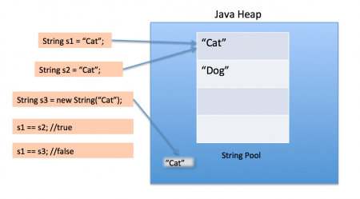

Slide 145
IMMUTABLE STRING IN JAVA
if we explicitely assign it to the reference variable, it will refer to "Sachin Tendulkar"
Example :
class Testimmutablestring{
public static void main(String args[]){
String s="Sachin";
s=s.concat(" Tendulkar");
System.out.println(s);
}
}
“Java uses the concept of string literal.”
“That is why string objects are immutable in Java”

Slide 146
JAVA STRING COMPARE
There are three ways to compare string in java:
    By equals() method
    By = = operator
    By compareTo() method
Uses
    in authentication (by equals() method),
    sorting (by compareTo() method),
    reference matching (by == operator) etc.

Slide 147
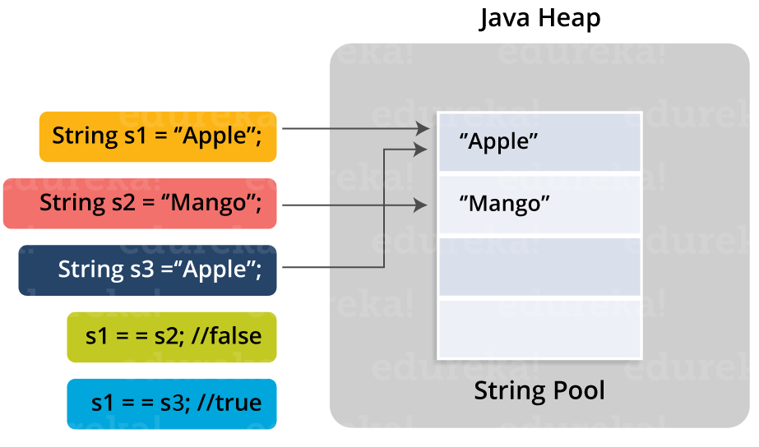

Slide 148
JAVA STRING COMPARE – EXAMPLE CODE
class Teststringcomparison{
public static void main(String args[]){
String s1="Sachin";
String s2=new String (“Sachin”);
String s3=“Sachin";
String s4=“SACHIN”
String s5=“Ratan”
System.out.println(s1.equals(s2)); // – Using equals() method
System.out.println(s1.equals(s3); // – Using equals() method
System.out.println(s1.equalsIgnoreCase(s4)); // – Using equalsIgnoreCase() method
System.out.println(s1==s2); // – using == operator (because s2 refers to instance created in nonpool)
System.out.println(s1==s3); // – using == operator (because s3 refers to instance created for s1)
System.out.println(s1.compareTo(s2)); //
System.out.println(s1.compareTo(s5)); //(because s1>s3)
System.out.println(s5.compareTo(s1)); //(because s3 < s1 )
}
}

Slide 149
Output :
true
true
true
false
true
0
1
-1

Slide 150
JAVA STRING COMPARE – NOTE
== compares references
compareTo() method
  Compares the given string with current string lexicographically
  Blank or empty string, it returns length of the string
  If second string is empty, result would be positive.
  If first string is empty, result would be negative.

Slide 151
JAVA STRING COMPARETO() METHOD EXAMPLE - CONTD
public class CompareToExample{
public static void main(String args[]){
String s1="hello";
String s2="hello";
String s3="meklo";
String s4="hemlo";
String s5="flag";
System.out.println(s1.compareTo(s2));//
System.out.println(s1.compareTo(s3));//"
System.out.println(s1.compareTo(s4));
System.out.println(s1.compareTo(s5));//
}}

Slide 152
Output :
0
-5
-1
2

Slide 153
JAVA STRING COMPARETO(): EMPTY STRING
public class CompareToExample2{
public static void main(String args[]){
String s1="hello";
String s2="";
String s3="me";
System.out.println(s1.compareTo(s2));
System.out.println(s2.compareTo(s3));
}}
Output :
5
-2

Slide 154
STRING CONCATENATION IN JAVA
There are two ways to concat string in java:
    By + (string concatenation) operator
    By concat() method
    + (string concatenation) operator
class TestStringConcatenation{
public static void main(String args[]){
String s1="Sachin"+" Tendulkar";
String s2=50+30+"Sachin"+40+40;
System.out.println(s1);//Sachin Tendulkar
System.out.println(s2);//80Sachin4040
}
}
Output :
Sachin Tendulkar
80Sachin4040

Slide 155
STRING CONCATENATION IN JAVA = USING + OPERATOR
The Java compiler transforms above code to this:
String s=(new StringBuilder()).append("Sachin").append(" Tendulkar).toString();
String concatenation is implemented through the StringBuilder (or StringBuffer) class and its append method
Note : After a string literal, all the + will be treated as string concatenation operator.

Slide 156
STRING CONCATENATION BY CONCAT() METHOD
class TestStringConcatenation3{
public static void main(String args[]){
String s1="Sachin ";
String s2="Tendulkar";
String s3=s1.concat(s2);
System.out.println(s3);//Sachin Tendulkar
}
}
Output :
Sachin Tendulkar

Slide 157
SUBSTRING IN JAVA
A part of string is called substring
substring from the given string object by one of the two methods:
  public String substring(int startIndex): This method returns new String object containing the substring of the given string from specified startIndex (inclusive).
  public String substring(int startIndex, int endIndex): This method returns new String object containing the substring of the given string from specified startIndex to endIndex.
In case of string:
  startIndex: inclusive
  endIndex: exclusive

Slide 158
EXAMPLE OF JAVA SUBSTRING
public class TestSubstring{
public static void main(String args[]){
String s="SachinTendulkar";
System.out.println(s.substring(6));//Tendulkar
System.out.println(s.substring(0,6));//Sachin
}
}
Output :
Tendulkar
Sachin

Slide 159
EXAMPLE 1 – ILLUSTRATING FEW BUILT IN STRING METHODS
public static void main(String args[]){
String s1=" SMART ";
String s2="Training";
System.out.println(s1.toLowerCase()); // toLowercase()
System.out.println(s1.toUpperCase()); // toUppercase()
System.out.println(s1+s2); //before Trim
System.out.println(s1.trim()+s2); //After Trim
String s3=String.join("-",s1,s2); // Join method
System.out.println(s3);
System.out.println(s1.startsWith("SM")); // Space is also String
System.out.println(s1.startsWith(" SM"));
System.out.println(s1.endsWith("art")); // Case Sensitive
System.out.println(s1.endsWith("ART "));
System.out.println(s1.contains("AR")); //contains() Case sensitive
}

Slide 160
OUTPUT :
smart
SMART
SMART Training
SMARTTraining
SMART -Training
false
true
false
true
true

Slide 161
EXAMPLE 2 – ILLUSTRATING FEW BUILT IN STRING METHODS
public static void main(String args[]){
String s1=" SMART ";
String s2="TRAINING";
int value=30;
String s3=String.valueOf(value); //Represents primitive data in string format
System.out.println(s3);
char ch[]=new char[6];
System.out.println(s1.charAt(5)); //Returns Char at index given
char cha[]=s2.toCharArray(); // Converts string to array
System.out.println(cha);
for (int i=0; i<s2.length()-3;i++)
{System.out.println(cha[i]);}
s2.getChars(1,5,ch,0); //Returns char seq within the index No Exception
System.out.println(ch);
//s2.getChars(1,8,ch,0); //Exception - Array Size is low
}}

Slide 162
OUTPUT :
30
A
TRAINING
T
R
A
I
N
RAIN

Slide 163
EXAMPLE 3 – ILLUSTRATING REPLACE() , REPLACEALL() AND REPLACEFIRST()
public class Simple{
public static void main(String args[]){
String Str = "JAVA CLASS";
// replace()
System.out.println(Str.replace('A', 'E'));
System.out.println(Str.replace("JAVA", "SMART"));
// replaceFirst()
System.out.println(Str.replaceFirst("A", "E"));
System.out.println(Str.replaceFirst("JAVA","SMART"));
// replaceAll()
System.out.println(Str.replaceAll("A", "E"));
}}
replace()
Introduced in Java - 1.5
Accepts char and charSequence as argumets
Faster than replaceAll()
replaceAll()
Similar to replace()
Uses regular expression regEx
Signature :
public String replaceAll(String regex, String replacement)
replaceFirst()
Similar to replaceAll() – Uses regEx
Replaces the first occurrence of the given string

Slide 164
OUTPUT :
JEVE CLESS
SMART CLASS
JEVA CLASS
SMART CLASS
JEVE CLESS

Slide 165
JAVA STRINGBUFFER CLASS
StringBuffer class is used to create mutable (modifiable) string.
It is similar to String class except it is mutable.
Java StringBuffer class is thread-safe i.e. multiple threads cannot access it simultaneously. So it is safe and will result in an order.
Some important Constructors of StringBuffer are as follows,
Constructor | Description
StringBuffer() | Creates an empty string buffer with the initial capacity of 16.
StringBuffer(String str) | Creates a string buffer with the specified string.
StringBuffer(int capacity) | Creates an empty string buffer with the specified capacity as length.

Slide 166
JAVA STRINGBUILDER CLASS
The Java StringBuilder class is same as StringBuffer class except that it is non-synchronized.
It is available since JDK 1.5.
Some important Constructors of StringBuffer are as follows,
Constructor | Description
StringBuilder() | Creates an empty string builder with the initial capacity of 16.
StringBuilder(String str) | Creates a string builder with the specified string.
StringBuilder(int length) | Creates an empty string builder with the specified capacity as length.

Slide 167
StringBuffer
StringBuilder
public class stringExample{
public static void main(String []args)
{
StringBuffer sb=new StringBuffer("SMART "); System.out.println(sb);
sb.reverse(); // Reverse operation System.out.println(sb);
sb.reverse();
sb.append("Training"); // append operation System.out.println(sb);
sb.insert(6,"Java "); // insert operation System.out.println(sb);
sb.replace(6,10,"Provides"); // replace operation System.out.println(sb);
sb.delete(9,14); // delete operation System.out.println(sb);
}}
public class stringExample{
public static void main(String []args)
{
StringBuilder sb=new StringBuilder("SMART "); System.out.println(sb);
sb.reverse(); // Reverse operation System.out.println(sb);
sb.reverse();
sb.append("Training"); // append operation System.out.println(sb);
sb.insert(6,"Java "); // insert operation System.out.println(sb);
sb.replace(6,10,"Provides"); // replace operation System.out.println(sb);
sb.delete(9,14); // delete operation System.out.println(sb);
}}

Slide 168
PROGRAM OUTPUT
SMART
TRAMS
SMART Training
SMART Java Training
SMART Provides Training
SMART Pro Training
Both the class has similar methods And performs similarly

Slide 169
DIFFERENCE BETWEEN STRING AND STRINGBUFFER
No. | String | StringBuffer
1) | String class is immutable. | StringBuffer class is mutable.
2) | String is slow and consumes more memory when you concat too many strings because every time it creates new instance. | StringBuffer is fast and consumes less memory when you cancat strings.
3) | String class overrides the equals() method of Object class. So you can compare the contents of two strings by equals() method. | StringBuffer class doesn't override the equals() method of Object class.

Slide 170
DIFFERENCE BETWEEN STRINGBUFFER AND STRINGBUILDER
No. | StringBuffer | StringBuilder
1) | StringBuffer is synchronized i.e. thread safe. It means two threads can't call the methods of StringBuffer simultaneously. | StringBuilder is non-synchronized i.e. not thread safe. It means two threads can call the methods of StringBuilder simultaneously.
2) | StringBuffer is less efficient than StringBuilder. | StringBuilder is more efficient than StringBuffer.

Slide 171
STRING AND STRINGBUFFER HASHCODE TEST
String returns new hashcode value when you concat string but StringBuffer returns same
public class InstanceTest{
public static void main(String args[]){
System.out.println("Hashcode test of String:");
String str=“SMART";
System.out.println(str.hashCode());
str=str+“Training";
System.out.println(str.hashCode());
System.out.println("Hashcode test of StringBuffer:");
StringBuffer sb=new StringBuffer(“SMART");
System.out.println(sb.hashCode());
sb.append(“Training");
System.out.println(sb.hashCode());
}
}
Output :
Hashcode test of String:
79011241
-1461694045
Hashcode test of StringBuffer: 705927765
705927765

Slide 172
HOW TO CREATE IMMUTABLE CLASS?
“Immutable class is a class which once created, it’s contents can not be changed. Immutable objects are the objects whose state can not be changed once constructed. e.g. String class”
All the wrapper classes and String class is immutable
final keyword is used to create a immutable class.
final class with final data members is an immutable class.

Slide 173
EXAMPLE TO CREATE IMMUTABLE CLASS
public final class Employee{
final String pancardNumber;
public Employee(String pancardNumber){
this.pancardNumber=pancardNumber;
}
public String getPancardNumber(){
return pancardNumber;
}
}
The given class is immutable because:
The instance variable of the class is final i.e. we cannot change the value of it after creating an object.
The class is final so we cannot create the subclass.
There is no setter methods i.e. we have no option to change the value of the instance variable.

Slide 174
JAVA TOSTRING() METHOD
To represent any object as a string, toString() method is used.
toString() method returns the string representation of the object.
If you print any object, java compiler internally invokes the toString() method on the object.
So overriding the toString() method, returns the desired output
Advantage of Java toString() method
Overriding the toString() method of the Object class, we can return values of the object.
So code complexity is reduced

Slide 175
WITHOUT TOSTRING()
With toString()
class Student{
int rollno;
String name;
String city;
Student(int rollno, String name, String city){
this.rollno=rollno;
this.name=name;
this.city=city;
}
public static void main(String args[]){
Student s1=new Student(101,"Raj","lucknow");
Student s2=new Student(102,"Vijay","ghaziabad");
System.out.println(s1);
//compiler writes here s1.toString()
System.out.println(s2);
//compiler writes here s2.toString()
}
}
class Student{
int rollno;
String name;
String city;
Student(int rollno, String name, String city){
this.rollno=rollno;
this.name=name;
this.city=city;
}
public String toString(){//overriding the toString() method
return rollno+" "+name+" "+city;
}
public static void main(String args[]){
Student s1=new Student(101,"Raj","lucknow");
Student s2=new Student(102,"Vijay","ghaziabad");
System.out.println(s1);
//compiler writes here s1.toString()
System.out.println(s2);
//compiler writes here s2.toString()
}
}
OUTPUT
101 Raj lucknow
102 Vijay ghaziabad
OUTPUT
Student@1fee6fc Student@1eed786

Slide 176
STRINGTOKENIZER IN JAVA
The java.util.StringTokenizer class allows you to break a string into tokens. It is simple way to break string.
Constructors of StringTokenizer class
Constructor | Description
StringTokenizer(String str) | Creates stringtokenizer with specified string.
StringTokenizer(String str, String delim) | Creates stringtokenizer with specified string and delimeter.
StringTokenizer(String str, String delim, boolean returnValue) | Creates stringtokenizer with specified string, delimeter and returnvalue. If return value is true, delimiter characters are considered to be tokens. If it is false, delimiter characters serve to separate tokens.

Slide 177
METHODS OF STRINGTOKENIZER CLASS
The 6 useful methods of StringTokenizer class are as follows
Public method | Description
boolean hasMoreTokens() | checks if there is more tokens available.
String nextToken() | returns the next token from the StringTokenizer object.
String nextToken(String delim) | returns the next token based on the delimeter.
boolean hasMoreElements() | same as hasMoreTokens() method.
Object nextElement() | same as nextToken() but its return type is Object.
int countTokens() | returns the total number of tokens.

Slide 178
SIMPLE EXAMPLE OF STRINGTOKENIZER CLASS
import java.util.StringTokenizer;
public class Simple{
public static void main(String args[]){
StringTokenizer st = new StringTokenizer("my name is khan"," ");
while (st.hasMoreTokens()) {
System.out.println(st.nextToken());
}
}
}
StringTokenizer class that tokenizes a string "my name is khan" on the basis of whitespace.
OUTPUT
my
name
is
khan

Slide 179
EXAMPLE OF NEXTTOKEN(STRING DELIM) METHOD OF STRINGTOKENIZER CLASS
import java.util.*;
public class Test {
public static void main(String[] args) {
StringTokenizer st = new StringTokenizer("my,name,is,khan");
// printing next token
System.out.println("Next token is : " + st.nextToken(","));
}
}
StringTokenizer class is deprecated now. It is recommended to use split() method of String class or regex (Regular Expression).
OUTPUT
Next token is : my

Slide 180
JAVA ARRAY

Slide 181
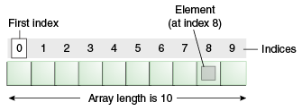
INTRODUCTION - JAVA ARRAY
“An array is a collection of similar type of elements that have a contiguous memory location.”
Java array is an object which contains elements of a similar data type.
It is a data structure where we store similar elements.
Java array size is bounded.
The first element of the array is stored at the 0 index.

Slide 182
ADVANTAGES
Code Optimization: It makes the code optimized, we can retrieve or sort the data efficiently.
Random access: We can get any data located at an index position.
Disadvantages
Size Limit: We can store only the fixed size of elements in the array. It doesn't grow its size at runtime.
To solve this problem, collection framework is used in Java which grows automatically.

Slide 183
TYPES OF ARRAY IN JAVA
There are two types of array.
    Single Dimensional Array
    Multidimensional Array
Single Dimensional Array in Java
Syntax to Declare an Array in Java
dataType[] arr; (or)
dataType []arr; (or)
dataType arr[];
Instantiation of an Array in Java
arrayRefVar=new datatype[size];

Slide 184
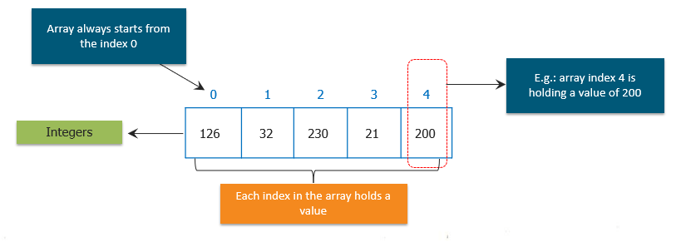
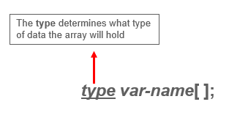
JAVA ARRAYS
General Form of Java Array Initialization
Example:- int month_days[];

Slide 185
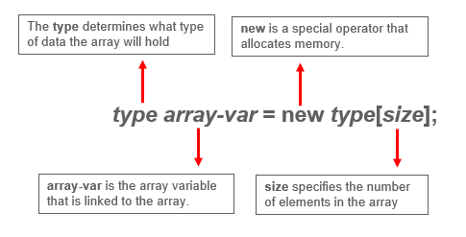
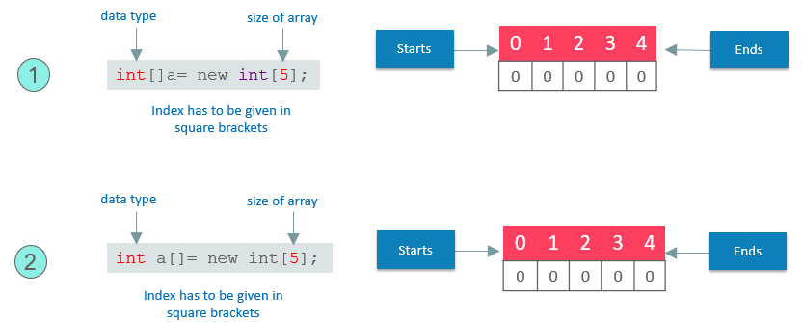
GENERAL FORM OF JAVA ARRAY INITIALIZATION

Slide 186
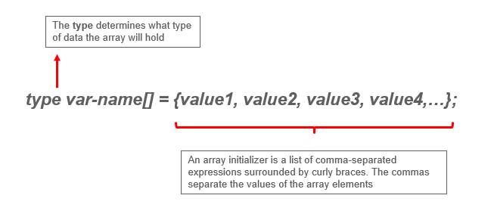
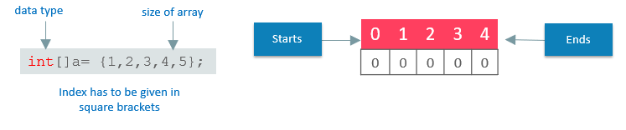

Slide 187
DECLARATION, INSTANTIATION AND INITIALIZATION OF JAVA ARRAY
METHOD 1
METHOD 2
int a[]=new int[5];
//declaration and instantiation
a[0]=10;//initialization
a[1]=20;
a[2]=70;
a[3]=40;
a[4]=50;
int a[]={10,20,70,40,50};
//declaration, instantiation and initialization

Slide 188
ARRAY INITIALIZATION USING USER INPUT
Using For Loop
class A{
public static void main(String[] arg)
{
int a[]=new int[5];
Scanner in = new Scanner(System.in);
for (int i=0; i<a.length ; i++)
{
a[i]=in.nextInt();
}
}
}

Slide 189
ARRAY OPERATIONS
Java array can be passed to a method
    Syntax -
methodname(arrayname);
We can also return an array from the method in Java
    Syntax -
returntype[] methodname() {
return new arrayType[]{array elements};
}
or
returntype[] methodname() {
arrayType arrayname = { Array Elements } ;
return arrayname;
}
Anonymous Array in Java
Don't need to declare the array while passing an array to the method
    Syntax -
methodname(new arrayType[]{array elements});

Slide 190
public class TestArray{
//creating method which returns an array
static int[] get(){
return new int[]{10,30,50,90,60};
}
public static void main(String args[]){
//calling method which returns an array
int arr[]=get();
System.out.println("Passing an array – returned by get()");
PrintArray(arr);
System.out.println("Passing an Anonymous array");
PrintArray(new int[]{10,22,44,66});
}
static void PrintArray(int temp[])
{
//printing the values of an array
for(int i=0;i<temp.length;i++)
System.out.println(temp[i]);
}
}
OUTPUT
Passing an array – returned by get()
10
30
50
90
60
Passing an Anonymous array
10
22
44
66

Slide 191
WHAT IS THE CLASS NAME OF JAVA ARRAY?
//Java Program to get the class name of array in Java
class Testarray4{
public static void main(String args[]){
//declaration and initialization of array
int arr[]={4,4,5};
//getting the class name of Java array
Class c=arr.getClass();
String name=c.getName();
//printing the class name of Java array
System.out.println(name);
}
}
In Java, an array is an object.
For array object, a proxy class is created whose name can be obtained by getClass().getName() method on the object.
OUTPUT
I

Slide 192
CLASS OBJECTS FOR ARRAYS
public class Test
{
public static void main(String args[])
{
int intArray[] = new int[3];
byte byteArray[] = new byte[3];
short shortsArray[] = new short[3];
// array of Strings
String[] strArray = new String[3];
System.out.println(intArray.getClass());
System.out.println(intArray.getClass().getSuperclass());
System.out.println(byteArray.getClass());
System.out.println(shortsArray.getClass());
System.out.println(strArray.getClass());
}
}
Every array has an associated Class object, shared with all other arrays with the same component type.
OUTPUT
class [I
class java.lang.Object
class [B
class [S
class [Ljava.lang.String;

Slide 193
WHAT IS THE CLASS NAME OF JAVA ARRAY?
Explanantion :
The string “[I” is the run-time type signature for the class object “array with component type int“.
The only direct superclass of any array type is java.lang.Object.
The string “[B” is the run-time type signature for the class object “array with component type byte“.
The string “[S” is the run-time type signature for the class object “array with component type short“.
The string “[L” is the run-time type signature for the class object “array with component type of a Class”. The Class name is then followed.

Slide 194
COPYING A JAVA ARRAY
Syntax :
public static void arraycopy ( Object src, int srcPos,Object dest, int destPos, int length)
//Java Program to copy a source array into a destination array in Java
class TestArrayCopyDemo {
public static void main(String[] args) {
//declaring a source array
char[] copyFrom = { 'd', 'e', 'c', 'a', 'f', 'f', 'e','i', 'n', 'a', 't', 'e', ‘d' }; //declaring a destination array
char[] copyTo = new char[7];
//copying array using System.arraycopy() method
System.arraycopy(copyFrom, 2, copyTo, 0, 7);
//printing the destination array
System.out.println(String.valueOf(copyTo));
}
}
OUTPUT
caffein

Slide 195
MULTIDIMENSIONAL ARRAY IN JAVA
Data is stored in row and column based index - Matrix form
Syntax to Declare Multidimensional Array in Java
    dataType[][] arrayRefVar; (or)
    dataType [][]arrayRefVar; (or)
    dataType arrayRefVar[][]; (or)
    dataType []arrayRefVar[]
Example
int[][] arr=new int[3][3];//3 row and 3 column

Slide 196
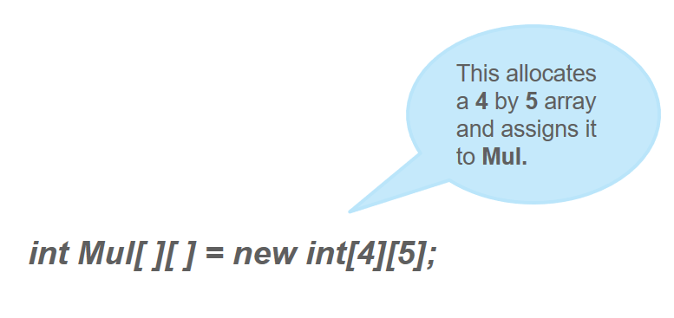
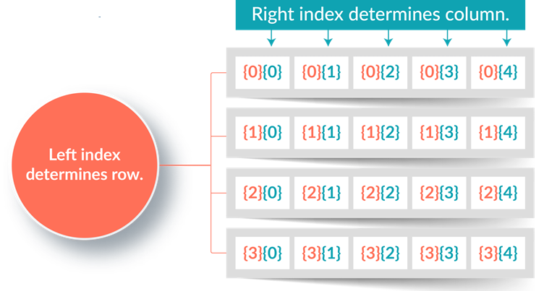
MULTIDIMENSIONAL ARRAY IN JAVA

Slide 197
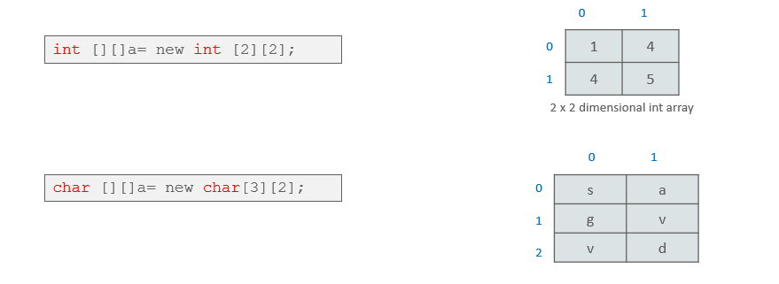
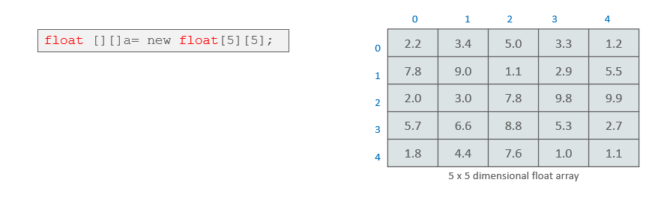
Multidimensional arrays representation of other data types.

Slide 198
EXAMPLE OF MULTIDIMENSIONAL JAVA ARRAY
//Java Program to illustrate the use of multidimensional array
class Testarray{
public static void main(String args[]){
//declaring and initializing 2D array
int arr[][]={{1,2,3},{2,4,5},{4,4,5}};
//printing 2D array
for(int i=0;i<3;i++){
for(int j=0;j<3;j++){
System.out.print(arr[i][j]+" ");
}
System.out.println();
}
}}
OUTPUT
1 2 3
2 4 5
4 4 5

Slide 199
ADDITION OF 2 MATRICES IN JAVA
class Testarray {
public static void main(String args[]){ //creating two matrices
int a[][]={{1,3,4},{3,4,5}};
int b[][]={{1,3,4},{3,4,5}};
//creating another matrix to store the sum of two matrices
int c[][]=new int[2][3];
//adding and printing addition of 2 matrices
for(int i=0;i<2;i++)
{
for(int j=0;j<3;j++)
{
c[i][j]=a[i][j]+b[i][j];
System.out.print(c[i][j]+" ");
}
System.out.println();//new line
}
}
}
OUTPUT
2 6 8
6 8 10

Slide 200
MULTIPLICATION OF 2 MATRICES IN JAVA
//Java Program to multiply two matrices
public class MatrixMultiplicationExample{
public static void main(String args[]){
//creating two matrices
int a[][]={{1,1,1},{2,2,2},{3,3,3}};
int b[][]={{1,1,1},{2,2,2},{3,3,3}};
//creating another matrix to store the multiplication of two matrices
int c[][]=new int[3][3]; //3 rows and 3 columns
//multiplying and printing multiplication of 2 matricesfor(int i=0;i<3;i++){
for(int j=0;j<3;j++){
c[i][j]=0;
for(int k=0;k<3;k++)
{
c[i][j]+=a[i][k]*b[k][j];
}//end of k loop
System.out.print(c[i][j]+" "); //printing matrix element
}//end of j loop
System.out.println();//new line
}
}}
OUTPUT
6 6 6
12 12 12
18 18 18

Slide 201
PATTERN SOLVING USING 2D ARRAY
Wap Letter “X” Shape pattern using 2d array in java?
[*,_,_,_,*]
[_,*,_,*,_]
[_,_,*,_,_]
[_,*,_,*,_]
[*,_,_,_,*]
char[][] xShape = new char[5][5];
for(int i=0; i<5;i++){
for(int j=0; j<5; j++){
xShape[i][j] = (i==j || i+j==4) ? '*':'_';
}
}
for(int i=0; i<5; i++){
System.out.print("[");
for(int j=0; j<5; j++){
System.out.print(xShape[i][j]+",");
}
System.out.println("]");
}

Slide 202
FEW APPLICATIONS OF ARRAYS
Leaderboards, Phone Contacts, Sudoku, Chess
Playfair-cipher is an old encrypting algorithm that uses a 2D array of alphabets as key to encrypt/decrypt text.
2D Arrays, generally called Matrices are mainly used in Image processing, machine learning
RGB image is a n*n*3 array
It is used in Speech Processing where each speech signal is an array of Signal Amplitudes
Stacks are used for storing intermediate results in Embedded systems
The filters that are used to remove noise in a recording are also arrays
To make webpage dynamic
Notes:
Machine Learning – Refference https://towardsdatascience.com/machine-learning-from-scratch-part-3-ed572330367d
webpage dynamic – reference https://www.quora.com/Where-can-arrays-be-used-in-real-life

Slide 203
BASIC OPERATION IN AN ARRAY
Sorting
Searching an element
Inserting an element
Deleting an element
Replacing

Slide 204
SORTING AN ARRAY
Ascending Order
Decending Order
for (int i = 0; i < n; i++)
{
for (int j = i + 1; j < n; j++)
{
if (a[i] > a[j]) //Ascending order
{
temp = a[i];
a[i] = a[j];
a[j] = temp;
}
}
}
for (int i = 0; i < n; i++)
{
for (int j = i + 1; j < n; j++)
{
if (a[i] < a[j]) //Descending order
{
temp = a[i];
a[i] = a[j];
a[j] = temp;
}
}
}

Slide 205
SEARCHING AN ELEMENT IN AN ARRAY
for(i = 0; i < n; i++)
{
if(a[i] == x)
{
flag = 1;
break;
}
else
{
flag = 0;
}
}
if(flag == 1)
{
System.out.println("Element found at position:"+(i + 1));
}
else
{
System.out.println("Element not found");
}
Variable Used
int n, x, flag = 0, i = 0;
n - Size of Array
x - Element to be find
flag – Status
i – Array index

Slide 206
INSERTING AN ELEMENT IN AN ARRAY
Deleting an element in an Array
for (int i = 0; i < n; i++) // Searching
{
if(a[i] == x)
{
flag =1;
loc = i;
break;
}
else
{
flag = 0;
}
}
if(flag == 1) // Deleting if element is
available
{
for(int i = loc+1; i < n; i++)
{
a[i]=a[i-1] ;
}
for(int i = (n-1); i >= (pos-1); i--)
{
a[i] = a[i-1];
}
a[pos-1] = x;
Variable Used
int n, x, flag = 1, loc = 0;
n - Size of Array
x - Element to be deleted
flag – Status of searching
loc – Location of element to be deleted

Slide 207
REPLACING AN ELEMENT IN AN ARRAY
public static void main(String[] args)
{
int n, pos;
Scanner s = new Scanner(System.in);
int a[]={5,4,2,1,8,9};
pos=s.nextInt();
n=s.nextInt();
a[pos-1]=n;
System.out.print("New Array after replacing");
for (int i = 0; i < a.length-1; i++)
{
System.out.print(a[i] + ",");
}
System.out.print(a[a.length - 1]);
}
Variable Used
int n, pos;
n - Element
pos - Position of the element to be replace

Slide 208
PROGRAMS BASED ON ARRAY
Finding the Largest and Smallest Numbers in an Array
Program to Put Even & Odd Elements of an Array in 2 Separate Arrays
Program to Sort Names in an Alphabetical Order
Program to Split an Array from Specified Position
Program to Find the Number of Non-Repeated Elements in an Array
Program to Find 2 Elements in the Array such that Difference between them is Largest
Program to Count the Number of Occurrence of an Element in an Array
Program to Segregate 0s on Left Side & 1s on Right Side of the Array

Slide 209
MCQ BASED ON ARRAY
In Java arrays are
    Objects
    Objects References
    Primitive data type
    None of the above
What is the result of compiling and running the following code?
public class Test{
public static void main(String[] args)
{
int[] a = new int[0];
System.out.print(a.length);
}
}
0
Compilation error, arrays cannot be initialized to zero size.
Compilation error, it is a.length() not a.length
None of the above

Slide 210
What will be the output?
    The program has a compile error because the size of the array wasn't specified when declaring the array.
    The program has a runtime error because the array elements are not initialized.
    The program runs fine and displays x[0] is 0.
    The program has a runtime error because the array element x[0] is not defined.
public class Test{
public static void main(String[] args)
{
int[] x = new int[3]; System.out.println("x[0] is " + x[0]);
}
}

Slide 211
What is the output of the following code?
    defined.
public class Test{
public static void main(String args[])
{
double[] myList = {1, 5, 5, 5, 5, 1};
double max = myList[0];
int indexOfMax = 0;
for(int i = 1; i < myList.length; i++)
{
if(myList[i] > max)
{
max = myList[i];
indexOfMax = i;
}
}
System.out.println(indexOfMax);
}
}
Options
0
1
2
3
4

Slide 212
What is the output of the following code?
    defined.
public class Test{
public static void main(String [] args){
String s1 = args[1];
String s2 = args[2];
String s3 = args[3];
String s4 = args[4];
System.out.print(" args[2] = " + s2);
}
}
Options
args[2] = 2
args[2] = 3
args[2] = null
An exception is thrown at runtime.
Command Line Invocation
C:Java> java Test 1 2 3 4

Slide 213
What would be the result of attempting to compile and run the following code?
public class HelloWorld{
public static void main(String[] args){
double[] x = new double[]{1, 2, 3};
System.out.println("Value is " + x[1]);
}
}
OPTION
The program has a compile error because the syntax new double[]{1, 2, 3} is wrong and it should be replaced by {1, 2, 3}.
The program has a compile error because the syntax new double[]{1, 2, 3} is wrong and it should be replaced by new double[3]{1, 2, 3};
The program has a compile error because the syntax new double[]{1, 2, 3} is wrong and it should be replaced by new double[]{1.0, 2.0, 3.0};
The program compiles and runs fine and the output 2.0

Slide 214
What is the output of the following code?
public class Test{
public static void main(String[] args){
int[] a = new int[4];
a[1] = 1;
a = new int[2];
System.out.println("a[1] is " + a[1]);
}
}
OPTION
The program has a compile error
The program has a runtime error
a[1] is 0
a[1] is 1

Slide 215
8. What will this code print?
    int arr[] = new int [5];
    System.out.print(arr);
OPTION
a) 0
b) value stored in arr[0].
c) 00000
d) Class name@ hashcode in hexadecimal form
9. Which of these is necessary to specify at time of array initialization?
a) Row
b) Column
c) Both Row and Column
d) None of the mentioned

Slide 216
10. What is the output of this program?
class array_output
{
public static void main(String args[])
{
int array_variable [] = new int[10];
for (int i = 0; i < 10; ++i)
{
array_variable[i] = i;
System.out.print(array_variable[i] + " ");
i++;
}
}
}
OPTION
0 2 4 6 8
1 3 5 7 9
0 1 2 3 4 5 6 7 8 9
1 2 3 4 5 6 7 8 9 10

Slide 217
11. What is the output of this program?
class multidimention_array
{
public static void main(String args[])
{
int arr[][] = new int[3][];
arr[0] = new int[1];
arr[1] = new int[2];
arr[2] = new int[3];
int sum = 0;
for (int i = 0; i < 3; ++i)
for (int j = 0; j < i + 1; ++j)
arr[i][j] = j + 1;
for (int i = 0; i < 3; ++i)
for (int j = 0; j < i + 1; ++j)
sum + = arr[i][j];
System.out.print(sum);
}
}
OPTION
11
10
13
14

Slide 218
12. What is the output of this program?
class array_output
{
public static void main(String args[])
{
char array_variable [] = new char[10];
for (int i = 0; i < 10; ++i)
{
array_variable[i] = 'i';
System.out.print(array_variable[i] + "");
}
}
}
OPTION
1 2 3 4 5 6 7 8 9 10
0 1 2 3 4 5 6 7 8 9 10
i j k l m n o p q r
i i i i i i i i i i

