Slide 1
SocialPy
Anando Zaman, Graeme Woods, Yuvraj Randhawa

Slide 2



Background
As much of the world is joining the modern web, the need for efficient and personal communication is ever growing.
SocialPy is a terminal-based social media application designed to remove the barriers of traditional phone calls and provide a personalized and enjoyable form of communication.
This application will allow users post short phrases(less than 200 characters) to express themselves as well as keep up-to-date with others through following/follower lists.
Notes:
-Anando-
So a quick backround of the project… As many of you know, the world is becoming further digital with an ever-growing need for efficient and more personal forms of communication. Traditional forms of communication such as telephone calls often feel subpar and prevents users from interacting with others in a personal way. In addition, it is often costly to conduct long-distance calls which all combines for a terrible user experience. Our proposed solution is to develop a terminal-based social media applications that can remove the barriers to traditional phone calls and provide a personalized and enjoyable form of communication via short message posts.

Slide 3

Purpose & Scope
Purpose: An application that provides a fluid form of communication that is personalized which replaces the need to use phone calls or SMS texts.
Scope: Re-implement an existing open-source social media application that provides extended functionality and authentication.
Notes:
---Anando---
Moving onto the purpose and scope.
PURPOSE:
The purpose of this project is to provide a form of communication that is more personal and smooth to ultimately replace everyday phone calls.
This will involve re-implement an existing social media platform with enhanced features such as account authentication & data persistence.
SCOPE:
In regards to the scope, the application is developed using the Python programming language and will facilitate the communication of several users in a format similar to an online thread/forum. Additionally, users will be able to view and follow other users to stay updated with one another.
Now I’ll hand it over to Graeme to speak further about the features of our application.

Slide 4

Discussion - Features and original project
Original Project:
Add/View posts & View posts of people you follow
Command Parser
New Features for re-implementation
Data Persistence (Saving posts, profile, etc)
Authentication - Register/Login with Firebase
Notes:
-Graeme-
Since our project is a re-implementation of an existing open-source project, it will feature the same features as that of the original but will now include additional features as listed on the screen.
The original project had the ability to add & view posts which were all done through the command parser. This was fairly basic and lacked the some key features that we decided to implement for the new re-implementation. This includes adding features for data persistence so that the data of the posts is saved and not reset after user. It also includes user authentication, following/follower lists,and editing/viewing profiles to name a few.

Slide 5
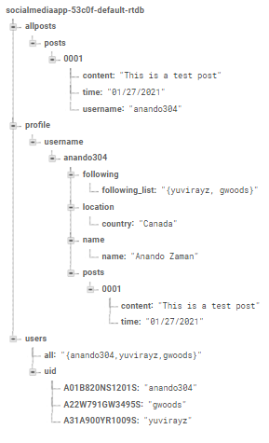
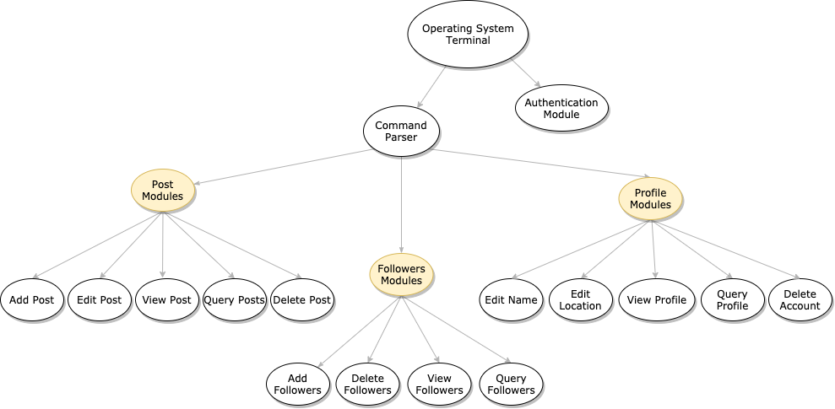
Module Diagram & Database Architecture
Notes:
-Graeme-
We will briefly discuss our module diagram and how the various modules work as part of a larger system. At the start, the user enters their credentials to become authenticated prior to use shown by the authentication module. After successful authentication, the user can type various commands related to posts or profile to do specific actions. These commands get parsed by the command parser. The command parser executes these commands from the posts or profile modules section and displays the result to the user. For example, if the user wanted to view all available posts, they could type the corresponding command which the command parser comprehends and then executes the View Post module from the Post Modules section. We will show case these features in action in the following slide.

Slide 6
Demo
It’s Demo time! :)
Notes:
demo:
authentication - Yuvi , sign up and sign in, help
posts - Anando, add, view, delete
profile - graeme view/edit profile, posts following view, following lists.

Slide 7
Qualities
Performance
- App responds under 4 seconds for any action such as authentication, addPost, etc.
Usability
- Simple command-line interface with ‘help’ function to list out commands to use.
- Short descriptions about commands similar to Python ‘help’ commands.
Robust
- Error handling and system response to incorrect commands.
Maintainability:
- Code is modularized and abstracted to ensure design for change.
- Use of PIP8 style guide, relevant variable names, and Doxygen documentation.
Notes:
-Yuvi-
Throughout the development of the application, various software qualities came to mind in order to have a fluid experience for the user and development teams.
We listed a few on the screen here but the rest can be found in-detail in the SRS document.
We’ll first discuss performance. Performance is crucial to this application because users usually have very little patience and will move to a competitor product if it doesn’t meet their expectations.
As a result, we decided to make the response time less than 4 seconds.

Slide 8
Conclusion
Summary:
SocialPy is an effective application for communication that provides personalized and fluid experience while ensuring data integrity.
Special Features:
Authentication & Data Persistence
Add/Delete/View posts of yourself and other users
Modify and View your followings and follower lists
View posts from only people you follow
Modify/Delete/View Profile sections
Notes:
-Yuvi-

