Slide 1

INSURANCE COST PREDICTION
PRCP-1021
PTID-CDS-DEC-22-1429
ANAND RAJ A
ANIRBAN DAS
AYUSH KUMAR
SAM SUGANESH

Slide 2

ABOUT PROJECT
About
In order to make their profit, insurance companies must collect a higher premium than the amount which may become due to the insured person. To achieve this, insurance companies invest a lot of time, effort, and money in creating models that accurately predict healthcare expenses.

Slide 3

OBJECTIVE
OBJECTIVE
Task 1
Task 3
Prepare a complete data analysis report on the given data.
Create a machine learning model to predict the insurance price charged to the customer.
Task 2
Prepare the data, identifying and extracting key features (both input and output parameters) relevant to the problem you will solve.
Build and train a machine learning model. Here you can evaluate different algorithms, settings and see which model is best for your scenario.

Slide 4

SOLUTION
Linear Regression
Decision Tree
Random Forest
Gradient Boosting
K Nearest Neighbour
XGBRegressor
Ada Boost Regressor
Support Vector Machine

Slide 5
ML model | Advantages | Disadvantages | Uses
Linear Regression | • Interpretability • Little tuning | • Correlated features may affect performance • Extensive feature engineering required | • Sales forecasting • House pricing
Decision Tree | Interpretability • Render feature importance • Less data pre-processing required | • Do not predict a continuous output (for regression) • It does not predict beyond the range of the response values in the training | • Risk Assessment • Fraud Prevention
Random Forest | •Interpretability• Render feature importance • Less data pre-processing required • Do not overfit (in theory) • Good performance /accuracy • Robust to noise • Little if any parameter tuning required • Apt for almost any machine learning problem | •Do not predict a continuous output (for regression) • It does not predict beyond the range of the response values in the training data • Biased towards categorical variables with several categories • Biased in multiclass problems toward more frequent classes | •Credit Risk Assessment • Predict breakdown of mechanical parts (automobile industry). • Assess probability of developing a chronic disease (healthcare) • Predicting the average number of social media shares
Gradient Boosting | • Great performance • Apt for almost any machine learning problem • It can approximate most nonlinear functions | •Prone to overfit • Needs some parameter tuning | • Same as Random Forests
K Nearest Neighbour | • Good performance | • Slow when predicting • Susceptible to high dimension (lots of features) | • Gene expression • Protein-protein interaction • Content retrieval (of webpages for example)
XGBRegressor | •Effective with large data sets. •Tree algorithms such as XGBoost and Random Forest do not need normalized features and work well if the data is nonlinear, non-monotonic, or with segregated clusters. | •Tree algorithms such as XGBoost and Random Forest can over-fit the data, especially if the trees are too deep with noisy data. | •Future sale prediction
Ada Boost Regressor | • It doesn’t overfit easily • Few parameters to tune | •Can be sensitive to noise and outliers | • Same as Random Forests, less used however, as xgboost and lightGBMs are more popular implementations of gradient boosted machines
Support Vector Machine | •Good for datasets with more variables than observations • Good performance • Good of-the-shelf model in general for several scenarios • Can approximate complex nonlinear functions | •Long training time required • Tuning is required to determine which kernel is optimal for non-linear SVMs | • Stock market forecasting • Value at risk determination

Slide 6

INITIAL ANALYSIS
BASIC
CATEGORICAL COLUMNs
1.There are total 7 columns with 1338 rows
2.There are no Null Values in any column. All column has same count of numbers.
1.Sex
2.Smoker
3.Region
Numerical columns
Target column
1.Age
2.BMI
3.Children
4.Changes
1.Charges

Slide 7
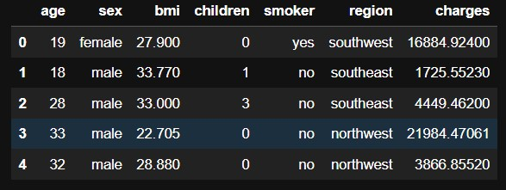
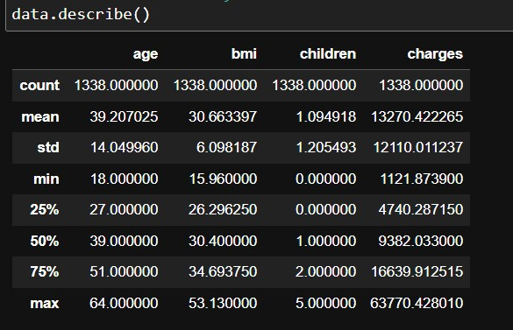

Slide 8
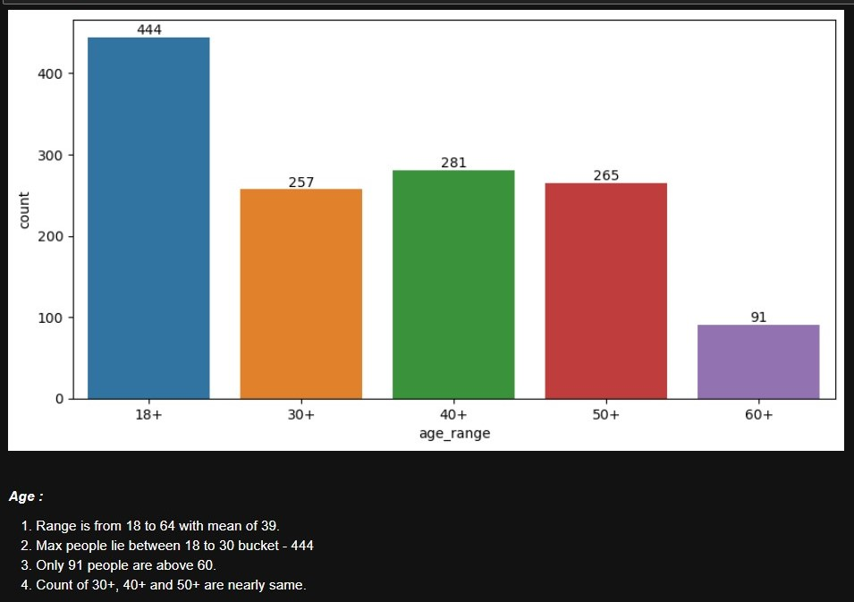

Slide 9
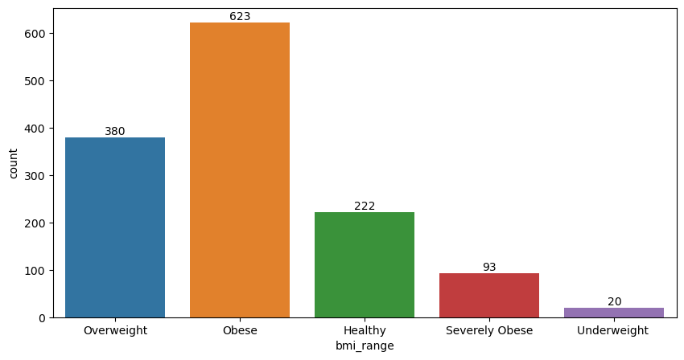
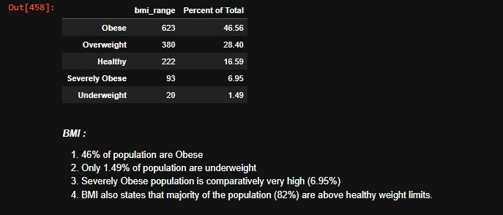

Slide 10
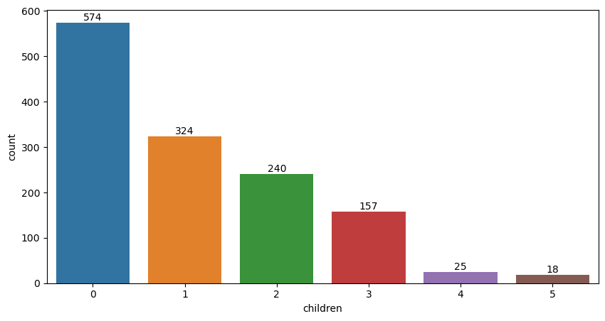
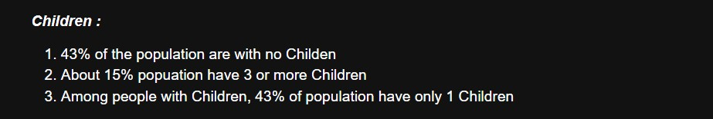

Slide 11
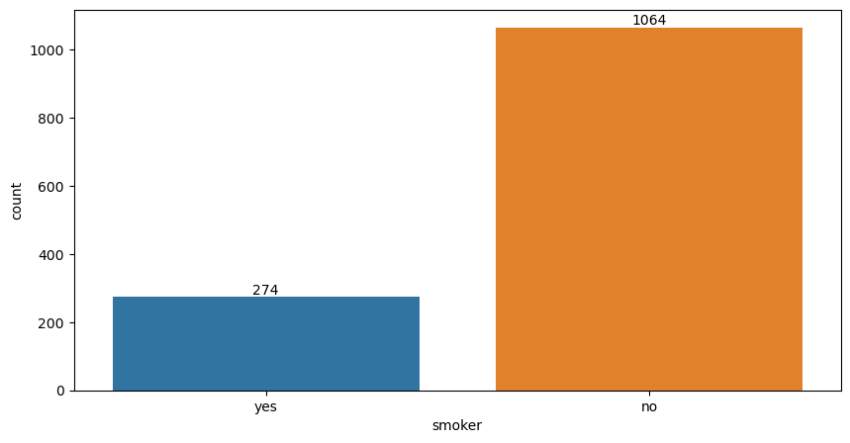
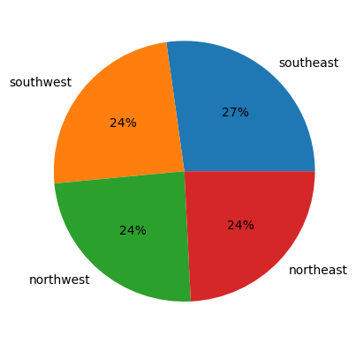
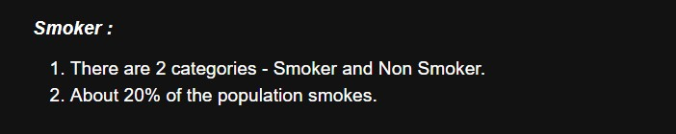
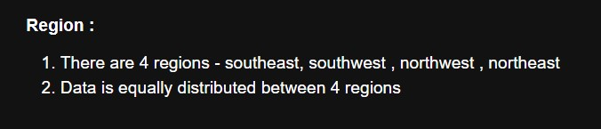

Slide 12
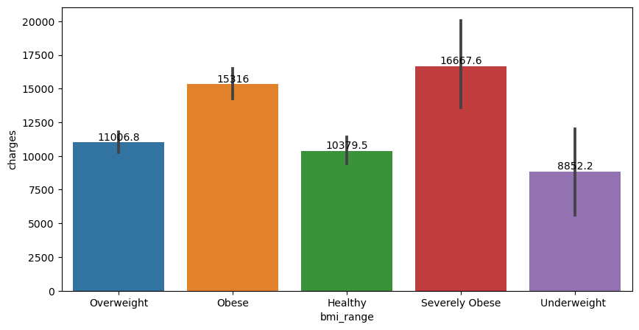
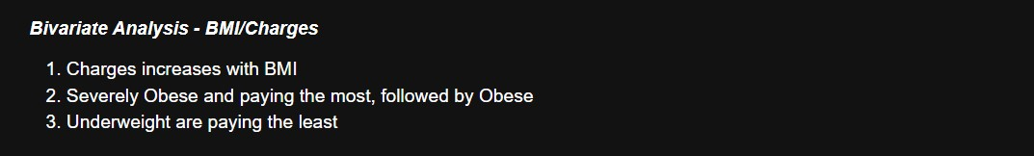

Slide 13
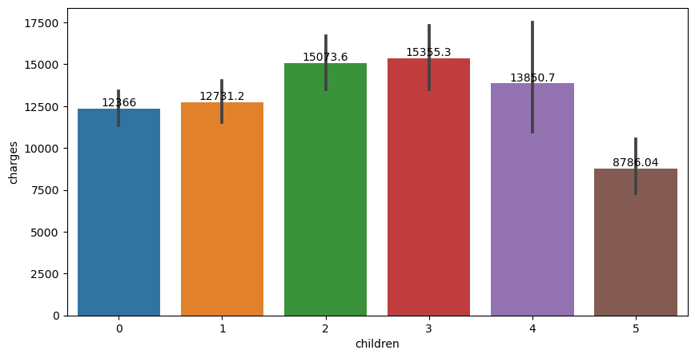
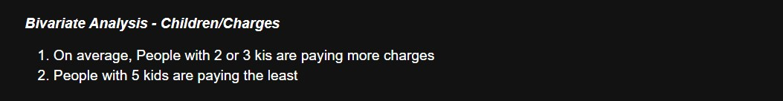

Slide 14
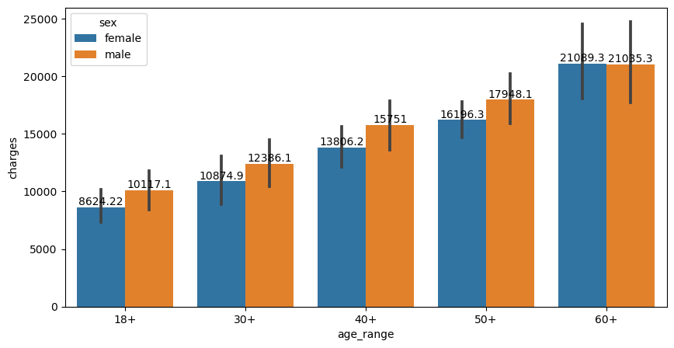
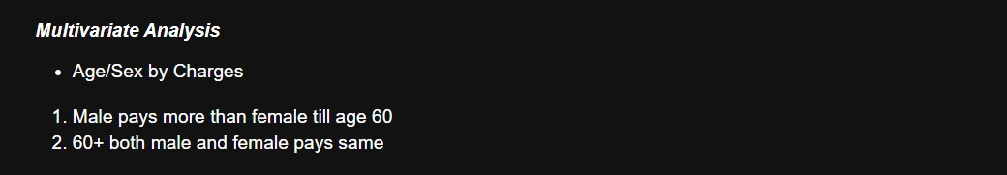

Slide 15
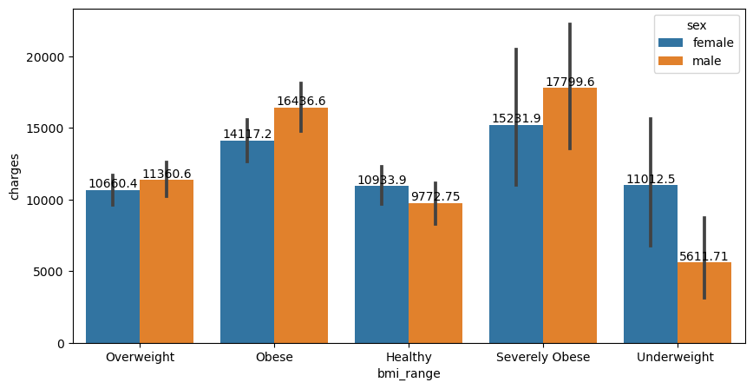
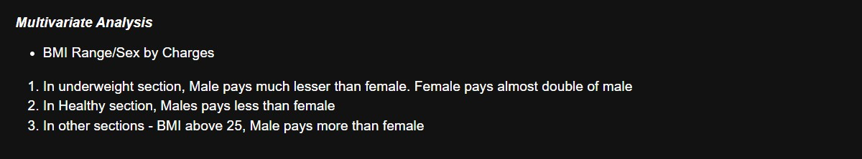

Slide 16
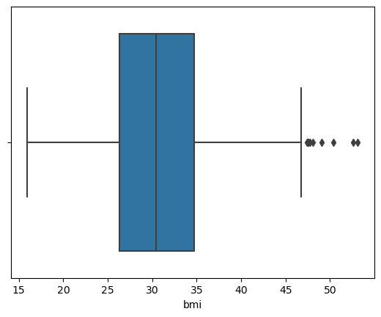
OUTLIERS
There are few outliers. Data not sckewed.
kurtosis is near 3.

Slide 17
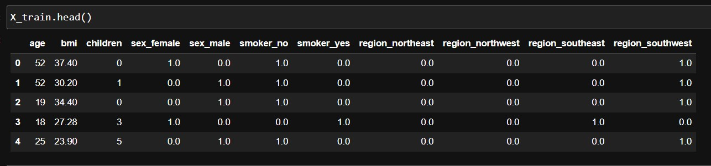

Slide 18
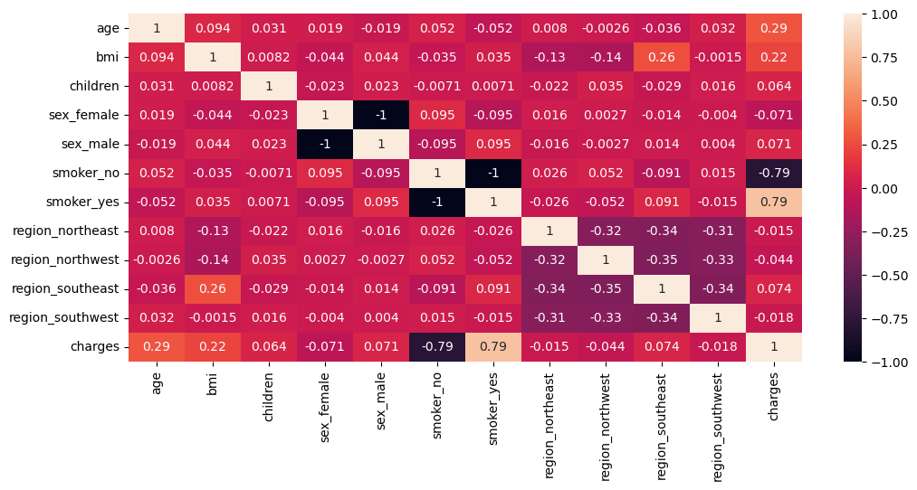
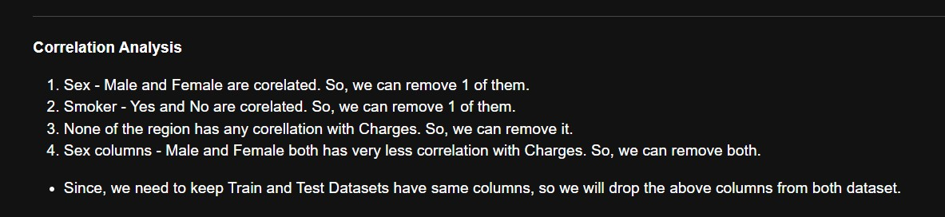
HEATMAP

Slide 19
Model Evaluation
No. | MODEL | PREDICTED PRICE | R2 SCORE | ABSOLUTE MEAN ERROR
1 | LinearRegression | 27032.824159 | 0.724542 | 5881.521343
2 | Decision Tree Regressor | 15006.57945 | 0.673600 | 6402.314217
3 | Random Forest | 17939.724794 | 0.861529 | 4170.055064
4 | Gradient Boosting | 18168.006804 | 0.861327 | 4173.092140
5 | XGB Regressor | 16314.869141 | 0.851517 | 4318.183523
6 | SVM Regressor | 18565.261719 | 0.802523 | 4979.896815
7 | KNeighbors | 17073.686314 | 0.833797 | 4568.588419
8 | AdaBoost | 18659.715017 | 0.833797 | 4244.376139

Slide 20
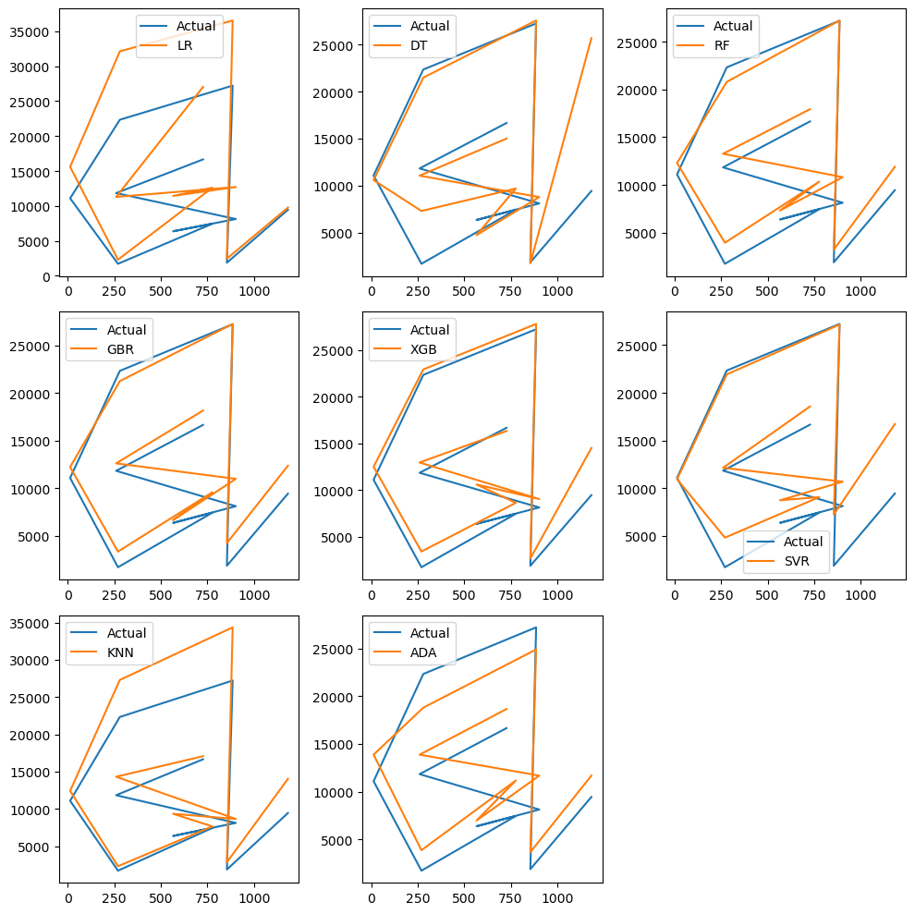

Slide 21
Predicting Charges For New Customer
Age | BMI | Children | Smoker | Predicted Value
34 | 31.92 | 1 | 0 | 16640.0749857

