Slide 1
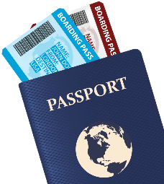

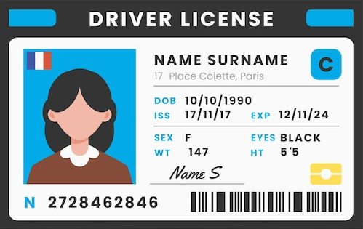

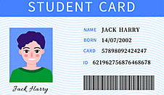
ONE-D
UNIQUE ID TO YOUR TRUE IDENTITY
DIGITIZE
GLOBALLY VERIFIED
TRAVEL SAFE
COURSE: CMPE-281- CLOUD TECHNOLOGIES
PROFESSOR : SANJAY GARJE
TEAM MEMBERS: ANANDU SREEKUMAR | JESWANTH VADLAMUDI| SAI KRISHNA

Slide 2
ABOUT THE PROJECT
Project’s Problem Statement: International travelers and students often face disruptions due to the absence of essential documents, whether they’re heading to a pub, checking into a hotel, going to a movie theater, school, or traveling abroad. The lack of these crucial documents can lead to various challenges and inconveniences, underscoring the need for a reliable, secure, and easily accessible method of carrying and presenting these documents.
Proposed Solution: The proposed solution is “ONE-D,” a unique digital platform that acts as a universal virtual ID card, replacing the need to carry multiple physical documents. This platform serves as a secure digital storage unit for users’ essential documents, mitigating the risks and inconveniences associated with forgetting or losing physical documents.
ONE-D is not just a storage solution; it also interfaces with local verification bodies (like notaries from UPS) to authenticate the digitally stored documents. When users upload their documents, the system generates questions that are subsequently verified by a local verification body. This step is vital as it authenticates the digital copy, ensuring it’s recognized and accepted as a valid form of identification or documentation globally.
Users are assigned a unique ID, which they can present for verification. Security is enhanced through a one-time password system, valid for one day, ensuring that information access is timely and secure. Additionally, users can share their information via NFC by tapping their phone, and VIP users benefit from physical cards with RFID technology, further simplifying the verification process. With ONE-D, carrying multiple physical documents becomes a thing of the past.
YouTube Video: https://www.youtube.com/watch?v=TvD2M7JQdms&ab_channel=AnanduSreekumar
GitHub Repo: https://github.com/AnanduSreekumar/one-d
Website link: www.one-d.cloud
Upload documents to cloud
Generate questions for verifications
Local notary authorize the documents by logging into the portal with their email ID
User gets unique generated ID and OTP
Any external body can confirm their identity online with ID and passcode.

Slide 3
FEATURES
Digital Document Storage: Securely store and manage all your essential documents in one digital location, eliminating the risk of loss or damage.
Universal Virtual ID Card: Replace multiple physical IDs with a single, universally accepted virtual ID card for all your identification needs.
Local Verification Integration: Seamlessly integrate with local verification authorities to ensure your digital documents are authenticated and valid.
Document Authentication Process: Rigorous authentication process for digital documents, ensuring their legitimacy and acceptance globally.
Unique User ID Assignment: Receive a unique identifier that simplifies and secures the process of proving your identity and accessing your documents.
Enhanced Security with OTP: Implement a one-time password system for robust security, ensuring safe and time-bound access to your digital documents.
Global Acceptance and Recognition: Achieve worldwide recognition and acceptance of your digital ID, making international travel and verification hassle-free.
Convenience and Accessibility: Enjoy unparalleled convenience with easy access to your documents anytime, anywhere, simplifying verification processes.
CICD based deployment
ML based text extraction using Textract

Slide 4
PROJECT DEMO

Slide 5
PROJECT COMPONENTS
User Login/signup
File management – segregation of files and life cycle policies
File Upload/Download
User portal
Document Verification Interface
Unique ID notification via SNS
Virtual ONE-D card
OTP generation for offline confirmation
ONE-D notary service portal
Virtual ONE-D card
OTP generation for offline confirmation
ONE-D notary service portal

Slide 6
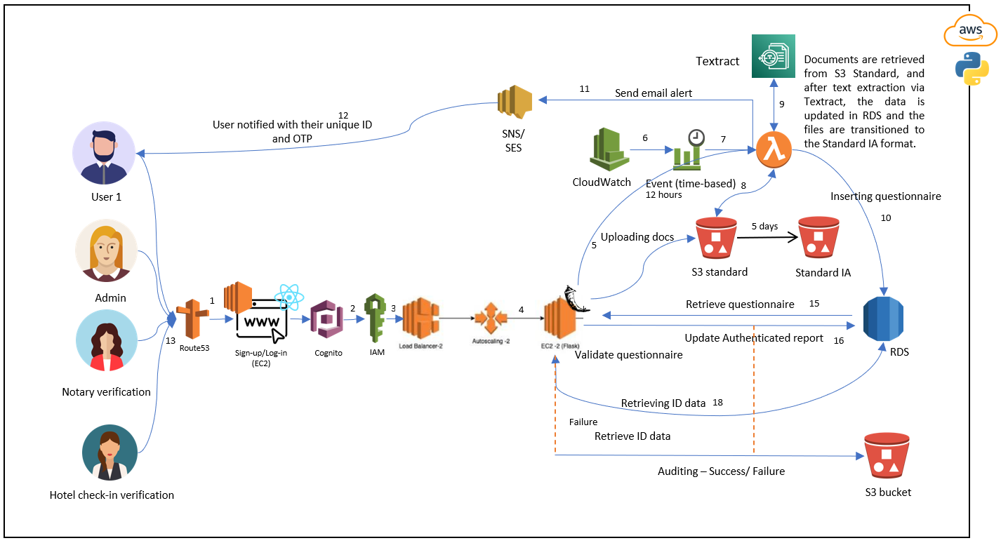
ARCHITECTURE

Slide 7

AWS Services and Technologies Used
Frontend – ReactJS
Backend - Flask
Database - RDS
S3
EC2 for backend and frontend
Cognito and IAM
Textract
Lambda
CloudWatch
Route53
RDS.
CICD via GitHub Action

Slide 8
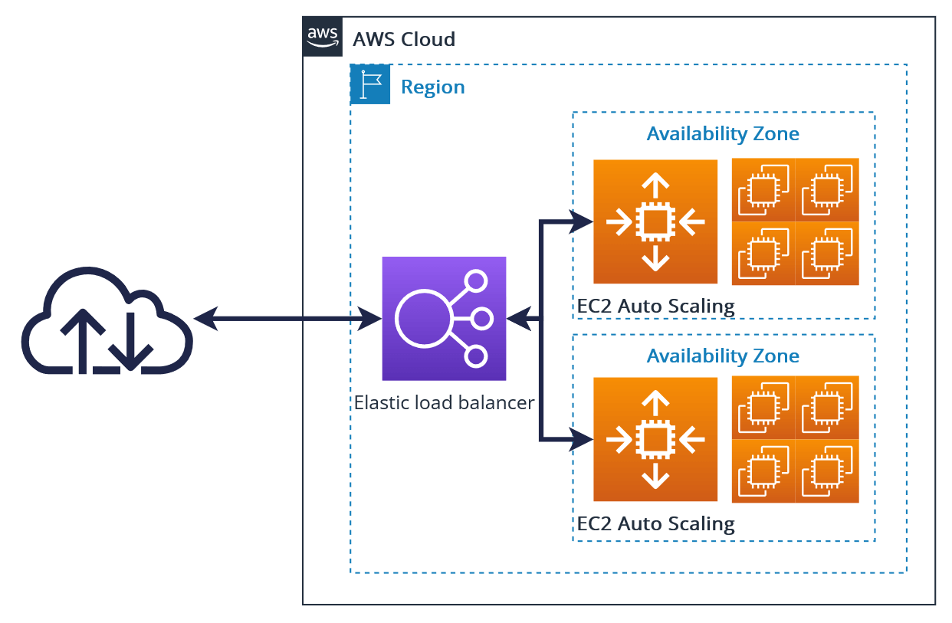
High Availability / Fault Tolerance/ Disaster Recovery
High Availability:
MultiAZs Implementation in S3 and RDS
CloudFront - Lambda @ Edgelocation
Fault Tolerance:
Elastic Load Balancer and Autoscaling
Disaster Recovery:
S3 Replication and RDS backup

Slide 9
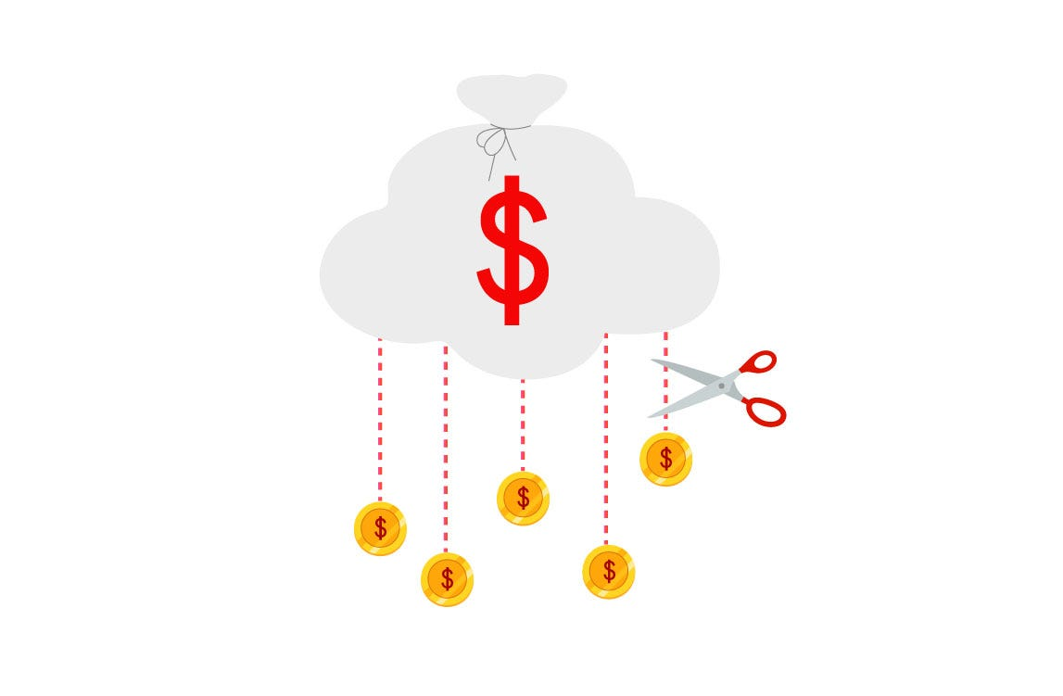
Security and Costs Optimization
Security:
Cognito and IAM
OTP based Authentication
Costs Optimization:
S3 lifecycle policies

Slide 10
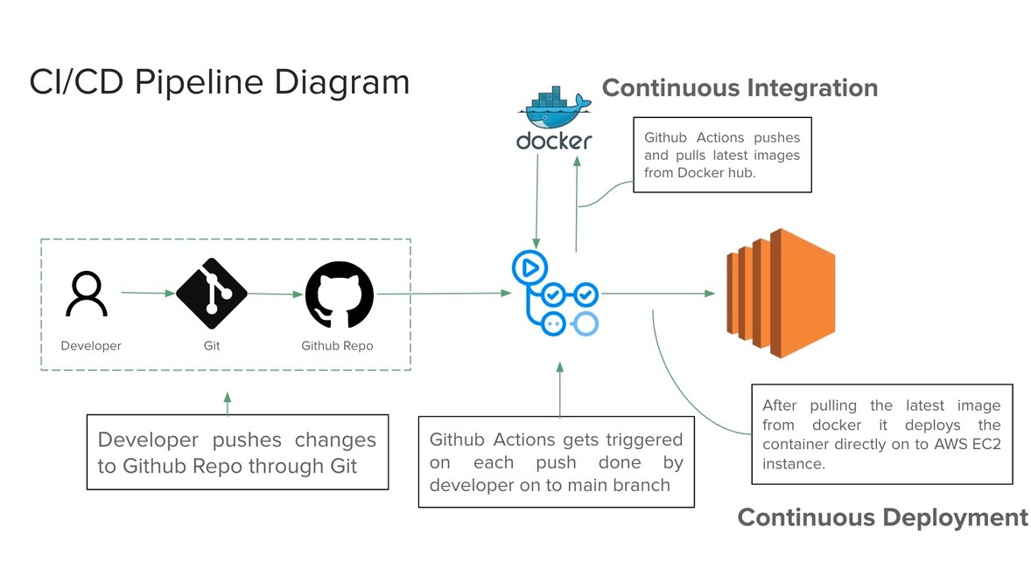
CI/CD – GitHub Actions

Slide 11

FUTURE SCOPE
Worldwide Service Validation: One-D is recognized and validated on a global scale.
E2E Encryption: VIP service with data masking in database level.
Third-Party App Integration via One-D Sign-Up API: Offers an API for third-party applications to integrate One-D's sign-up process, leveraging its pre-validated data for streamlined Single Sign-On (SSO) capabilities.
Secure Data Hub Utilizing Machine Learning: Acts as a secure repository for user data, employing machine learning to analyze and provide tailored recommendations.
Recommendation API for E-commerce: Provides a specialized API to e-commerce sites, ensuring user data security by only sharing analytical results, not the data itself, with third-party websites.

Slide 12

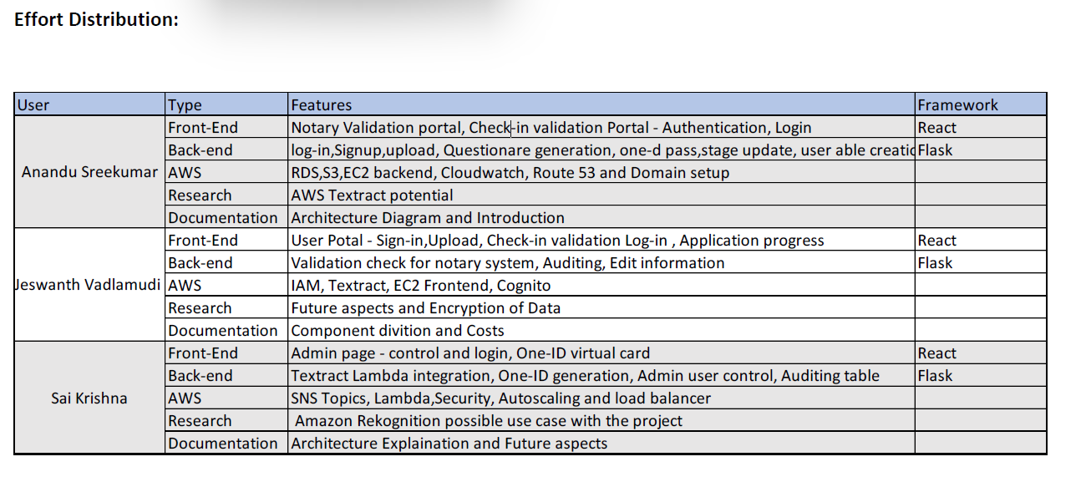
EFFORT DISTRIBUTION

Slide 13
Invest in us. Be a part of the change!

