Slide 1
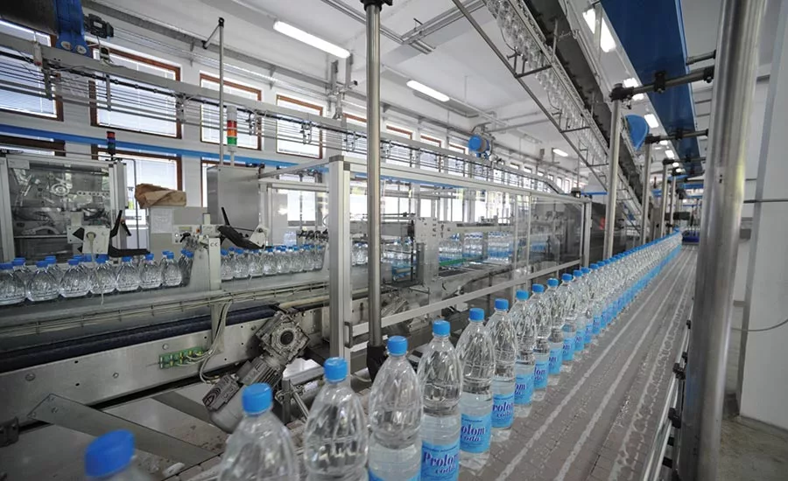
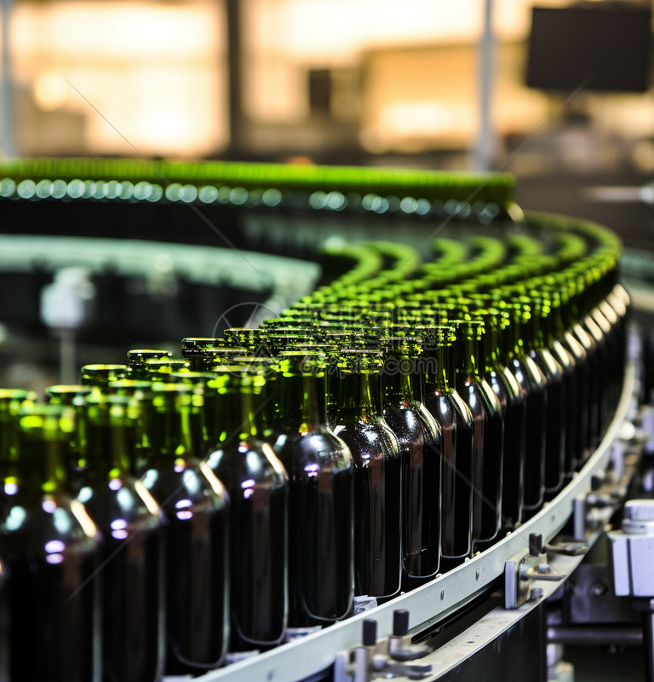

Title: NLP for Quality Control Reports in Production Objective: Automating quality inspection in production lines using image classification and defect-report text analysis. Course: MDM-09 Case Study: Intelligent Systems in Production Presented by: Teja Tadisetty Boshi Zhao Anandu Hari Guided by: Dr.Hamidreza Heidari Date: November 06, 2025

Slide 2

From Concept to Prototype – Progress Since Oct 16
Oct 16 (Initial) | Nov 6 (Current)
Motivation & Idea | Literature map + baseline model
No code yet | Baseline code
Concept Presentation | Concept + NLP integrated workflow
No business link | Profit and use of the factory owner

Slide 3
Literature Research Map
Dataset | Source | Description | Usage | Reference
Bottling Line Dataset | Kaggle (2023) | Real beverage production images with defects | CNN baseline & detection | [Siddharth Kumar Sah, 2023]
MVTec AD | MVTec GmbH (2020) | Industrial anomaly detection benchmark (Bottle class) | Transfer learning, benchmarking | [Bergmann et al., IJCV, 2020]
Few studies integrate Computer Vision + NLP in one pipeline.
Limited open datasets for food / beverage defect detection.
Need an easy-deploy prototype for SMEs with simple data.

Slide 4
Method Outline
Data Collection
Pre-processing (Resize, Normalize)
Evaluation (Accuracy)
NLP Analysis (Keyword / Word Cloud)
Visualization

Slide 5
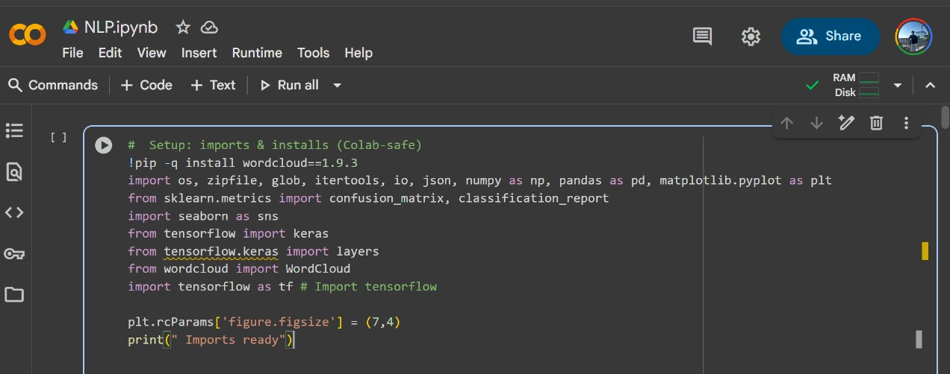
Core Code & Baseline Simulation
Dataset upload & unzip code (files.upload() → “Unzipped to /content/…”).
Architecture summary table (model.summary output).
Early training curve (graph of loss & accuracy).
Confusion Matrix snapshot (baseline results ~ 50%).

Slide 6
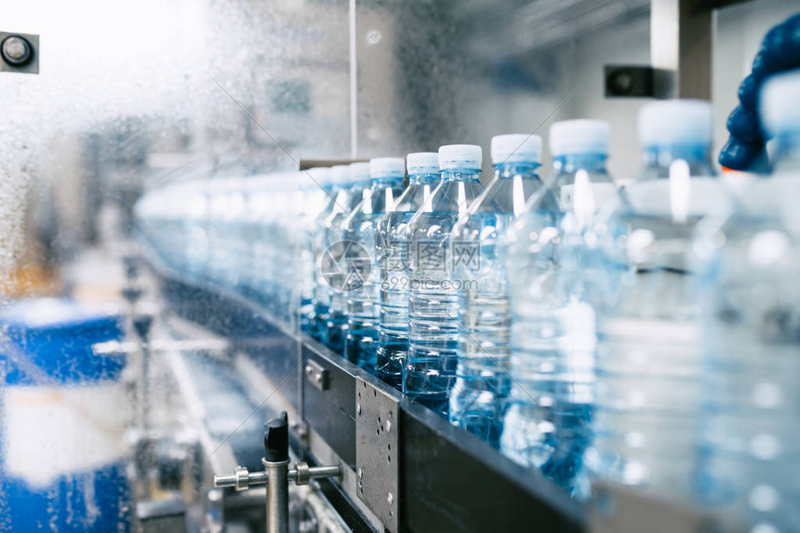

Issues Faced & How We Solved Them
Challenge | Cause | Solution
Dataset path errors | Wrong directory | Fixed paths in Colab
Low accuracy | Small dataset | Plan transfer learning
NLTK download failures | Runtime issue | Used Colab stable connection
Missing labels.csv | Absent file | Created manual CSV
Cluttered plots | Combined outputs | Split visuals per plot

Slide 7

Profit & Use for Factory Owner
Business Impact:
Reduces manual inspection cost
Minimizes rework & scrap
Improves line speed & product quality
Return on Investment Examples
Metric | Before AI | After AI | Savings per Year
Defect Rate | 1.5 % | 0.7 % | ≈ €100 k
Inspection Labor | 8 operators | 5 operators | €40 k

Slide 8

NLP Module Plan (Upcoming)
Input: defect reports / operator logs
Preprocessing: tokenization, stopword removal, lemmatization
Output: top defect keywords + word cloud
Tools: NLTK, spaCy, WordCloud
Goal: support root-cause identification

Slide 9
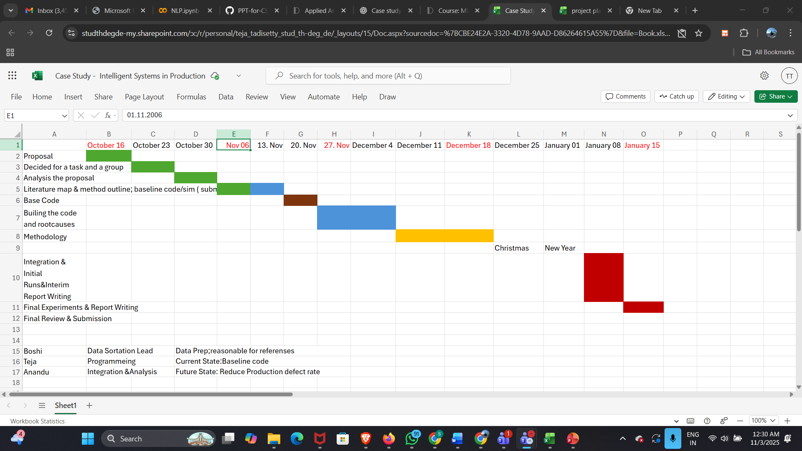

Gantt Chart & Team Roles
Gantt Chart & Team Roles
Boshi Zhao : Data preparation & research references
Teja: Programming & baseline model
Anandu Hari: Integration & analysis

Slide 10
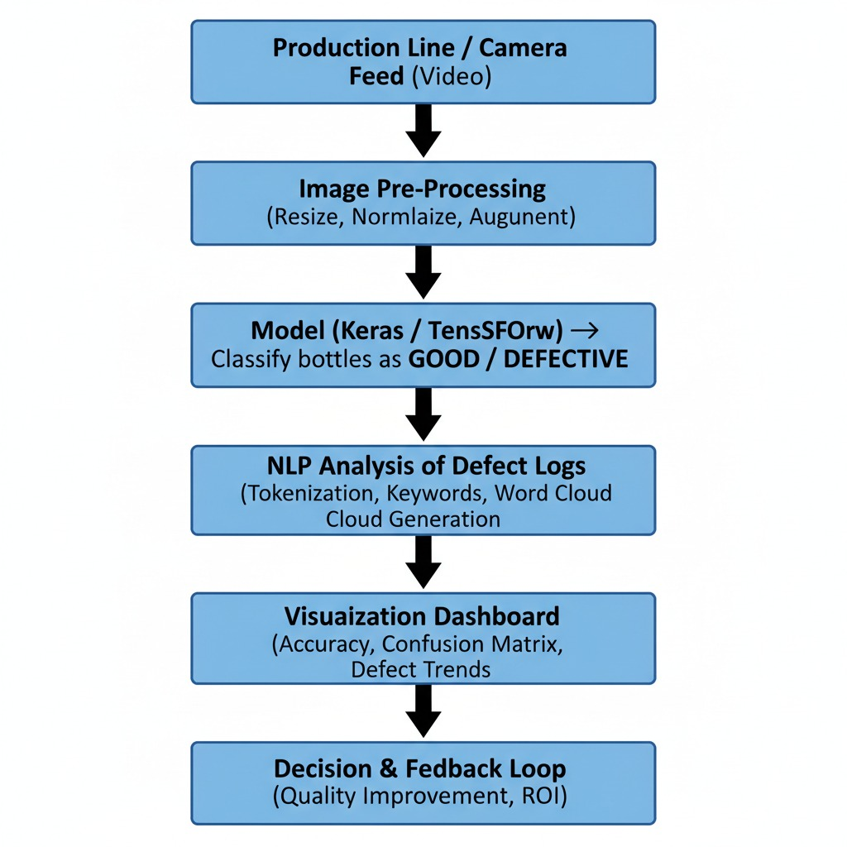
CAD / Early Prototype Idea
Even if you don’t have a physical assembly:
Show a simple block diagram or image of camera + conveyor + bottles.
Label: “Camera captures frames → Model classifies defect → Alert dashboard.”
This counts as your early CAD concept.
Mention: “We plan to use an inexpensive webcam or open factory video dataset for simulation.”

Slide 11
Thank You

