Slide 1

Agentic RAG Chatbot for Multi-Format Document QA Chatbot
Leveraging MCP for Modular and Intelligent Systems

Slide 2





Query Processing Workflow
Document Upload
Orchestrator Request
File Parsing & Chunking
The user initiates the process by uploading a document to the system.
The Orchestrator sends an INGEST_REQUEST to the IngestionAgent, initiating the next phase.
The IngestionAgent parses and chunks the file into manageable segments, then responds with CHUNKS_READY.
Embedding & Storage
Storage Confirmation
The Orchestrator passes these chunks to the RetrievalAgent, which creates embeddings and stores them in Pinecone.
A STORAGE_SUCCESS message is returned, confirming the successful storage of the document's embeddings.

Slide 3




Query Processing Workflow
User Query Initiation
Orchestrator Request
The user initiates the process by asking a query to the system.
The Orchestrator sends a RETRIEVE_REQUEST to the RetrievalAgent.
Data Retrieval
Response Generation
The RetrievalAgent fetches the top-k relevant chunks and returns a CONTEXT_RESPONSE.
The Orchestrator sends the context to the LLMResponseAgent, which then generates the FINAL_RESPONSE.

Slide 4





Core Technologies Powering Our Agents
Python 3.10+
LangChain & Unstructured
Pinecone & SentenceTransformers
The backbone language, enabling custom agent classes for modular development.
Frameworks for robust agent orchestration and efficient document parsing (PDF, DOCX, TXT).
Vector database for similarity search (cosine) and embedding generation for high-performance retrieval.
Groq-hosted LLaMA3-8B
MCP (Model Context Protocol)
Leveraging the power of Groq for rapid, factual answer generation through langchain_groq.
Standardized JSON-based communication protocol ensuring clear, traceable, and structured inter-agent messages.

Slide 5
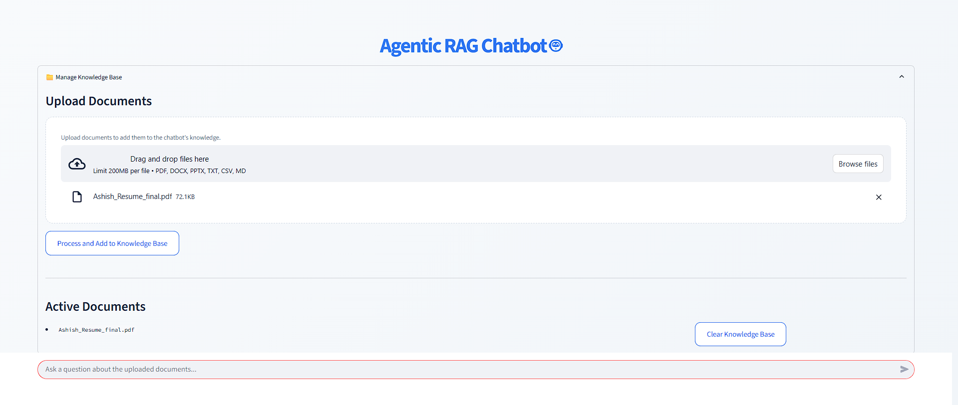
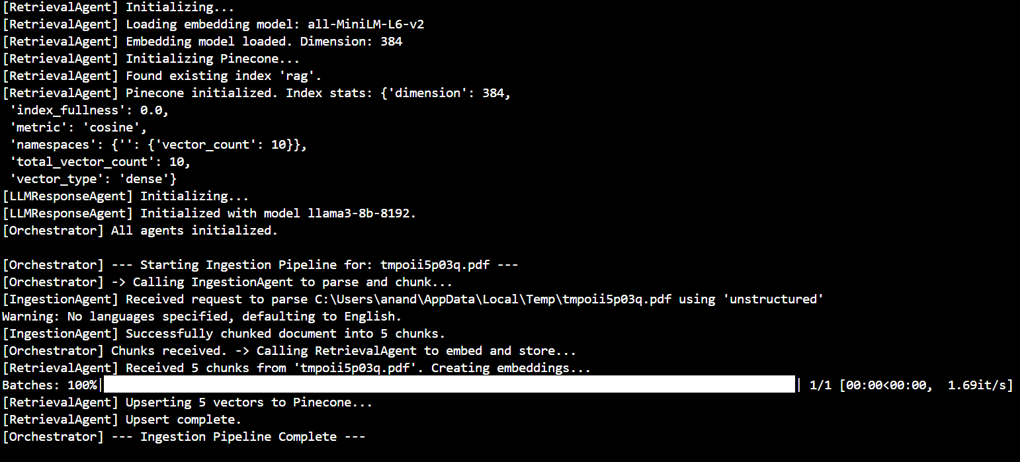
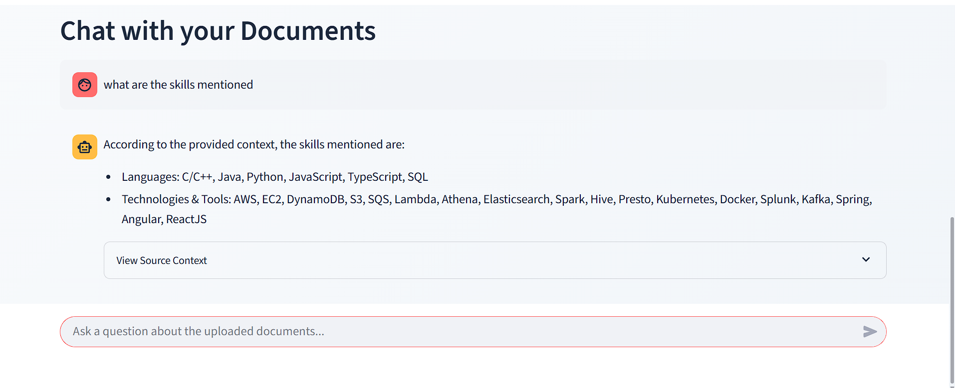
Key Interactions: Visualizing Agent Data Flow

Slide 6
Overcoming Development Challenges
LLM Accuracy & Control
Vector Database Synchronization
Testing & Debugging
Challenge: LLM hallucination. Solution: Strict prompt engineering to restrict LLM to provided context only.
Challenge: Difficulties in isolated testing. Solution: Added isolated __main__ blocks for each agent for independent testing.
Challenge: Pinecone indexing delay. Solution: Added a wait-loop with describe_index_stats() for reliable synchronization.

