Slide 1
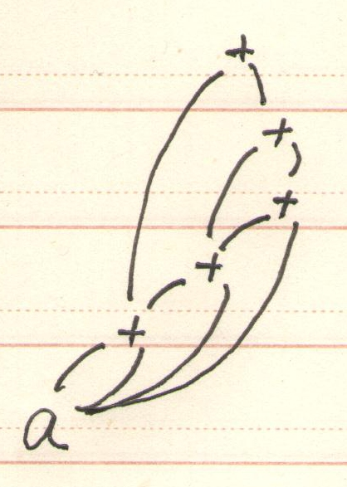
1.练习6.1.2(3)
a的入口
1
2
3
4
5
6
id
+ | 1 | 1
+ | 2 | 1
+ | 3 | 1
+ | 3 | 4
+ | 2 | 5

Slide 2
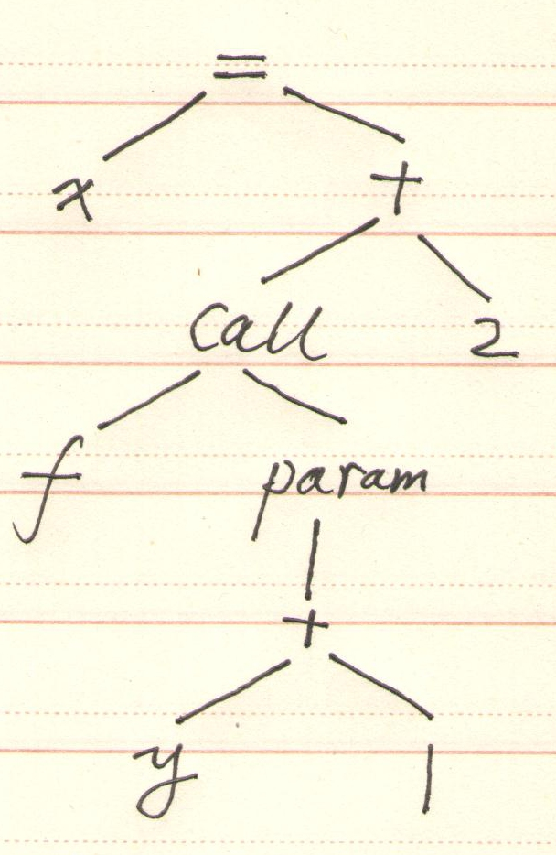
2.练习6.2.2(3)

Slide 3
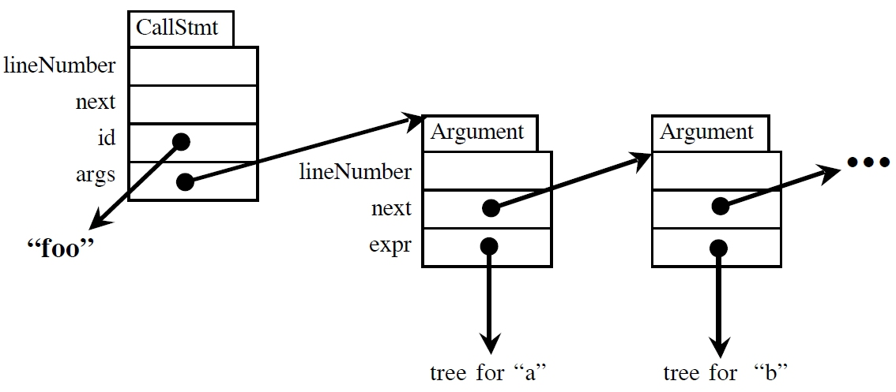
注：AST中的函数调用语句常采用链表存储参数表
如:foo(a,b,c)

Slide 4
2.四元式
 | op | arg1 | arg2 | result
(0) | + | y | 1 | t₁
(1) | param | t₁
(2) | call | f | 1 | t₂
(3) | + | t₂ | 2 | t₃
(4) | = | t₃ |  | x

Slide 5
2.三元式
 | op | arg1 | arg2
(0) | + | y | 1
(1) | param | (0)
(2) | call | f | 1
(3) | + | (2) | 2
(4) | = | x | (3)

Slide 6
2.间接三元式
 | statement
(0) | (10)
(1) | (11)
(2) | (12)
(3) | (13)
(4) | (14)
 | op | arg1 | arg2
(10) | + | y | 1
(11) | param | (10)
(12) | call | f | 1
(13) | + | (12) | 2
(14) | = | x | (13)

Slide 7
3.练习6.3.1
标识符 | 类型 | 相对地址
x | float | 0
p p.x p.y | record((x X float) X (y X float)) float float | 8 8 16
q q.tag q.x q.y | record((tag X integer) X (x X float) X (y X float)) integer float float | 24 24 28 36

Slide 8
4.练习6.4.3(2) 假设float a[10][20], b[15][5];
t1 = i * 160
t2 = j * 8
t3 = t1 + t2
t4 = a[t3]
t5 = i * 40
t6 = j * 8
t7 = t5 + t6
t8 = b[t7]
t9 = t4 + t8
x = t9

Slide 9
5.练习6.5.1(3)
t1 = (int) s
t2 = (int) c
t3 = t1 + t2
t4 = (int) t
t5 = (int) d
t6 = t4 + t5
t7 = t3 * t6
t8 = (float) t7
x = t8

Slide 10
6.练习6.6.1(1)
产生式规则 | 语义规则
S→repeat S1 while B | B.true=newlabel( ); B.false=S.next; S1.next=newlabel( ); S.code=label(B.true)||S1.code||label(S1.next)||B.code

Slide 11
7.练习6.6.5（图６－３６）
翻译方案
P → {S.next=newlabel( ) }S{P.code=S.code || label(S.next)}
S → assign{S.code = assign.code}
S → if ({B.true=newlabel( ); B.false=S.next;}B) {S₁.next=S.netx}S₁ {S.code=B.code || label(B.true) || S₁.code}
S → if ({B.true=newlabel( ); B.false=newlabel( )}B) {S₁.next=S₂.next=S.next}S₁ else S₂ {S.code=B.code || label(B.true) || S₁.code || gen(‘goto’ S.next) || label(B.false) || S₂.code}
S → while({begin=newlabel( ); B.true=newlabel( );B.false=S.next} B ){S₁.next=begin}S₁{S.code=label(begin) || B.code || label(B.true) || S₁.code || gen(‘goto’ begin)}
S → {S₁.next=newlabel( )}S₁ {S₂.next=S.next} S₂{S.code = S₁.code || label(S₁.next) || S₂.code}

Slide 12
8.将以下程序译成三地址码 while(x>15){ if ( a>x || x>y && b==20 || y<1) y=1; else x=x-1; b=a+y*x;
}
解：
100: if x >15 goto 102
101: goto 118
102: if a>x goto 110
103: goto 104
104: if x>y goto 106
105: goto 108
106: if b==20 goto 110
107: goto 108
108: if y<1 goto 110
109: goto 112
110: y=1
111: goto 114
112: t1=x-1
113: x=t1
114: t2=y*x
115: t3=a+t2
116: b= t3
117: goto 100
118:

