Slide 1
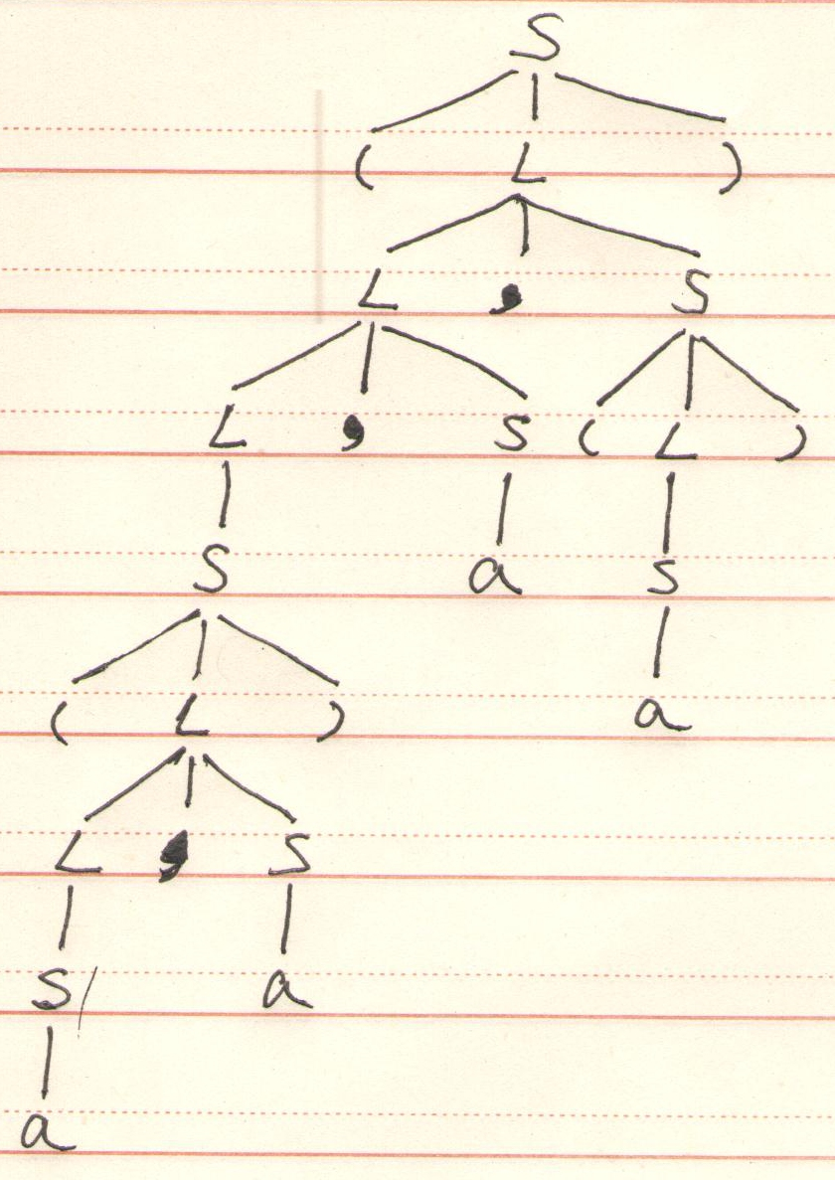
对于文法S→(L)|a L→L,S|S 给出最左推导,最右推导,基于某个推导构建分析树。
解：最左推导 S⇒(L)⇒(L,S)⇒(L,S,S) ⇒(S,S,S)⇒((L),S,S)⇒((L,S),S,S)
⇒((S,S),S,S)⇒((a,S),S,S)⇒((a,a),S,S)
⇒((a,a),a,S)⇒((a,a),a,(L))⇒((a,a),a,(S))⇒((a,a),a,(a))
最右推导 S⇒(L)⇒(L,S)⇒(L,(L))⇒(L,(S))
⇒(L,(a))⇒(L,S,(a))⇒(L,a,(a)) ⇒(S,a,(a))⇒((L),a,(a))⇒((L,S),a,(a))
⇒((L,a),a,(a))⇒((S,a),a,(a))
⇒((a,a),a,(a))

Slide 2
2.P147练习4.4.4(5)(7)
(5)S→(L)|a L →L,S|S
FIRST(S)={(,a} FIRST(L)=FIRST(S)={(,a}
FOLLOW(S)={$} U FOLLOW(L)={, , ) , $}
FOLLOW(L)={‚ , )}
(7)bexpr→bexpr or bterm | bterm bterm→bterm and bfactor | bfactor bfactor→not bfactor | (bexpr) | true | false
FIRST(bexpr)=FIRST(bterm)=FIRST(bfactor)={not,(,true,false}
FOLLOW(bexpr)={$} U {or, )} = {$, or, )}
FOLLOW(bterm)=FOLLOW(bexpr) U {and} = {$, and, or, )}
FOLLOW(bfactor)=FOLLOW(bterm) = {$, and, or, )}

Slide 3
3.对文法： S→aA|B A →aAd|B B→Sd|Aa
(1)消除左递归 （2） 提取左公共因子
解：（1）设定文法符号的顺序为S、A、B。
S和A无左递归。
B→Sd逆序，将S代入得：B→aAd|Bd|Aa
B→Aa逆序，将A代入得：B→aAd|Bd|aAda|Ba
B存在直接左递归，引入B’:
B→aAdB’|aAdaB’ B’→aB’|dB’| ε
所得文法为： S→aA|B A →aAd|B B→aAdB’|aAdaB’ B’→aB’|dB’| ε
（2）B为左部的规则存在左公共因子，引入C：
B→aAdC C →B’|aB’ 故所得文法为： S→aA|B A →aAd|B B→aAdC C →B’|aB’ B’→aB’|dB’| ε

Slide 4
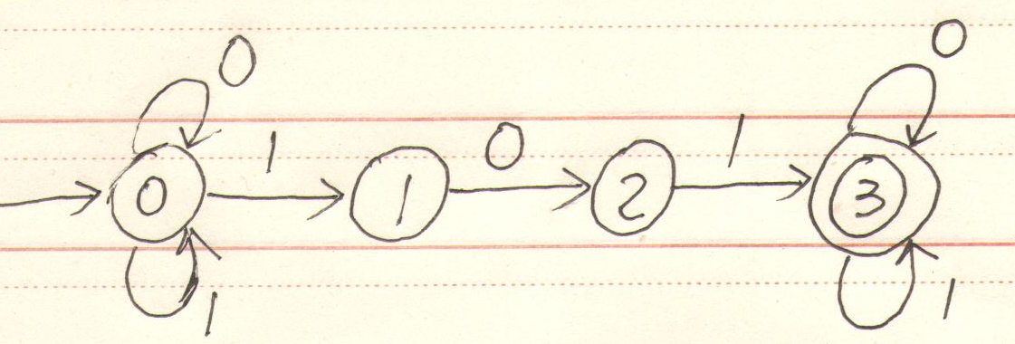
4.试写出定义在Σ＝{0,1}上，至少含有一个101子串的符号串集合的正则表达式，并构造与之等价的最小化的DFA
解：正则表达式(0|1)*101(0|1)*
对应之NFA为：

Slide 5
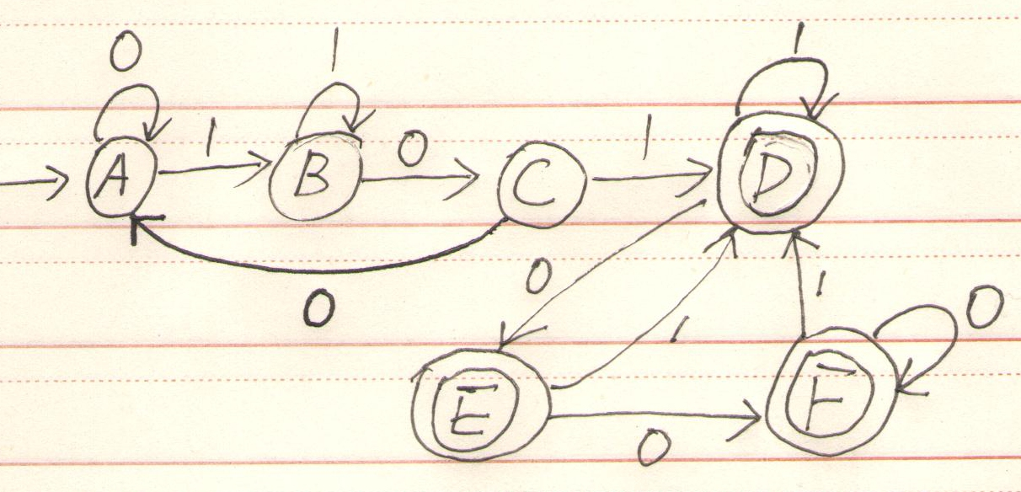
DFA NFA | 0 | 1
A {0} | A | B
B {0,1} | C | B
C {0,2} | A | D
D {0,1,3} | E | D
E {0,2,3} | F | D
F {0,3} | F | D
确定化NFA：

Slide 6
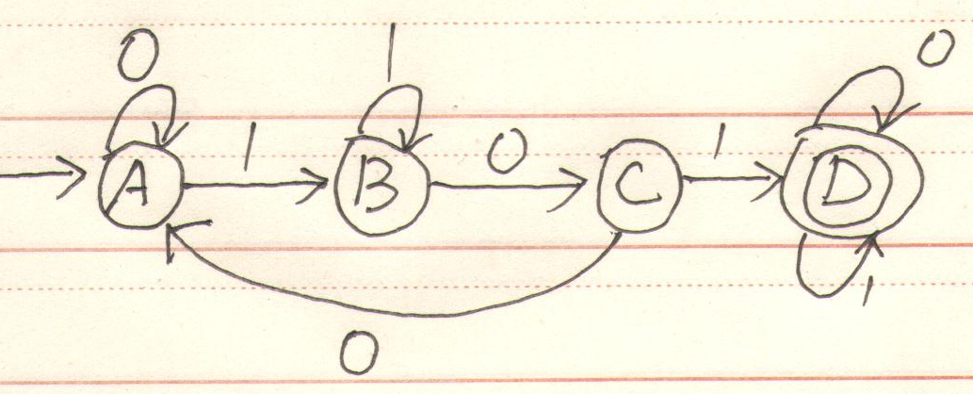
最小化：
g1={A,B,C}, g2={D,E,F}
将g1分为g3={A,B}, g4={C}
将g3分为g5={A}, g6={B}.
故所得分划为：g5={A}, g6={B}, G4={C}, g2={D,E,F}
即最小的DFA为：

Slide 7
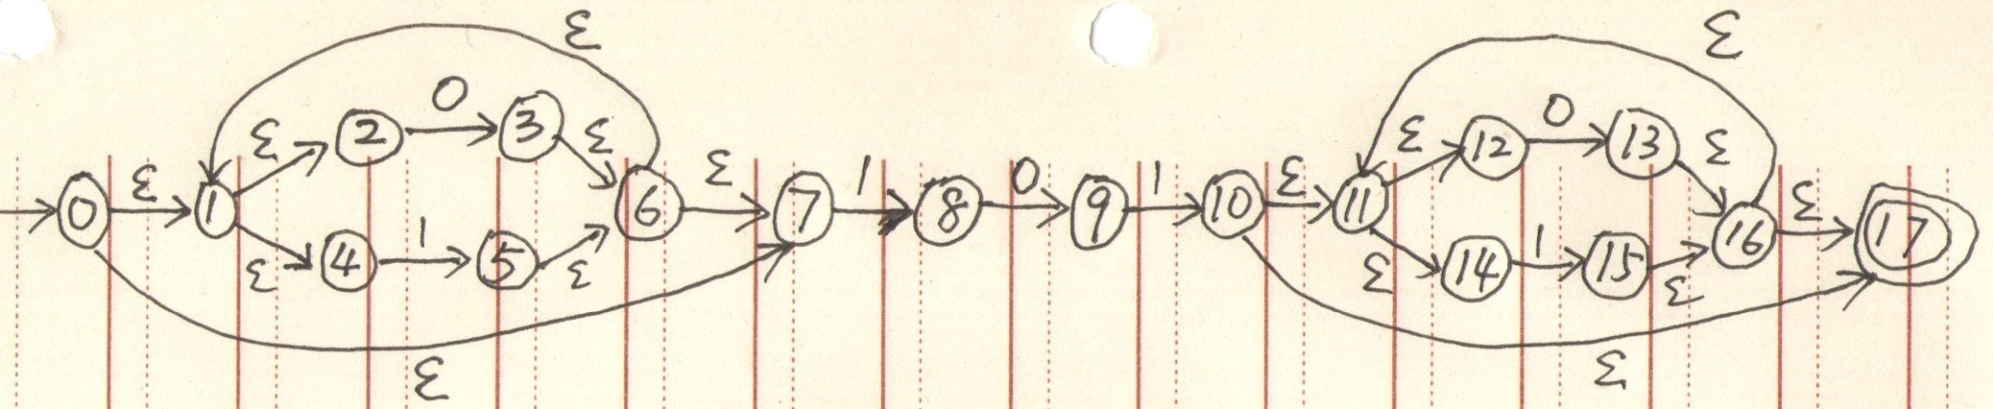
解法2：
NFA为：
确定化：
DFA NFA | 0 | 1
A ε_closure(0)={0,1,2,4,7} | B | C
B ε_closure(3)={1,2,3,4,6,7} | B | C
C ε_closure({5,8})={1,2,4,5,6,7,8} | D | C
D ε_closure({3,9})={1,2,3,4,6,7,9} | B | E
E ε_closure({5,8,10})={1,2,4,5,6,7,8,10,11,12,14,17} | F | G
F ε_closure({3,9,13})={1,2,3,4,6,7,9,11,12,13,14,16,17} | H | I
G ε_closure({5,8,15})={1,2,4,5,6,7,8,11,12,14,15,16,17} | F | G
H ε_closure({3,13})={1,2,3,4,6,7,11,12,13,14,16,17} | H | G
I ε_closure({5,8,10,15})={1,2,4,5,6,7,8,10,11,12,14,15,16,17} | F | G

Slide 8
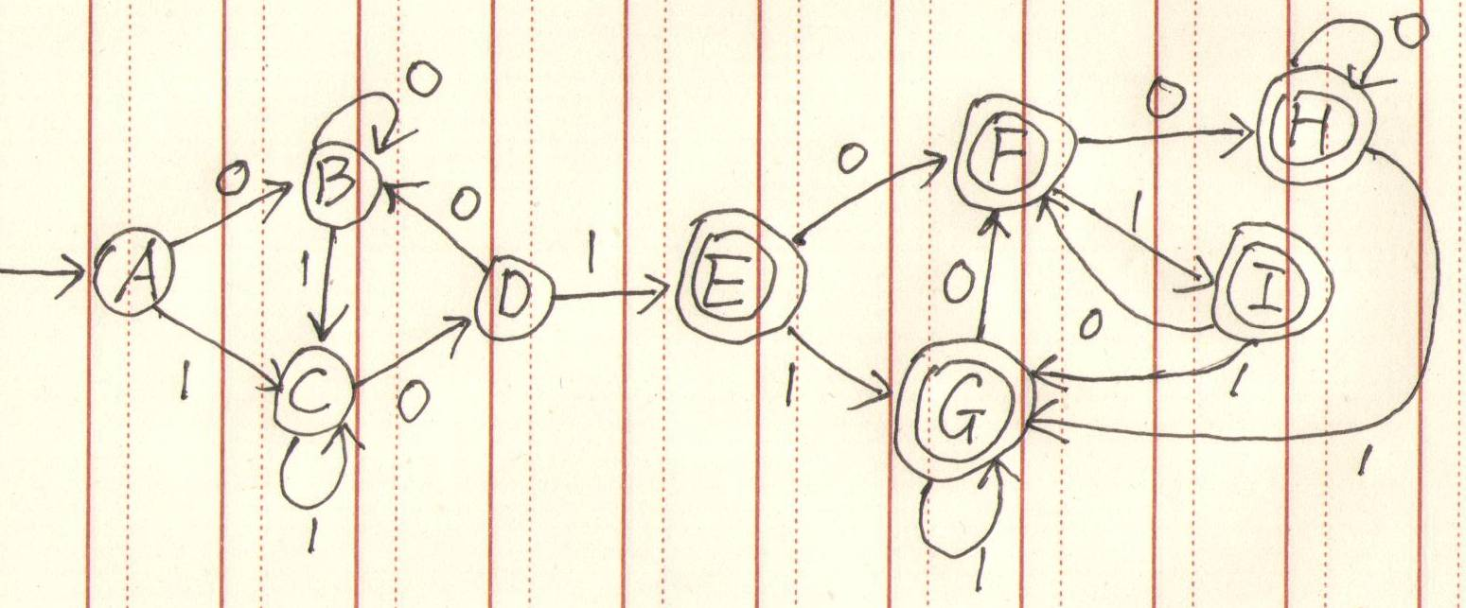
最小化：
g1={A,B,C,D}, g2={E,F,G,H,I}
将g1分为g3={A,B,C}, g4={D}
将g3分为g5={A,B}, g6={C}.
故所得分划为：g5={A,B}, g6={C}, G4={D}, g2={E,F,G,H,I}
即最小的DFA为：

Slide 9
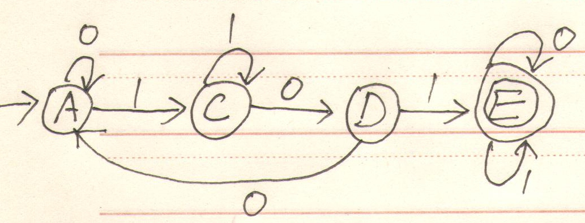

Slide 10
5. 对于上下文无关文法：
S → aTUb ∣ε
T → cUc∣bUb ∣aUa
U → Sb ∣cc
(1)写出各非终结符的FIRST集和FOLLOW集。
(2)构建LL(1)分析表, 本文法是LL(1)文法吗,为什么?
(3)如果是LL(1)文法，基于分析表，试给出aababb的分析过程。
解：(1) FIRST(S)={a,ε} FIRST(T)={a,b,c} FIRST(U)={a,b,c}
FOLLOW(S)={$,b} FOLLOW(T)={a,b,c} FOLLOW(U)={a,b,c}
(2)构建LL（1）分析表如下
 | a | b | c | $
S | S → aTUb | S→ε |  | S→ε
T | T→aUa | T→bUb | T→cUc
U | U→Sb | U→Sb | U→cc

Slide 11
表中无冲突项目，故本文法LL(1)
(3)分析过程：
Matched | Stack | Input | action
 | S$ | aababb$
 | aTUb$ | aababb$ | S→aTUb
a | TUb$ | ababb$ | Match a
a | aUaUb$ | ababb$ | T→aUa
aa | UaUb$ | babb$ | Match a
aa | SbaUb$ | babb$ | U→Sb
aa | baUb$ | babb$ | S→ε
aab | aUb$ | abb$ | Match b
aaba | Ub$ | bb$ | Match a
aaba | Sbb$ | bb$ | U→Sb
aaba | bb$ | bb$ | S→ε
aabab | b$ | b$ | Match b
aababb | $ | $ | Match b

Slide 12
6.P148, 4.4.12
FOLLOW(stmt)={$} U (FIRST(stmtTail)-{ε}) U FOLLOW(stmtTail) U (FIRST(listTail)-{ε}) U FOLLOW(list)={$, else, ;, end}
FOLLOW(stmtTail)=FOLLOW(stmt)={$, else, ;, end}
FOLLOW(list)={end} U FOLLOW(listTail)={end}
FOLLOW(listTail)=FOLLOW(list)={end}
将规则编号如下:
stmt→ if e then stmt stmtTail (2) stmt →while e do stmt
(3) stmt →begin list end (4) stmt →s
stmtTail →else stmt (6) stmtTail →ε
(7) list → stmt listTail (8) listTail →;list (9)listTail → ε

Slide 13
构建预测分析表如下：
 | begin | e | else | end | do | if | s | then | while | ; | $
stmt | 3 |  | synch | synch |  | 1 | 4 |  | 2 | synch | sysch
stmtTail |  |  | 5 | 6 |  |  |  |  |  | 6 | 6
list | 7 |  |  | synch |  | 7 | 7 |  | 7
listTail |  |  |  | 9 |  |  |  |  |  | 8
if e then s; if e then s end的分析过程：
stack | input | action
stmt $ | if e then s; if e then s end$
if e then stmt stmtTail $ | if e then s; if e then s end$ | stmt→ if e then stmt stmtTail
e then stmt stmtTail $ | e then s; if e then s end$ | Match if
then stmt stmtTail $ | then s; if e then s end$ | Match e
stmt stmtTail $ | s; if e then s end$ | Match then
s stmtTail $ | s; if e then s end$ | stmt →s

Slide 14
stack | input | action
stmtTail $ | ; if e then s end$ | Match s
$ | ;if e then s end$ | stmtTail →ε
$ | ;if e then s end$ | ERROR, skip all
while e do begin s; if e then s; end的分析过程：
stack | input | action
stmt $ | while e do begin s; if e then s; end$
while e do stmt $ | while e do begin s; if e then s; end$ | stmt →while e do stmt
e do stmt $ | e do begin s; if e then s; end$ | Match while
do stmt $ | do begin s; if e then s; end$ | Match e
stmt $ | begin s; if e then s; end$ | Match do
begin list end $ | begin s; if e then s; end$ | stmt →begin list end
list end $ | s; if e then s; end$ | Match begin
stmt listTail end $ | s; if e then s; end$ | list → stmt listTail
s listTail end $ | s; if e then s; end$ | stmt →s

Slide 15
stack | input | action
listTail end $ | ; if e then s; end$ | Match s
; list end $ | ; if e then s; end$ | listTail →;list
list end $ | if e then s; end$ | Match ;
stmt listTail end $ | if e then s; end$ | list → stmt listTail
if e then stmt stmtTail listTail end $ | if e then s; end$ | stmt→ if e then stmt stmtTail
e then stmt stmtTail listTail end $ | e then s; end$ | Match if
then stmt stmtTail listTail end $ | then s; end$ | Match e
stmt stmtTail listTail end $ | s; end$ | Match then
s stmtTail listTail end $ | s; end$ | stmt →s
stmtTail listTail end $ | ; end$ | Match s
listTail end $ | ; end$ | stmtTail →ε
;list end $ | ; end$ | listTail →;list
list end $ | end$ | Match ;
end $ | end$ | Error, pop list
$ | $ | Match end

