Slide 1
1.练习4.6.6 说明下面的文法: S→SA | A A→a
是SLR(1)的，但不是LL(1)的
解：由于本文法存在直接右递归规则S→SA，故本文法非LL(1)。
引入新的文法识别符S’和规则S’ →S，构建增广文法。对文法中规则编号：
（0）S’ →S (1) S→SA (2) S→A (3)A→a
Follow(S’)={$}
Follow(S)={a,$}
Follow(A)={a,$}
从S’→S开始，构建LR(0)项目集族如下：

Slide 2
状态 | 项目集 | 后继符号 | 后继状态
S₀ | { S’→•S S→•SA S→•A A→•a} | S S A a | S1 S1 S2 S3
S1 | { S’→S• S→S•A A→•a} | $ # S’→S A a | S5 S4 S3
S2 | {S→A•} | a|$ # S→A | S5
S3 | {A→a•} | a|$ # A→a | S5
S4 | {S→SA•} | a|$ # S→SA | S5
可尝试构建SLR(1)分析表如下：
state | action |  | goto
 | a | $ | S | A
0 | S3 |  | 1 | 2
1 | S3 | acc |  | 4
2 | r2 | r2
3 | r3 | r3
4 | r1 | r1
分析表没有冲突项目，故本文法是SLR(1)文法。

Slide 3
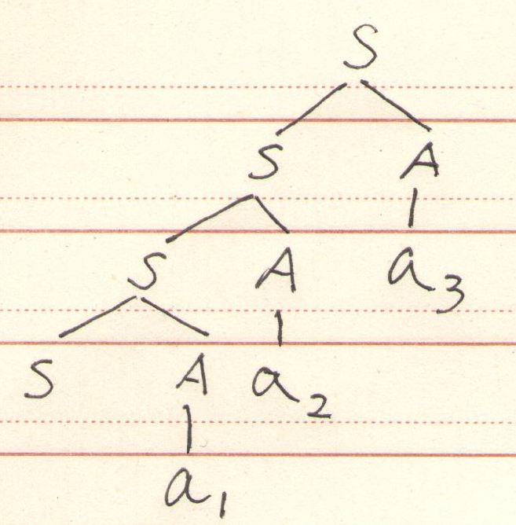
２、对于4.6.6的文法，说明句型Saaa的短语，句柄，可归前缀和可行前缀。
解：构建Saaa的分析树如下，
故短语有：a₁, Sa₁, a₂, Sa₁a₂, a₃, Sa₁a₂a₃
句柄有：a₁
可归前缀为:Sa₁
可行前缀为：S, Sa₁

Slide 4
3、练习4.7.4.说明文法S→Aa | bAc | dc | bda A→d
是LALR(1)的，但不是SLR(1)的
解：引入产生式S’→ S，得到增广文法G[S’] ：
(0)S’→S (1)S→Aa (2)S→bAc
(3)S→dc (4)S→bda (5)A→d
FOLLOW(S)=FOLLOW(S ')={$} FOLLOW(A)={a,c}
可尝试构建LR(0)项目集族如下
状态 | 项目集 | 后继符号 | 后继状态
S₀ | {S’→•S S→•Aa S→•bAc S→•dc S→•bda A→•d} | S A b d b d | S₁ S₂ S₃ S₄ S₃ S₄

Slide 5
状态 | 项目集 | 后继符号 | 后继状态
S₁ | {S’→S•} | $ #S’→S
S₂ | {S→A•a} | a | S₅
S₃ | {S→b•Ac S→b•da A→•d} | A d d | S₆ S₇ S₇
S₄ | {S→d•c A→d•} | c a|c #A→d
显然在S₄状态时，如果当前输入为c，则无法确定是移入还是按规则A→d归约，故本文法非SLR(1)

Slide 6
可尝试构建LR(1)项目集族如下
状态 | 项目集 | 后继符号 | 后继状态
S₀ | {S’→•S, $ S→•Aa, $ S→•bAc, $ S→•dc, $ S→•bda, $ A→•d, a} | S A b d b d | S₁ S₂ S₃ S₄ S₃ S₄
S₁ | {S’→S•, $} | #S’→S | S₁₁
S₂ | {S→A•a, $} | a | S₅
S₃ | {S→b•Ac, $ S→b•da, $ A→•d, c} | A d d | S₆ S₇ S₇
S₄ | {S→d•c, $ A→d•, a} | c #A→d | S₈ S₁₁

Slide 7
状态 | 项目集 | 后继符号 | 后继状态
S₅ | {S→Aa•, $} | #S→Aa | S₁₁
S₆ | {S→bA•c, $} | c | S₉
S₇ | {S→bd•a, $ A→d•, c} | a #A→d | S₁₀ S₁₁
S₈ | {S→dc•, $} | #S→dc | S₁₁
S₉ | {S→bAc•, $} | #S→bAc | S₁₁
S₁₀ | {S→bda•, $} | #S→bda | S₁₁
没有待合并的同心集，可给出分析表如下：

Slide 8
状态 | ACTION |  |  |  |  | GOTO
 | a | b | c | d | $ | S | A
0 |  | S₃ |  | S₄ |  | 1 | 2
1 |  |  |  |  | acc
2 | S₅
3 |  |  |  | S₇ |  |  | 6
4 | r₅ |  | S₈
5 |  |  |  |  | r₁
6 |  |  | S₉
7 | S₁₀ |  | r₅
8 |  |  |  |  | r₃
9 |  |  |  |  | r₂
10 |  |  |  |  | r₄
分析表中无冲突项目，故本文法为LALR(1)

Slide 9
4.考虑如下文法：
S→A A→BA|ε B→aB|b
（1）构造该文法的LR(1)分析表
（2）给出对于输入符号串abab的分析过程
解：引入产生式S’→ S，得到增广文法G[S’] ：
(0)S’→S (1)S→A (2)A→BA
(3)A→ε (4)B→aB (5)B→b
可尝试构建LR(1)项目集族如下：

Slide 10
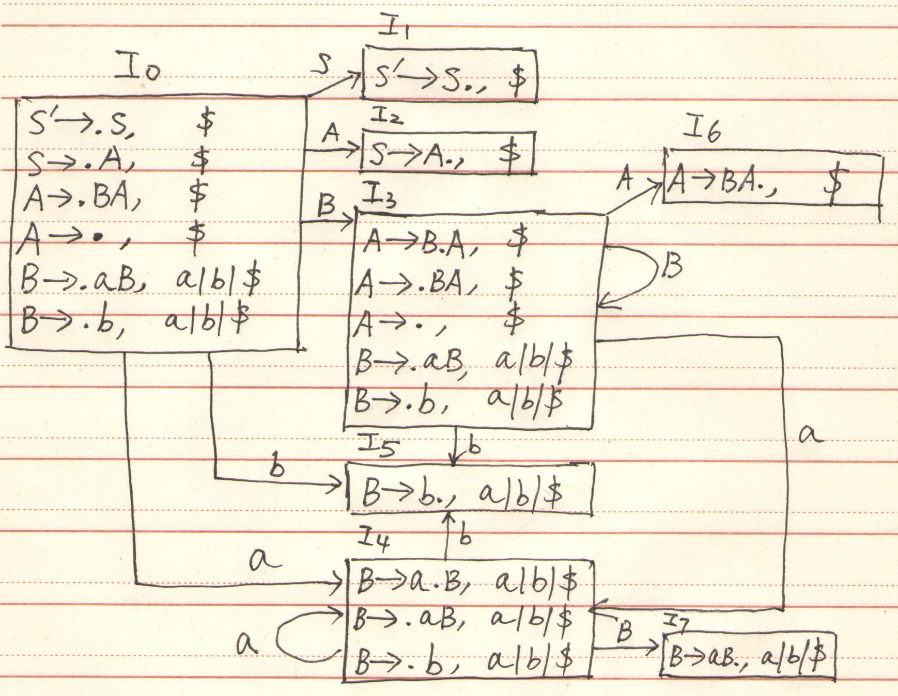

Slide 11
状态 | ACTION |  |  | GOTO
 | a | b | $ | S | A | B
0 | S₄ | S₅ | r₃ | 1 | 2 | 3
1 |  |  | acc
2 |  |  | r₁
3 | S₄ | S₅ | r₃ |  | 6 | 3
4 | S₄ | S₅ |  |  |  | 7
5 | r₅ | r₅ | r₅
6 |  |  | r₂
7 | r₄ | r₄ | r₄
分析表中无冲突项目，故本文法为LR(1)

Slide 12
stack | symbol | input | action
0 | $ | abab$ | Shift 4
0 4 | $ a | bab$ | Shift 5
0 4 5 | $ a b | ab$ | Reduce B→b
0 4 7 | $ a B | ab$ | Reduce B→aB
0 3 | $ B | ab$ | Shift 4
0 3 4 | $ B a | b$ | Shift 5
0 3 4 5 | $ B a b | $ | Reduce B→b
0 3 4 7 | $ B a B | $ | Reduce B→aB
0 3 3 | $ B B | $ | Reduce A→ε
0 3 3 6 | $ B B A | $ | Reduce A→BA
0 3 6 | $ B A | $ | Reduce A→BA
0 2 | $ A | $ | Reduce S→A
0 1 | $ S | $ | accept

Slide 13
5.练习4.8.2：
(1)解：引入产生式S’→ stmt，得到增广文法G[S’] ：
(0)S’→stmt (1)stmt→if e then stmt
(2)stmt→if e then stmt else stmt
(3)stmt→while e do stmt (4)stmt→begin list end
(5)stmt→s (6)list→list ; stmt (7) list→stmt
FOLLOW(stmt)={$, else, end, ;}
FOLLOW(list)={end, ;}
可尝试构建LR(0)项目集族如下：

Slide 14
状态 | 项目集 | 后继符号 | 后继状态
S₀ | {S’→•stmt stmt→•if e then stmt stmt→•if e then stmt else stmt stmt→•while e do stmt stmt→•begin list end stmt→•s } | stmt if if while begin s | S₁ S₂ S₂ S₃ S₄ S₅
S₁ | {S’→stmt•} | $ #S’→stmt | S₁₉
S₂ | {stmt→if •e then stmt stmt→if•e then stmt else stmt} | e | S₆
S₃ | {stmt→while•e do stmt} | e | S₇
S₄ | {stmt→begin• list end list→•list;stmt list→•stmt stmt→•if e then stmt stmt→•if e then stmt else stmt stmt→•while e do stmt stmt→•begin list end stmt→•s } | list list stmt if if while begin s | S₈ S₈ S₉ S₂ S₂ S₃ S₄ S₅

Slide 15
状态 | 项目集 | 后继符号 | 后继状态
S₅ | {stmt→s • } | $|else|end|; #stmt→s | S₁₉
S₆ | {stmt→if e• then stmt stmt→if e• then stmt else stmt} | then | S₁₀
S₇ | {stmt→while e• do stmt} | do | S₁₁
S₈ | {stmt→begin list• end list→list•;stmt} | end ; | S₁₂ S₁₃
S₉ | {list→stmt• } | end|; #list→stmt | S₁₉
S₁₀ | {stmt→if e then• stmt stmt→if e then• stmt else stmt stmt→•if e then stmt stmt→•if e then stmt else stmt stmt→•while e do stmt stmt→•begin list end stmt→•s } | stmt stmt if if while begin s | S₁₄ S₁₄ S₂ S₂ S₃ S₄ S₅

Slide 16
状态 | 项目集 | 后继符号 | 后继状态
S₁₁ | {stmt→while e do• stmt stmt→•if e then stmt stmt→•if e then stmt else stmt stmt→•while e do stmt stmt→•begin list end stmt→•s } | stmt if if while begin s | S₁₅ S₂ S₂ S₃ S₄ S₅
S₁₂ | {stmt→begin list end•} | $|else|end|; #stmt→begin list end | S₁₉
S₁₃ | {list→list; •stmt stmt→•if e then stmt stmt→•if e then stmt else stmt stmt→•while e do stmt stmt→•begin list end stmt→•s } | stmt if if while begin s | S₁₆ S₂ S₂ S₃ S₄ S₅
S₁₄ | {stmt→if e then stmt• stmt→if e then stmt• else stmt} | $|else|end|; #stmt→if e then stmt else | S₁₉ S₁₇
S₁₅ | {stmt→while e do stmt•} | $|else|end|; #stmt→while e do stmt | S₁₉

Slide 17
状态 | 项目集 | 后继符号 | 后继状态
S₁₆ | {{list→list; stmt•} | end|; #list→list;stmt | S₁₉
S₁₇ | {stmt→if e then stmt else• stmt stmt→•if e then stmt stmt→•if e then stmt else stmt stmt→•while e do stmt stmt→•begin list end stmt→•s } | stmt if if while begin s | S₁₈ S₂ S₂ S₃ S₄ S₅
S₁₈ | {stmt→if e then stmt else stmt•} | $|else|end|; #stmt→if e then stmt else stmt | S₁₉
对于项目集S₁₄,在输入为else时存在移入/归约冲突，
此时选择移入
故可得SLR(1)分析表如下

Slide 18
状态 | ACTION |  |  |  |  |  |  |  |  |  |  | GOTO
 | if | e | then | else | while | do | begin | end | ; | s | $ | stmt | list
0 | S₂ |  |  |  | S₃ |  | S₄ |  |  | S₅ |  | 1
1 |  |  |  |  |  |  |  |  |  |  | acc
2 |  | S₆
3 |  | S₇
4 | S₂ |  |  |  | S₃ |  | S₄ |  |  | S₅ |  | 9 | 8
5 |  |  |  | r₅ |  |  |  | r₅ | r₅ |  | r₅
6 |  |  | S₁₀
7 |  |  |  |  |  | S₁₁
8 |  |  |  |  |  |  |  | S₁₂ | S₁₃
9 |  |  |  |  |  |  |  | r₇ | r₇
10 | S₂ |  |  |  | S₃ |  | S₄ |  |  | S₅ |  | 14
11 | S₂ |  |  |  | S₃ |  | S₄ |  |  | S₅ |  | 15
12 |  |  |  | r₄ |  |  |  | r₄ | r₄ |  | r₄

Slide 19
状态 | ACTION |  |  |  |  |  |  |  |  |  |  | GOTO
 | if | e | then | else | while | do | begin | end | ; | s | $ | stmt | list
13 | S₂ |  |  |  | S₃ |  | S₄ |  |  | S₅ |  | 16
14 |  |  |  | S₁₇ |  |  |  | r₁ | r₁ |  | r₁
15 |  |  |  | r₃ |  |  |  | r₃ | r₃ |  | r₃
16 |  |  |  |  |  |  |  | r₆ | r₆
17 | S₂ |  |  |  | S₃ |  | S₄ |  |  | S₅ |  | 18
18 |  |  |  | r₂ |  |  |  | r₂ | r₂ |  | r₂
(2) 为了解决（３）中的错误，在分析表中额外归约动作和
错误处理例程，得到分析表如下：

Slide 20
状态 | ACTION |  |  |  |  |  |  |  |  |  |  | GOTO
 | if | e | then | else | while | do | begin | end | ; | s | $ | stmt | list
0 | S₂ |  |  |  | S₃ |  | S₄ |  |  | S₅ |  | 1
1 |  |  |  |  |  |  |  |  | e₁ |  | acc
2 |  | S₆
3 |  | S₇
4 | S₂ |  |  |  | S₃ |  | S₄ |  |  | S₅ |  | 9 | 8
5 |  |  |  | r₅ |  |  |  | r₅ | r₅ |  | r₅
6 |  |  | S₁₀
7 |  |  |  |  |  | S₁₁
8 |  |  |  |  |  |  |  | S₁₂ | S₁₃
9 |  |  |  |  |  |  |  | r₇ | r₇
10 | S₂ |  |  |  | S₃ |  | S₄ |  |  | S₅ |  | 14
11 | S₂ |  |  |  | S₃ |  | S₄ |  |  | S₅ |  | 15
12 |  |  |  | r₄ |  |  |  | r₄ | r₄ |  | r₄

Slide 21
状态 | ACTION |  |  |  |  |  |  |  |  |  |  | GOTO
 | if | e | then | else | while | do | begin | end | ; | s | $ | stmt | list
13 | S₂ |  |  |  | S₃ |  | S₄ | e₂ |  | S₅ |  | 16
14 |  |  |  | S₁₇ |  |  |  | r₁ | r₁ |  | r₁
15 |  |  |  | r₃ |  |  |  | r₃ | r₃ |  | r₃
16 |  |  |  |  |  |  |  | r₆ | r₆
17 | S₂ |  |  |  | S₃ |  | S₄ |  |  | S₅ |  | 18
18 |  |  |  | r₂ |  |  |  | r₂ | r₂ |  | r₂
(3a) if e then s; if e then s end分析过程如下：

Slide 22
stack | symbol | input | action
0 | $ | if e then s; if e then s end$ | Shift 2
0 2 | $ if | e then s; if e then s end$ | Shift 6
0 2 6 | $ if e | then s; if e then s end$ | Shift 10
0 2 6 10 | $ if e then | s; if e then s end$ | Shift 5
0 2 6 10 5 | $ if e then s | ; if e then s end$ | Reduce stmt→s
0 2 6 10 14 | $ if e then stmt | ; if e then s end$ | Reduce stmt→if e then stmt
0 1 | $ stmt | ; if e then s end$ | e1, pop state 1, push state 4 and 8, push symbol list
0 4 8 | $ stmt list | ; if e then s end$ | Shift 13
0 4 8 13 | $ stmt list ; | if e then s end$ | Shift 2
0 4 8 13 2 | $ stmt list ; if | e then s end$ | Shift 6

Slide 23
stack | symbol | input | action
0 4 8 13 2 6 | $ stmt list ; if e | then s end$ | Shift 10
0 4 8 13 2 6 10 | $ stmt list ; if e then | s end$ | Shift 5
0 4 8 13 2 6 10 5 | $ stmt list ; if e then s | end$ | Reduce stmt→s
0 4 8 13 2 6 10 14 | $ stmt list ; if e then stmt | end$ | Reduce stmt→if e then stmt
0 4 8 13 16 | $ stmt list ; stmt | end$ | Reduce list→list ; stmt
0 4 8 | $ stmt list | end$ | Shift 12
0 4 8 12 | $ stmt list end | $ | Reduce stmt→begin list end
0 1 | $ stmt | $ | accept
(3b) while e do begin s; if e then s;end分析过程如下：

Slide 24
stack | symbol | input | action
0 | $ | while e do begin s;if e then s; end$ | Shift 3
0 3 | $ while | e do begin s;if e then s; end$ | Shift 7
0 3 7 | $ while e | do begin s;if e then s; end$ | Shift 11
0 3 7 11 | $ while e do | begin s;if e then s; end$ | Shift 4
0 3 7 11 4 | $ while e do begin | s;if e then s; end$ | Shift 5
0 3 7 11 4 5 | $ while e do begin s | ; if e then s end$ | Reduce stmt→s
0 3 7 11 4 9 | $ while e do begin stmt | ; if e then s end$ | Reduce list→stmt
0 3 7 11 4 8 | $ while e do begin list | ; if e then s end$ | Shift 13
0 3 7 11 4 8 13 | $ while e do begin list ; | if e then s end$ | Shift 2
0 3 7 11 4 8 13 2 | $ while e do begin list ; if | e then s end$ | Shift 6
0 3 7 11 4 8 13 2 6 | $ while e do begin list ; if e | then s; end$ | Shift 10
0 3 7 11 4 8 13 2 6 10 | $ while e do begin list;if e then | s; end$ | Shift 5

Slide 25
stack | symbol | input | action
0 3 7 11 4 8 13 2 6 10 5 | $ while e do begin list;if e then s | ; end$ | Reduce stmt→s
0 3 7 11 4 8 13 2 6 10 14 | $ while e do begin list;if e then stmt | ; end$ | Reduce stmt→if e then stmt
0 3 7 11 4 8 13 16 | $ while e do begin list; stmt | ; end$ | Reduce list→list; stmt
0 3 7 11 4 8 | $ while e do begin list | ; end$ | Shift 13
0 3 7 11 4 8 13 | $ while e do begin list ; | end$ | e2 push state 16,push symbol stmt
0 3 7 11 4 8 13 16 | $ while e do begin list ; stmt | end$ | Reduce list→list; stmt
0 3 7 11 4 8 | $ while e do begin list | end$ | Shift 12
0 3 7 11 4 8 12 | $ while e do begin list end | $ | Reduce stmt→begin list end
0 3 7 11 15 | $ while e do stmt | $ | Reduce stmt→while e do stmt
0 1 | $ stmt | $ | accept

