Slide 1
Development of a Machine Learning Model for Early-Stage Parkinson's Disease Prediction Using Voice Recording Data
Ananna Biswas & Keerthi Kesavan
SAT5114: AI in Healthcare
Department of Applied Computing
Michigan Technological University (MTU)

Slide 2

Outlines
Motivation and Background
Why use Voice Data for Parkinson’s Disease (PD) Detection
Challenges in Machine Learning Model Development
Our Approach to Address these Challenges
Performance Comparison among proposed ML models
Comparison with Literature Benchmarks
Conclusion and Future Work

Slide 3
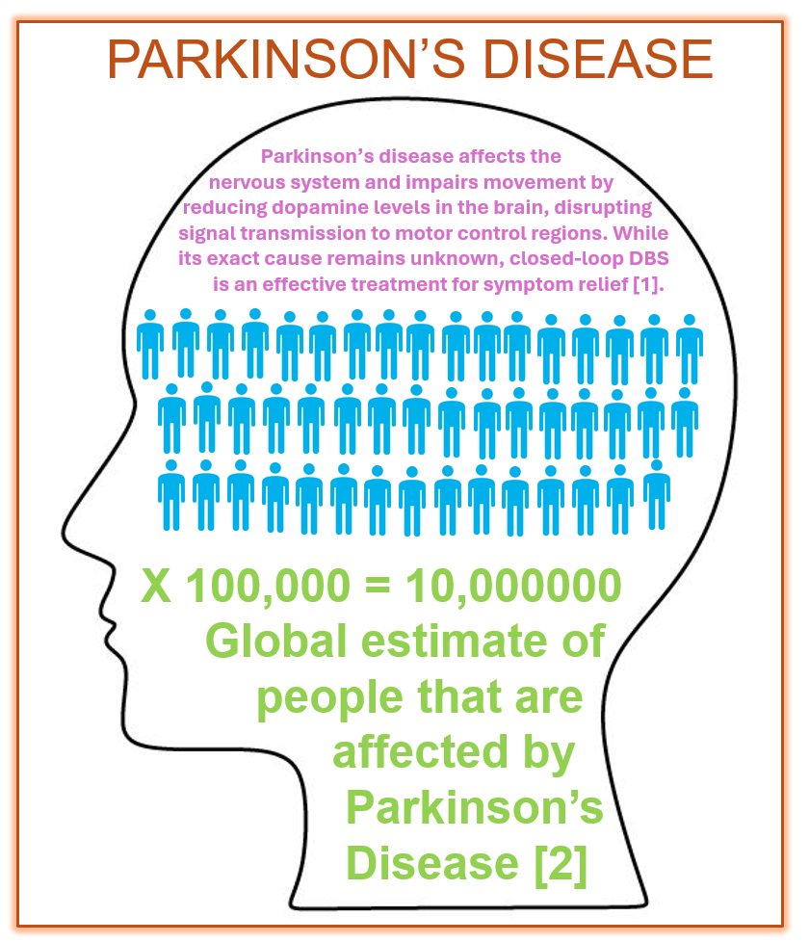
Motivation and Background
Parkinson’s Disease (PD):
It is a neurodegenerative disorder that affects movement, balance, and coordination.
It leads to motor symptoms like tremors, bradykinesia, and rigidity, as well as non-motor symptoms such as cognitive impairment and mood disturbances.
While the exact cause of PD remains uncertain, early detection is key to improving patient outcomes and slowing disease progression.

Slide 4

Why use Voice Data for Parkinson’s Disease (PD) Detection
Speech Abnormalities: reduced vocal intensity, imprecise articulation, and speech monotony are the earliest signs of PD.
Studies show that voice is the most commonly and severely affected feature in the early stages of Parkinson’s disease [3].
Voice analysis for PD is a promising tool: non-invasive, cost-effective, and can be monitored remotely.
Voice Data For PD Prediction

Slide 5
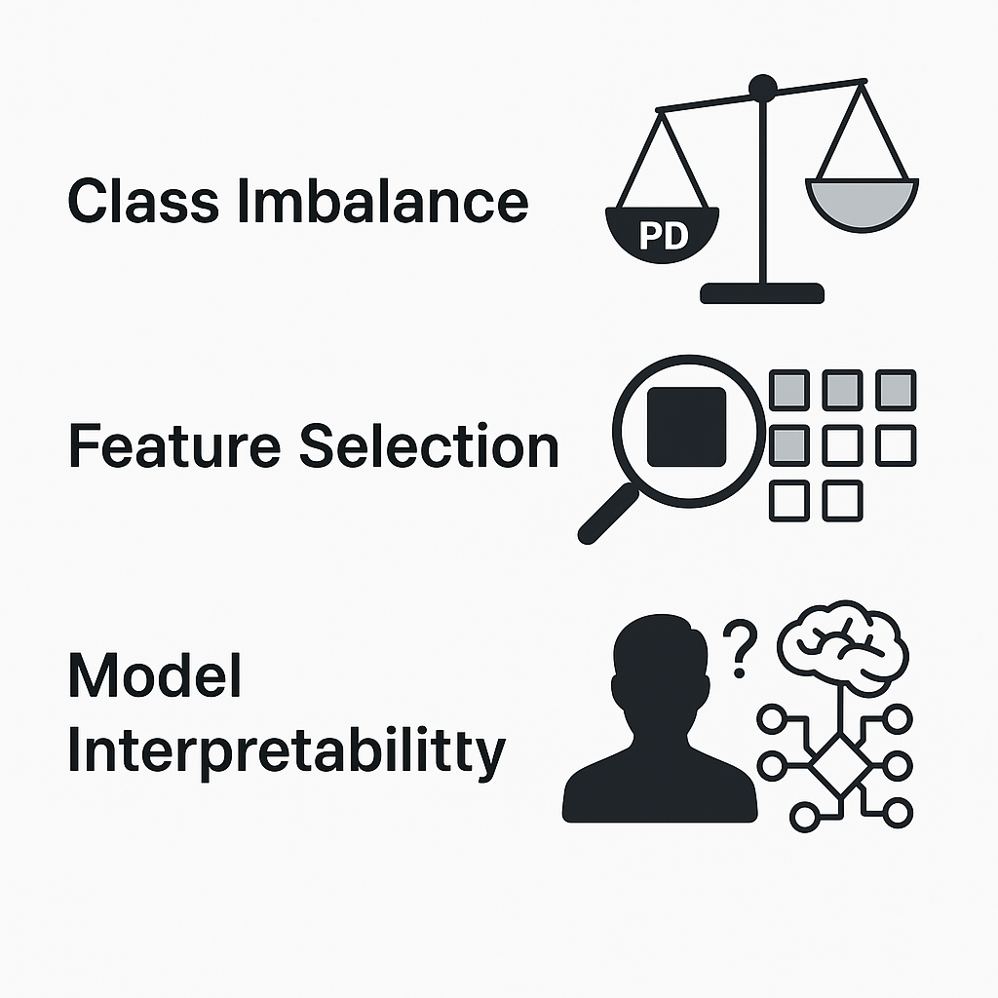
Challenges in ML based PD Detection
Class Imbalance: PD samples greatly outnumber healthy controls, risking biased model predictions [4].
Feature Selection: Irrelevant or redundant features can reduce model accuracy.
Model Interpretability: Clinically useful models must provide understandable decision logic for healthcare professionals.

Slide 6
PD Detection using ML Models
Our Approach to Address the Challenges:
Handling Class Imbalance: Applied SMOTE (Synthetic Minority Over-sampling Technique) to balance the dataset and reduce prediction bias.
Improving Feature Selection: We used Recursive Feature Elimination (RFE) to retain only the most relevant features.
Ensuring Robust Model Performance: Trained and compared three ML models: Random Forest, SVM, and KNN, with and without RFE.

Slide 7
PD Detection using ML Models
Handling Data Imbalance for Voice Dataset:
The publicly available voice data of PD and Healthy Subjects, accessed via the UCI Machine Learning Repository [5].
This dataset has gained significant attention in Parkinson’s disease research due to its extensive range of speech-related features.
It comprises 195 voice recordings from 31 participants, with an imbalanced class distribution (23 PD patients and 8 healthy subjects).

Slide 8
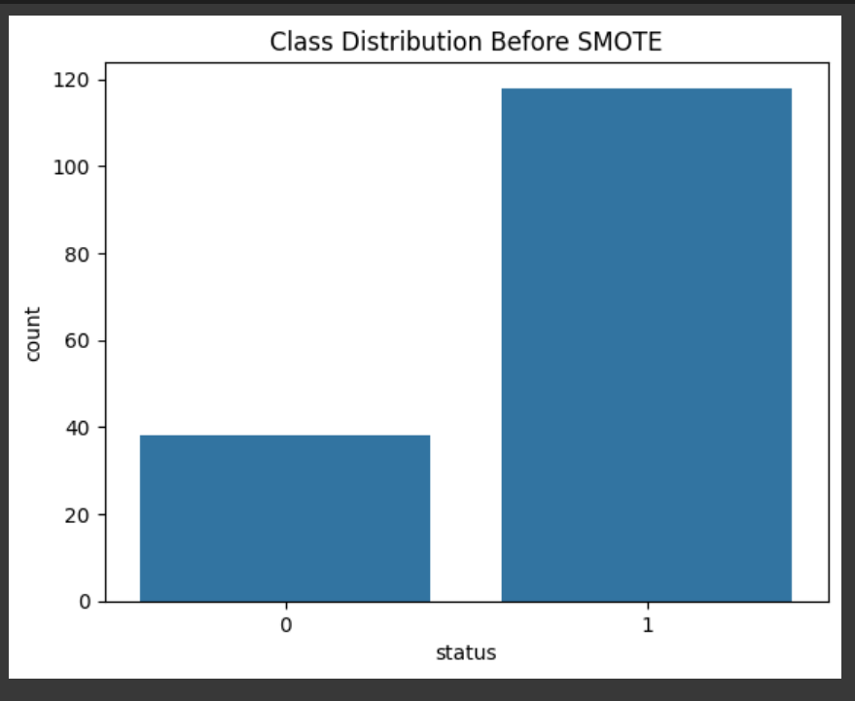
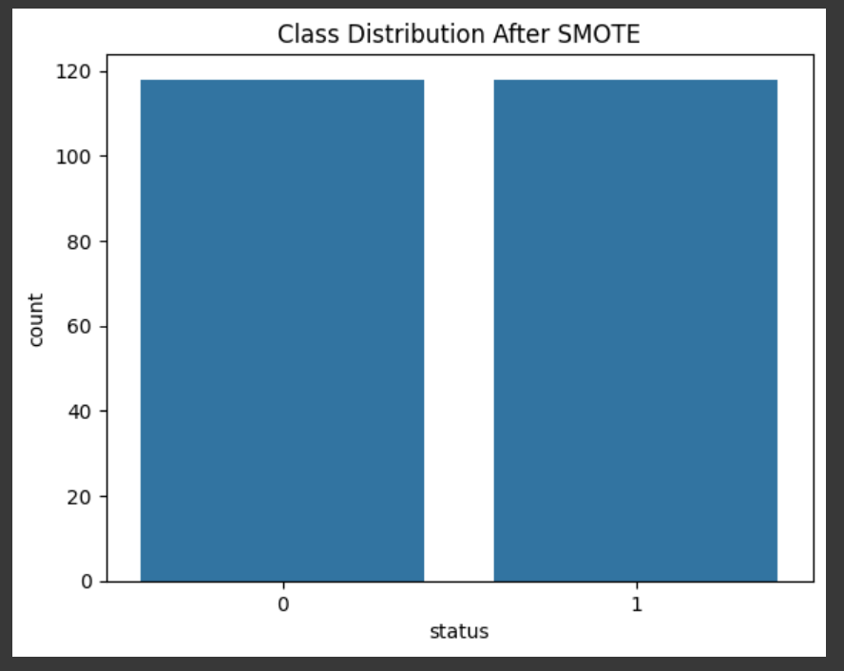
PD Detection using ML Models
Handling Data Imbalance for Voice Dataset: SMOTE generates synthetic examples of the minority class to create a balanced training set. Healthy Status = 0, PD status = 1

Slide 9
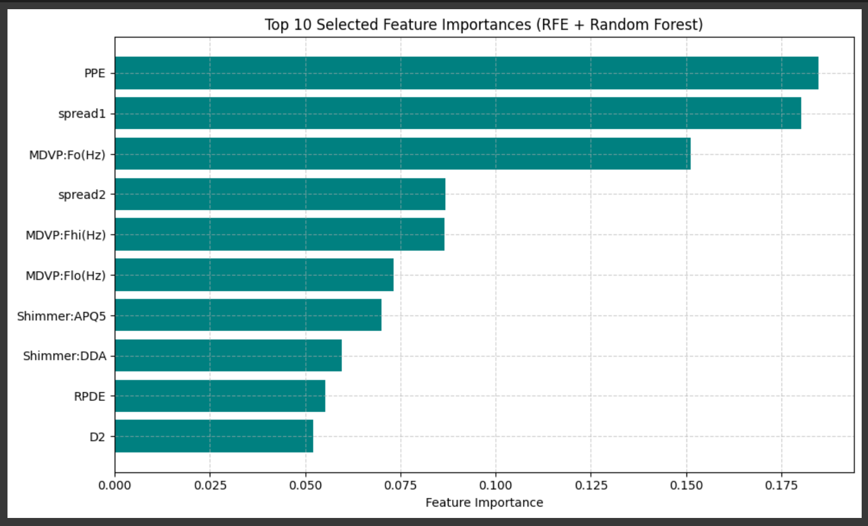
PD Detection using ML Models
Feature Selection and Training with Hyperparameter Tuning:
We have used RFE (Recursive Feature Elimination) for improving Feature Selection.
RFE helps in selecting a subset of the most significant features by recursively eliminating the least important ones.
To improve our models’ performance, we have fine-tuned hyperparameters using Grid Search CV.

Slide 10
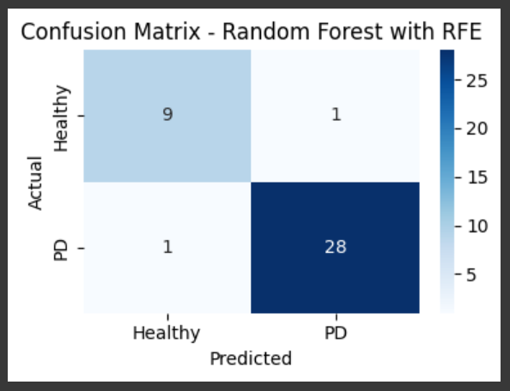
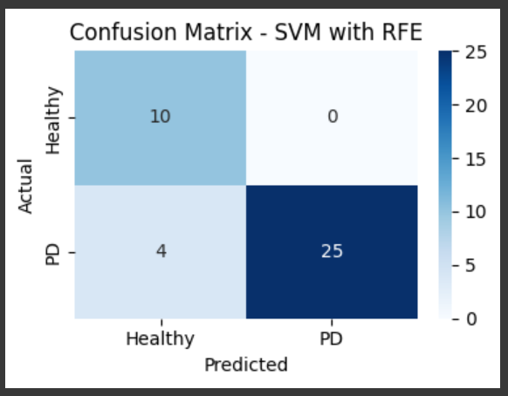
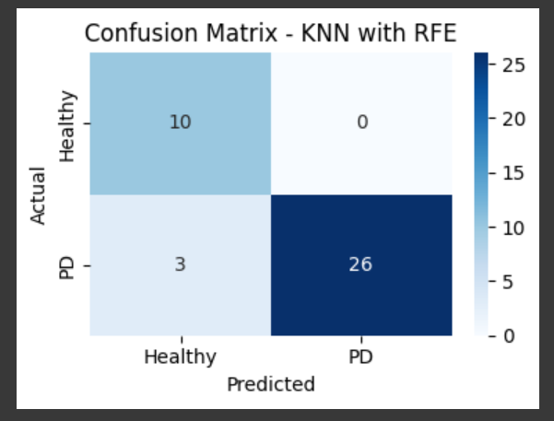
Performance Comparison of ML Models
Confusion Matrix Comparison among Random Forest, SVM, and KNN of SMOTE with RFE Model:
Random Forest Model outperformed with 0.9847 accuracy.

Slide 11
Performance Comparison of ML Models
Comparison of Performance Matrices between SMOTE with RFE and SMOTE without RFE Model
SMOTE with RFE Model | Accuracy | Precision | Sensitivity (Recall) | F1 Score
Random Forest | 0.9487 | 0. 9487 | 0. 9487 | 0. 9487
KNN | 0.9231 | 0.9408 | 0.9231 | 0.9260
SVM | 0.8974 | 0.9267 | 0.8974 | 0.9022
SMOTE without RFE Model | Accuracy | Precision | Sensitivity (Recall) | F1 Score
Random Forest | 0.8974 | 0.9630 | 0.8966 | 0.9286
KNN | 0.9231 | 1.0000 | 0.8966 | 0.9455
SVM | 0.8205 | 0.9583 | 0.7931 | 0.8679

Slide 12
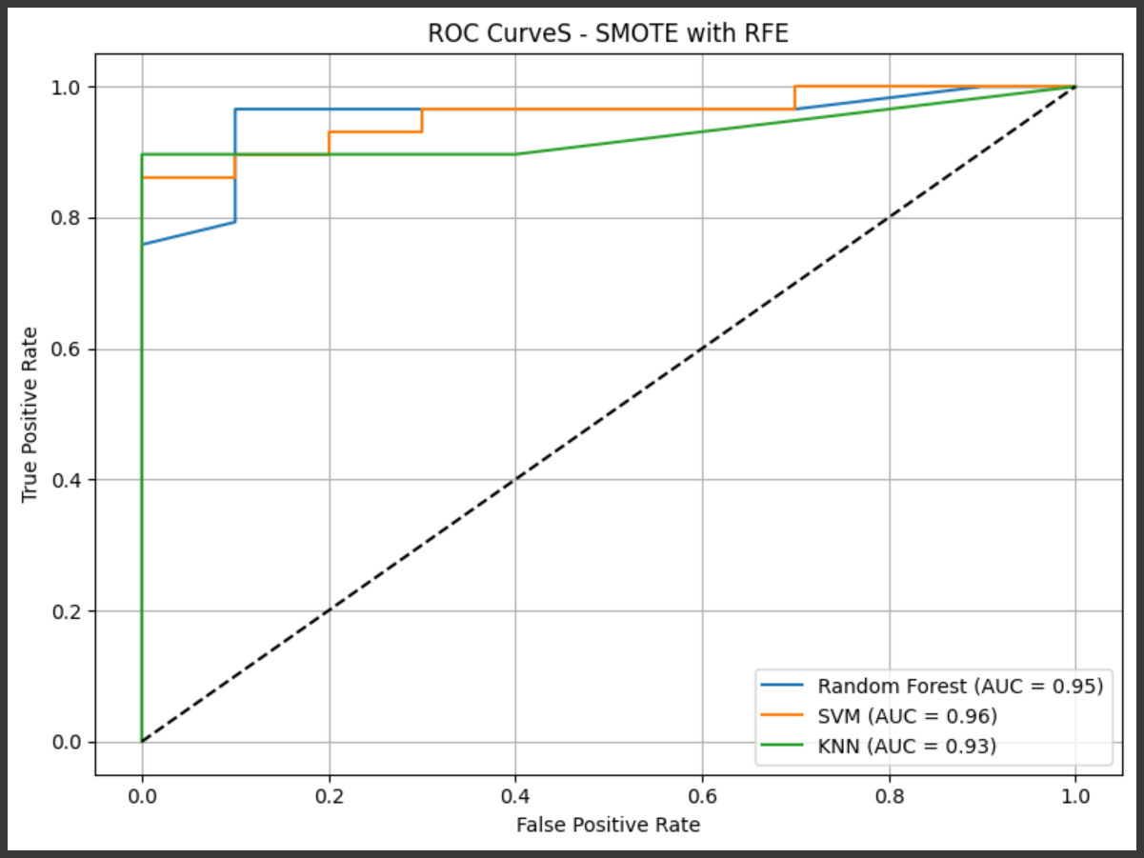
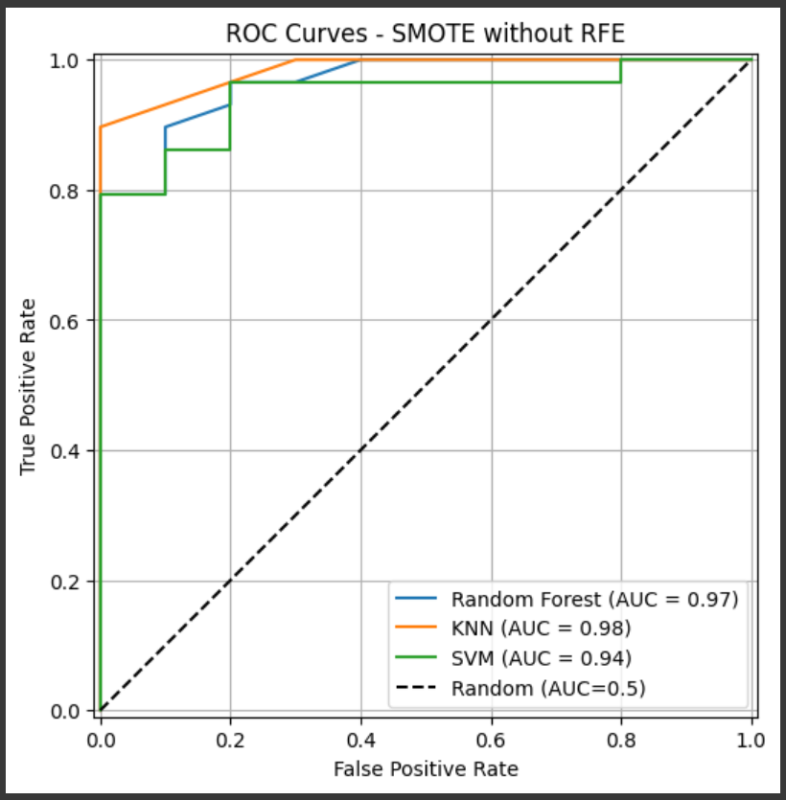
Performance Comparison of ML Models
Comparison of ROC Curve between SMOTE with RFE and SMOTE without RFE Model

Slide 13
Comparison with Literature Benchmarks
Literature | Model(s) Used | Reported Accuracy | Our Proposed Model | Our Accuracy
Tsanas et al., 2012 [6] | SVM, Regression Models | 93.00% | Random Forest (SMOTE + RFE) | 94.87%
Little et al., 2009 [7] | Kernel-based SVM | 91.40% | SVM (SMOTE + RFE) | 90.22%
K. Velu et al., 2025 [8] | Interpretable Feature Ranking IFRX (XGBoost), SVC | 96.61% (IFRX) 90.29% (SVC) | Random Forest (SMOTE + RFE) KNN (SMOTE + RFE) SVM (SMOTE + RFE) | 94.87% 92.30% 90.22%

Slide 14
Conclusion and Future Work
Our study successfully applied multiple machine learning models (Random Forest, SVM, KNN) to Parkinson’s Disease detection using voice features.
Feature selection using RFE and class balancing with SMOTE significantly improved performance.
The Random Forest model achieved the highest accuracy (94.87%), outperforming several established benchmarks.
Our KNN (92.3%) and SVM (90.22%) models also showed competitive results compared to prior work.
In the future, we want to apply CNNs or RNNs to automatically learn features from raw audio data. To further validate the model’s performance and generalizability, we also plan to test it on additional datasets [9].

Slide 15
References:
[1] Ito, Hidefumi. "Symptoms and signs of Parkinson’s disease and other movement disorders. “Deep Brain Stimulation for Neurological Disorders: Theoretical Background and Clinical Application. Cham: Springer International Publishing, 2014. 21-37.
[2] Fang, Congcong, et al. "Cognition deficits in Parkinson’s disease: mechanisms and treatment. “Parkinson’s disease 2020.1 (2020): 2076942.
[3] Ho, Aileen K., et al. "Speech impairment in a large sample of patients with Parkinson’s disease.“ Behavioural neurology 11.3 (1999): 131-137.
[4] K. Velu and N. Jaisankar, "Design of an Early Prediction Model for Parkinson’s Disease Using Machine Learning," IEEE Access, vol. 13, pp. 17457-17472, 2025, doi:
10.1109/ACCESS.2025.3533703.
[5] Little, M. A., McSharry, P. E., Hunter, E. J., Spielman, J., & Ramig, L. O. (2009). Suitability of dysphonia measurements for telemonitoring of Parkinson’s disease. IEEE Transactions on Biomedical Engineering,56(4), 1015-1022. Dataset: https://archive.ics.uci.edu/dataset/174/parkinsons
[6] Tsanas, A., Little, M. A., McSharry, P. E., Spielman, J., & Ramig, L. O. (2012). Novel speech signal processing algorithms for high-accuracy classification of Parkinson's disease. IEEE Transactions on Biomedical Engineering, 59(5), 1264-1271. https://doi.org/10.1109/TBME.2012.2183367
[7] M. A. Little ∗, P. E. McSharry, E. J. Hunter, J. Spielman and L. O. Ramig, "Suitability of Dysphonia Measurements for Telemonitoring of Parkinson's Disease," in IEEE Transactions on Biomedical Engineering, vol. 56, no. 4, pp. 1015-1022, April 2009, doi: 10.1109/TBME.2008.2005954.
[8] K. Velu and N. Jaisankar, "Design of an Early Prediction Model for Parkinson’s Disease Using Machine Learning," IEEE Access, vol. 13, pp. 17457-17472, 2025, doi:10.1109/ACCESS.2025.3533703
[9] Dataset: “Voice Samples for Patients with Parkinson’s Disease and Healthy controls”, https:// doi.org/ 10. 6084/ m9. figsh are. 23849 127

Slide 16


Team Members
Keerthi Kesavan
MS Student in Health Informatics
Department of Applied Computing, Michigan Technological University (MTU)
Ananna Biswas
PhD Student in Computer Engineering,
Dept of Electrical and Computer Engineering, Michigan Technological University (MTU)

Slide 17

Ananna Biswas, anannab@mtu.edu
Website: https://anannabiswas.github.io/
Keerthi Kesavan, kkesavan@mtu.edu

