Slide 1
EXPLORATORY DATA ANALYSIS
From Fundamentals to Advanced Techniques
Anannya Vyas
AI/ML Training Course
2026

Slide 2
Table of Contents
1. Introduction to EDA
2. EDA Philosophy & Anscombe's Quartet
3. Data Types & First Look
4. Distribution Analysis
5. Correlation Analysis
6. Categorical Analysis
7. Best Practices & Pitfalls
8. Tools & Resources
9. Key Takeaways
EDA Presentation | Slide 2

Slide 3
What is Exploratory Data Analysis?
📊 Definition:
Critical process of initial data investigation
🎯 Key Objectives:
🔍 Understand data structure
📈 Identify patterns
🎯 Detect outliers
💡 Generate hypotheses
🧹 Guide preprocessing
EDA Presentation | Slide 3

Slide 4
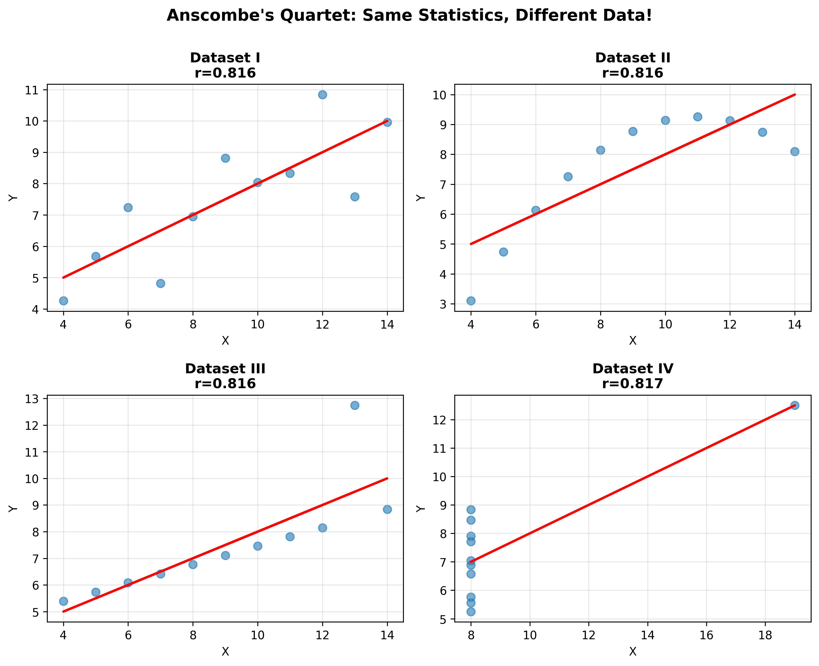
Anscombe's Quartet: Always Visualize!
🔥 Hidden Gem:
All 4 datasets have:
• Same mean
• Same variance
• Same correlation
But COMPLETELY
different distributions!
💡 Never trust
statistics alone!
EDA Presentation | Slide 4

Slide 5
Understanding Data Types
📊 CATEGORICAL (Qualitative):
├─ Nominal: Colors, Gender, Country
├─ Ordinal: Education Level, Ratings
└─ Binary: Yes/No, True/False
📈 NUMERICAL (Quantitative):
├─ Discrete: Count data (0,1,2,3...)
└─ Continuous: Measurements
├─ Interval: Temperature °C
└─ Ratio: Height, Weight
🔥 Don't treat ordinal as nominal - BIG MISTAKE!
EDA Presentation | Slide 5

Slide 6
First Look at Data
The 5-Step Ritual:
1️⃣ Check shape & size
2️⃣ Examine dtypes
3️⃣ Preview rows
4️⃣ Calculate statistics
5️⃣ Find missing values
Dataset: (1000, 8)
Missing: 50
df.shape
df.info()
df.head()
df.describe()
df.isnull().sum()
EDA Presentation | Slide 6

Slide 7
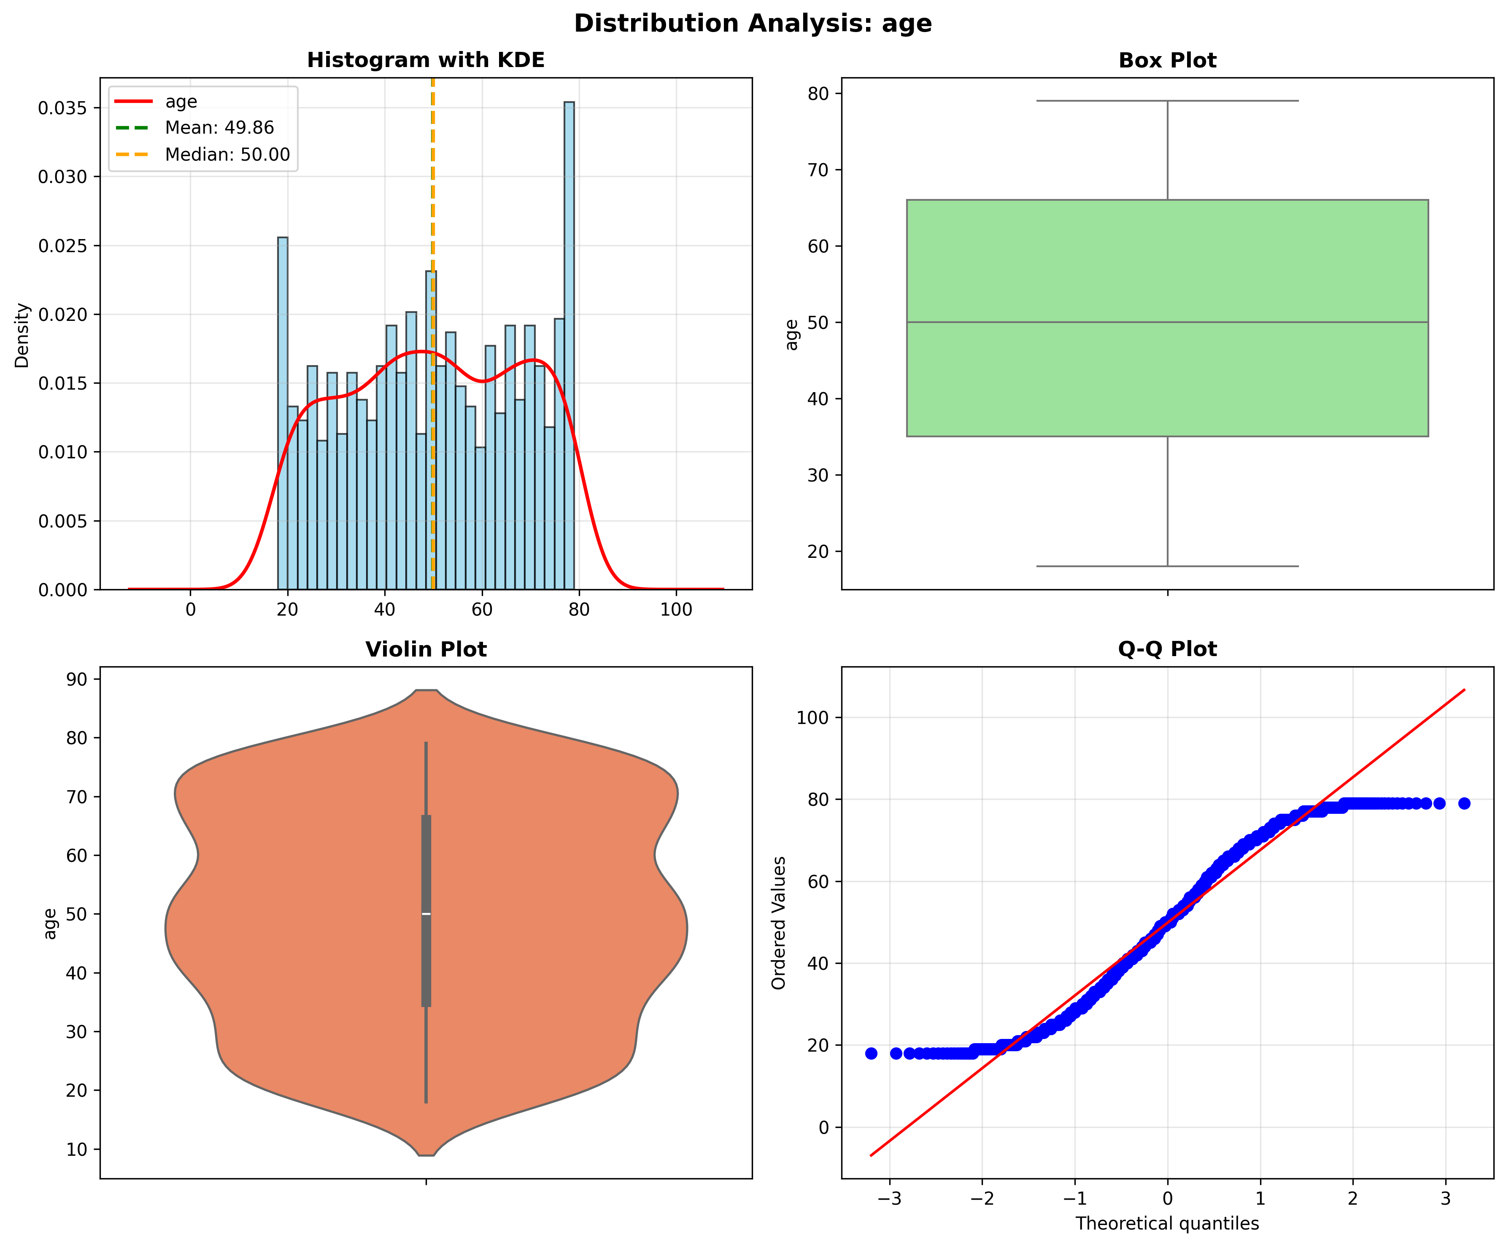
Distribution Analysis
📊 Key Metrics:
Mean: 49.86
Median: 50.00
Std: 18.11
Skew: -0.07
Check for:
• Normality
• Outliers
• Symmetry
EDA Presentation | Slide 7

Slide 8
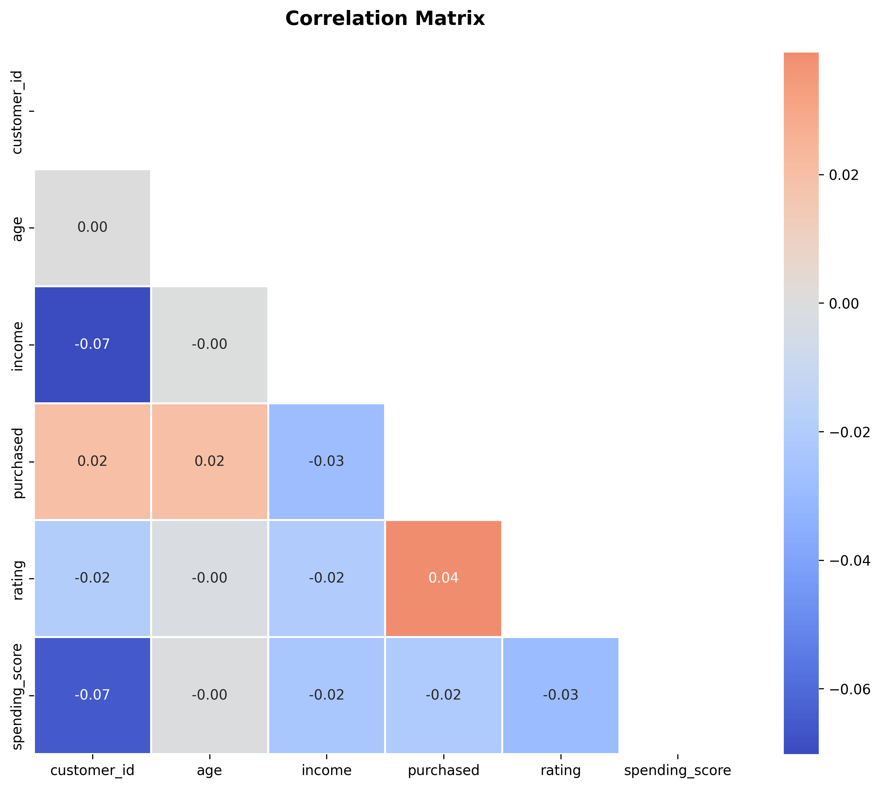
Correlation Analysis
🔗 Types:
• Pearson
(Linear)
• Spearman
(Monotonic)
• Kendall
(Robust)
Use all three!
EDA Presentation | Slide 8

Slide 9
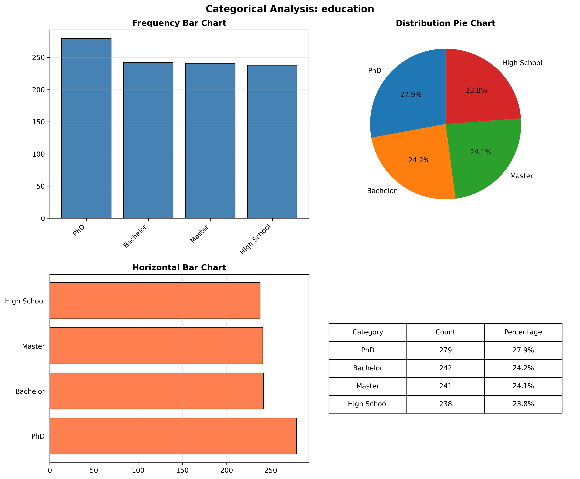
Categorical Analysis
📊 Steps:
1️⃣ Frequencies
2️⃣ Percentages
3️⃣ Mode
4️⃣ Entropy
Categories: 4
Mode: PhD
EDA Presentation | Slide 9

Slide 10
EDA Best Practices
✅ Always visualize first
✅ Use multiple methods
✅ Check assumptions
✅ Document findings
✅ Question anomalies
❌ Don't auto-remove outliers
❌ Don't trust stats alone
❌ Don't ignore missing patterns
❌ Don't skip visualization
EDA Presentation | Slide 10

Slide 11
Automated EDA Tools
🔥 Top Tools:
1️⃣ Pandas Profiling
2️⃣ Sweetviz
3️⃣ AutoViz
4️⃣ D-Tale
5️⃣ DataPrep
All generate HTML reports
with one line of code!
EDA Presentation | Slide 11

Slide 12
Key Takeaways
🎯 THE GOLDEN RULES:
1️⃣ 👁️ ALWAYS VISUALIZE
2️⃣ 🔍 QUESTION EVERYTHING
3️⃣ 📊 USE MULTIPLE METHODS
4️⃣ 📝 DOCUMENT FINDINGS
5️⃣ 🔄 EDA IS ITERATIVE
EDA Presentation | Slide 12

Slide 13
THANK YOU!
Questions?
anannyavyas91@gmail.com

