Slide 1
Machine Learning approaches for Taxonomic Classification

Slide 2
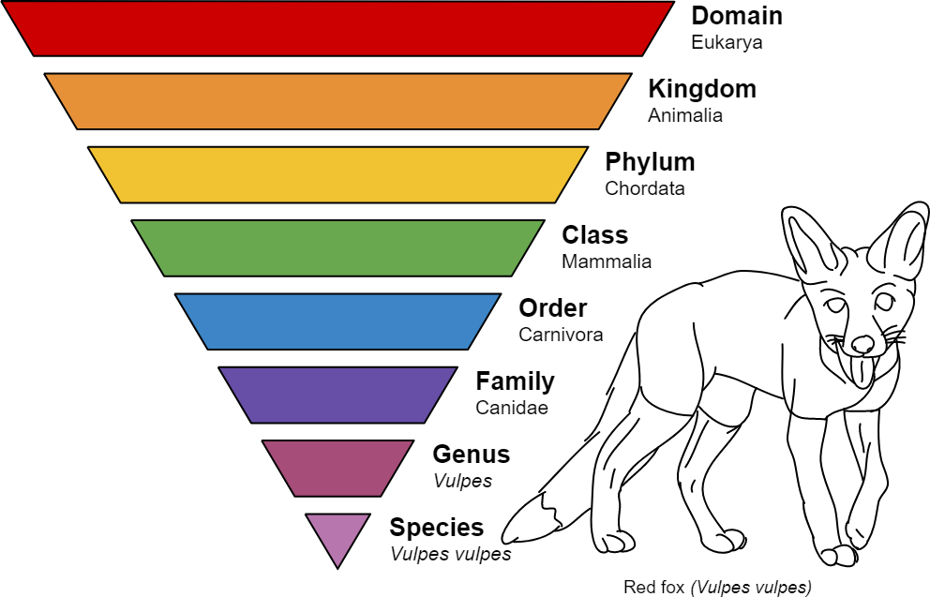
Taxonomic classification
Phylum, Class, and Order level classification achieves >99% accuracy in most of the models due to sequences belonging to lesser categories

Slide 3
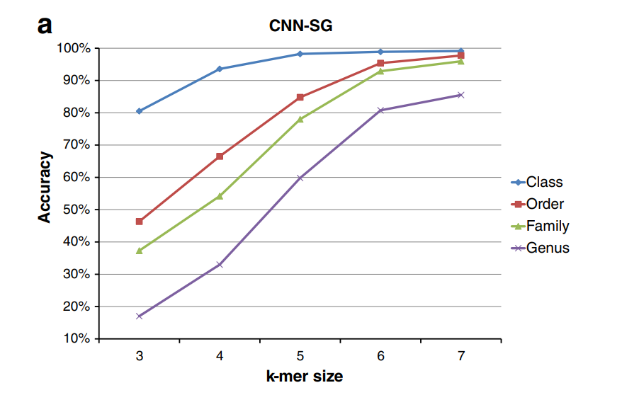

Slide 4
16s Ribosomal RNA
16s rRNA is a ribosomal RNA, Length- 1500bp, 5-10 copies present in genome
There are 9 to 10 variation regions (V1 ~ V10) between the conservative areas. There are different degrees of difference in the families, genera and species of different bacteria, so 16S rRNA can be used as both It is a marker for bacterial classification and can be used as a target molecule for detection and identification of clinical pathogens.

Slide 5
18s Ribosomal RNA
Eukaryotic homologue of 16s rRNA.
Similar to 16S rRNA, 18S rRNA gene has nine variable regions (V1-V9).
full-length 18S rRNA sequences or partial regions (around V2, V4, and V9) of the 18S rRNA gene are useful for the discrimination of samples at both the family and order levels;
V9 has a higher resolution at the genus level;
V4 is the most divergent region in length

Slide 6
Internal Transcribed Spacer Region
ITS is located between the 18S and 5.8S rRNA genes and has a high degree of sequence variation.
Similar to 18S rRNA, ITS is often used in metagenomic analysis. However, 18S rRNA is mainly used for high resolution taxonomic studies of fungi, while the ITS region is mainly used for fungal diversity studies as a fungal barcode marker. Compared to 18S, ITS is more variable and thereby, more suitable as the genetic marker to measure intraspecific genetic diversity.

Slide 7
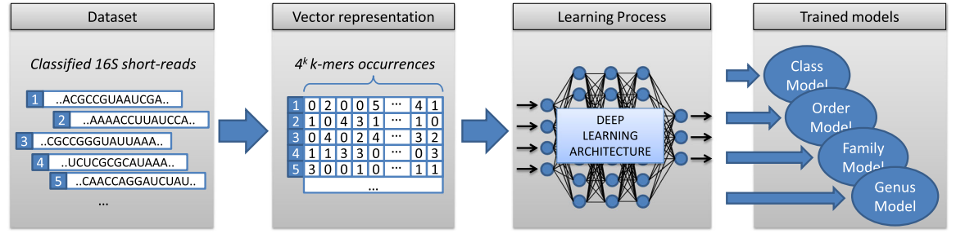
Classification Pipeline

Slide 8
Type of Sequences- Whole Genome Shotgun Sequences vs Amplicon Sequences
Whole Genome Shotgun Sequences | Amplicon Sequences
Contains the whole genome sequence | Contains the 16s rRNA gene sequence with hypervariable regions.
High-throughput | Low-Throughput, faster Turnaround
Simpler, No chimaera formation | Less simple, Chimaera may form during PCR, errors may be introduced during sequencing
Trained models showed lower accuracy | Trained models showed higher accuracy
High cost | Lower cost

Slide 9
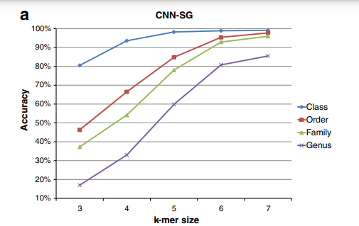
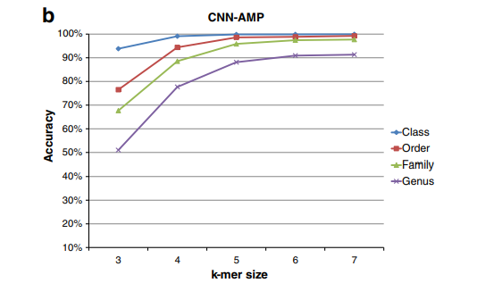

Slide 10
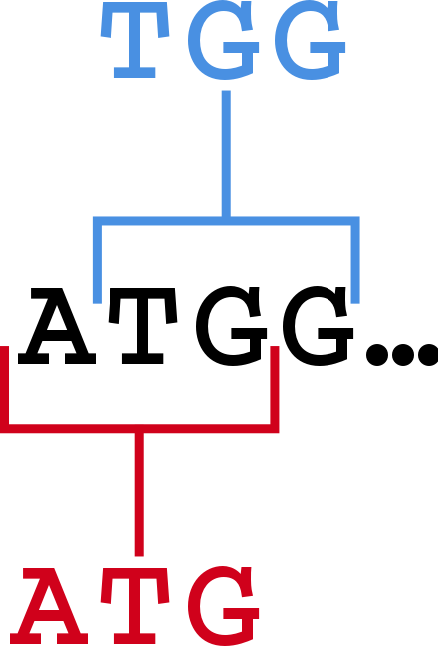
SEQUENCE-REPRESENTATION: K-mers
K- mers are substrings of a given sequence having size k.
Experimentally larger values of K gives larger model accuracy.
However, with increases in k-value, the coordinate space increases exponentially. Thus increasing processing time.
“Law of diminishing returns”
3-mers of ‘ATGG’ Sequence

Slide 11
Classifier Choice
Convolutional Neural Network
CNNs are often used for classification purposes due to their ability of processing raw data .
Systems based on CNNs can recognize specific patterns or objects in the images regardless of their position.
Deep Belief Network
When trained on a set of examples without supervision, a DBN can learn to probabilistically reconstruct its inputs. The layers then act as feature detectors. After this learning step, a DBN can be further trained with supervision to perform classification.
RDP Classifier
RDP classifier is simple to implement and extremely efficient in most of its applications, sequence data classification included. The term naïve is referred to the assumption of independence between data features.

Slide 12
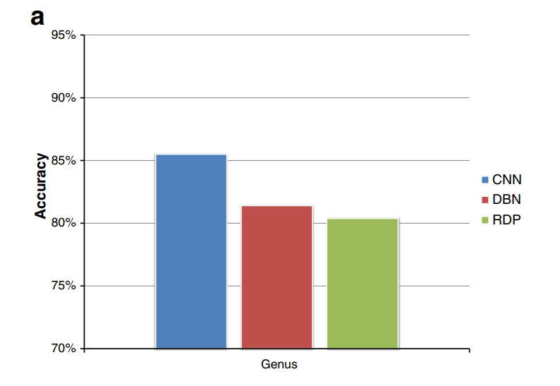
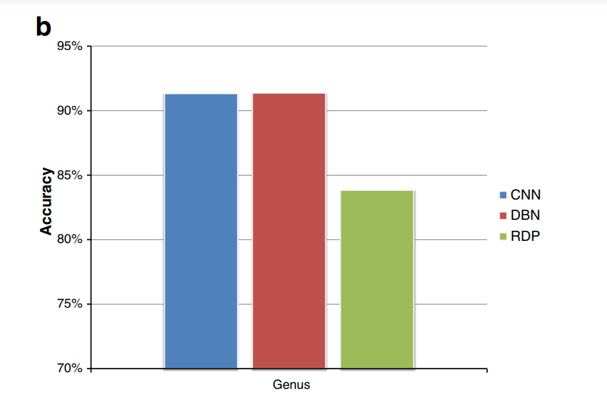
Accuracy validation of CNN, DBN and RDP classifiers, at genus level. Comparison among CNN, DBN and RDP classification algorithms, with respect to (a) SG and (b) AMP datasets

Slide 13
Proposed Improvements
1) Although CNN gives the greatest accuracy( 91% on amplicon sequences), it still loses position dependent information in the sequences. Recurrent neural networks retain these, thus they may have better accuracy.
2) The accuracy is proportional to k-mer value. The experiment used kmax=7. Using more computing power and greater k value, accuracy can be increased to an extent.
3)Since different models capture different aspects of the data, bagging(combination) of different models will give better results as compared to a single standalone model.

Slide 14
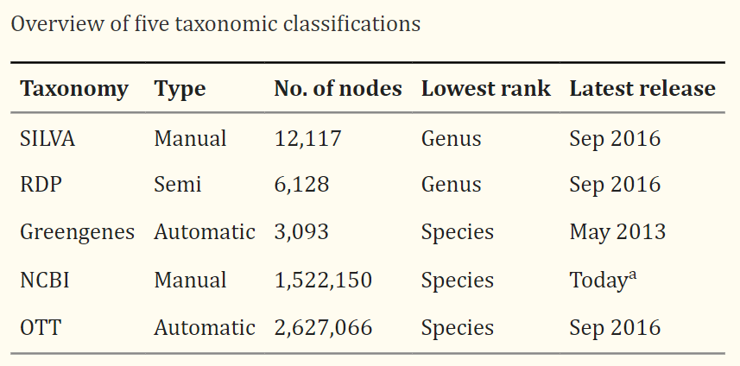

Databases

Slide 15
GRD is a manually-curated 16S rRNA database, in which both the 5' and 3' regions, including the anti-SD sites, have been carefully checked and contaminating sequences have been removed.
>Downloaded 2,275 complete and 5,664 draft genome sequences including the Human Microbiome Project (HMP) genome sequences data from NCBI (2013. Feb)
>Performed similarity analysis with the 16S rRNA gene sequence annotated in Escherichia coli str. K-12 substr. W3110 as reference sequence using GLSEARCH (version 36.3.5e).
>Extracted 16S rRNA candidate sequences with global/local scores ≥ 0 with the E. coli 16S rRNA gene sequence.

Slide 16

The SILVA database contains taxonomic information for the domains of Bacteria, Archaea and Eukarya. It is based primarily on phylogenies for small subunit rRNAs (16S for prokaryotes and 18S for Eukarya).
Taxonomic rank information for Archaea and Bacteria is obtained from Bergey’s Taxonomic Outlines and from the List of Prokaryotic Names with Standing in Nomenclature (LPSN)whereas eukaryotic taxonomy is based on the consensus views of the International Society of Protistologists

Slide 17

The Greengenes taxonomy is dedicated to Bacteria and Archaea. Classification is based on automatic de novo tree construction and rank mapping from other taxonomy sources (mainly NCBI).
Phylogenetic tree is constructed from 16S rRNA sequences that have been obtained from public databases and passed a quality filtering. Sequences are aligned by their characters and secondary structure and then subjected to tree construction with FastTree.
The latest Greengenes database was released on May 2013. Although Greengenes is still included in some metagenomic analyses packages, for example QIIME, it has not been updated since 2013.

Slide 18

The NCBI taxonomy contains the names of all organisms associated with submissions to the NCBI sequence databases. It is manually curated based on current systematic literature, and uses over 150 sources, for example, the Catalog of Life , the Encyclopedia of Life, NameBank and WikiSpecies as well as some specific databases dedicated to particular groups of organisms.
It contains some duplicate names that represent different organisms. Each node has a scientific name and may have some synonyms assigned to it. NCBI taxonomic classification files are updated on a daily basis

