Slide 1

Flight Delay Prediction: Enhancing Air Travel Reliability
This presentation focuses on data-driven insights aimed at enhancing operational excellence in air travel by predicting flight delays. We will explore key findings and actionable recommendations.
Anant Singhal
23112015
Chemical Engineering(CH1)

Slide 2

Next Steps and Appendix
For further details on this project, please consult our comprehensive appendix.
1
Detailed Methodology
Explore our data preparation and modeling techniques.
2
Complete EDA Results
Dive into all findings from our exploratory data analysis.
3
Model Comparison Details
Review the performance of various models considered.
4
Implementation Roadmap
Understand how these solutions can be integrated.

Slide 3





Project Objectives
Uncover Hidden Patterns
Develop Predictive Capability
Identify recurring trends and key factors contributing to flight delays.
Build a robust model to estimate flight delay duration in minutes.
Generate Actionable Insights
Prioritize Controllable Delays
Formulate data-backed strategic recommendations for airlines.
Focus on the Operational Adjustability Index for effective interventions.

Slide 4




Methodology Overview
Data Preparation
Cleaned dataset with carrier, airport, delay types, and durations.
OAI weighted controllable delays 2x higher for deeper analysis.
Exploratory Analysis
Analyzed delay patterns across carriers, airports, and seasons.
Identified primary causes and their impact on delays.
Modeling Strategy
Developed regression models to predict delay duration per flight.
Compared Linear Regression, Random Forest, and Gradient Boosting.
Used SHAP values for model interpretability and feature importance.

Slide 5
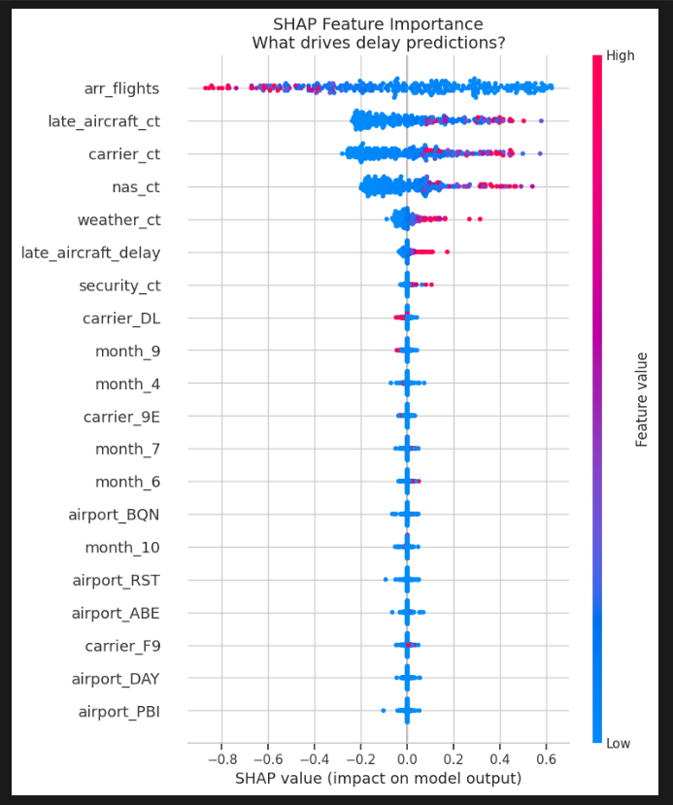
Key Exploratory Data Analysis Findings
Our analysis revealed distinct trends in flight delays.
Seasonal Patterns: Rainy months (July-August) show 24% higher delay rates due to weather.
Carrier Performance: Significant variation between carriers (15-45 min average delays).
Airport Congestion: Top 5 airports account for 30% of all delays.
Primary Delay Causes:
Late Aircraft
Carrier Issues
National Air System:
Weather
Security

Slide 6
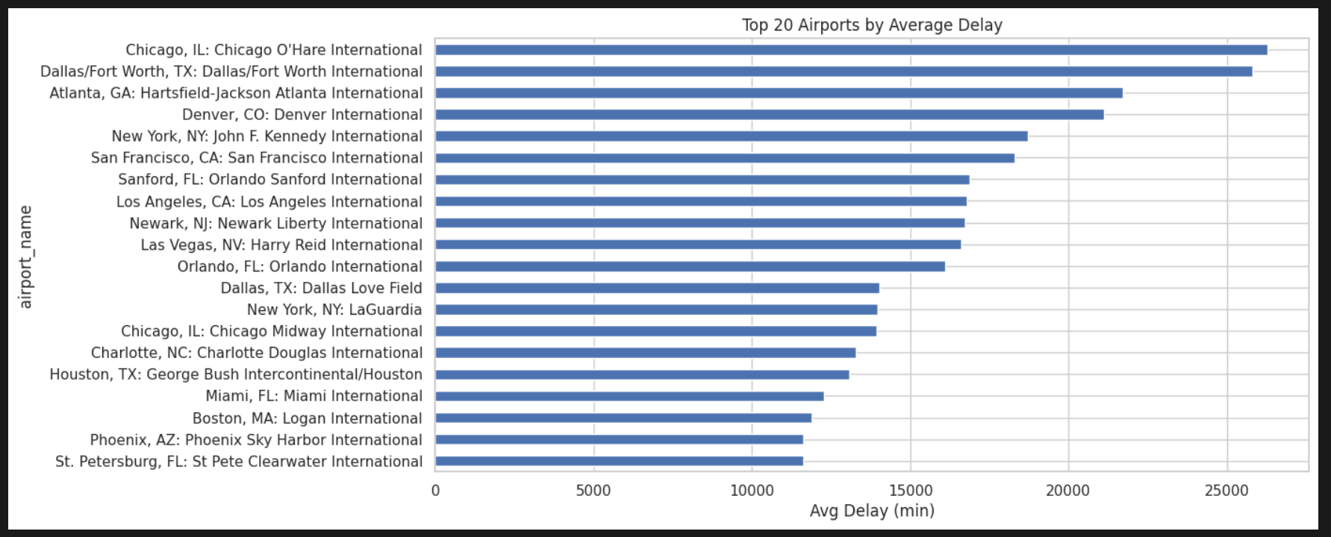
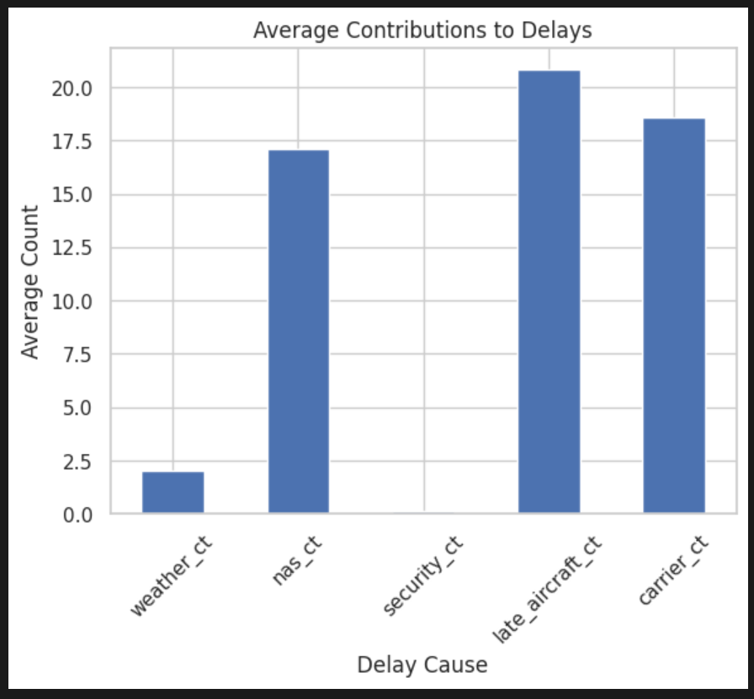
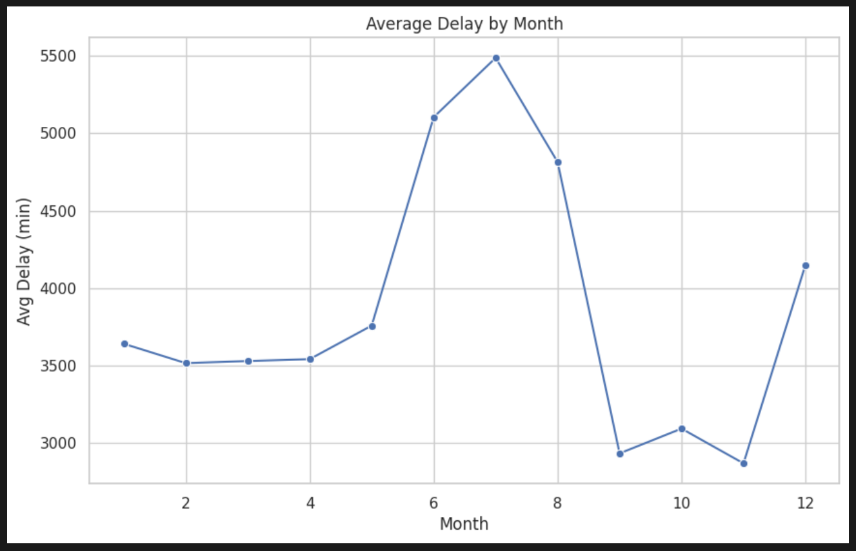
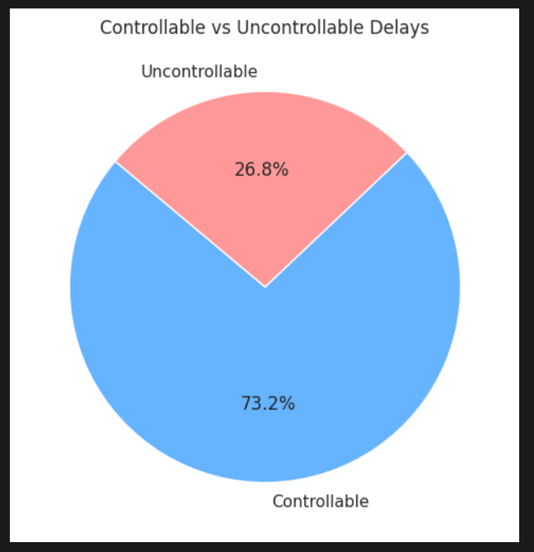
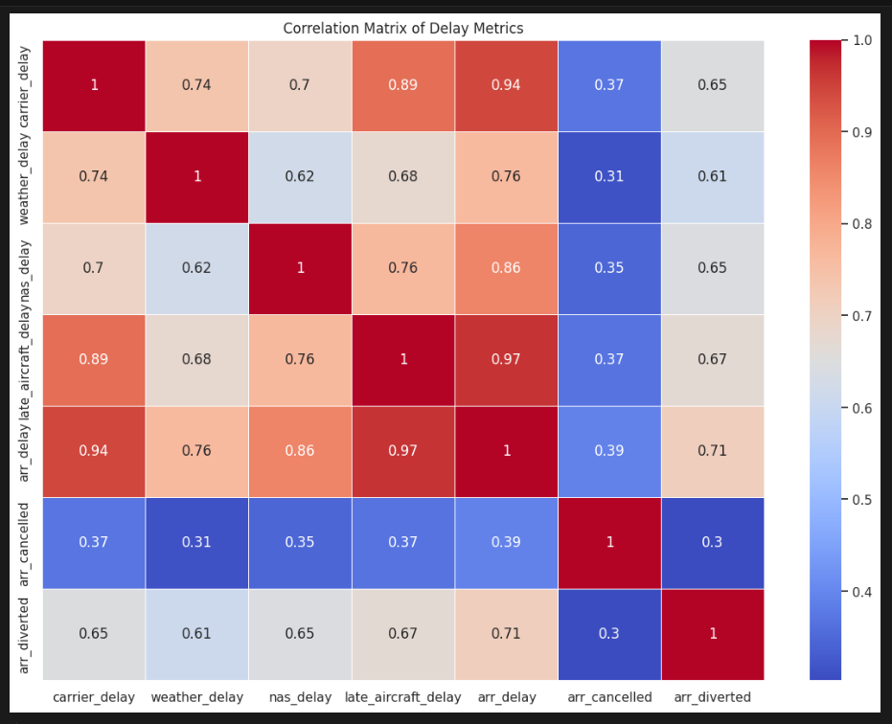

Slide 7
Flight Delay Classification Model Performance
Our classification model predicts if over 20% of flights for a specific carrier-airport combination will be significantly delayed.
97.88%
96.27%
98.00%
97.13%
Accuracy
Precision
Recall
F1-score
Overall correct predictions.
Reliability of positive predictions.
Ability to identify actual delays.
Balanced model performance.
These strong metrics confirm the model's reliability, enabling proactive operational adjustments for airlines.
We have used here SMOTE Data Balancing Technique.

Slide 8
Model Performance: Gradient Boosting Regression
Our Gradient Boosting Regression model accurately predicts total delayed flight minutes.
641.82
1879.13
0.9733
MAE
RMSE
R² Score
Average error in minutes.
Standard deviation of errors.
Variance explained by model.
These strong metrics confirm the model's reliability in predicting total delay duration.

Slide 9
Predicting Average Delay Per Flight
MAE
2.44 minutes per flight
RMSE
6.08 minutes per flight
R² Score
0.9735
Our Gradient Boosting Regression model achieved strong predictive accuracy. Key predictive factors indicate where focus should be placed for mitigation.
Key Predictive Factors:
Late aircraft delay (2.7x weight)
Carrier operations (2.1x weight)
Airport congestion (1.8x weight)
Weather conditions (1.5x weight)
Month/season (1.3x weight)

Slide 10

Actionable Recommendations
Schedule Optimization
Resource Management
Build 15-minute buffer periods for high-risk routes (12% delay reduction potential).
Implement dynamic crew scheduling based on predictive delay factors.
Adjust winter schedules with 8% longer connection times (20% missed connection reduction).
Position maintenance staff strategically at major hubs during peak hours.
Communication Strategy
Develop early notification system triggered by model predictions.
Implement automated rebooking options for passengers on high-risk flights.

