Slide 1
CHATBOT
Submitted by-
Kunwer Manvendra Singh
201010101120021
Subhash Verma
201810101120018
Anant Narayan Singh
201810101120031
Lal Babu Singh
201810101120009

Slide 2
History
The first chatbot ever was developed by MIT professor Joseph Weizenbaum in the 1960s. It was called ELIZA and after that PARRY (1972) was created.

Slide 3
ELIZA
One of the first chatbots designed in 1966
Parodies a therapist rephrasing statements of the user and posing them back as questions
Works by simple parsing and substitution of key words into canned phrases
People get emotionally caught up by ELIZA’s confident replies forgetting that it’s a machine

Slide 4
What is Chatbot?
A chatbot is a conversational agent that interacts with users using natural language.
Started as an attempt to fool humans.
Numerous applications of chatbots such as Customer Service, call centres etc

Slide 5
Why do we need Chatbot?
Widespread use of personal machines
Better Human Computer Interaction
“To express their interest, wishes, or queries directly and naturally, by speaking, typing, and pointing”.
Chatbot can be used to assist users or consumers for a specific task, whenever they want. And as chatbot do not get tired or bored, hence can be employed to provide customer service round the clock.

Slide 6
Why Chatbot?
Bots are lot easier to install than mobile apps.
Bots are easily distributed.
Quality mobile apps are more expensive to build , maintain and deploy.
Moving complexity to the cloud reduces the users cognitive role

Slide 7
How do Chatbot work?
Don’t have a good understanding of conversation
Are based on pattern matching
Chatbots have a set of input and output rules
Recognize cue words from user and responds with a pre-calculated response
For e.g.:- Human: “I am feeling very worried today.”
Chatbot: “Why are you feeling worried lately?”
Other chatbots learn through user interactions

Slide 8
How Do Chatbot works?
Human Interface
Cases
Module
Management

Slide 9
Why we should use chatbot?
Chatbots Simplify Things
Chatbots Talk the Talk
Chatbots Are Always There For Us
Chatbots Make Things Better
Chatbots Convert Visitors Into Customers
Chatbots Build Brand Trust
Available anytime.
Eliminate the need for a live representative.

Slide 10
Types of chatbot
Simple Chatbot
Advance Chatbot

Slide 11
Simple Chatbot
Simple chatbots respond to pre-written keywords or commands programmed by a developer. These bots are simple and limited when it comes to communication. For example, if a website visitor were to ask a bot a question, or type in words that didn’t hit any of those specific keywords or phrases the bot was programmed to recognize, the bot would fail to understand.

Slide 12
Advance Chatbot
Advanced chatbots use AI (Artificial Intelligence) when communicating with online visitors. This allows them to understand basic language and communication and respond with multiple suggestions, without the need of pre-programmed keywords or phrases being entered.

Slide 13
Advantage of chatbot
Gather Customer Insights. Chatbots can help you gather precious data from your customers by interacting with them.
Increase Sales.
Available 24/7.
Save Money.
Improve Customer Satisfaction.

Slide 14
Disadvantages of Chatbot
Lack Emotions
Require Maintenance
Difficult to Create
Made to Handle First-Level Questions

Slide 15
Examples of Chatbot
Google Assistant
Alexa
Siri
Cortana
Alice

Slide 16
Technology
Html
Java Script
CSS
Other
Python
Amazon lex etc.

Slide 17
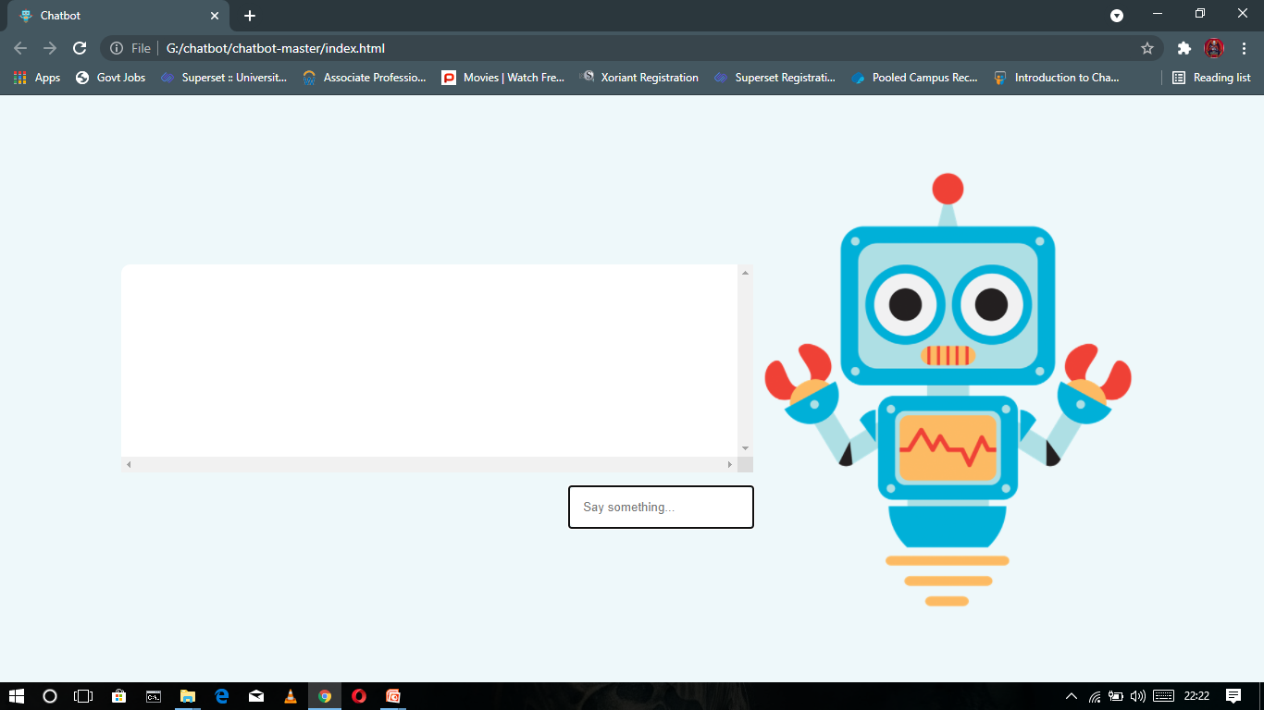
Project

Slide 18
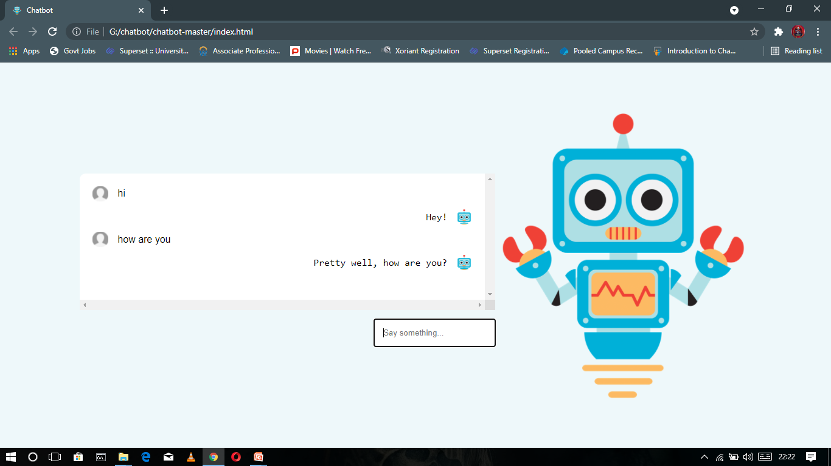
Output

Slide 19
THANK YOU

