Slide 1
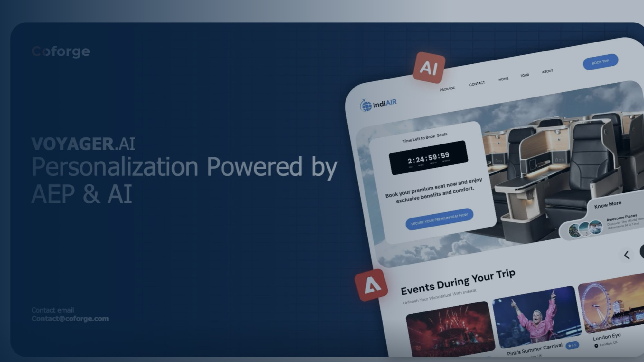
ALL-HANDS SESSION · EXPERIENCE TEAM
VOYAGER.AI
Coforge's first Adobe-badged solution — the story, the architecture, and how 1,800 of us take it to market.
SANDEEP UPPAL
ADOBE ARCHITECT
ANANT
30 MINUTES · 7 CHAPTERS
1,800 EXPERIENCE TEAM
ADOBE RAPID DEPLOYMENT SOLUTION
Joint session · Sandeep Uppal × Adobe Architect × Anant
contact@coforge.com
Notes:
Open the joint session. Introduce all three speakers and the colour code up front: coral = Sandeep, blue = Adobe, teal = Anant. Every slide shows whose it is, top-right, so handoffs are clean. Set the frame in one line: 'Thirty minutes, seven chapters, three voices — you'll leave knowing what this is, why Adobe put their name on it, and exactly how you plug in.' Thirty minutes is fully programmed with no separate Q&A window, so keep to the clock on the top-right of every slide.

Slide 2






AGENDA 01 · WHY IT MATTERS
SANDEEP UPPAL · 3 MIN
Why Voyager.AI matters
THE MARKET NEED
WHY IT MATTERS FOR COFORGE
Airlines know everything about you — and can act on almost none of it.
Strategic relevance
Customer intelligence and real-time personalisation is exactly where Adobe's platform and our domain depth overlap.
A Platinum flyer's cancellation alert is identical to the promo-fare seat behind her
A repeatable asset
This is not one more project. It is an accelerator we can sell again and again across the airline sector.
Rich data sits in four systems that were never built to talk in real time
The opportunity
Segments of millions, sent hours late — personalisation in name only
A credible entry into a high-value CX conversation with every airline already running Adobe.
VOYAGER.AI ALL-HANDS · COFORGE × ADOBE
01 / 07
Notes:
Three minutes, so lead with the story, not the slide. Open on Gate 42 — the Platinum passenger whose cancellation alert is identical to the cheapest seat on the aircraft. Left column is the market pain; right column is why it is ours to win. Land the right-hand 'strategic relevance' card: this is where Adobe's platform and Coforge's airline domain meet. Hand to yourself for the next slide — you keep the mic through chapter two.

Slide 3




AGENDA 02 · THE SOLUTION
SANDEEP UPPAL · 5 MIN
What Voyager.AI is
The proposition: an AI-powered accelerator that lets an airline run real-time, one-to-one personalisation at scale — prebuilt on Adobe Experience Platform.
Target industries
Key use cases
Business outcomes
Airlines — the primary, proven market
VIP Disruption Care — real-time recovery
50% faster personalisation rollout
Adjacent travel: hotels, cruise, rail, OTAs
Smart Seat Upgrade — known + unknown stitched
+20% retention via predictive offers
The pattern extends to any data-rich CX sector
Loyalty, churn and next-best-offer journeys
40% more accurate targeting
VOYAGER.AI ALL-HANDS · COFORGE × ADOBE
02 / 07
Notes:
Five minutes and four things to land: the proposition (top banner), then industries, use cases and outcomes across the three columns. Spend most of the time in the middle column — the two named journeys are the concrete proof and they set up Anant's architecture walkthrough later. Say you'll show the disruption journey in more detail during the walkthrough. Outcome numbers come from the Voyager solution deck — confirm them before the session.

Slide 4



AGENDA 03 · THE ADOBE VIEW
ADOBE ARCHITECT · 5 MIN
Adobe perspective & solution badging
WHAT AN ADOBE RAPID DEPLOYMENT SOLUTION IS
Ecosystem alignment
It runs on Adobe Experience Platform, Journey Optimizer, CJA, AEM and Target — deepening, not bypassing, the customer's Adobe investment.
A predefined service package that simplifies and speeds up implementing one or more Adobe products — using consistent configuration patterns and repeatable deployment steps.
The validation process
Adobe experts review the architecture, the configuration patterns and the outcomes before anything earns the designation.
Verified technically by Adobe experts. Market-tested. Published on Adobe Exchange.
Why the badge matters
Coforge's first — for airline customer intelligence & personalisation.
For the customer, assurance. For Coforge, a listing on Adobe Exchange and Adobe sellers who can now co-sell our solution.
VOYAGER.AI ALL-HANDS · COFORGE × ADOBE
03 / 07
Notes:
This chapter belongs to the Adobe Architect — the slide is built to support their voice, not replace it. Left panel is Adobe's own definition of a Rapid Deployment Solution, quoted accurately. Right panel walks ecosystem fit, the validation process, and why the badge is worth having. Adobe should feel free to reframe any of it. The honest, powerful point for this room: Adobe looked under the hood and is willing to stand next to the solution in front of a customer.

Slide 5





AGENDA 04 · UNDER THE HOOD
ANANT + ADOBE ARCHITECT · 7 MIN
Architecture & solution walkthrough
DATA SOURCES
ADOBE EXPERIENCE PLATFORM
AI ORCHESTRATION
ACTIVATION
PSS / Sabre — bookings, PNRs, fares
Real-Time CDP
Propensity: conversion & churn
Journey Optimizer orchestration
Web & app behaviour
›
Unified traveller profile
›
Agentic identity stitching
›
Web · app · email · SMS · push
Loyalty & tier data
Identity — known + unknown
GenAI content — xTender.AI
Social & offline
Live operations & disruption
AI-enhanced airline schemas
Next-best-offer decisioning
Measured in CJA, closed loop
ADOBE COMPONENTS
Scales to millions of profiles in real time. → live use-case demo
Experience Platform · Real-Time CDP · Journey Optimizer · Customer Journey Analytics · AEM · Target
VOYAGER.AI ALL-HANDS · COFORGE × ADOBE
04 / 07
Notes:
Seven minutes — the longest chapter, shared by Anant and the Adobe Architect. Anant drives the flow left to right; Adobe confirms the platform components underneath. Read it as one sentence: data comes in on the left, becomes a single real-time profile in AEP, AI decides who-what-when in the middle, and it activates everywhere on the right — measured and closed-loop. Leave ~2 minutes for the live use-case demo (VIP Disruption Care is the strongest). If the demo environment is shaky, keep it to the disruption journey only.

Slide 6


AGENDA 05 · TAKING IT TO MARKET
SANDEEP UPPAL · 5 MIN
How Voyager.AI is sold
Buyer personas
Customer triggers
Chief Customer / Loyalty Officer
A stalled or costly Adobe rollout
VP Digital & E-commerce
Disruption / IROPS pain in the press
Head of CRM / Personalisation
Loyalty churn or flat ancillary revenue
Discovery questions
Positioning
“How fast can you act on a disruption?”
Not a project — a prebuilt accelerator
“Can you tell known from unknown?”
Adobe-validated, on Adobe Exchange
“How long is a new campaign today?”
Weeks-to-value, not quarters
Spotting the opportunity: any airline account already on Adobe, with a disruption, loyalty or personalisation problem, is a Voyager conversation.
VOYAGER.AI ALL-HANDS · COFORGE × ADOBE
05 / 07
Notes:
Five minutes of pure enablement — this is what the Experience team most needs to walk away with. The four quadrants are who buys, when they buy, what to ask, and how to frame it. The bottom strip is the opportunity-identification cue: an Adobe airline account plus a CX pain equals a lead. Sales specifics — personas and triggers — should be validated with the Voyager go-to-market owner before this is presented widely; treat what's on the slide as a strong starting point.

Slide 7





AGENDA 06 · YOUR TURN
ANANT + SANDEEP UPPAL · 3 MIN
How the Experience team can participate
1
2
3
4
5
Get enabled
Run the demos
Bring your industry
Sharpen delivery
Nominate a customer
Complete the Voyager.AI enablement path and the Adobe credentials that back it.
Learn the two flagship journeys and be able to demo them live in a customer room.
Adapt the pattern to your sector — banking, insurance, retail, healthcare, travel.
Build the AEP, AJO and AI skills that turn the accelerator into a shipped outcome.
Know an account that fits? Put it forward — that is how the pipeline starts.
You don't need permission to start. Every one of these is open to all 1,800 of us from tomorrow.
VOYAGER.AI ALL-HANDS · COFORGE × ADOBE
06 / 07
Notes:
Three minutes, shared by Anant and Sandeep — the energy peak of the session. This is the ask to a very large room, so keep it concrete: five specific ways to plug in, all open from tomorrow. Stress 'bring your industry' and 'nominate a customer' — those two turn 1,800 listeners into a pipeline. Have the enablement link and the nomination route ready to show on the next slide. Name the owner or channel for nominations out loud before you move on.

Slide 8
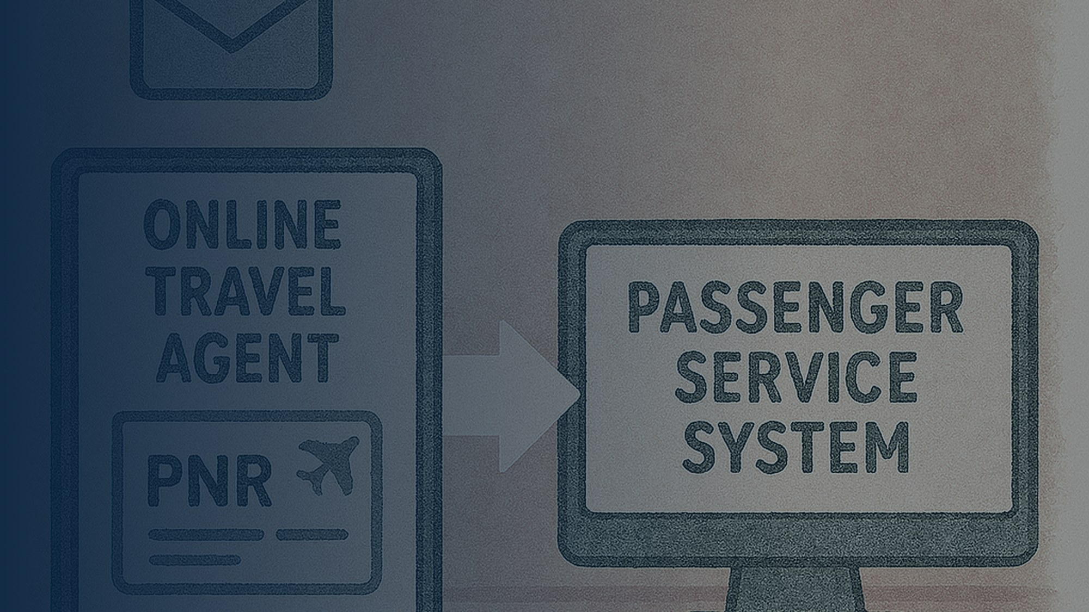



AGENDA 07 · CALL TO ACTION
SANDEEP UPPAL + ADOBE ARCHITECT + ANANT · 2 MIN
Voyager was somebody's idea before it was Coforge's first badge.
Next steps
Enablement material
Nominate a customer
Take the enablement path and get Voyager-ready this quarter.
Deck, demo scripts and playbook — on the Voyager.AI hub.
One account that fits. That is all it takes to start a pursuit.
Thank you.
Coforge × Adobe · Voyager.AI is live on Adobe Exchange · contact@coforge.com
VOYAGER.AI ALL-HANDS · COFORGE × ADOBE
07 / 07
Notes:
Two minutes, all three speakers. Keep it tight and shared — a sentence each works well. Three asks, deliberately small: get enabled, grab the material, nominate one customer. Point to exactly where the enablement hub lives and who receives nominations. Close by handing to the Adobe Architect for a final line — their presence on the podium is the endorsement. Then end on time.

