Slide 1
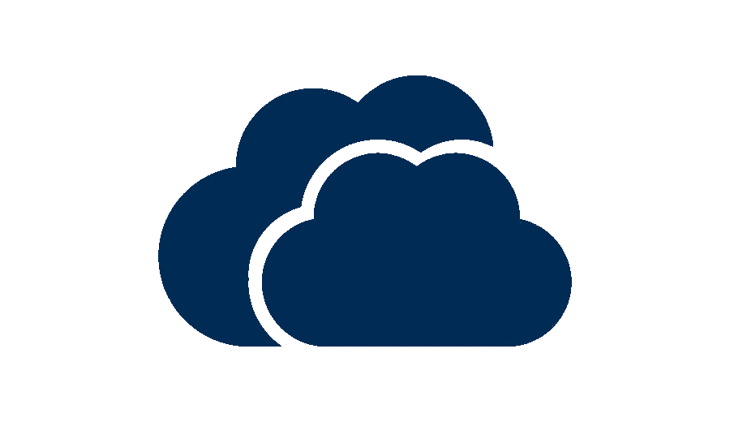
Cloud Computing
CLOUD COMPUTING
Prepared By
Anant Jain
MCA – V Sem
UCCS & IT UOR

Slide 2
INTRODUCTION
Cloud Computing provides us a means by which we can access the application and computing resources as utilities, over the Internet.
With Cloud Computing users can access digital resources via the internet from anywhere for as long as they need without worrying about any maintenance or management of actual resources.

Slide 3
What is Cloud?
The term “Cloud” refers to a Network or Internet. In other words, we can say that Cloud is something which is present at “remote”location.
Cloud can provide services over network, i.e. on public network or on private networks.
Applications such as e-mail, online video streaming, customer relationship management (CRM) all run in cloud.

Slide 4
What is Cloud Computing?
Cloud Computing refers to manipulating, configuring, and accessing the applications, and computing resources online. It offers online data storage, infrastructure and application.
Cloud Computing is both a combination of software and hardware based computing resources delivered as a network service.

Slide 5
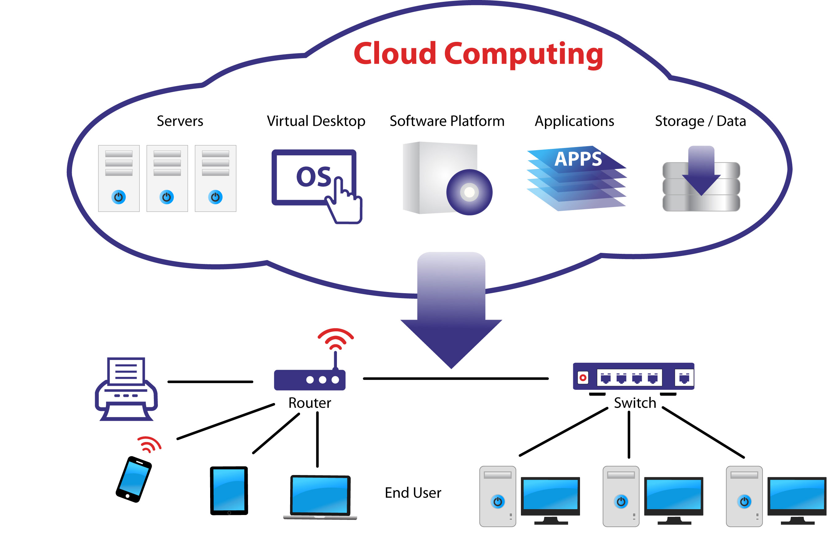
Cloud Computing Architecture

Slide 6
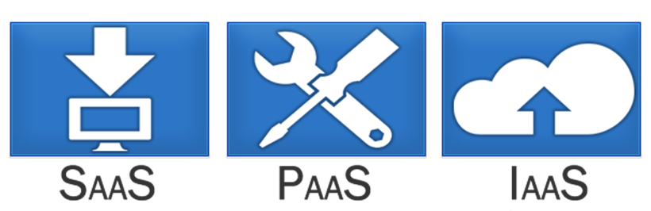
Service Models
“Service Models” are the reference models on which the Cloud Computing is based.

Slide 7
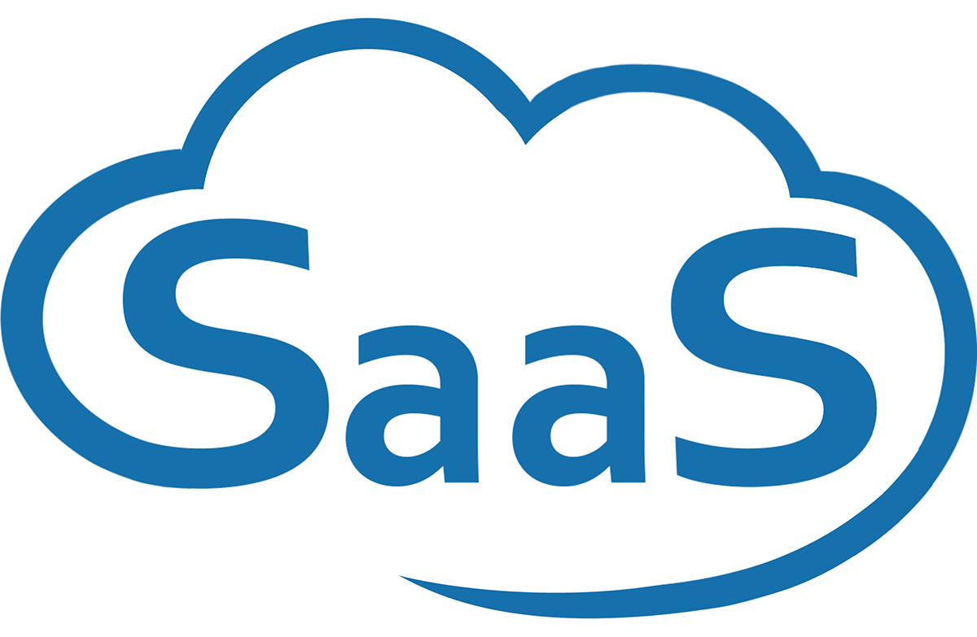
1. Software as a Service
Cloud Providers leases applications or softwares which are owned by them to its client.
Examples: Gmail, Office 365, Google docs.

Slide 8
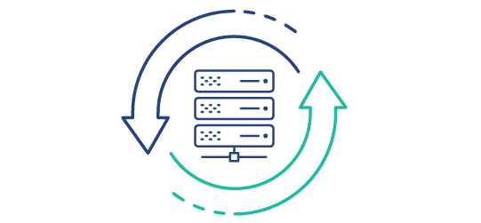
2. Platform as a Service
The Cloud Provider gives the ability to the customer to deploy customer crated apps using programming languages, tools etc that are provided by the Cloud Provider.
Examples: Google App Engine, Heroku, Git Hub pages.

Slide 9

3. Infrastructure as a Service
Provides virtualized computing resources over the Internet.
Abstract the user from the physical machine.
Ex. AWS, Google Cloud Platform, Microsoft Azure.

Slide 10
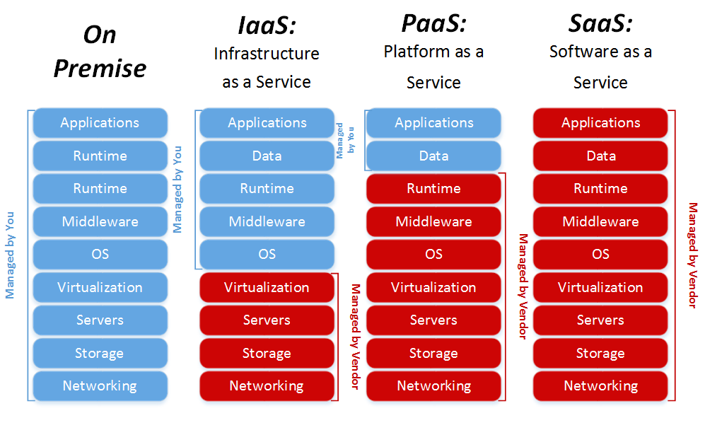
IaaS v/s PaaS v/s SaaS

Slide 11
Deployment Models
Deployment models define the type of access to the cloud, i.e. how the cloud is located?
Cloud can have any of the three type of access:
  Public
  Private
  Hybrid

Slide 12
1. Public Cloud
A service provider makes resources, such as applications and storage, available to the general public over the Internet.
Easy and inexpensive set-up because hardware, application and bandwidth costs are covered by the provider.
No wasted resources because you pay for what you use.

Slide 13

2. Private Cloud
Offers hosted services to a limited number of people behind firewall, so it minimizes the security concerns.
Private cloud gives companies direct control over their data.

Slide 14
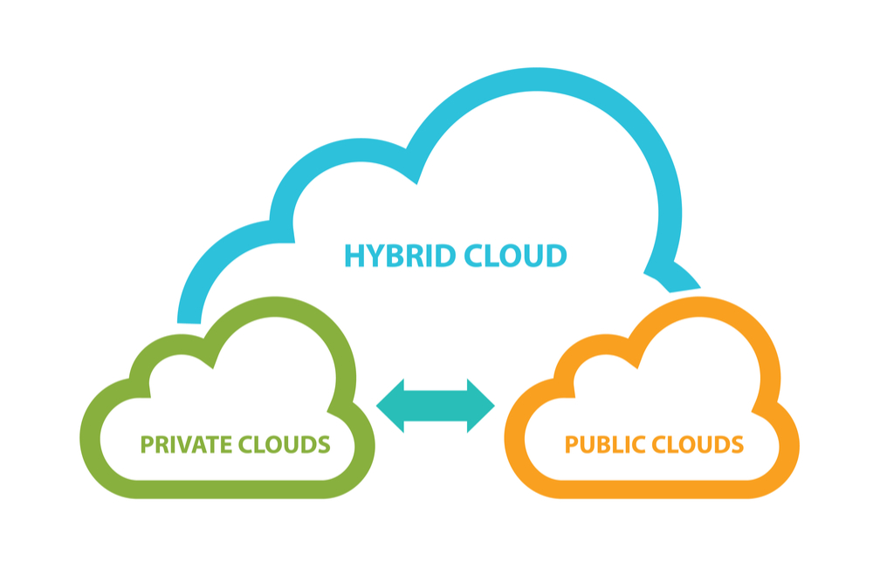
3. Hybrid Cloud
A cloud computing environment which uses a mix of on-premises, private cloud and third-party, public cloud services.

Slide 15






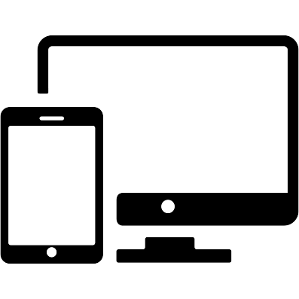
Advantages of Cloud Computing
High Performance
Lower hardware cost
Reduced Software Cost
Instant software update
High Scalability
Universal Access
Device Independence

Slide 16
Disadvantages
Requires a constant Internet connection
Does not work well with low-speed connections Features might be limited
Can be slow
Stored data can be lost
Stored data might not be secure
Privacy Issues

Slide 17
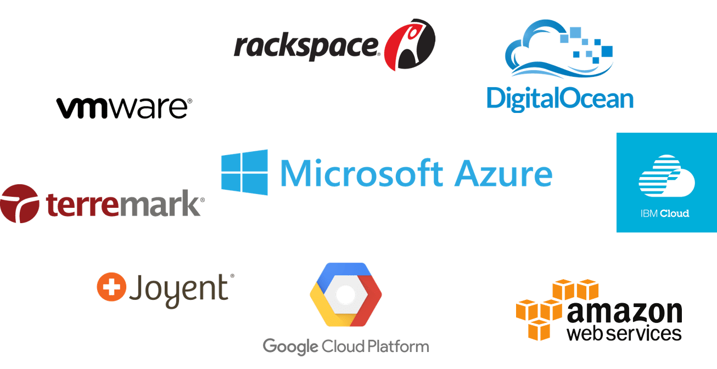
Popular Cloud Service Providers

Slide 18
Thank you…

