Slide 1
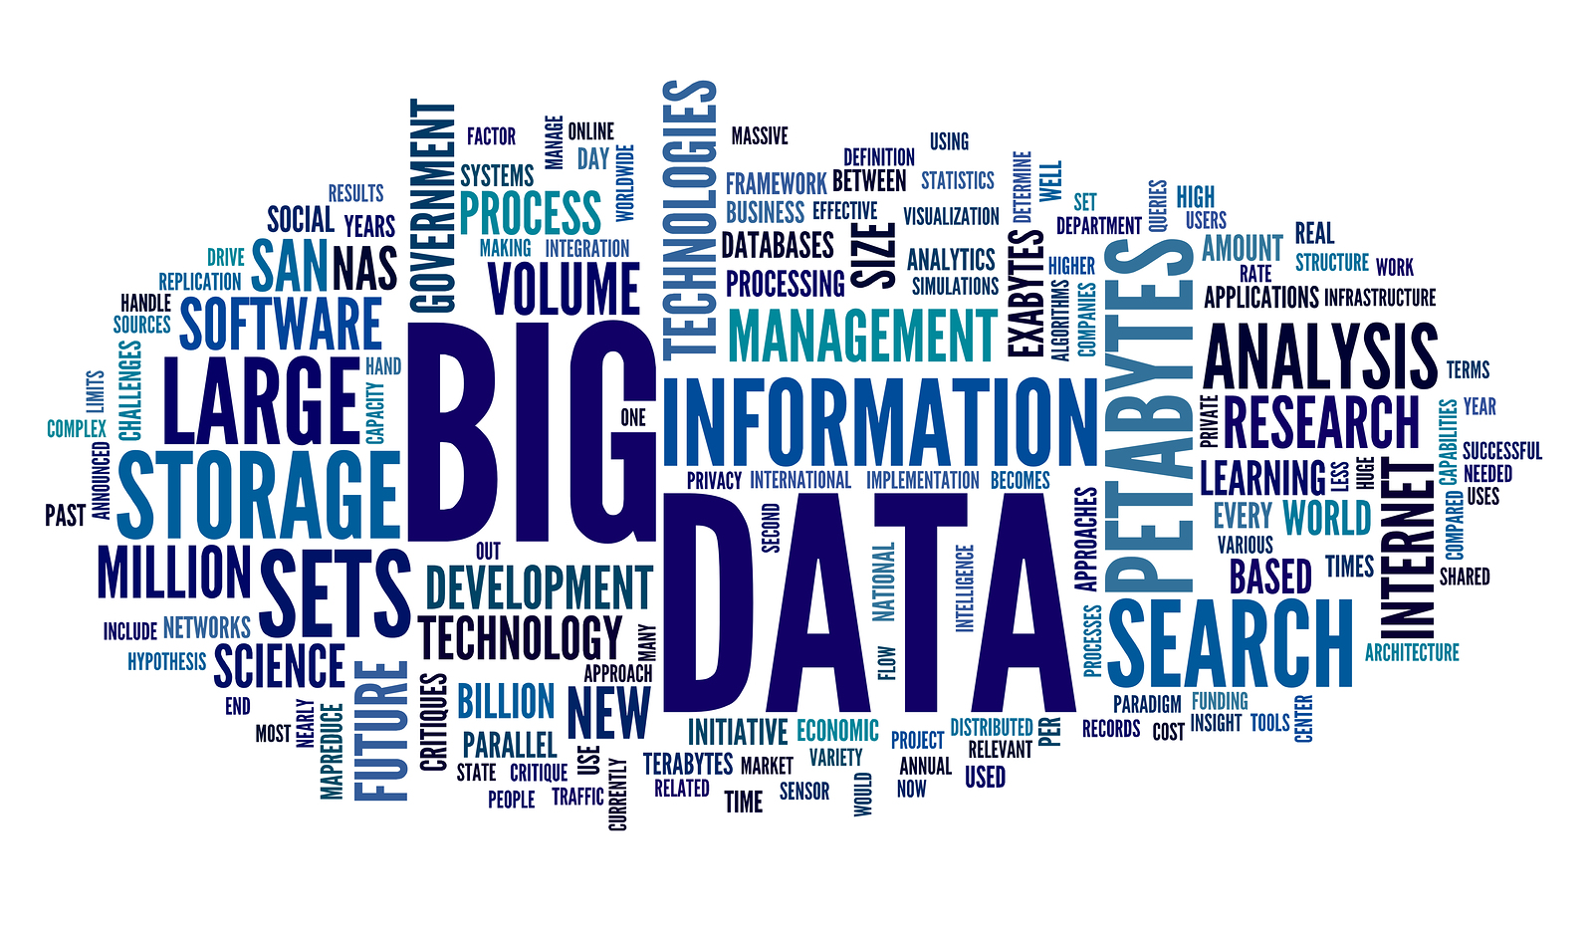
BIG DATA
Prepared By
Anant Jain
MCA V Sem
UCCS&IT UOR

Slide 2
Content
Introduction
What is Big Data
Why Big Data
Characteristic of Big Data
Big data tools
Types of technology
Storing,selecting and processing of Big Data
Data generation points
Application
Impact on IT
Potential Value

Slide 3
Introduction
Big data burst upon the scene in the first decade of the 21st century.
The first organizations to embrace it were online and startup firms. Firms like Google, eBay, LinkedIn, and Facebook were built around big data from the beginning.
Like many new information technologies, big data can bring about dramatic cost reductions, substantial improvements in the time required to perform a computing task, or new product and service offerings.

Slide 4
What is BIG DATA
"Big data" is a field that treats ways to analyze, systematically extract information from, or otherwise deal with data sets that are too large or complex to be dealt with by traditional data-processing application software.

Slide 5
What is BIG DATA
Big Data is similar to ‘Data’, but bigger in size.
Having data bigger in size it requires different approaches : Techniques, Tools and Architecture.
An aim to solve new problems or old problems in a better way.
Big Data generates value from the storage and processing of very large quantities of digital information that cannot be analyzed with traditional computing techniques.

Slide 6
WHY BIG DATA
Cost reduction.
Fast Processing.
Faster, better decision making.
New products and services.
Competitive Advantage.

Slide 7
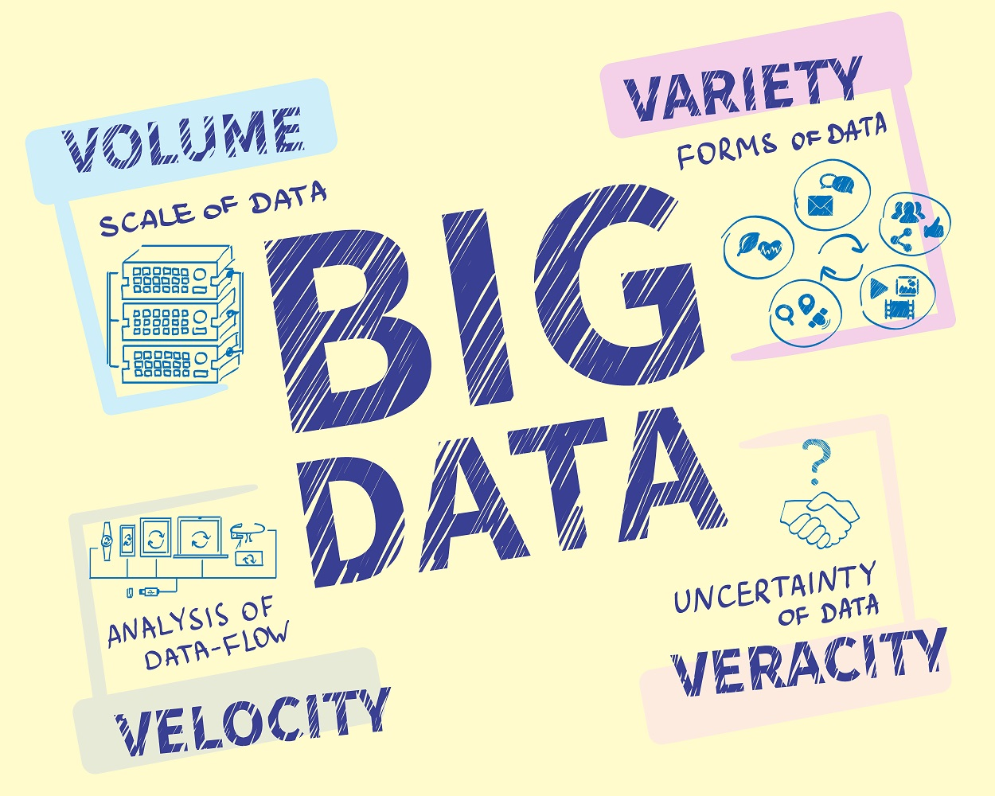
Four Characteristics of Big Data V4s
Volume
Data quantity

Slide 8
1. Data Volume
Today, Facebook ingests 500 terabytes of new data every day.
Boeing 737 will generate 240 terabytes of flight data during a single flight across the US.
The smart phones, the data they create and consume; sensors embedded into everyday objects will soon result in billions of new, constantly-updated data feeds containing environmental, location, and other information, including video.

Slide 9
2. Data Velocity
Data velocity means the speed at which the data is generated and processed.
Compared to small data, big data are produced more continually.
On average, Google now processes more than 40000 searches every second (3.5 billion searches per day).

Slide 10
3. Data Variety
Data variety means the type and nature of data.
Big Data isn't just numbers, dates, and strings. Big Data is also geospatial data, 3D data, audio and video, and unstructured text, including log files and social media.
It can be divided into 3 categories: Structured, unstructured and semi-structured.

Slide 11
4. Data Veracity
It is the extended definition for big data, which refers to the data quality and the data value.
The data quality of captured data can vary greatly, affecting the accurate analysis.
To ensure accuracy of of data, data cleaning is used.

Slide 12
Types of tools used in Big-Data
Processing
  Commodity Hardware, Distributed Servers / Cloud (e.g. Amazon EC2)
Storage
  Distributed Storage (e.g. Amazon S3)
Programming model
  Distributed Processing (e.g. MapReduce)
Indexing
  High-performance schema-free databases (e.g. MongoDB)
Operations performed
  Analytic / Semantic Processing

Slide 13
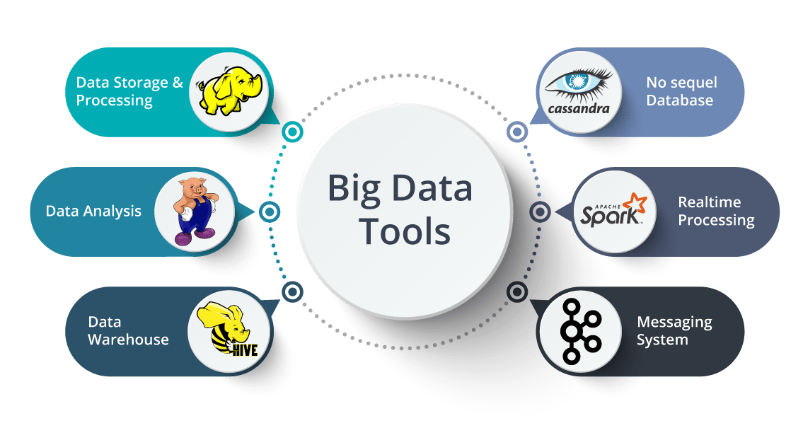

Slide 14
Types of Technology used in Big-Data
Processing
  Commodity Hardware, Distributed Servers / Cloud (e.g. Amazon EC2)
Storage
  Distributed Storage (e.g. Amazon S3)
Programming model
  Distributed Processing (e.g. MapReduce)
Indexing
  High-performance schema-free databases (e.g. MongoDB)
Operations performed
  Analytic / Data cleaning

Slide 15
STORING BIG DATA
Analyzing your data characteristics.
Selecting data sources for analysis.
Eliminating redundant data, and Data cleaning.
Establishing the role of NoSQL.
Overview of Big Data stores
Data models: key value, graph, document, column-family
Hadoop Distributed File System
HBase
Hive

Slide 16
PROCESSING BIG DATA
Integrating disparate data stores
Mapping data to the programming framework
Connecting and extracting data from storage
Transforming data for processing
Subdividing data in preparation for Hadoop MapReduce
Employing Hadoop MapReduce
Creating the components of Hadoop MapReduce jobs.
Distributing data processing across server farms
Executing Hadoop MapReduce jobs
Monitoring the progress of job flows

Slide 17
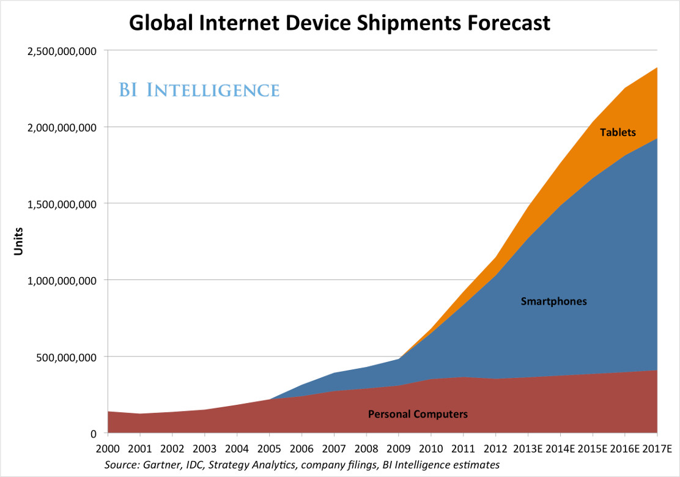
Data Generation points Examples
Mobile Devices
Microphones Readers/Scanners Science facilities Programs/ Software Social Media
Cameras

Slide 18

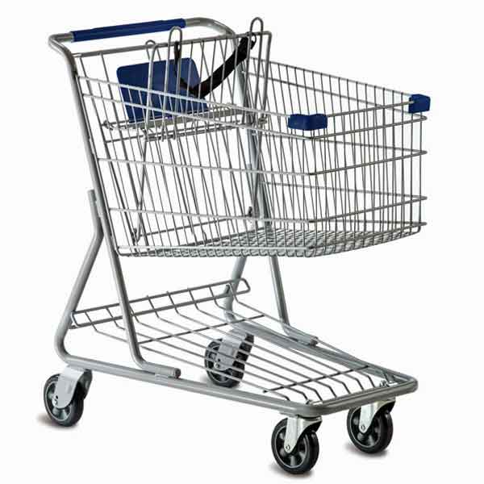
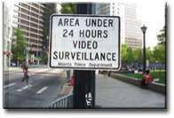

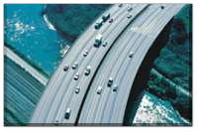

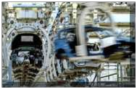

Application Of Big Data analytics
Smarter
Healthcare
Multi
Channel
sales
Homeland
Security
Telecom
Trading
Analytics
Traffic Control
Manufacturing
Search
Quality

Slide 19
How Big data impacts on IT
Big data is a force presenting opportunities with challenges to IT organizations.
In 2015 there were approx 4.4 million IT jobs in Big Data ; 1.9 million is in US itself. And this number will grow in future.
India will require a minimum of 100 thousand data scientists in the next couple of years in addition to data analysts and data managers to support the Big Data space.

Slide 20
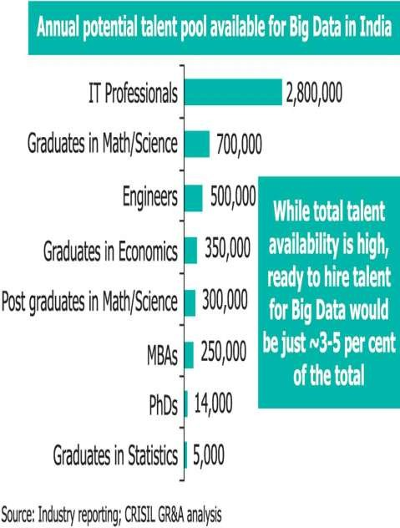
Potential Value of Big Data
$300 billion potential annual value to US health care.
$600 billion potential annual consumer surplus from using personal location data.
60% potential in retailers’ operating margins.

Slide 21
References
Wikipedia
Tech Republic
Youtube
wikibon.org
statista.com

Slide 22
Thank You.

