Slide 1
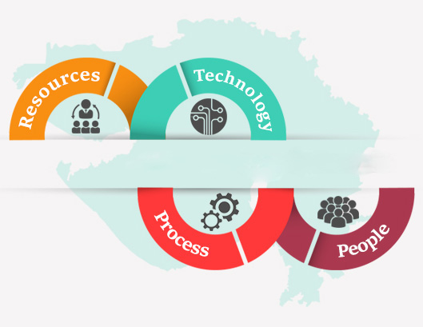
E-GOVERNANCE
Prepared By
Anant Jain
MCA – V Sem
UCCS & IT UOR

Slide 2

Introduction
E-governance can be defined as
  Use of information & communication technology by government to enhance the range and quality of information & services provided to the citizen in an cost effective manner.
  Through e-governance, government services are made available to citizens in a convenient, efficient, and transparent manner.

Slide 3
Why e-governance
Quick access to information
Transparency
Enhance citizen economic and social opportunities
Less paper work
24 x 7 information access
Fast processing of government tasks

Slide 4
Components Of E-governance
Technological Component
Social Component
Political Component
Psychological Component
Service Component

Slide 5
1. Technological Component
This relates to electronic and communication technology to develop better connectivity within and with the system.
It requires
  Use of Digital devices to access and share information
  Development of Databases
  Establishment of networking to facilitate the communication
  Educate the users to work with technology.

Slide 6
2. Social Component
Social component in E-Governance means the interaction of society with government.
Using E-Governance governments works for the welfare of society, by means of fast and transparent access to information and services.
A vigilant society can be evolved where they can raise their voices by questioning the governmental decisions.

Slide 7
3. Political component
It is the essential aspect of governance.
This refers to the importance of enactment of laws to stop society from disintegration.
It holds responsibility of rationalizing various operative framework by enacting laws.
This helps to maintain & sustain the cohesive force that is required by society to integrate its people and abide them to follow a uniform policy to fulfill their targets.

Slide 8
4. Psychological Component
Facilitate formation and inculcation of right type of attitudes in the people.
Provide readiness to connect to people, to listen to their queries, to look for solution, to improve communication quality.
Help to develop constructive collaborative social relationship.

Slide 9
5. Service Component
It refers to provide good services to citizens to assimilate the basic needs and also to full fill the expectations of common man.
E-governance develops a constant pressure on the government to respond to public demands as this leads to the realization of power they can exercise on government to maintain impartiality, integrity and transparency in its functioning.

Slide 10
Types of Interaction in e-governance
G2G (Government of Government)
G2C (Government to Citizens)
G2B (Government to Business)
G2E (Government to Employees )

Slide 11
1. Government to Government
Technology is used to increase the flow of information and services within and between different government entities.
This kind of interaction is only within the sphere of government and can be both horizontal i.e. between different government agencies, or vertical i.e. between national, provincial and local government agencies.
The primary objective is to increase efficiency, performance and output.

Slide 12
2. Government to Citizens
An interface is created between the government and citizens which enables the citizens to benefit from efficient delivery of large range of public services.
This expands the availability and accessibility of public services on the one hand and improves the quality of service on the other.
Provide 27 x 7 access to those services.

Slide 13
3. Government to Business
E-Government tools are used to aid the business community.
The object is to cut red tape, save time, reduce operational costs and to create a more transparent business environment when dealing with the government.
It provide services like : licensing, permits, procurement and revenue collection.

Slide 14
4. Government to Employees
Provides the two-way communication process between the organization and the employee.
Use ICT tools to help in making these interaction fast and efficient.
Helps to increase satisfaction levels of employees.

Slide 15
Interventional strategies
Transitive Counseling
Electronic Accessibility
Ethical Framework
Role Shifting Strategies

Slide 16
1. Transitive Counseling
In order to reduce the resistance, people need to be prepared for coming out of transitional phase. Thus proper counseling is required regarding changes in attitudes, reorienting mind sets etc. at various levels of governmental functioning.

Slide 17
2. Electronic Accessibility
There is a need to equip people with necessary knowledge regarding use of electronic multi media by imparting it through various Institutions.
Technologically advanced Institutes with expertise must be set up which must established themselves as the centers of excellence by imparting to people the e-knowledge.

Slide 18
3. Ethical Framework
Apart from legal framework morality has to be the key area where any society must work out strategic plan by designing ethos before adopting e- governance. The framework has to be supportive of fundamental societal normative pattern so that it gets extra leverage for perpetuating necessary values patterns.

Slide 19
4. Role Shifting Strategies
In the process of implementing e-governance, a major role shifting may result.
Each role, organizational as well as personal must shift in such a way that effects of change can be managed without resulting into situation of crisis. This is to be learn that how & where role shift is required.

Slide 20
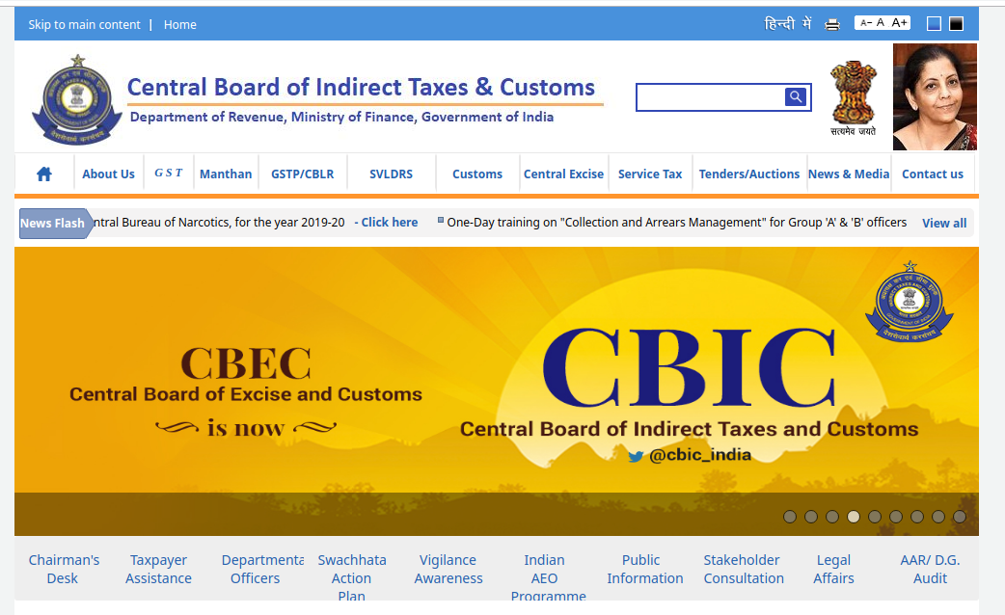
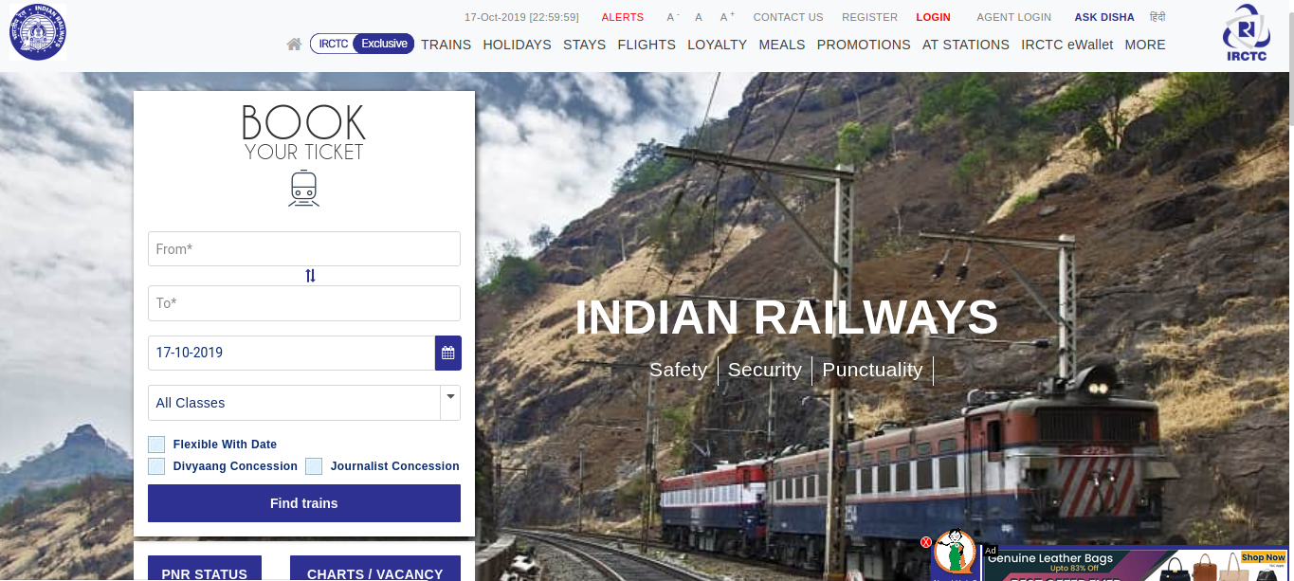
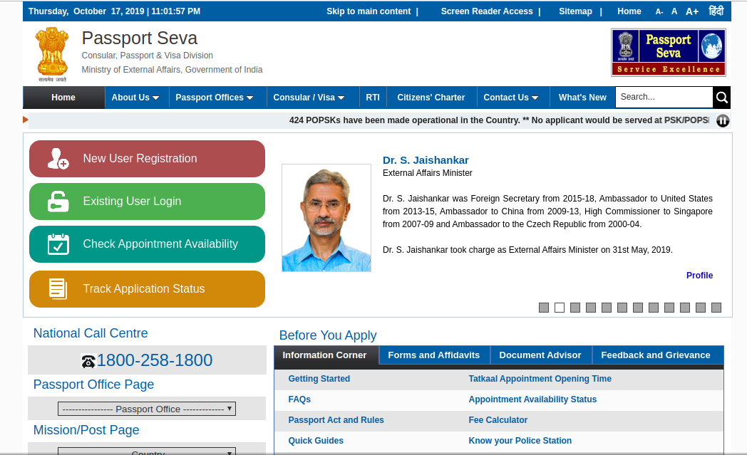
Indian E-Gov initiatives
•
Custom and Excise | Indian Railway | Passport / Visa
• 98% of export and 90-95% of import documentation computerized • Electronic filing through ICEGATE at 3 locations (Mumbai, Delhi, Chennai) • 80% of Service Tax returns electronically processed | • Anywhere to Anywhere reservation from Anywhere • Electronic Booking of tickets on select sectors • Online Information on Railway reservation on Internet | • 100% passport information computerized • All 33 Regional Passport Offices covered • Machine readable passports at some locations

Slide 21
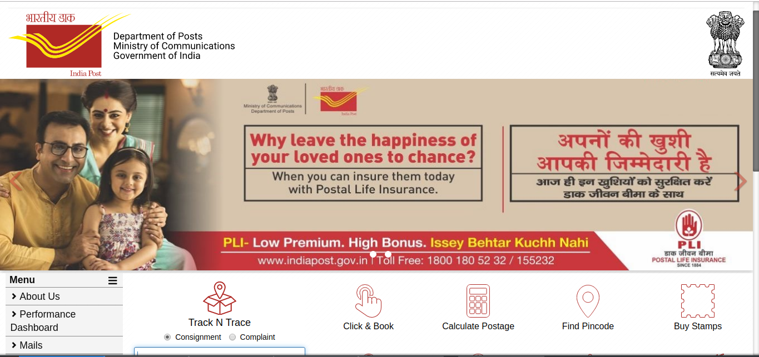
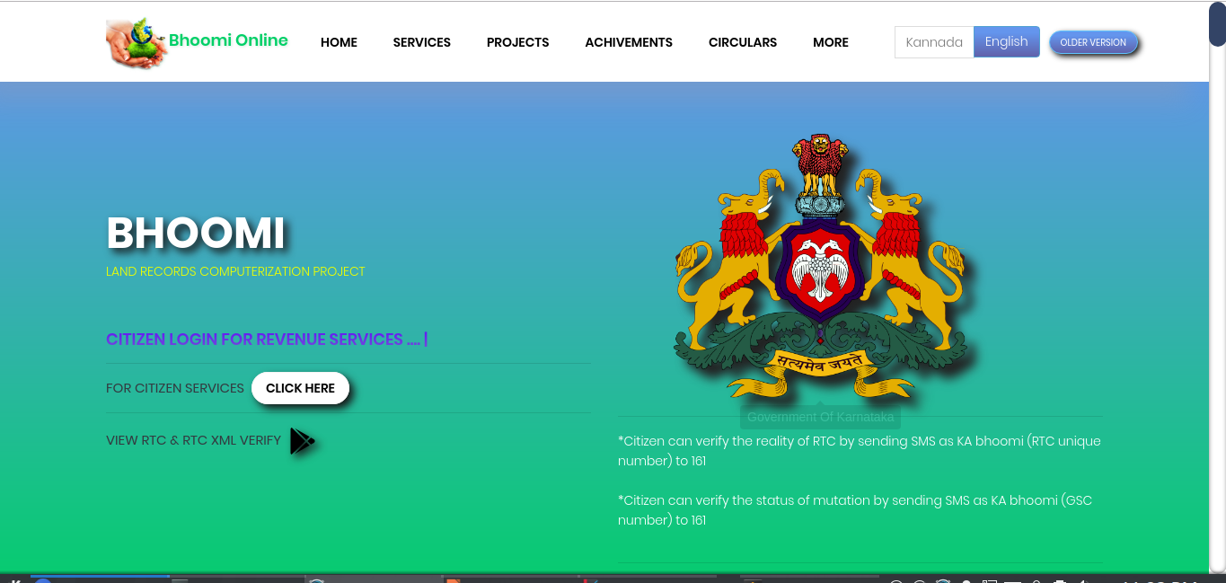
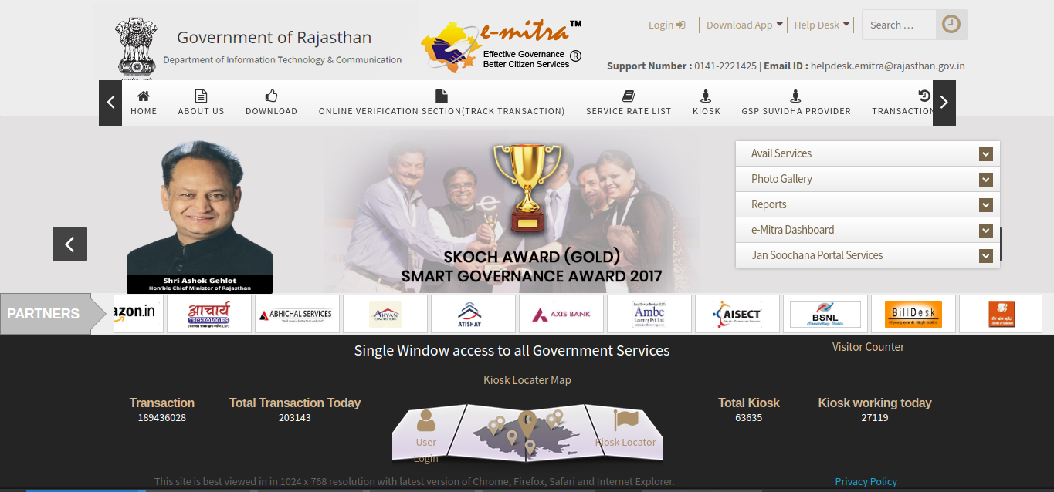
Indian E-Gov initiatives
Indian Postal Service | E-Mitra (Rajasthan) | Boomi (Karnatka Govt.)
• Direct e-credit of Monthly Income Scheme returns into the investors accounts • Dematerialization of Savings Certificate (NSC) and Vikas Patras (KVP), offering full portability | Payment of electricity, water, telephone bills Payment of taxes Ticket Reservations Filing of Passport applications Registration of birth/death Payment by cash/cheque/ credit card | Provides computerized records of Right Tenancy & Corps (RTC) This project has benefited 20 million rural land records covering 6.7 million farmers.

Slide 22
E-Governance Challenges Specific to India
Lack of Integrated Services
Lack of communication between different departments.
Lack of Key Persons
Population
Person Identities
Different Languages

Slide 23
Thank You!

