Slide 1
GeM
Government e-marketplace
Presented by : Anant Jain

Slide 2
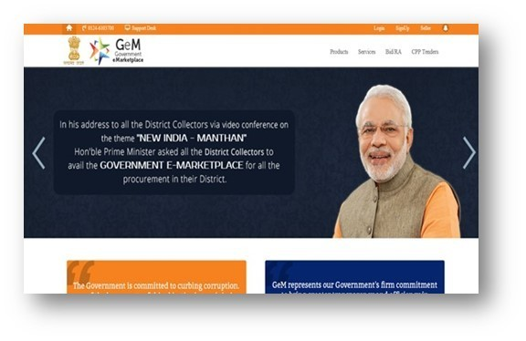
GeM– A Path Breaking Initiative
•
GeM to facilitate online procurement of Goods & Services.
•
Launched on 9th August 2016. (https://www.gem.gov.in/ )
•
Rule 149 of GFR amended to “.. Procurement of Goods and Services by Ministries or Department will be mandatory for Goods or Services available on GeM.
Winner of the South Asia Procurement Innovation Awards of the World Bank, 2016

Slide 3
Why GeM

Slide 4
Why GeM
Pre-GeM GeM
Tender based specific requirements of general good and Market Based generic requirements across all govt. agencies services even with in same buyer agency
Absence of standardisation leading to incomparable data relating to prices of procurement
Standardization of specifications of both products and services enabling empirical price comparability
Opacity of procurements based on quotations Completely transparent transactions across all ranges
Services entirely non standardized both cost wise and performance wise
Generic standards established through universal service levels and cost comparison enabled
Lack of dynamicity in both vendor participation and product listing
Open and dynamic market place with rating based on performance of user on website

Slide 5
Why buy on GeM

Slide 6










Why Buy on GeM
Various Products/Services
on offer with multiple sellers
Direct Purchase/e bid/RA
Integrated Payment System
Buyer/Supplier/Service Provider Registration
Market Search/ Comparison
Online Ordering/Contract Generation
Contact Centre and Online Training
Modules

Slide 7
Purchase redefined – Offline to Online difference
DGS&D GeM
Registration very cumbersome with physical inspection, etc. ; average time 4-6 months
Registration of vendors and buyers online and based on trust; made possible through GeM integration with Aadhaar, MCA21, PAN, NIC
Registration within 10 minutes
Rate Contract restricted to registered vendors. Chances of cartelization. Limited vendor base: About 2500-3500 suppliers in 250-300 item categories
Open marketplace – 42,000 + sellers 380 product category and counting
Localised vendor base: NCR, Agra-Kanpur, Ludhiana and Current supplier base from different regions: opportunity to do Kolkata business with Government
Tendering involved manual rate negotiation: resultant opacity and possible cartel formation
Totally reengineered and objective processes, obviating paper submissions, subjective discretions and visits to offices of buyers for transacting business
Duration of RC one year or more – vendors, products and price locked for years- to the disadvantage of the Government
The suppliers no longer get a license to supply one model at fixed price for one full year; they have to participate in multiple daily biddings on GeM and compete.

Slide 8
Transacting on GeM

Slide 9
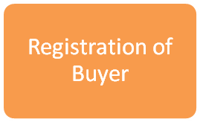
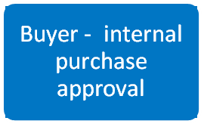
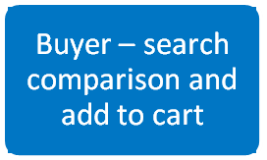
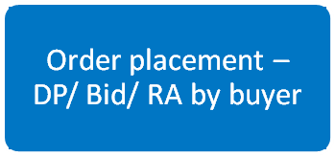



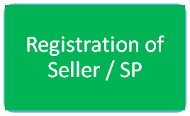
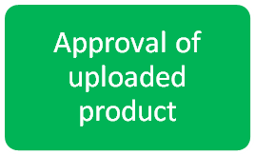


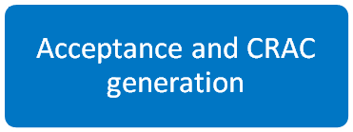
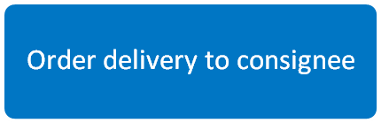


GeM – e-Procurement lifecycle
20 Mins
DP - 20 Mins Bid/ RA – 7 days
20 Mins
48 hrs
As per contract
(Min 15/45(for Automobiles)
10 days from acceptance
10 days from delivery

Slide 10
Preview of GeM 3.0

Slide 11
Learning from GeM 2.0
STANDARDISATION of
specifications
PRICE REASONABILITY of
non RC items
Need for BUNDLING and
BUNCHING
ONLINE Payments
QUALITY ASSURANCE
(Lack of Offline checking System)
WATCHLIST
Need for RATING

Slide 12


Major Enhancements
CATALOGUE/ CMS
Catalogue Based Standardization of Specifications.
Services also on catalogue based generic Standardisation.
BUNDLING AND BUNCHING
Bundling of Products and Services. Bunching of Products and Products
UPGRADED SEARCH
SOLR , Full Text and Navigational Search
SECURITY
Encryption and Enhanced Security Feature involving e-Signing and Hash module
USER RATING
Performance Based Buyer and Vendor rating User Feedback
PRICE COMPARISON
Price comparison using third party sites
– multisource and real time
STANDARD BID/RA
Products and Services Integrated leading to Seamless Bid/RA , Templates
e-EMD, e-PBG
DEMAND AGGREGATION
VENDOR ASSESSMENT
Online Vendor Assessment Enabled

Slide 13
Major Enhancements
...contd
MULTIPLE CARTS
Integration with CPPP
Linked with Certification Agencies (Online)
Non RC Price Framework
Filters - Govt. Policy of MSME, Make in India, Start up Enabled
USER ANALYTICS as
Decision Support System for Buyers including for establishing price reasonableness
Working Groups
Standing Committees
Price Engine Enabled
(Catalogue Based)
SoPs and Manual on
CONSULTATION Mode
Sourcing of PRICE REASONABLENESS
through BUYER
Features of ADVANCE ANALYTICS such as product recommendation, demand forecasting etc.

Slide 14
Major Enhancements
...contd
Institutional Mechanism
Standing Committee on GeM
Working Groups
Price Dekho - Online price comparison
GS1 - Catalogue Management
Gartner - LMS
QCI - Certification
Post - Courier
Google - Images
NASSCCOM - Software

Slide 15
THANK YOU

