Slide 1
Cryptographic Hash Functions
Prepared By
Anant Jain
MCA – V Sem
UCCS & IT UOR

Slide 2
Overview
Hash Functions Intro.
Cryptographic Hash Func.
Applications of Crypto Hash Functions
Examples of Hash functions
Probability of Hash functions
Secure Hash Algorithm (SHA)

Slide 3
Hash Function
Hash tables used in data searches
The hash function should
Take variable size input
Produce fixed output size (Size of the table)
Be easy to compute
Be pseudorandom so that it distributes uniformly over the table
⇒ Minimizes collisions
Data
Hash Fn

Slide 4
Cryptographic Hash Functions
Variable Size Input
Fixed output size
Efficient computation
Pseudorandom
Pre-image Resistant = one-way
It is not possible to find M, given h.
2nd Pre-Image Resistant
Pre-image Resistant
Collision Resistant
2nd Pre-image Resistant: = Weak Collision Resitant It is not possible to find y, such that h(y)=h(x)
Strong Collision Resistant: It is not possible to find any two x and y, such that h(y)=h(x)

Slide 5
Examples of Crypto Hash Functions
MD4 = Message Digest 4 [RFC 1320] - 32b operations
MD5 = Message Digest 5 [RFC 1321] - 32b operations
SHA = Secure hash algorithm [NIST]
SHA-1 = Updated SHA
SHA-2 = SHA-224, SHA-256, SHA-384, SHA-512
SHA-512 uses 64-bit operations

Slide 6

Applications of Crypto Hash Fn
1. Message Authentication = Integrity
MD5 has is used to check if a file has been modified.
Use a secret value before hashing so that no one else can modify M and hash
M
H(M)
Can encrypt Message, hash, or both for confidentiality
Digital Signatures: Encrypt hash with private key
Password storage: Hash of the user’s password is compared with that in the storage. Hackers can not get password from storage.
M
E(PR_{A}, H(M))
4. Pseudorandom number generation: Hash an IV, Hash the hash, …, repeat

Slide 7
Probability of Hash Collisions
Arbitrary length message ⇒ Fixed length hash
⇒ Many messages will map to the same hash
Given 1000 bit messages ⇒ 2¹⁰⁰⁰ messages
128 bit hash ⇒ 2¹²⁸ possible hashes
⇒ 2¹⁰⁰⁰/2¹²⁸ = 2⁸⁷² messages/hash value
n-bit hash ⇒ Need avg 2^{n/2} tries to find two messages with same hash
64 bit hash ⇒ 2³² tries (feasible)
128 bit hash ⇒ 2⁶⁴ tries (not feasible)

Slide 8
Secure Hash Algorithm (SHA)
Successor to and similar to MD5 (by Ron Rivest)
SHA-0: FIPS PUB 180, 1993. Withdrawn shortly after publ.
SHA-1: FIPS PUB 180-1, 1995. 160 bit hash
SHA-2: FIPS PUB 180-2, 2002
SHA-224
SHA-256
SHA-384
SHA-512
SHA-1 is used in TLS, SSL, PGP, SSH, S/MIME, and IPsec
Required by law in US Govt applications
Used in Digital Signature Standard
Pseudo-codes for SHA algorithms are available.
NIST certifies implementations.

Slide 9
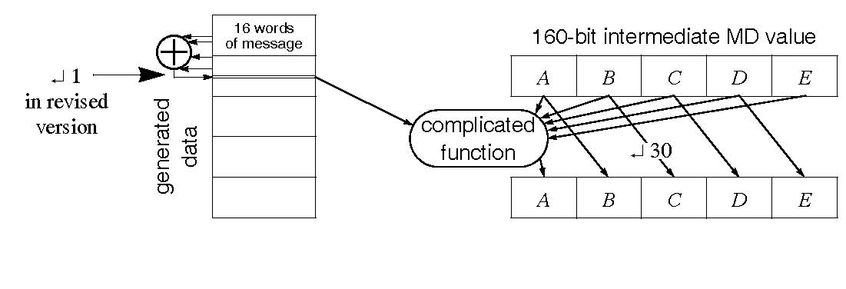
SHA-1 Algorithm
160 bit hash using 512 bit blocks and 32 bit operations
Five passes (4 in MD5 and 3 in MD4) of 16 operations each
Maximum message size is 2⁶⁴ bit
512 bits are expanded to 5x512 bits:
n^{th} word = xor of n-3, n-8, n-14, and n-16
In SHA-1 these words are rotated left by one bit before xor
Total 80 words: W₀, ..., W₇₉

Slide 10
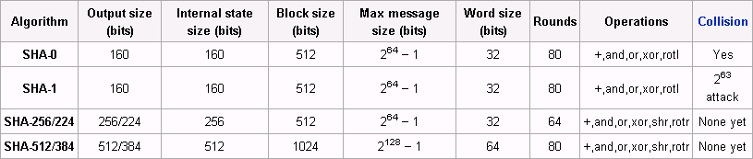
SHA-2
SHA-256 uses 32-bit operations
SHA-512 uses 64-bit operations
Use different shift amounts and additive constants
SHA-224 and SHA-384 are simply truncated versions of SHA- 256 and SHA-512 using different initial values.
SHA-224 matches the key length of two-key triple-DES

Slide 11
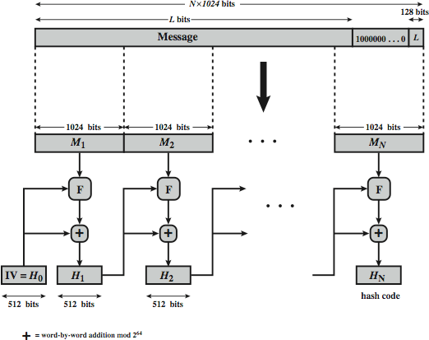
SHA-512 Overview
1. Append padding bits
2. Append length
80 Rounds

Slide 12
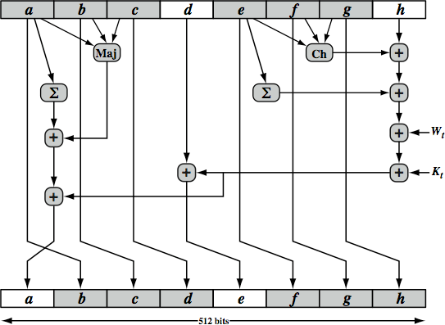
SHA-512 Round Function
Input sequence word
Constant (see table)
Conditional fn Ch(e,f,g): if e then f else g
= (e AND f) ⊕(Not e and g)
Majority Fn Maj(a, b, c): True if 2 of 3 args are true
=(a AND b) ⊕(a AND c) ⊕(b AND c)

Slide 13
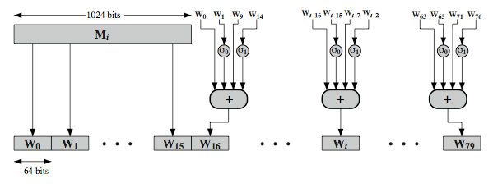
80-Word Input Sequence
^{W}t^{= σ}1^{(W}t-2^{)+W}t-7^{+σ}0^{(W}t-15^{)+W}t-16
σ₀(x)=ROTR¹(x)+ROTR⁸(x)+SHR⁷(x)
σ₁(x)=ROTR¹⁹(x)+ROTR⁶¹(x)+SHR⁶(x)
ROTR^{n}(x)=rotate right by n bits
SHR^{n}(x)=Left shift n bits with padding by 0’s on the right
❑ + = Addition modulo 2⁶⁴

Slide 14
SHA-3
SHA-2 (esp. SHA-512) seems secure
Shares same structure and mathematical operations as predecessors so have concern
NIST announced in 2007 a competition for the SHA-3
Has had 3 rounds of narrowing down the selections
Five algorithms advanced to the third (and final) round in December 2010
Final selection to be announced by 2012

Slide 15
SHA-3 Requirements
Replace SHA-2 with SHA-3 in any use
So use same hash sizes
Preserve the online nature of SHA-2
So must process small blocks (512 / 1024 bits)
Evaluation criteria
Security close to theoretical max for hash sizes
Cost in time & memory
Characteristics: such as flexibility & simplicity

Slide 16
SUMMARY
Hash functions are used to get a digest of a message Must take variable size input, produce fixed size pseudorandom output, be efficient to compute
Cryptographic hash functions should be preimage resistant, 2nd preimage resistant, and collision resistant
Cryptographic hashes are used for message authentication, digital signatures, password storage
SHA-1 produces 160 bit output, SHA-224, SHA-256, SHA- 384, and SHA-512 produce 224, 256, 384, and 512 bit outputs. All consist of 80 rounds.
SHA-3 competition is underway

