Slide 1


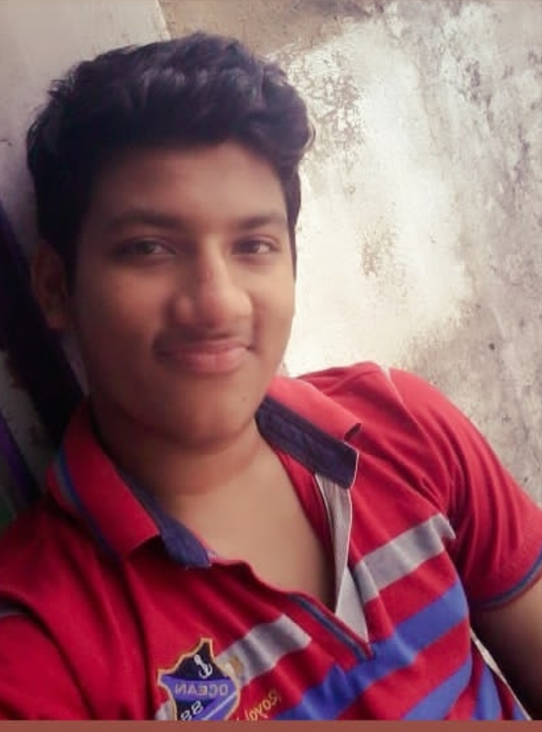
RedHat
About Me :
Name : D Ananta Narayan
College : <NATIONAL INSTITUTE OF
SCIENCE AND TECHNOLOGY>
Github : https://github.com/Anant777
PHOTO You Liked the Most :)

Slide 2
My learning : W1
RedHat
Achievements : A basic idea of what a project is I Got know about Open Source Project Management Space . Lean Principle approach(Little of Scrum and Agile). And also thinking like being a product owner along with sprint planning. Got introduced to Kanban board. And learn how to present the project to someone via User Stories .
Learnings : From rhcsa and python, got introduced to Linux Environment and its fundamental commands along with its structure. Fundamentals of Python, along with their respective attributes. Learn to differentiate between Open Source and Closed Source.

Slide 3
RedHat
<Golden career>
SCQ:
SITUTION: CAREER GUIDENCE AFTER MATRICULATION AND INTERMEDIATE
We all are very aware from this sitution ,in which an intermedate or matriculation student gets confused about the career
To choose and when they realise they loss the opportunities to make there career a better one.
CHALLENGE: to create a platform for students wher they will get all the answers for there golden career.
QUESTIONS: what are the opportunities one get after 10th or 12th?
how to creat a web which will be better access?
User Stories :
As <developer>, I want <to creat a web>, so that <each and every student can get the proper guide for there career>.
For example : web like quora.
As an administrator, I want to be able to connect to a server, so that I can manage user accounts.

