Slide 1
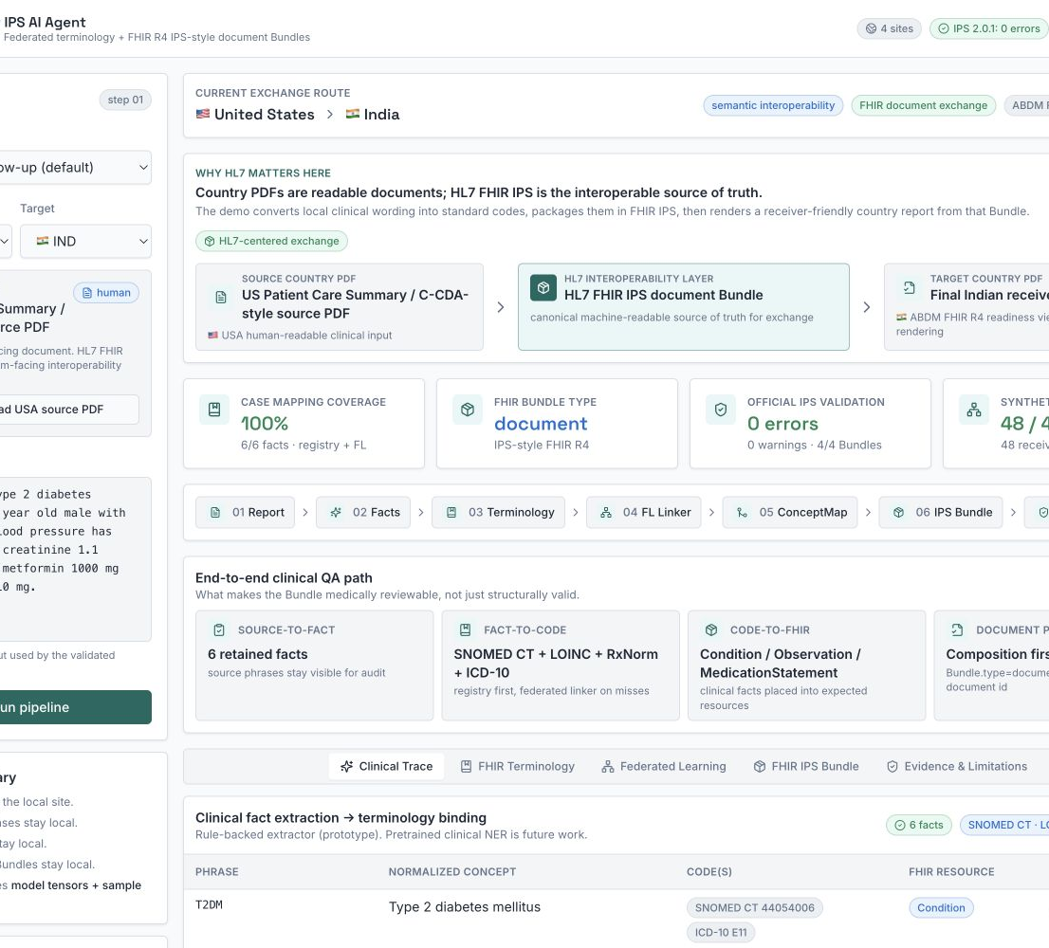
HL7 AI CHALLENGE 2026
Cross-Border
IPS AI Agent
Federated, FHIR-native terminology alignment for cross-border Type 2 diabetes summaries.
FHIR IPS is the interoperable artifact.
PDFs are human-readable renderings.
Working demo · synthetic evidence · official IPS 2.0.1 validation

Slide 2
PROBLEM
02
One condition arrives under many local names
USA
T2DM
sugar disease · madhumeha type 2
Canonical meaning
India
→
Type 2 diabetes mellitus
Australia
type 2 DM
SNOMED CT 44054006
Europe
DM2 · diabetes mellitus type II
ICD-10 E11
Without semantic alignment, a receiver EHR gets ambiguous text instead of computable clinical data.
Cross-Border IPS AI Agent · HL7 AI Challenge 2026

Slide 3
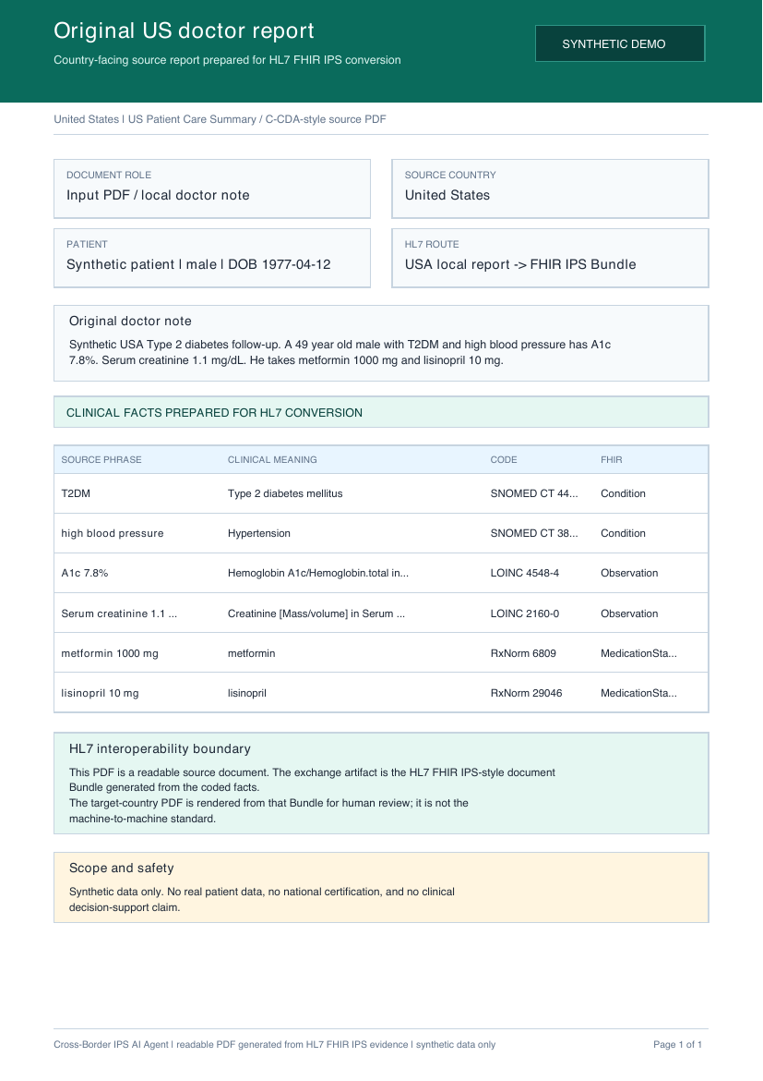
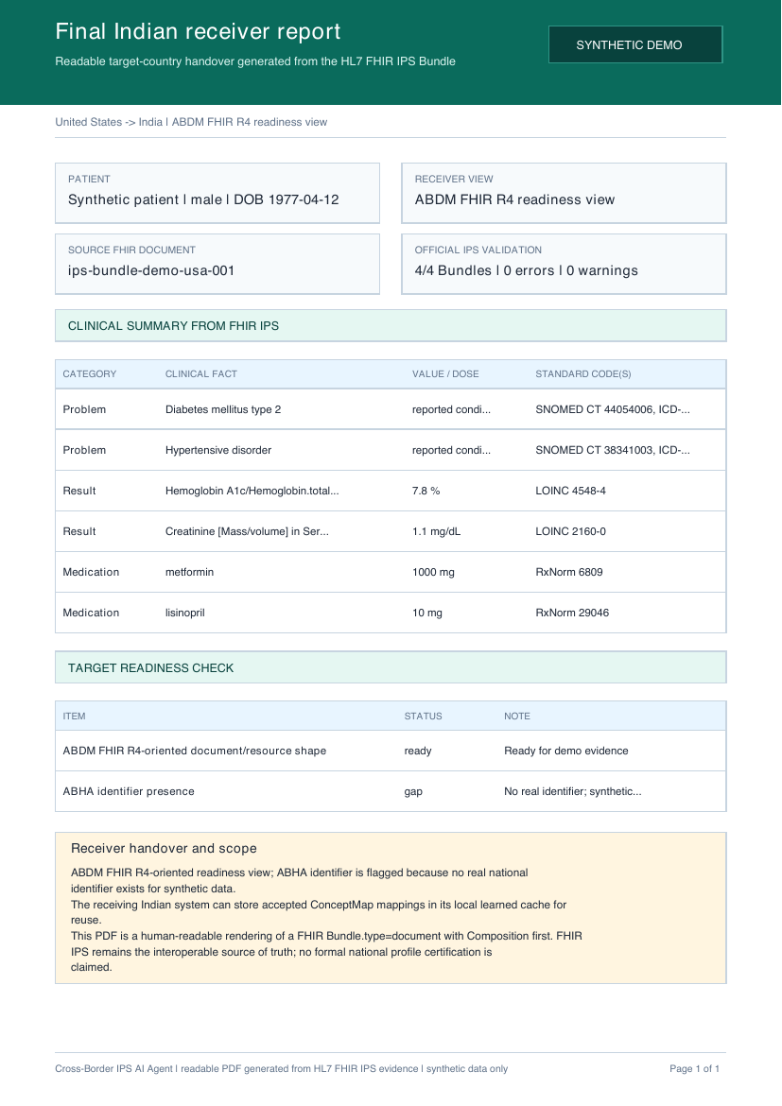
OBJECTIVE
03
FHIR IPS is the artifact that crosses the border
HL7 FHIR IPS
→
Bundle.type = document
Composition first
Coded clinical resources
→
Human input
Human receiver view
Cross-Border IPS AI Agent · HL7 AI Challenge 2026

Slide 4
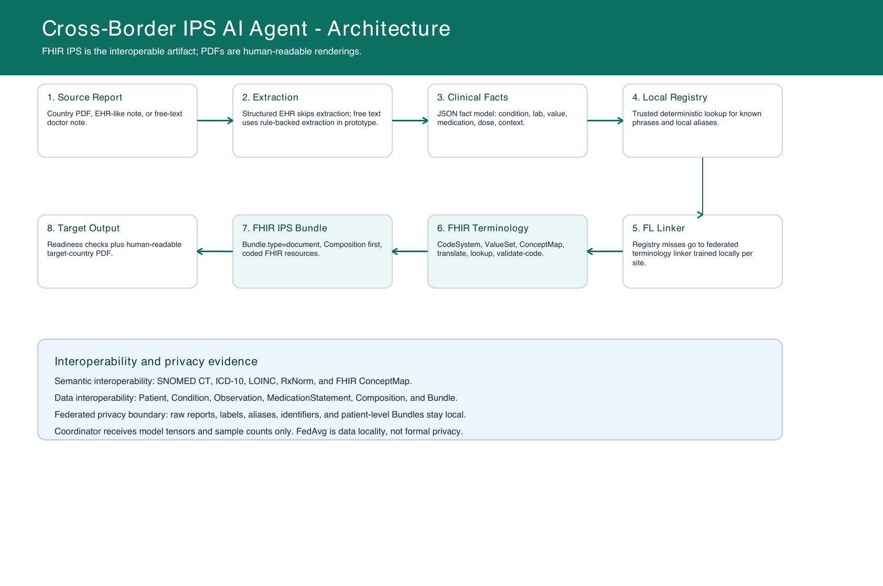
ARCHITECTURE
04
Every transformation remains inspectable
The registry is deterministic; the federated linker is used only on misses; FHIR terminology validates and publishes the mapping.
Cross-Border IPS AI Agent · HL7 AI Challenge 2026

Slide 5
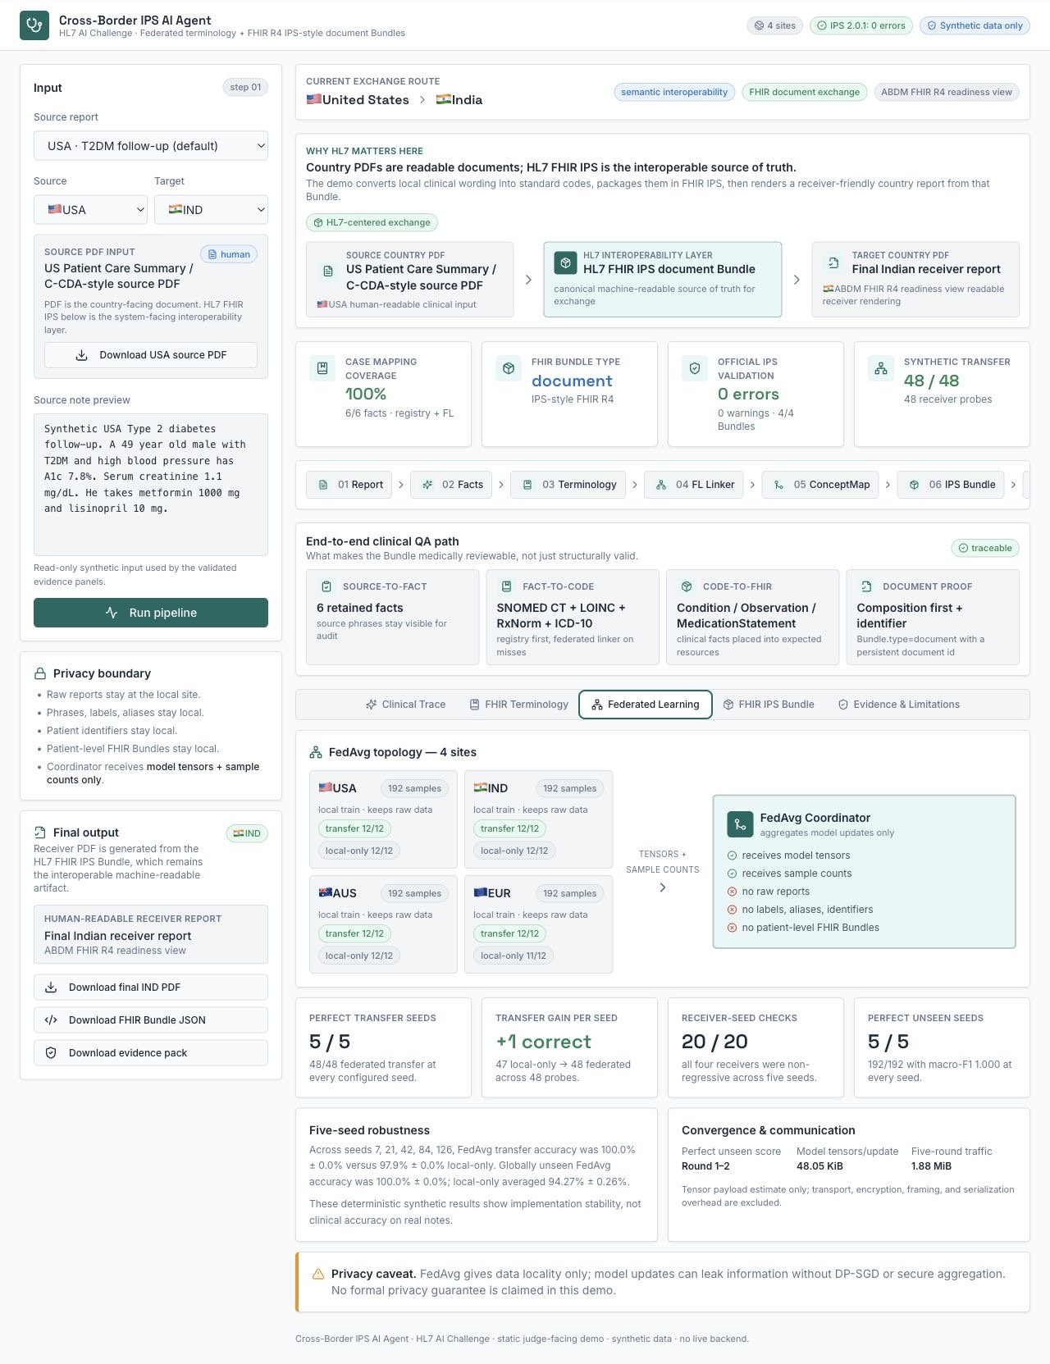
FEDERATED LEARNING
05
Five seeds reproduce the cross-site gain without moving reports
48/48
federated transfer at all 5 seeds
47/48
local-only transfer at all 5 seeds
+1
measured gain per seed
20/20 receiver-seed checks were non-regressive
1.88 MiB five-round tensor traffic. Synthetic study; not clinical accuracy.
Cross-Border IPS AI Agent · HL7 AI Challenge 2026

Slide 6
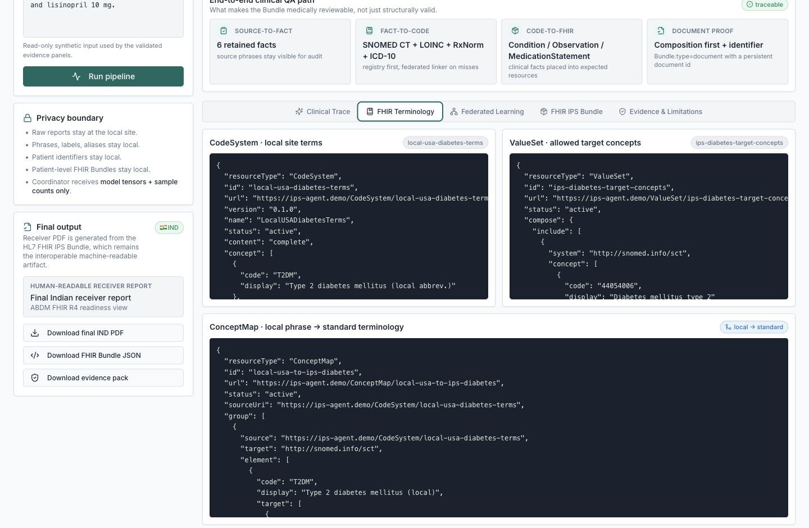
FHIR-NATIVE LINKER
06
FHIR turns an AI prediction into an auditable mapping
1
CodeSystem
represents local site terms
2
ValueSet
constrains allowed targets
3
ConceptMap + local $translate
publishes local → standard
4
External $lookup / $validate-code
tx.fhir.org accepted 4/4 representative codes
External code validity does not prove phrase mapping; low confidence → human review
Cross-Border IPS AI Agent · HL7 AI Challenge 2026

Slide 7
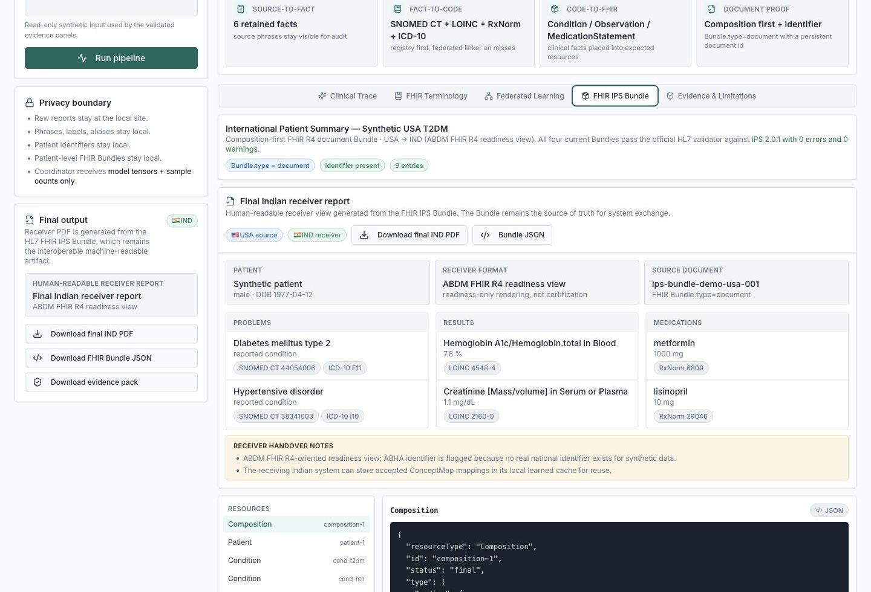
VALIDATION
07
All four exchange Bundles pass the IPS 2.0.1 profile
4/4
current route Bundles
0
errors
0
warnings
2 information notes per Bundle
RxNorm ingredient codes are outside the IPS guide's recommended medication ValueSet.
Structural/profile conformance for synthetic Bundles; not clinical or national certification.
Cross-Border IPS AI Agent · HL7 AI Challenge 2026

Slide 8
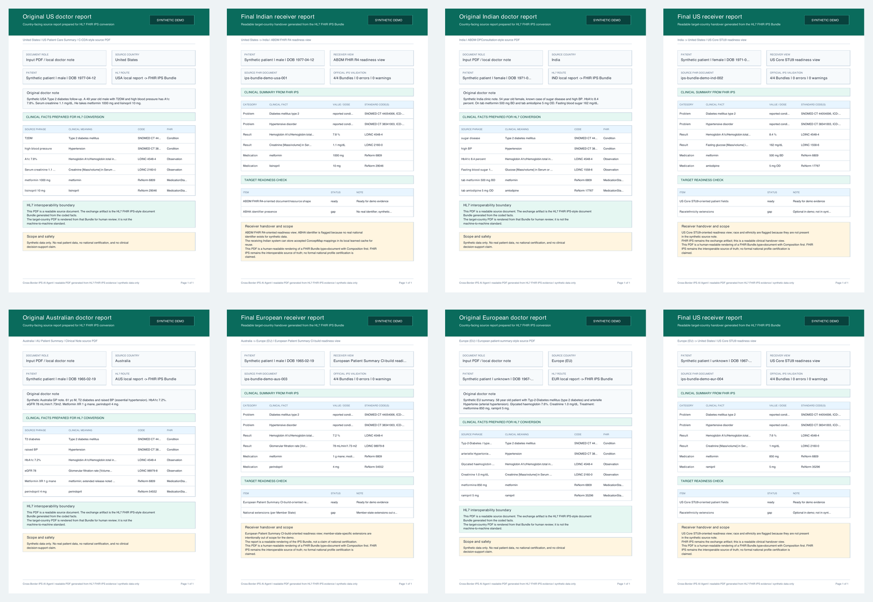
CROSS-BORDER EVIDENCE
08
One machine-readable summary supports four receiver journeys
USA → India · India → USA · Australia → Europe · Europe → USA
The PDFs are readable renderings. The FHIR IPS Bundle remains the system-facing source of truth.
Cross-Border IPS AI Agent · HL7 AI Challenge 2026

Slide 9
REPRODUCIBILITY
09
The evidence is executable, downloadable, and reviewable
16/16
$ npm test -- --run
✓ 16 tests passed
$ PYTHONPATH=src pytest -q
✓ 13 tests passed
$ HL7 FHIR Validator + IPS 2.0.1
✓ 4 Bundles · 0 errors · 0 warnings
$ tx.fhir.org terminology snapshot
✓ 4/4 lookup + validate-code
frontend behavior and evidence tests
13/13
Python pipeline and FedAvg tests
16/16
route downloads click-tested
GitHub includes the PyTorch clients, FedAvg coordinator, external terminology snapshot, Bundles, review packet, and unedited validator logs.
Cross-Border IPS AI Agent · HL7 AI Challenge 2026

Slide 10
THE CLOSING CLAIM
The standards do the traveling.
The reports stay local.
Federated learning
FHIR terminology
FHIR IPS
aligns local clinical terminology without centralizing raw reports
makes CodeSystem, ValueSet, ConceptMap, and validation evidence auditable
packages coded facts into a cross-border patient summary
Working demo
crossroad-fhir-link-three.vercel.app
Synthetic prototype · readiness checks only · no formal privacy guarantee

