Slide 1

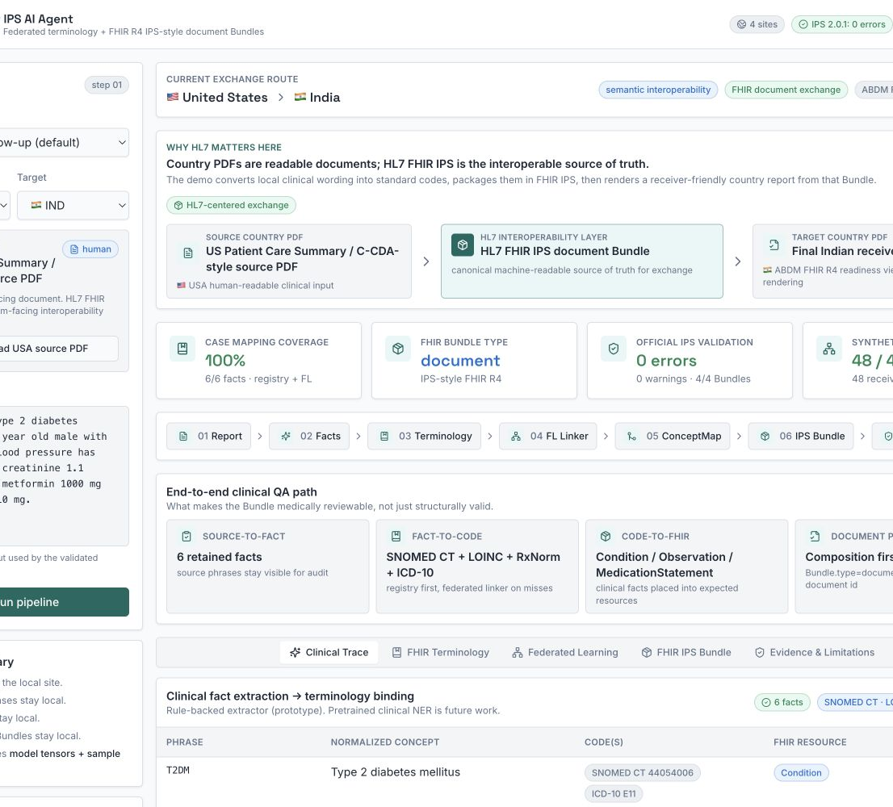
HL7 AI CHALLENGE 2026 · EFFICIENCY & EFFECTIVENESS
Cross-Border
IPS AI Agent
Federated terminology learning + FHIR-native mappings + an International Patient Summary (IPS) Bundle
Local clinical language becomes coded, auditable, and exchangeable across borders.
TEAM · TECH ADAPTIVE PANDIT
Anant Gupta · Manish Gupta · Gourav Gupta

Slide 2
EXECUTIVE SUMMARY
02
Make local clinical language computable across borders
PROBLEM
Receiver EHRs cannot interpret local terms
One coded, machine-readable patient summary
CORE THESIS
OBJECTIVE
→
The interoperable summary travels.
SOLUTION
Federated terminology learning + FHIR IPS
The learning stays local.
IMPACT
Auditable sharing; less manual recoding
FHIR terminology + IPS
The deck proves this with a synthetic benchmark, FHIR-native mapping traces, and official IPS validator evidence.
Tech Adaptive Pandit · Cross-Border IPS AI Agent · HL7 AI Challenge 2026

Slide 3
OBJECTIVE + EXPECTED IMPACT
03
One coded summary supports a cross-border handoff
SOURCE VIEW
INTEROPERABLE ARTIFACT
RECEIVER VIEW
USA follow-up note
FHIR IPS-style
document Bundle
India patient summary
T2DM · A1c 7.8%
metformin 1000 mg
>
>
Type 2 diabetes
HbA1c 7.8%
readiness gaps shown
Composition first
Coded Condition, Observation, MedicationStatement
Human-readable input
Human-readable rendering
FHIR IPS is the machine-readable cross-border artifact; PDFs remain human-readable views.
Expected impact: less recoding, traceable handoffs
Tech Adaptive Pandit · Cross-Border IPS AI Agent · HL7 AI Challenge 2026

Slide 4
THE SOLUTION
04
Every mapping is traceable from source phrase to FHIR
Registry first. Federated linker for unknown phrases. FHIR terminology checks. Then IPS packaging.
01
02
03
04
05
06
07
Report / EHR
Clinical facts
Local registry
Federated linker
FHIR terminology
FHIR IPS Bundle
Receiver readiness
structured or text
source spans retained
trusted mappings first
unknown local phrase
ConceptMap + checks
document + resources
gaps, not certification
AUDIT TRACE
SOURCE PHRASE
CANONICAL CONCEPT
STANDARD CODES
FHIR DESTINATION
T2DM
>
Type 2 diabetes mellitus
>
SNOMED CT 44054006 · ICD-10 E11
>
Condition resource
Low-confidence predictions stop for human review and do not create trusted clinical codes.
Tech Adaptive Pandit · Cross-Border IPS AI Agent · HL7 AI Challenge 2026

Slide 5
FEDERATED TERMINOLOGY LEARNING
05
Federated learning aligns local terms without pooling reports
Across five seeds, the federated model mapped all 48 transfer phrases; local-only models missed one.
768
INDIA
USA
local training phrase examples
madhumeha type 2
T2DM
47/48
FEDAVG COORDINATOR
sample-weighted
FedAvg model
local-only correct transfer mappings
receives tensors + sample counts
48/48
federated correct transfer mappings
AUSTRALIA
EUROPE
type 2 DM
DM2
192/192
globally unseen test / seed · macro-F1 1.000
Data locality, not cryptography: model updates may leak information without secure aggregation or differential privacy.
48.05 KiB/client update · 1.88 MiB total / 5 rounds
Tech Adaptive Pandit · Cross-Border IPS AI Agent · HL7 AI Challenge 2026

Slide 6
FHIR-NATIVE GLOBAL LINKER
06
The mapping is an auditable HL7 artifact, not a hidden AI guess
01
Local CodeSystem
MAPPING TRACE
Represents the site's local phrase or code.
SOURCE
India local term | madhumeha type 2
02
Target ValueSet
PREDICTION
Type 2 diabetes mellitus | confidence 0.94
Constrains candidate concepts by clinical category.
CONCEPTMAP $TRANSLATE
SNOMED CT 44054006 | equivalent
$LOOKUP
target code exists | display resolved
03
FHIR ConceptMap
Publishes source-to-target mapping with provenance.
$VALIDATE-CODE
member of allowed condition ValueSet
RESULT
trusted mapping | reusable local cache entry
04
Terminology operations
confidence < 0.70 -> human review; no code emitted
$translate maps; $lookup resolves; $validate-code checks.
A valid target code does not prove the semantic mapping is correct. Gold labels, trace review, and clinician adjudication remain required.
Tech Adaptive Pandit · Cross-Border IPS AI Agent · HL7 AI Challenge 2026

Slide 7
VALIDATION EVIDENCE
07
All four checked cross-border Bundles passed with zero errors
4/4
REPRESENTATIVE ROUTE
VALIDATOR
RESULT
Validated against FHIR R4 + IPS 2.0.1
USA -> India
HL7 FHIR Validator + IPS 2.0.1
0 errors
India -> USA
HL7 FHIR Validator + IPS 2.0.1
0 errors
0
errors
Australia -> Europe
HL7 FHIR Validator + IPS 2.0.1
0 errors
Europe -> USA
HL7 FHIR Validator + IPS 2.0.1
0 errors
0
warnings
Claim boundary: validator success is evidence, not production certification or national profile conformance.
Composition first
Bundle.type = document
Validator proof is structural and profile-oriented. Semantic correctness is tested separately against synthetic gold labels and trace review.
Tech Adaptive Pandit · Cross-Border IPS AI Agent · HL7 AI Challenge 2026

Slide 8
DEMONSTRATED IMPACT
08
One IPS Bundle supports four receiver ecosystems
Each receiver gets the same machine-readable IPS, a readable PDF, and an explicit list of readiness gaps.
USA
AUSTRALIA
US Core STU9
AU Core CI
FHIR IPS
race/ethnicity gaps
Medicare/IHI gaps
PDF rendering + gap report
document Bundle
PDF rendering + gap report
Composition + coded resources
INDIA
EUROPE
ABDM R4 draft
EPS ballot
ABHA identifier gap
regional identifier gaps
PDF rendering + gap report
PDF rendering + gap report
Readiness checks are informative only: US Core STU9, ABDM R4 draft, AU Core CI, and European Patient Summary ballot materials.
Tech Adaptive Pandit · Cross-Border IPS AI Agent · HL7 AI Challenge 2026

Slide 9
WHY THIS IS DIFFERENT
09
The AI layer ends in HL7 artifacts, evidence, and review boundaries
COMMON PROTOTYPE
OUR JUDGE-VERIFIABLE DIFFERENCE
LLM directly emits FHIR
Registry-first mapping; low confidence stops for review
Mapping hidden in model output
FHIR CodeSystem, ValueSet, ConceptMap, and operation trace
Data pooled centrally
Local training + sample-weighted FedAvg; no raw reports sent
Single destination format
One FHIR IPS artifact + four receiver readiness checks
Structure checked once
Gold-label semantic tests + official validator evidence
REPRODUCIBLE EVIDENCE
29 tests · 48/48 transfer · 0 validator errors · coordinator payload verified · JSON + evidence pack
Tech Adaptive Pandit · Cross-Border IPS AI Agent · HL7 AI Challenge 2026

Slide 10
THE CLOSING CLAIM
The interoperable summary travels.
The learning stays local.
Federated learning
FHIR terminology
FHIR IPS
aligns local clinical phrases without centralizing raw reports
publishes auditable CodeSystem, ValueSet, ConceptMap, and validation traces
packages coded facts into a machine-readable cross-border patient summary
PROPOSED NEXT PILOT
Two hospitals · 500 governed local mentions per site · independent clinician adjudication · live terminology server
Synthetic prototype · readiness checks only · no formal privacy guarantee · no production certification

