Slide 1



SMART INDIA HACKATHON 2026
TITLE PAGE
Problem Statement ID – 26127
Problem Statement Title- City-Wide AI Engine for Multi-Camera ANPR Trajectory Tracking and Urban Traffic Analytics
Theme- Smart Automation
PS Category- Software
Team ID-
Team: Tech_Innovation_Crew
Notes:
Saloni — about 22 seconds.
Good morning. We are Tech Innovation Crew. TRINETRA-VIG is an uncertainty-aware vehicle identity and trajectory system for city-wide ANPR. A camera may misread one character, but the surrounding journey can still reveal the correct vehicle. Our core principle is: OCR is evidence, not identity.
Handover: Anant will show the failure in current systems and how TRINETRA solves it.
[Sources]
- Project facts and official visual template: user-provided TRINETRA SIH deck.
- Narrative benchmark only: user-provided SIH 2025 winner PDF.

Slide 2
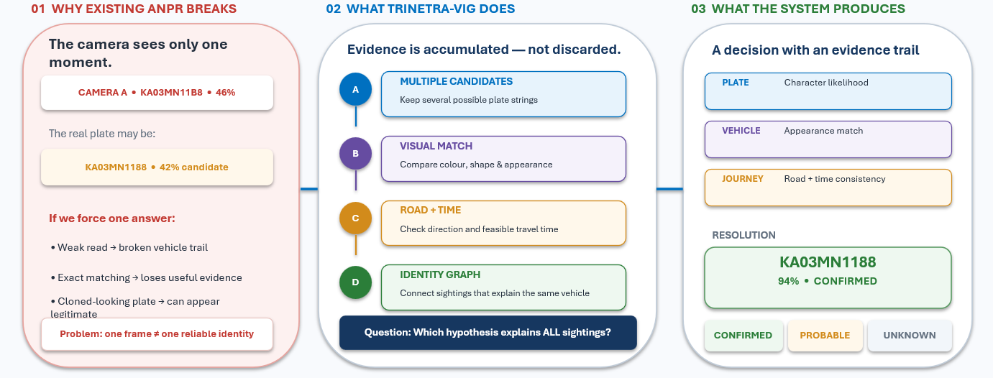
IDEA TITLE
    TRINETRA-VIG connects uncertain camera sightings into a verified, explainable vehicle journey.
KEY DIFFERENTIATOR
Later evidence can REPAIR an earlier weak match — while the original camera reading remains preserved for auditability.
Camera observations → Candidate hypotheses → Evidence fusion → Identity graph → Verified journey + alert
Notes:
Anant — about 45 seconds.
The problem is not simply reading a number plate. Rain, darkness, motion, dirt and camera angle can change one character. Current systems often commit to one string at each camera, so the vehicle trail breaks. TRINETRA keeps multiple candidates, then checks appearance, direction, time and road feasibility. In this synthetic example, later agreement resolves KA03MN1188 while preserving the original weak read.
Innovation: we are not claiming to invent ANPR or vehicle re-identification. Our contribution is the explainable fusion and reasoning layer after OCR.
Handover: The next slide shows exactly how evidence travels through the system.
[Sources]
- Problem, solution and synthetic example: user-provided TRINETRA project brief.
- PARSeq: https://doi.org/10.1007/978-3-031-19815-1_11
- CityFlow: https://openaccess.thecvf.com/content_CVPR_2019/html/Tang_CityFlow_A_City-Scale_Benchmark_for_Multi-Target_Multi-Camera_Vehicle_Tracking_and_CVPR_2019_paper.html

Slide 3
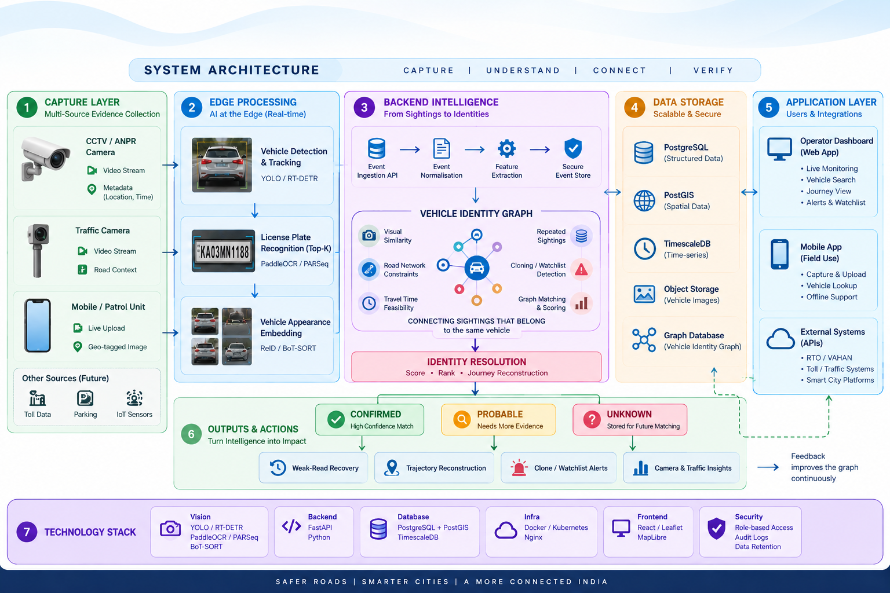
TECHNICAL APPROACH
Notes:
Piyush — about 43 seconds.
The flow is modular. A camera supplies the crop, time and location. Detection and tracking create a stable observation. We keep several plate possibilities instead of discarding uncertainty, compare the vehicle appearance, and send one secure event. The identity graph connects sightings only when appearance, direction, road and travel time agree. The operator receives the reconstructed journey and the evidence behind any alert.
Handover: Sushant will explain how we can pilot and scale this responsibly.
[Sources]
- ByteTrack: https://doi.org/10.1007/978-3-031-20047-2_1
- TransReID: https://openaccess.thecvf.com/content/ICCV2021/html/He_TransReID_Transformer-Based_Object_Re-Identification_ICCV_2021_paper.html
- CityFlow: https://openaccess.thecvf.com/content_CVPR_2019/html/Tang_CityFlow_A_City-Scale_Benchmark_for_Multi-Target_Multi-Camera_Vehicle_Tracking_and_CVPR_2019_paper.html
- Proposed architecture and production controls: user-provided TRINETRA project brief.

Slide 4
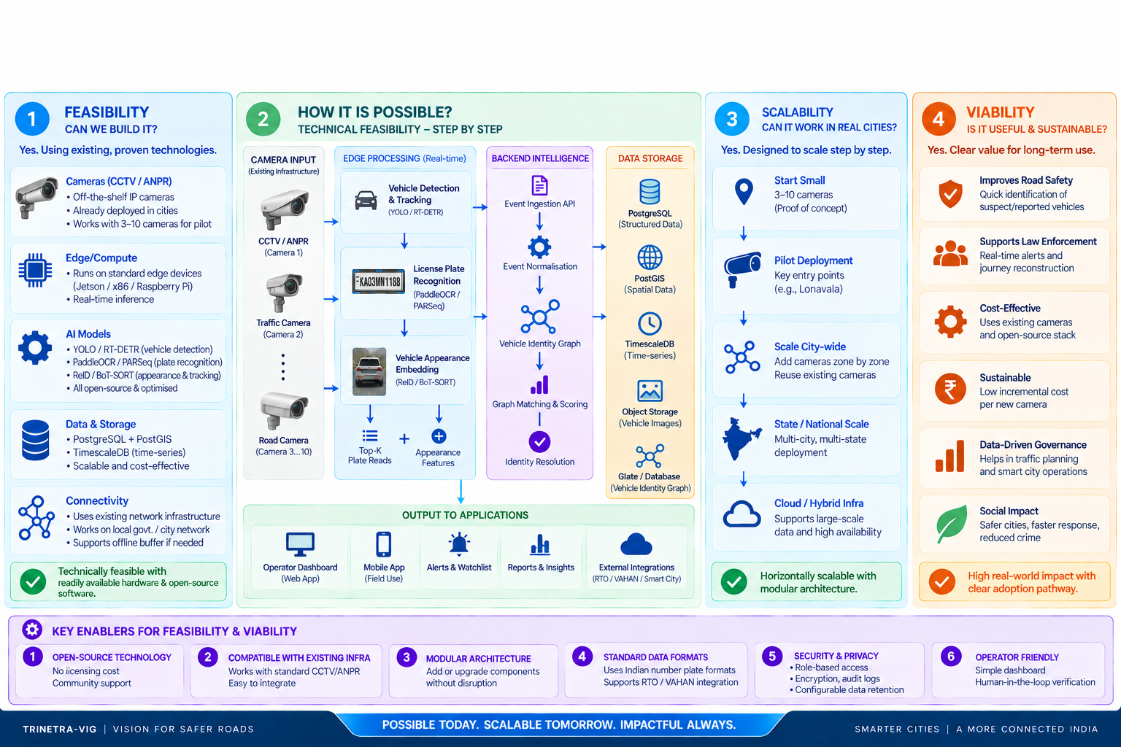
FEASIBILITY AND VIABILITY
Notes:
Sushant — about 43 seconds.
The prototype uses modular, proven components, so feasibility is tested in stages. First we prove weak-read recovery and clone reasoning on recorded feeds. Then a 3-to-10-camera Lonavala pilot calibrates Indian plates and measures operator workload. We scale only after accuracy, association, clone precision, latency and evidence-completeness gates pass. Every enforcement decision remains human verified and audited.
Handover: Piyush will show the functional proof, then Prathamesh will close on impact and novelty.
[Sources]
- Pilot structure, metrics and safeguards: user-provided TRINETRA project brief.
- Lonavala jurisdiction reference: Maharashtra Motor Vehicle Department, https://transport.maharashtra.gov.in/site/upload/pdf/Know%20Your%20RTO.pdf

Slide 5
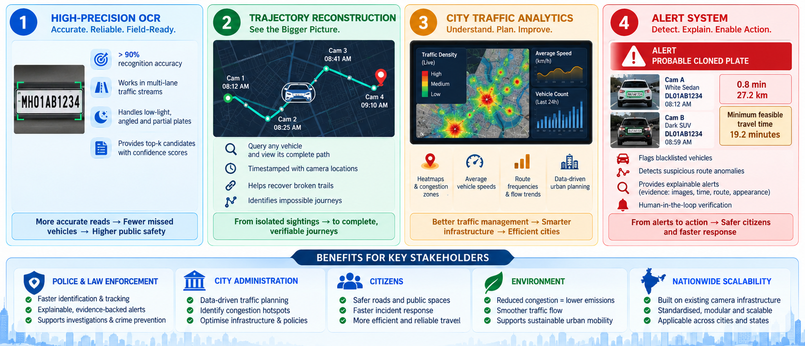
IMPACT AND BENEFITS
Notes:
Piyush — about 42 seconds.
These numbers are synthetic functional validation, not field accuracy. Isolated exact matching resolves 12 of 14 observations. The graph resolves all 14 by recovering two weak reads. For the clone test, the same registration appears on a white sedan and a dark SUV, 27.2 kilometres apart after 0.8 minutes; the minimum feasible journey is 19.2 minutes. The system explains the conflict and waits for human review.
Handover: Prathamesh will close with the research foundation and our precise contribution.
[Sources]
- All validation and clone values: user-provided TRINETRA project brief; synthetic observations only.

Slide 6
RESEARCH AND REFERENCES
Established components support each step; TRINETRA contributes the explainable fusion.
RESEARCH + GOVERNMENT FOUNDATION
OUR SYSTEM CONTRIBUTION
PARSeq
Bautista & Atienza • ECCV 2022
multiple scene-text hypotheses
A fusion layer that retains OCR uncertainty, compares vehicle appearance, checks road/time feasibility and preserves evidence when identity is revised.
ByteTrack
Zhang et al. • ECCV 2022
robust within-camera tracking
TransReID
He et al. • ICCV 2021
vehicle appearance evidence
CityFlow
Tang et al. • CVPR 2019
multi-camera association benchmark
NOT ANOTHER OCR MODEL
Innovation happens after OCR: the camera network reasons across observations before it alerts.
Maharashtra “Know Your RTO”
Motor Vehicle Department
Lonavala, Maval → MH-14 jurisdiction
JUDGE TAKEAWAY
Observe. Connect. Verify. Explain.
Support human action.
Website Link : https://trinetra-vig.vercel.app/
Notes:
Prathamesh — about 35 seconds.
The individual techniques are established and cited. Our contribution is their unified use as an explainable vehicle identity graph: retain OCR uncertainty, compare appearance, test road and time, preserve original evidence, and revise identity when later observations justify it. We do not claim access to private VAHAN owner records; production integration would require government authorization. Our closing promise is simple: observe, connect, verify, explain and support human action.
Thank you. We are ready to demonstrate the prototype.
[Sources]
- PARSeq: https://doi.org/10.1007/978-3-031-19815-1_11
- ByteTrack: https://doi.org/10.1007/978-3-031-20047-2_1
- TransReID: https://openaccess.thecvf.com/content/ICCV2021/html/He_TransReID_Transformer-Based_Object_Re-Identification_ICCV_2021_paper.html
- CityFlow: https://openaccess.thecvf.com/content_CVPR_2019/html/Tang_CityFlow_A_City-Scale_Benchmark_for_Multi-Target_Multi-Camera_Vehicle_Tracking_and_CVPR_2019_paper.html
- Maharashtra Motor Vehicle Department, Know Your RTO: https://transport.maharashtra.gov.in/site/upload/pdf/Know%20Your%20RTO.pdf

