Slide 1
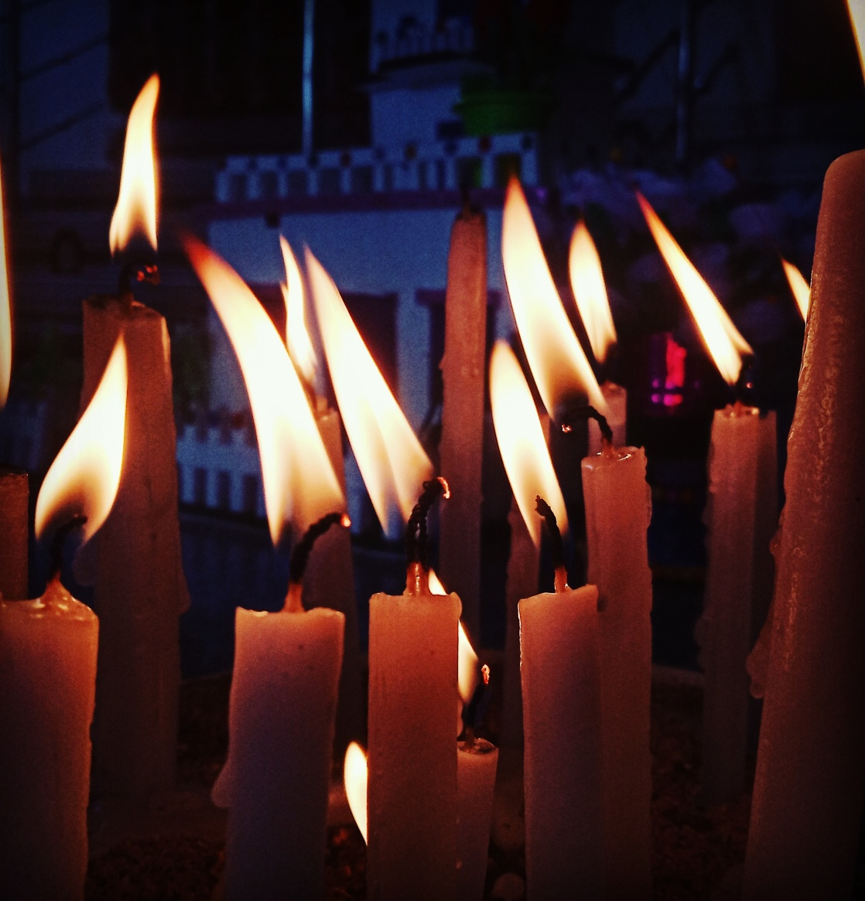
Life and candles
Life is just a burning candle. A burning candle melts slowly and slowly giving out light …...
“Thousands of candles can be lighted from a single candle, and the life of the single candle will not be shortened. Happiness never decreases by being shared.”
Like the light of candle shows us the path we are moving on similarly we should give the right direction to others life and hlp them and fill their lives with happiness and joy.

Slide 2
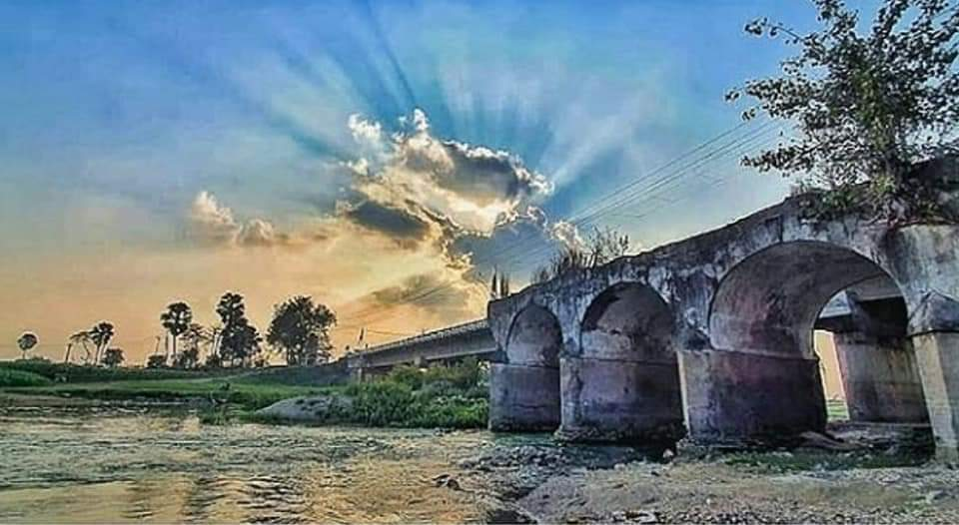
River and Bridge
“ I believe in going with the flow . I don’t believe in fighting against the flow. You ride on your and you go with the tides and the flow . But it has to be your river , not someone else’s . Everyone has their own river , and you don’t need to swim , float , sail , on their’s , but you need to be in your own river and you need to go with it . And I don’t believe In fighting the wind. You go and you fly with your wind . Let everyone else catch their own gusts of wind and let them fly with their own gusts of wind and you go and you fly with yours .

