Slide 1
IntelliScan
AI-Powered Business Card Scanner & Intelligent CRM Automation
Submitted by: Anant Prabhudesai (245300694048)
Internal Guide: Prof. Nil Gosai | SVIT, Vasad | April 2026

Slide 2
Agenda
01 Introduction and Industry Context
02 Overview of the Platform
03 Core Platform Features
04 Workflow of the System
05 Tools & Technology Used
06 System Design
07 Development
08 Agile Documentation
09 Proposed Enhancements
10 Conclusion

Slide 3
Introduction & Industry
Context

Slide 4
Introduction & Industry Context
B2B networking still begins in the physical world (events, meetings, conferences).
Manual CRM entry causes delays, errors, and lost opportunities.
Sales teams need instant capture + deduplication + routing + follow-ups in one workflow.
LLM + Vision OCR enables accurate extraction and demographic inference at scan-time.

Slide 5
About IntelliScan (Overview)
Enterprise-grade web platform for end-to-end lead capture and pipeline execution.
AI card scanning with OCR + Gemini Vision to extract text and infer missing demographics.
Shared workspace (Rolodex + Kanban pipeline) to prevent double-outreach.
Email marketing hub for AI-authored follow-ups and scheduled drip sequences.
Public networking tools (public profile + calendar links) to convert leads into meetings.

Slide 6
Core Platform
Features

Slide 7
Core Platform Features
AI Card Scanning & Deduction Engine
Multimodal extraction (image → structured contact)
Industry/Seniority inference to enrich lead profiles
Shared Rolodex & CRM Pipeline
Workspace-wide contact store with deduplication alerts
Kanban-style pipeline tracking and stage progression
Email Marketing Hub
AI Composer for personalized follow-ups
Drip sequences + engagement telemetry (opens/clicks)
Public Networking Tools
Public profile (digital business card)
Calendar booking links for frictionless scheduling

Slide 8
End-to-End Workflow
Scan / Upload
Camera or file upload
AI Extract
OCR + structured fields
Infer
Industry & seniority
Deduplicate
Workspace match alerts
Route
Assign to rep / pipeline
Manage
Kanban stages & notes
Compose
AI email drafting
Schedule
Automated sequences

Slide 9
Tools & Technologies Used
Frontend | Backend | Database | AI Integration | Dev & Testing
React (Vite) | Node.js + Express | SQLite | Google Gemini Pro Vision | Git + Postman
Tailwind CSS | REST APIs | Relational schema | OCR + demographic inference | npm

Slide 10
System
Design

Slide 11
Target Users & Roles
Enterprise Sales Teams
Event Marketing / HR Recruitment Teams
Executive Networking Professionals
RBAC roles: Super Admin, Enterprise Admin, Workspace Member, Anonymous (Public Profile)

Slide 12
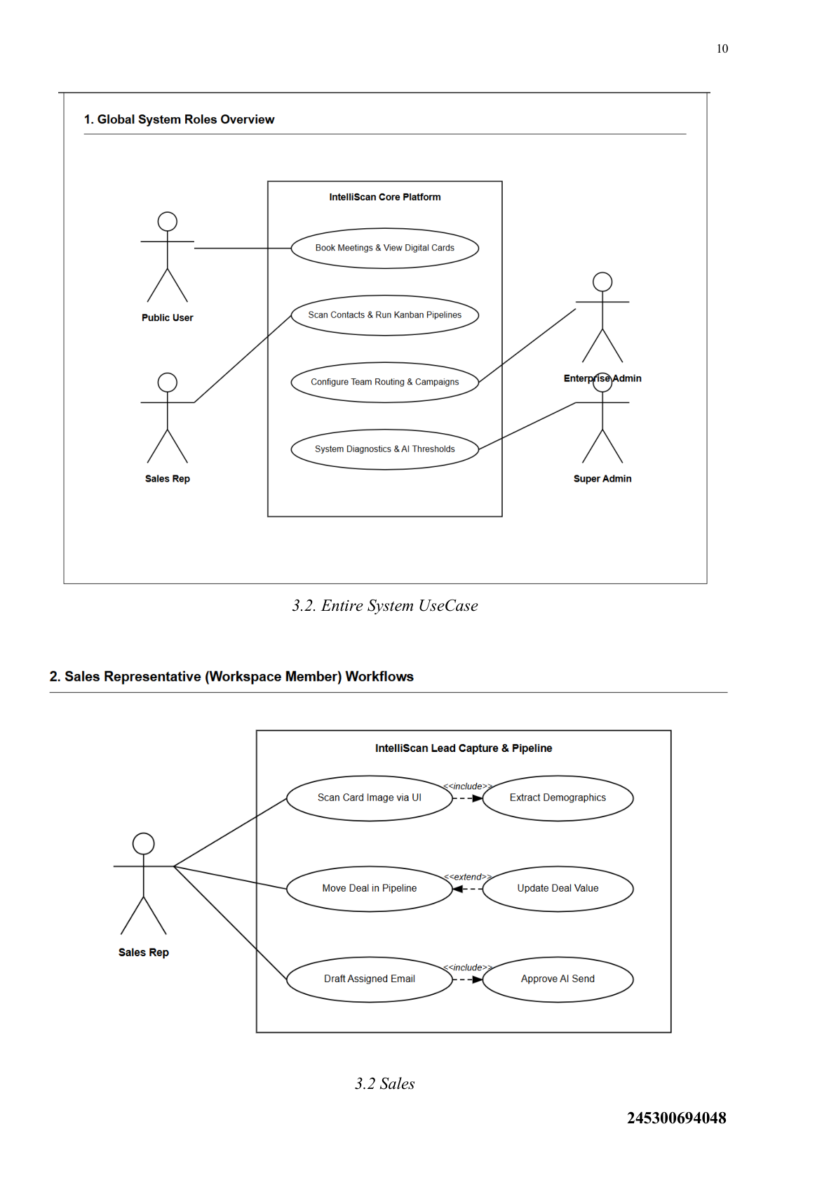
Use Case Diagram (Entire System + Sales)

Slide 13
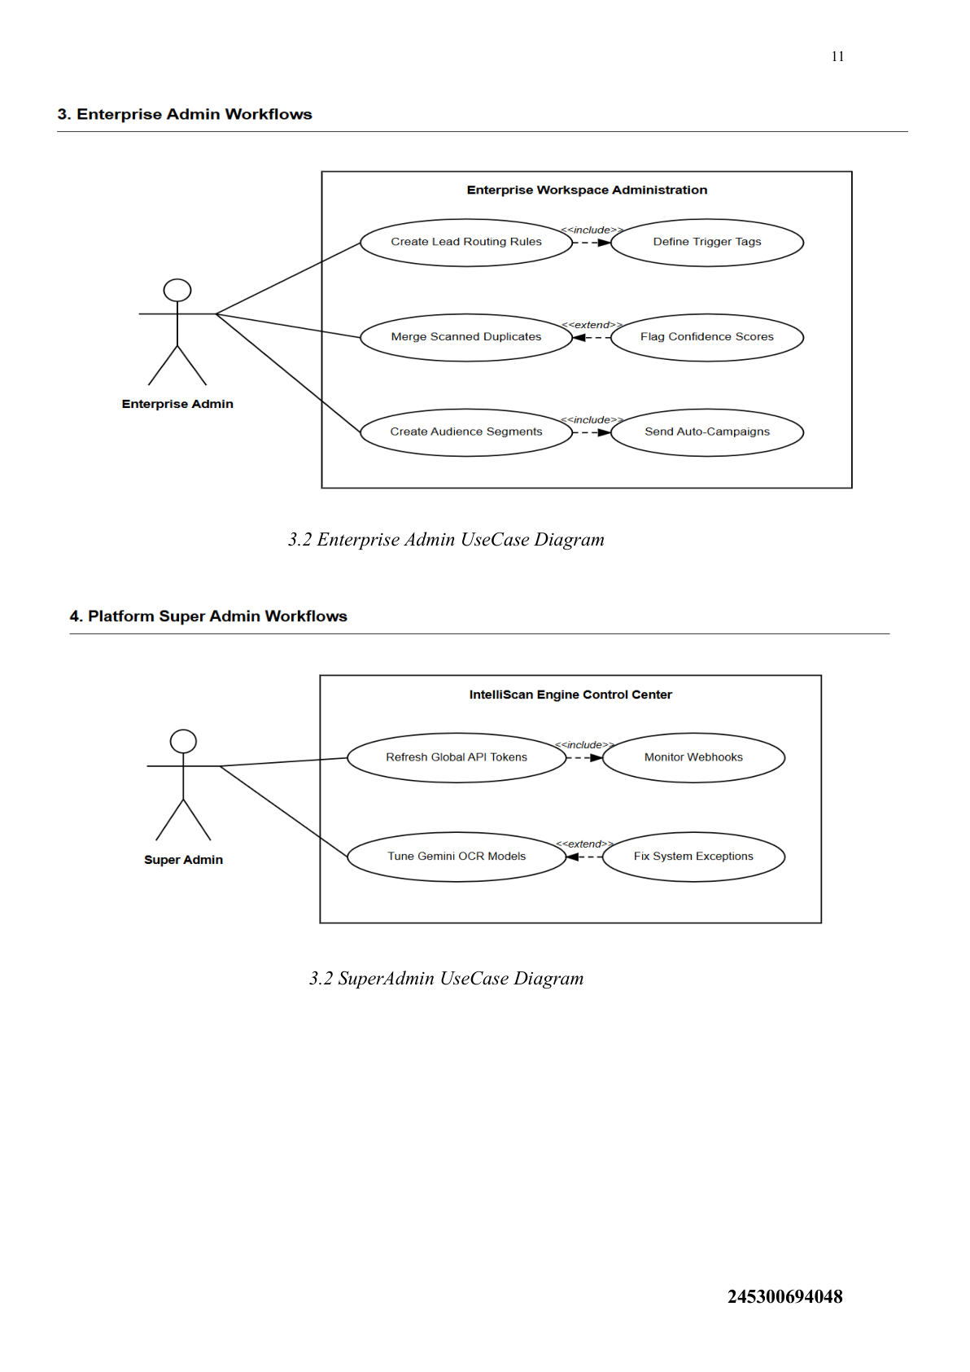
Use Case Diagram (Enterprise Admin + Super Admin)

Slide 14
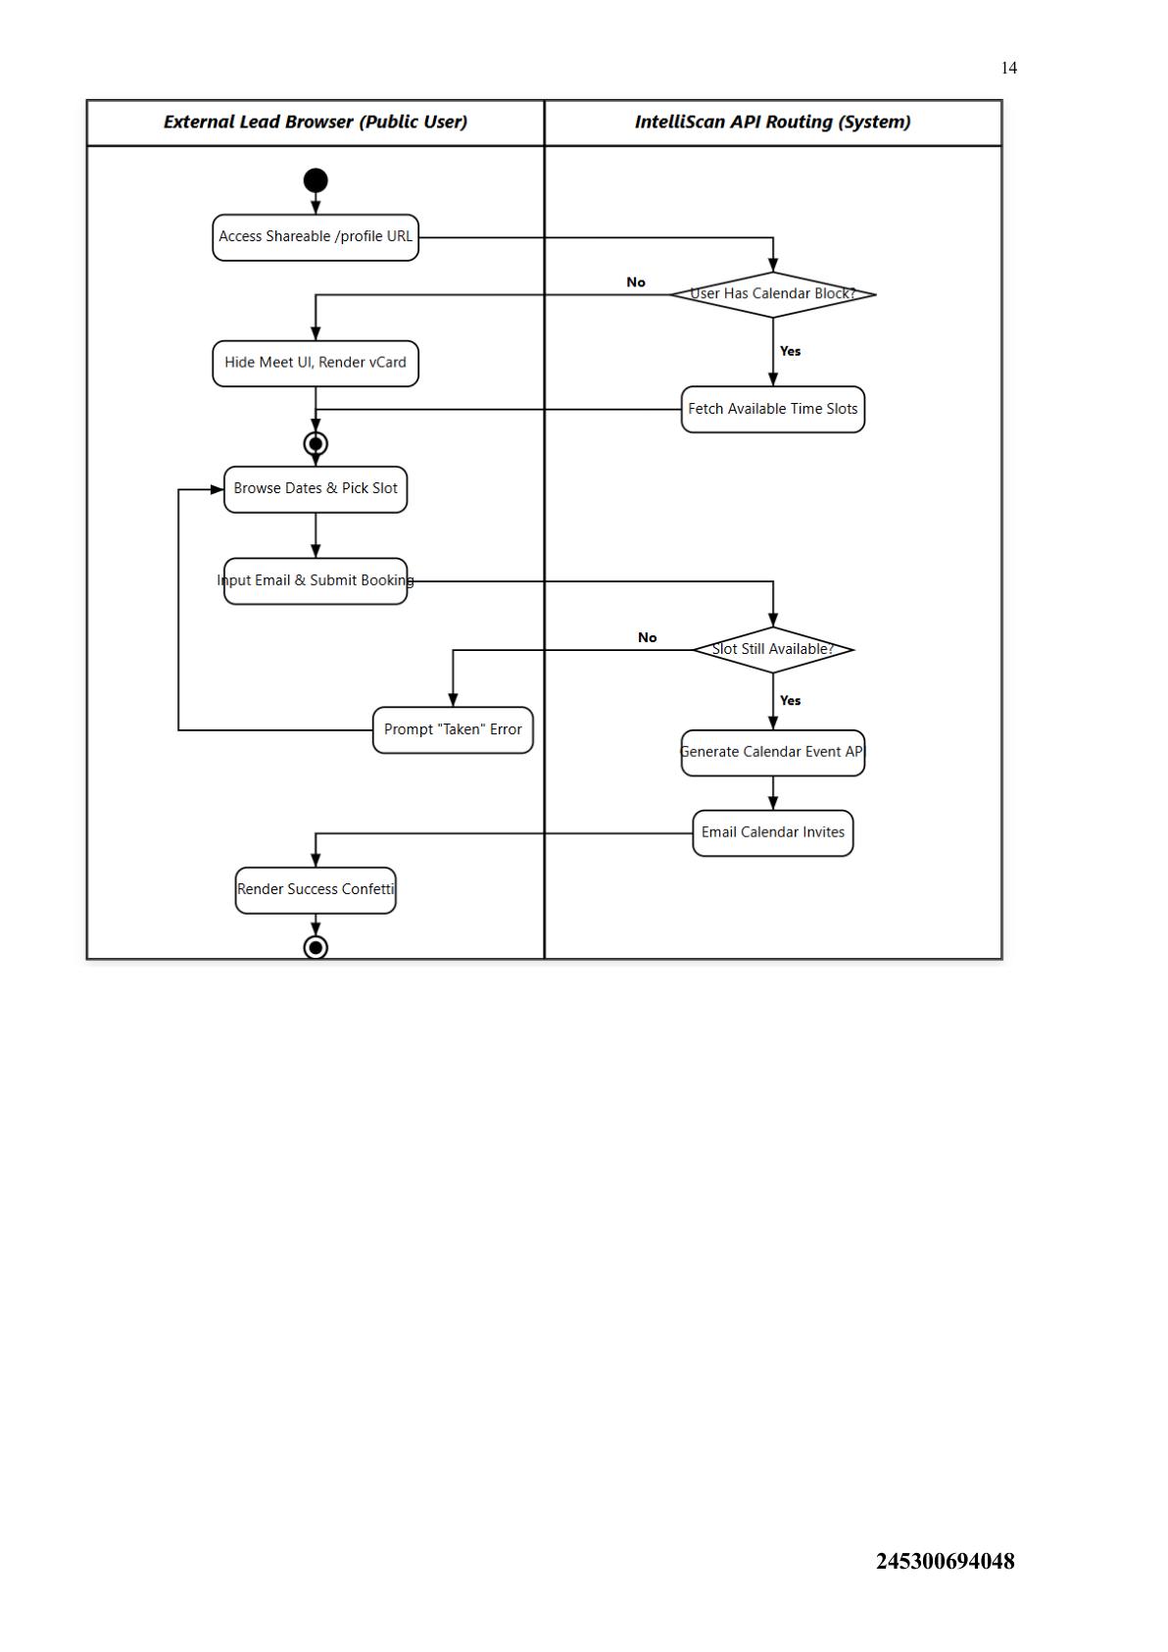
Activity Diagram (Public Booking / Calendar Flow)

Slide 15
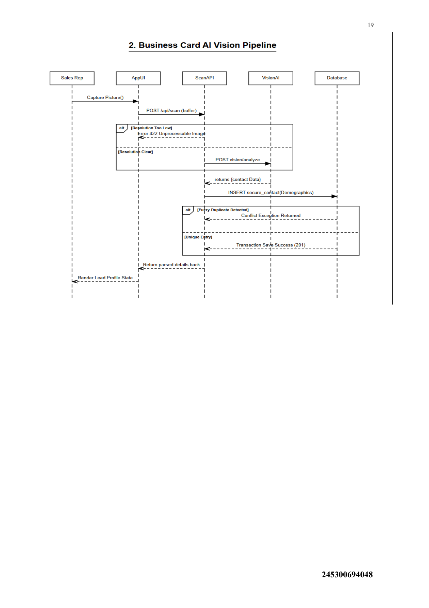
Sequence Diagram (Business Card AI Vision Pipeline)

Slide 16
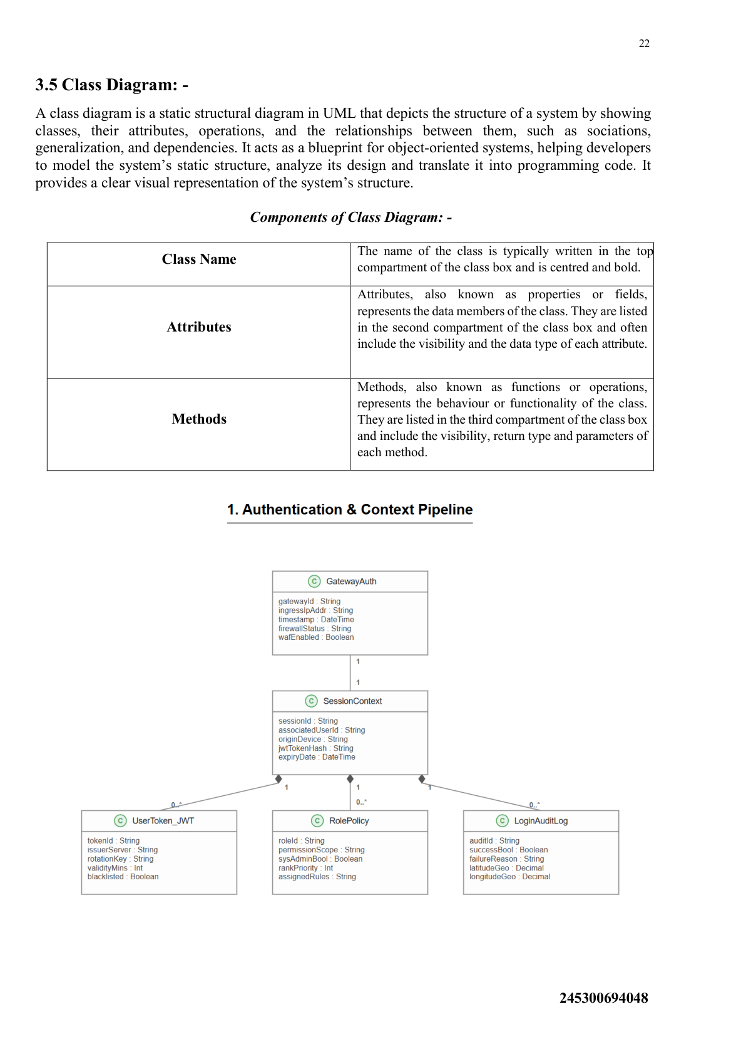
Class Diagram (Authentication & Context Pipeline)

Slide 17
Data Dictionary (Key Tables)
Table | Primary Purpose | Key Fields | Constraints | Notes
Workspaces | Tenant/company context | workspace_id, company_name | PK, NN | quota_scans, max_users
Users | Authentication + RBAC | user_id, workspace_id, email | PK, FK, UQ | password_hash, is_active

Slide 18
Data Dictionary (Leads & Scans)
Table | Primary Purpose | Key Fields | Constraints | Notes
Contacts | Lead record | contact_id, workspace_id | PK, FK | pipeline_stage, confidence_score
Scanned_Images | Raw image & OCR | image_id, contact_id | PK, FK | raw_ocr_json

Slide 19
Data Dictionary (Automation)
Table | Primary Purpose | Key Fields | Constraints | Notes
Events | Campaign grouping | event_id, workspace_id | PK, FK | custom_qr_url
Email_Campaign_Nodes | Email queue | campaign_id, target_contact_id | PK, FK | delivery_status
Calendar_Bookings | Public scheduling | booking_id, host_user_id | PK, FK | start/end blocks

Slide 20
Development
(UI Screens)

Slide 21
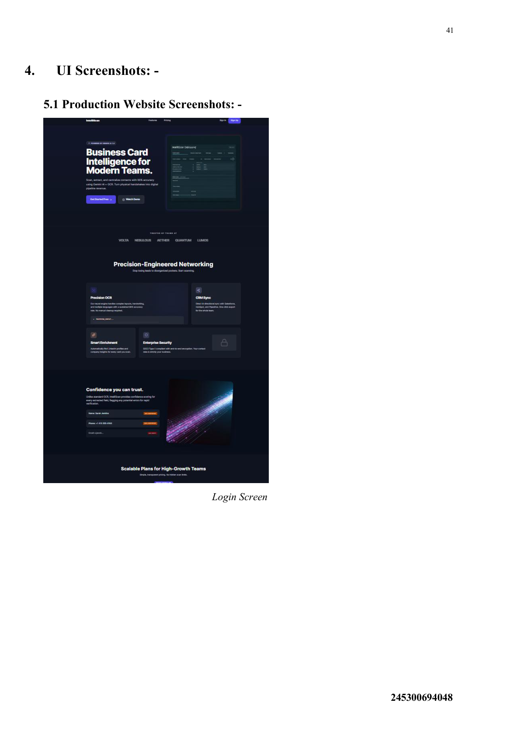
UI Screenshot: Landing / Login Screen

Slide 22
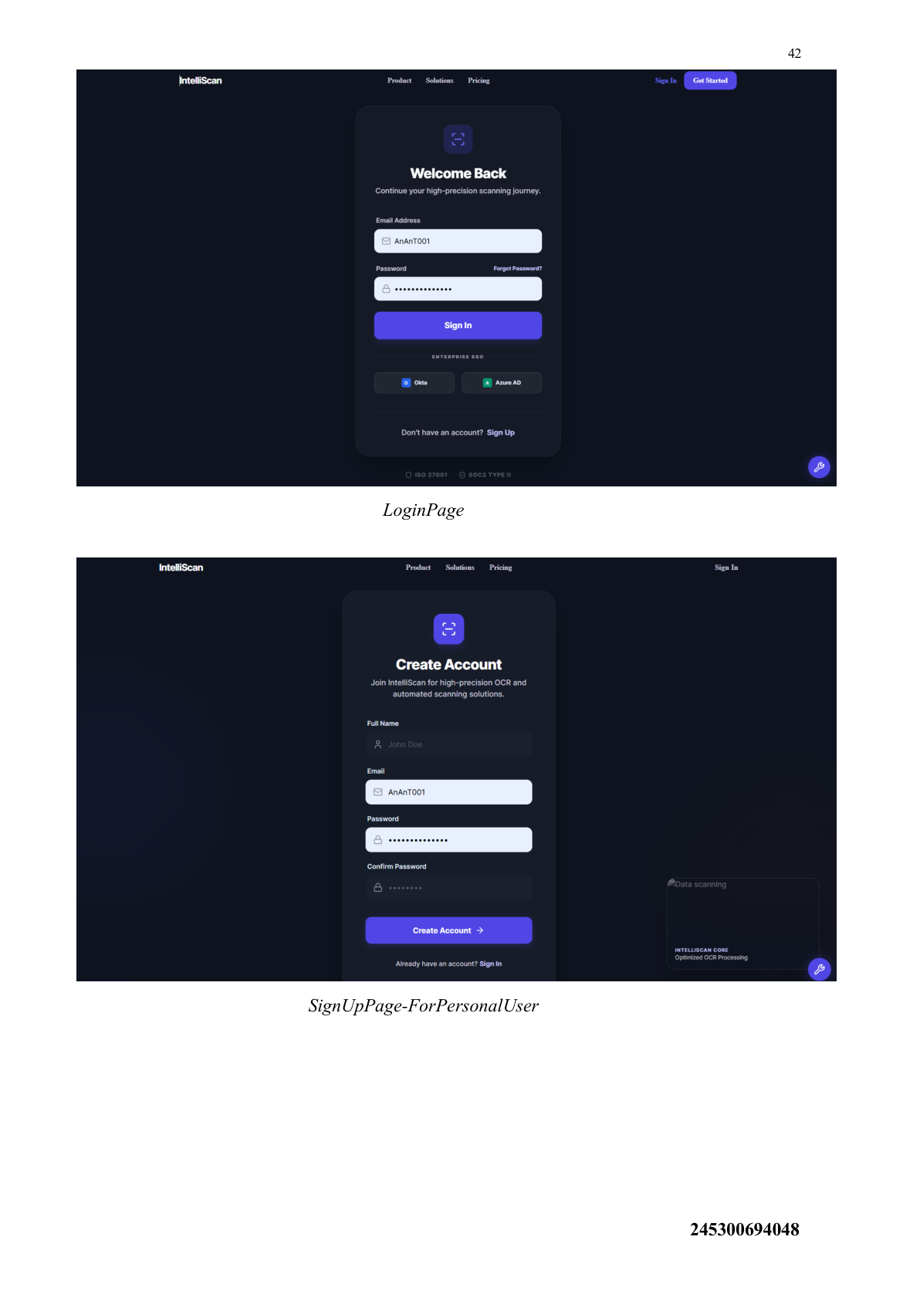
UI Screenshot: Login + Sign Up

Slide 23
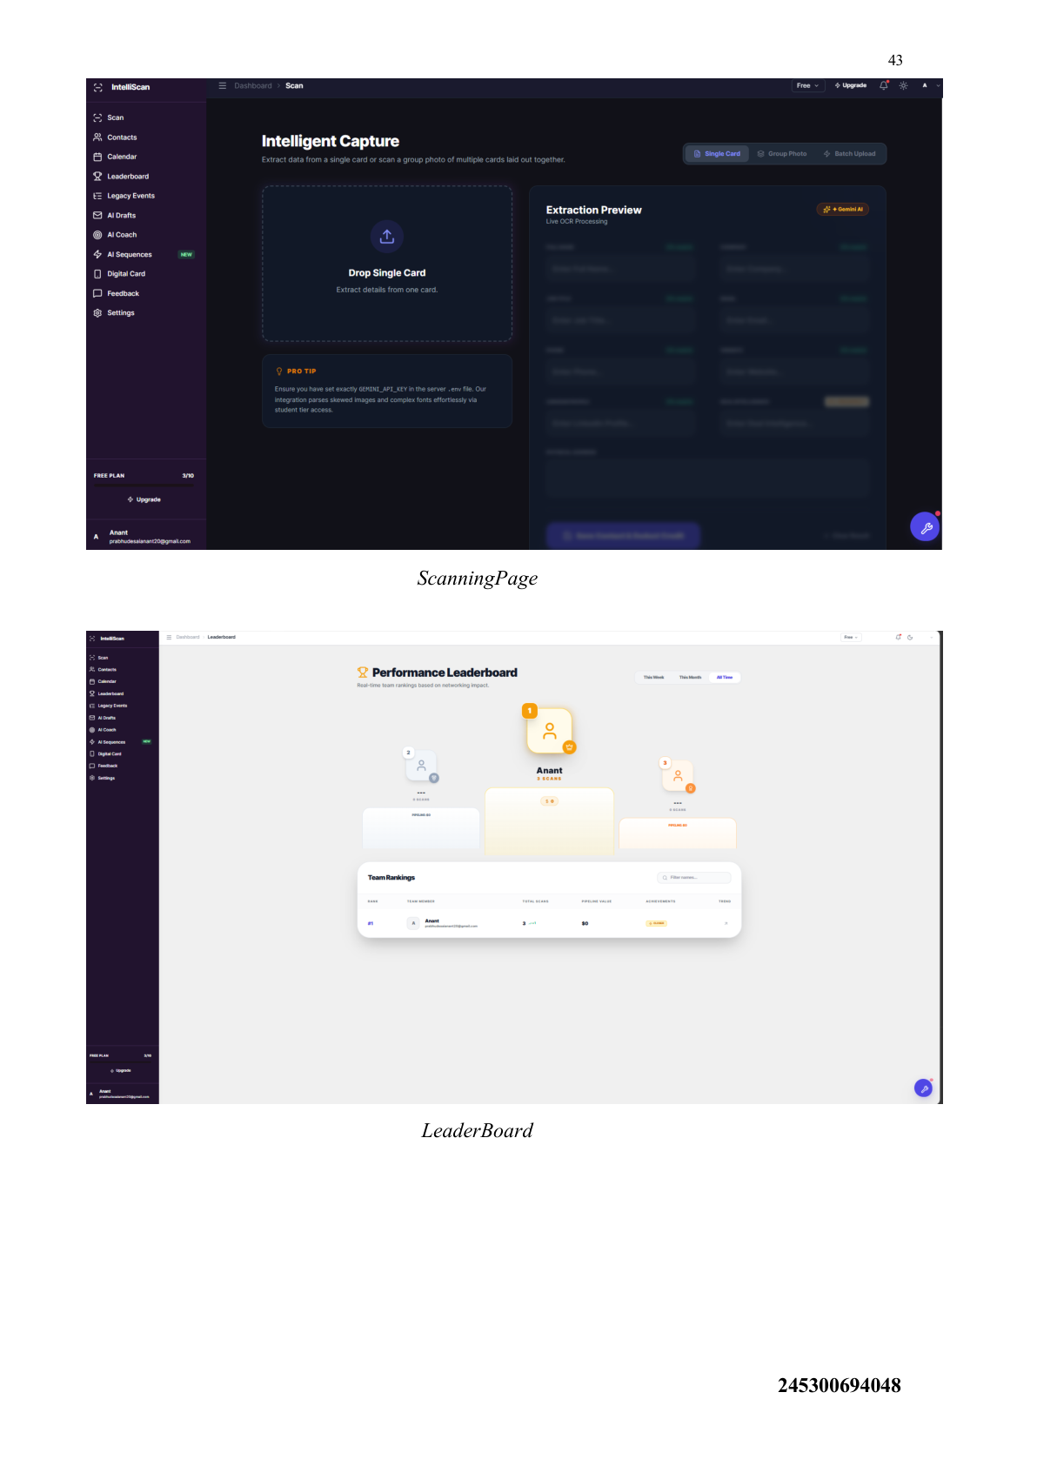
UI Screenshot: Scanning Page + Leaderboard

Slide 24
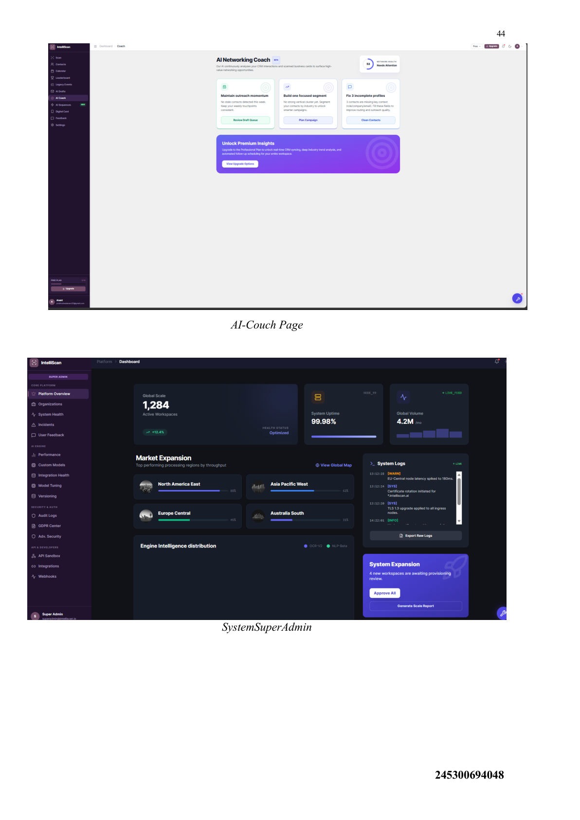
UI Screenshot: AI Coach + System Super Admin

Slide 25
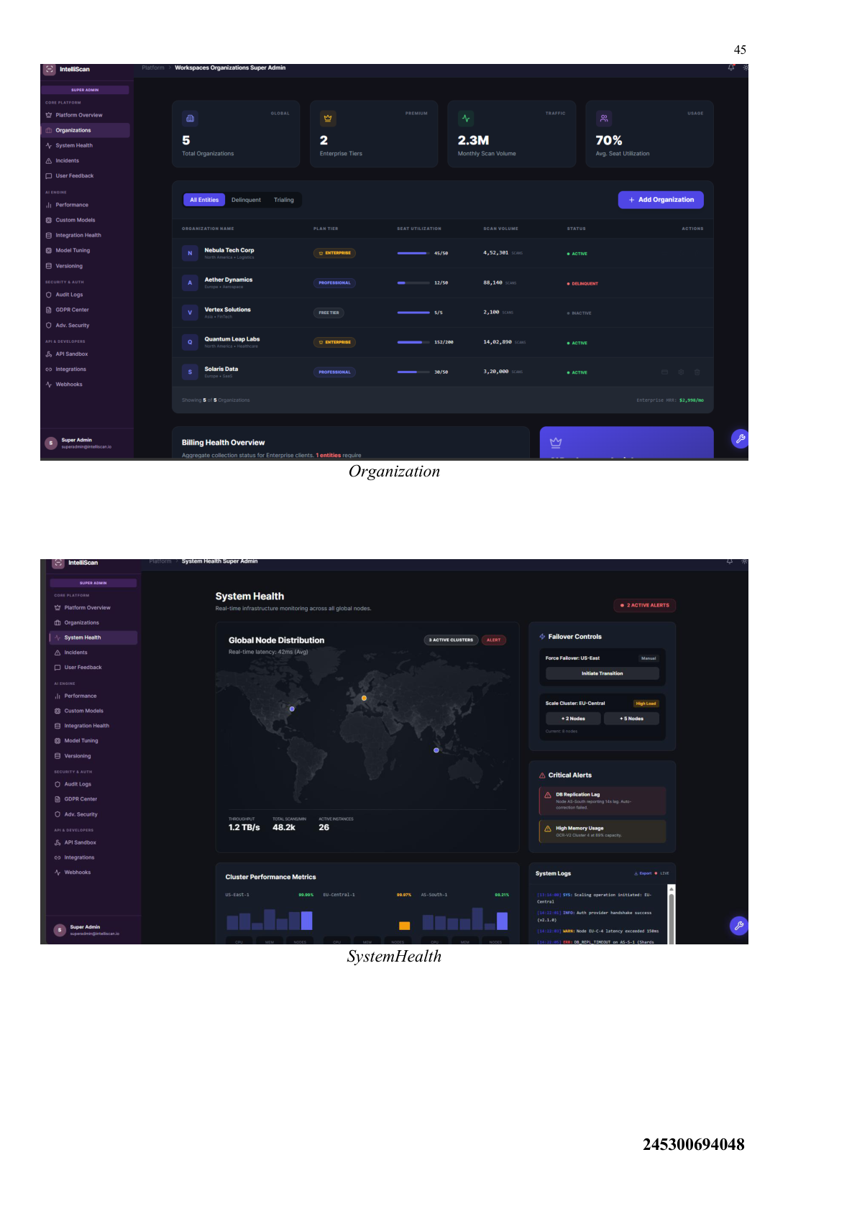
UI Screenshot: Organization + System Health

Slide 26
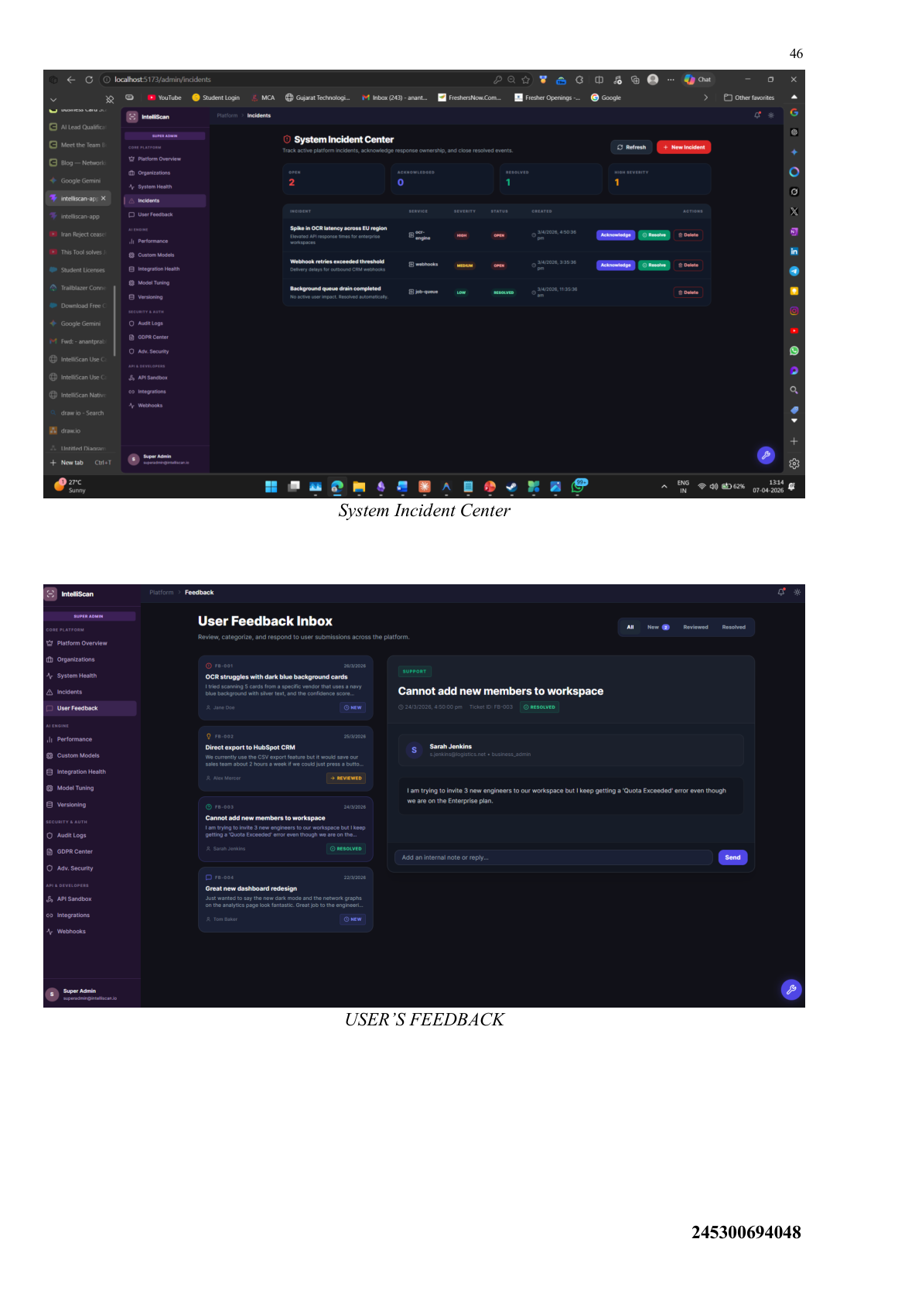
UI Screenshot: Incident Center + Feedback

Slide 27
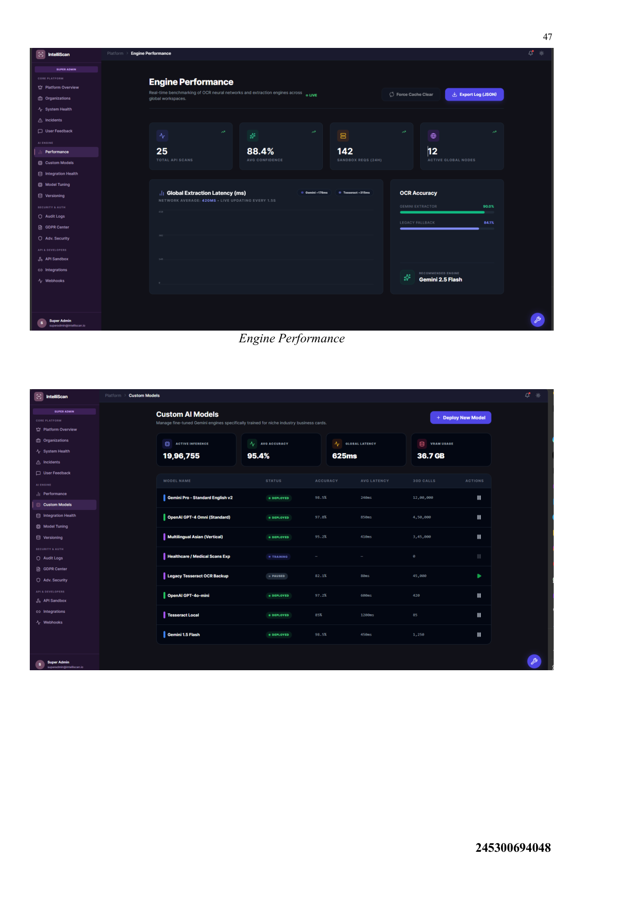
UI Screenshot: Engine Performance

Slide 28
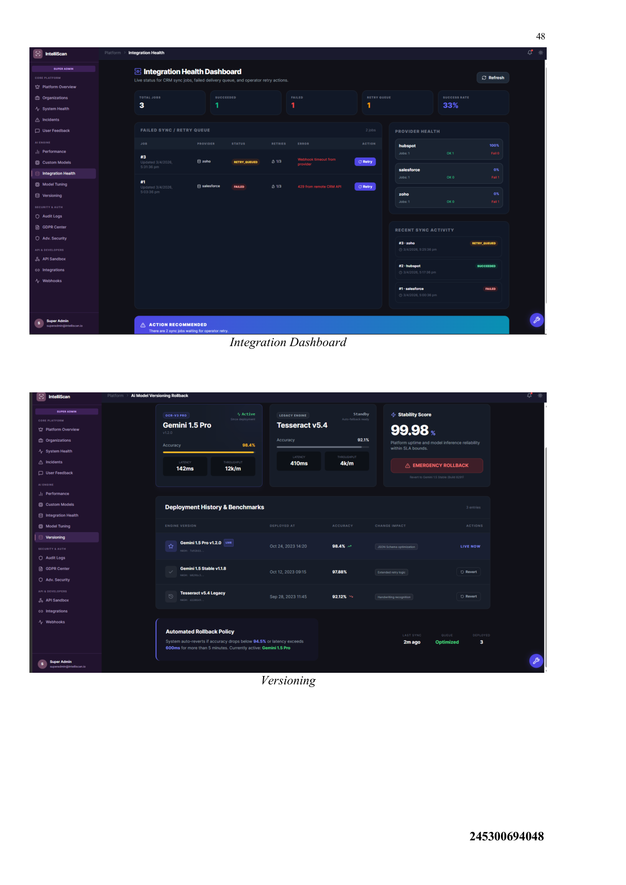
UI Screenshot: Integrations + Versioning

Slide 29
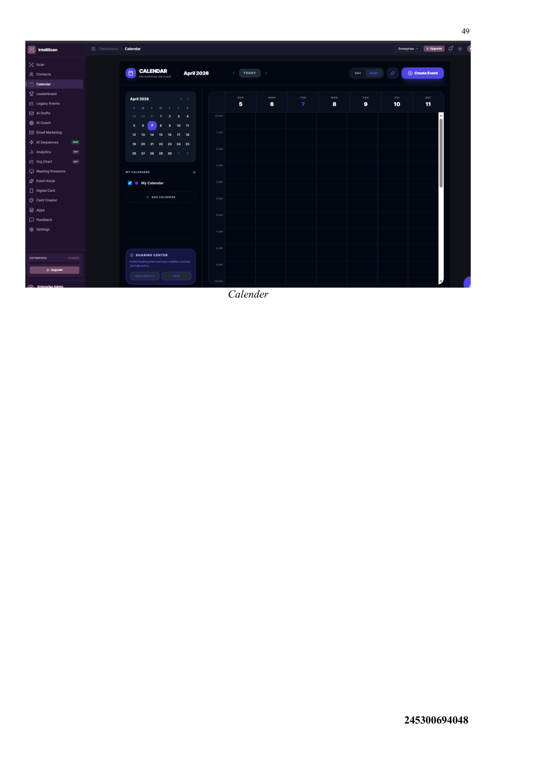
UI Screenshot: Calendar

Slide 30
Agile
Methodology

Slide 31
Agile Project Charter (Summary)
Project Title: IntelliScan
Duration: 02/01/2026 – 30/04/2026
Deliverables: AI Scanner, CRM Pipeline, AI Email Sequences, Event/Kiosk Module
Risks: API rate limits/latency, complex React state, low-quality images
Assumptions: stable internet, SMTP credentials available, adequate server resources

Slide 32
Agile Roadmap
Q1 (02/01–16/01): Requirements + architecture + React/Node setup
Q2 (19/01–30/01): DB schema + JWT auth + multi-tenancy
Q3 (02/02–13/02): Gemini Vision integration (single & batch scanning)
Q4 (16/02–27/02): CRM pipeline + semantic search + export
Q5 (02/03–13/03): Email marketing hub + automation engine
Q6 (16/03–27/03): Calendar + kiosk mode + enterprise theme
Q7 (30/03–10/04): Testing + performance + deployment configs
Q8 (13/04–30/04): Final documentation + submission

Slide 33
Agile Project Plan
Release: v1.0
Goals: architect an enterprise-grade AI SaaS and optimize heavy data workflows
Core tasks: React state management, Gemini APIs, SQLite backend, integration testing, UI/UX rollout
Success criteria: all modules integrated; documentation clarity; OCR accuracy

Slide 34
User Stories (Core Modules)
AI Scanning Module: image → mapped CRM fields automatically
CRM Data Pipeline: repository + smart semantic search + exports (CSV/vCard)
Automated AI Sequences: personalized follow-ups based on inferred context
Event & Kiosk Module: bulk lead capture during events + assignment to campaigns

Slide 35
Sprint Backlog (Completed Highlights)
Sprint 1: requirement analysis, React setup, DB schema + UI prototypes
Sprint 2: JWT auth + multi-tenancy; backend routing logic
Sprint 3: Gemini Vision integration + scanning endpoint UI wiring
Sprint 4: CRM pipeline + filtering; semantic search
Sprint 5: AI email sequences; responsive CRM tables
Sprint 6: calendar + kiosk mode; enterprise UI theme rollout
Sprint 7: integration/system testing; academic documentation

Slide 36
Earned Value Summary
Sprint | Planned Hours | Actual Hours | Earned Value
Sprint 1 | 240 | 240 | 10
Sprint 2 | 240 | 200 | 8.3
Sprint 3 | 240 | 200 | 8.3
Sprint 4 | 240 | 336 | 14
Sprint 5 | 240 | 240 | 10
Sprint 6 | 240 | 190 | 7.9
Sprint 7 | 120 | 100 | 8.3

Slide 37
Proposed Enhancements
Secure connectors to external CRMs (Salesforce/HubSpot/SAP) with scoped permissions
Advanced routing rules and scoring (industry + seniority + engagement)
Improved batch processing and image-quality feedback
Workspace collaboration improvements (audit logs, mentions, shared notes)
Scaling to very large datasets (indexing + background jobs)

Slide 38
Conclusion
IntelliScan bridges physical networking and digital sales execution.
Unifies scanning, CRM pipeline, and automated follow-ups in one workspace.
Reduces manual effort, speeds outreach, and prevents duplicate contact collisions.
Built with modern full-stack tools and Gemini Vision-powered intelligence extraction.

Slide 39
Thank You
Questions?

