Slide 1
Nesterov Accelerated Gradient Descent
Momentum based gradient descent works good in gentle regions but it overshoots sometimes as its moving really fast and having many oscillations. And then it has to take a lot of U-turns.
Any better way to avoid this ? … Yes. The main idea is ‘ Look before you leap ‘.
Nesterov accelerated gradient descent update has two steps.
We know that we are moving at least by the history term. So think !!! what can we do next ??
Yeah !! we are calculating gradient at the look ahead point.
This prevent us from moving too fast and increased responsiveness.

Slide 2
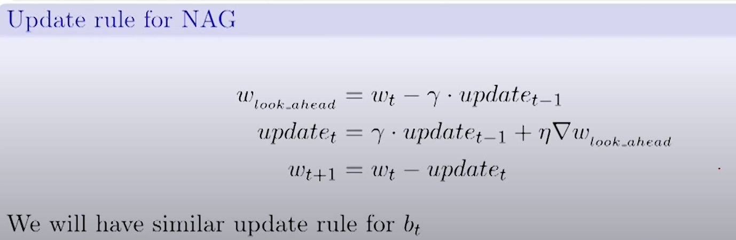
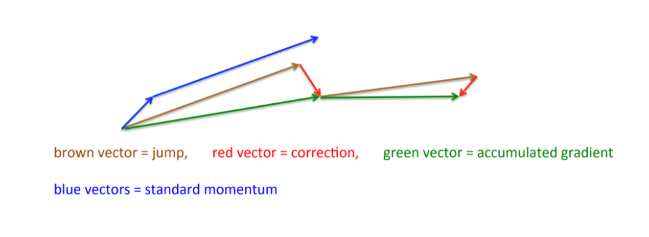

Slide 3
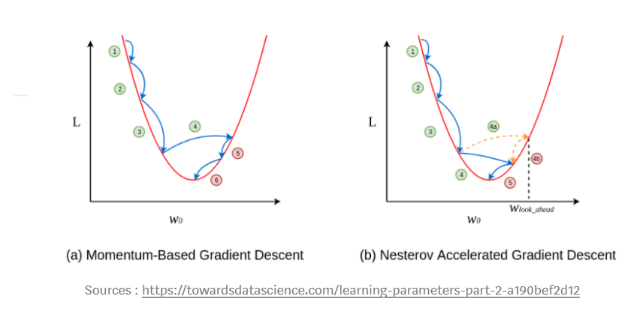

Slide 4
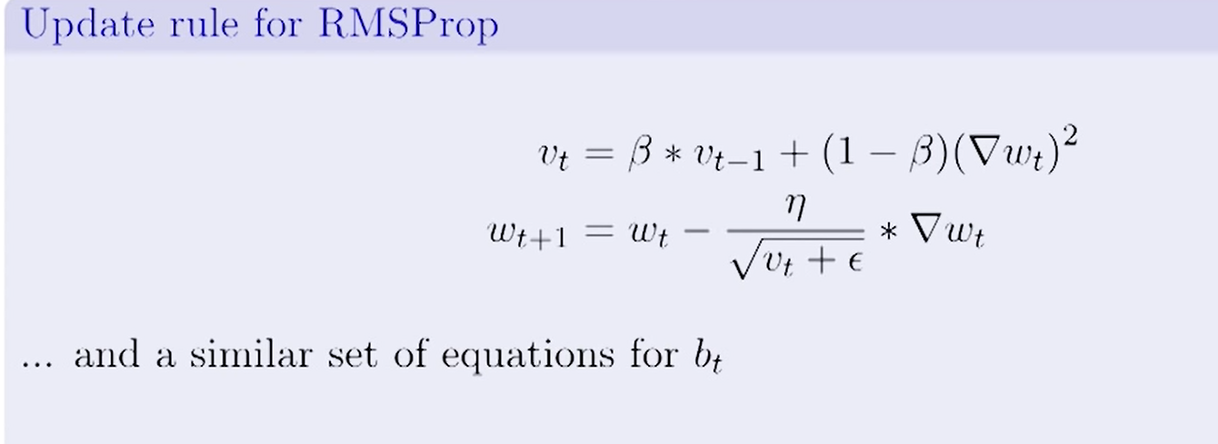
Root Mean Squared Prop
Adagrad decays the learning rate very aggressively( as the denominator grows ).
As a result , after a while the frequent parameters will start receiving smaller updates because of decayed learning rate.
To overcome this , RMSprop is introduced.
Beta is close to 0.95. We are doing the same thing but we aren't doing aggressively. At each step ,we are multiplying a fraction of it.

Slide 5
Additional strategy for optimizing SGD
Shuffling and curriculum learning :
Try to avoid providing the training examples in a meaningful order as this may bias the optimization algorithm.
It is often a good idea to shuffle the training data after every epoch.
Sometimes supplying the training examples in a meaningful order may actually lead to improved performance. It is called curriculum learning.
Batch Normalization :
Normalize the initial values of our parameters by initializing them with zero mean and unit variance.
It reduces the sensitivity to initializing starting weights.
Batch normalization reestablishes these normalizations for every mini-batch.Batch normalization additionally acts as a regularizer.

Slide 6
3. Early Stopping :
Always monitor error on a validation set during training and stop if your validation error does not improve enough.
4. Gradient Noise :
Adding this noise makes networks more robust to poor initialization and helps training particularly deep and complex networks.

Slide 7
Resources :
https://www.youtube.com/watch?v=sV9aiEsXanE
https://www.youtube.com/watch?v=FKCV76N9Ys0
https://arxiv.org/pdf/1609.04747.pdf
https://medium.com/iitg-ai/into-the-depths-of-gradient-descent-52cf9ee92d36
https://ruder.io/optimizing-gradient-descent/index.html

