Slide 1


Apache Hadoop Yarn
What is Yarn
Problems with Hadoop
What does Yarn Do ?
Old Architecture
New Architecture
Yarn Example
Additions

Slide 2
Hadoop Yarn – What is it ?
Next Generation MapReduce MRv2
Split Job Tracker into
Resource Manager
Scheduling / Monitoring
Improves scaling
Improves resource management
Already used by Yahoo

Slide 3
Problems with Hadoop 1.0
Problems with large scaling
> 4000 nodes
> 40k concurrent tasks
Problems with resource utilization
Slots only for Map or Reduce
Single NameNode, single point of failure
Clients and Cluster must be at same version

Slide 4
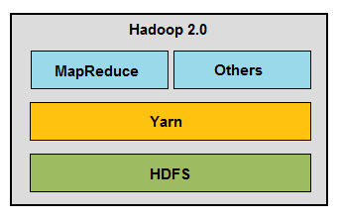
What does Yarn do ?
Provides a cluster level resource manager
Adds application level resource management
Provides slots for jobs other than Map / Reduce
Improves resource utilization

Slide 5
Thank you,
Anant S. Shelgaonkar,
(9923127569,7820809661)

