Slide 1

WELCOME TO LOAN PROCESSING SYSTEM

Slide 2
Contents
Project Objectives
Problem Statement
Modules
Project Work Flow
Technologies Used
Conclusion

Slide 3
Objective
General Objective :To automate the process of Loan Processing System & Management & hence minimize errors resulting from manual system operations
Special Objective : To develop distinguished institutions and organize loan management.
There are many goals and focus:
1.Saving time and effort.
2.Eliminate the use of paperwork for transactions.
3.Customer's vision towards the organization.

Slide 4
Problem Statement
Most loan providers still use the old fashion, where they record all the details on the papers. No online service. When a customer wants to know the remaining amount, he needs to go to in person or contact the provider. Then, the provider representative has to review the customer details manually and calculate the remaining amount. Unfortunately, this method is a waste of time, inaccurate and inefficient.
Loan Processing System Application Development is an application where Customer can apply loan , access loan information, and interact with the loan providers through this application.

Slide 5
Modules
There are basically 3 types of users:
Admin
Customer
Client

Slide 6
Admin
The administrators will be able to perform following functionalities :
Login to the system using his/her credentials.
Add or delete information of the loan programs offer by the home finance provider.
View List of loan applications approved/accepted (waiting for interview)/rejected for a loan program.
Add clients and generate his/her login credentials and delete client.

Slide 7
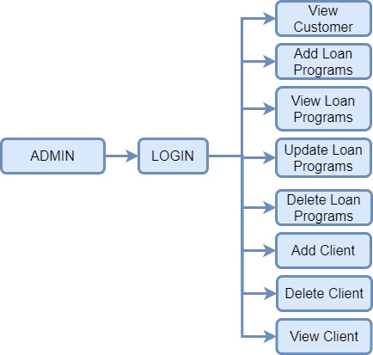
Admin job

Slide 8
Client
The Client can perform following functionalities:
Login into the system using his/her credentials.
View all loan programs offered by the home finance provider
View loan applications for a specific loan program. Accept/Reject an application on the basis of the details of the customer

Slide 9
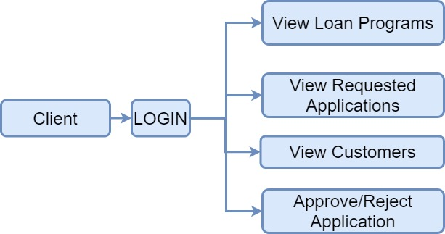
Client job

Slide 10
Customer
Customers will be able to perform following functionalities :
Login into the system using his/her credentials.
View all loan programs offered by the home finance provider.
Apply online for a loan program offered by the home finance provider, by filling up the application form that auto generates the application ID.
View the application status of application, based on the application ID.

Slide 11
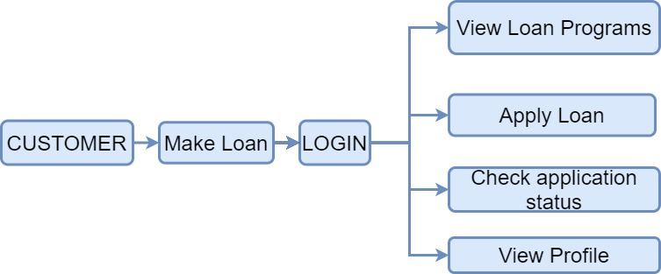
Customer Job

Slide 12
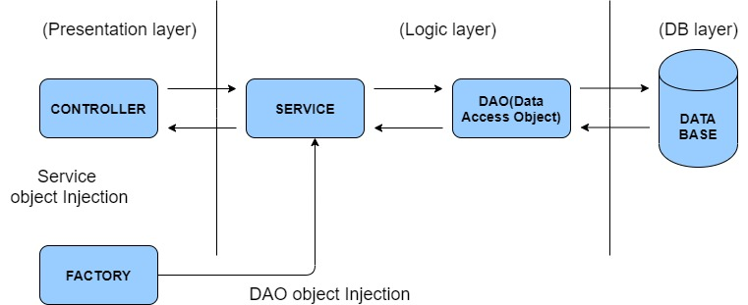
Project Work Flow

Slide 13
Technologies Used
Collections Framework + Core Java
log4j
Junit

Slide 14
Conclusion
The Loan Automation Application Software would help boost a lending institution’s customer service in many ways, and make the lending operations more efficient and transparent.
The computational speed, accuracy and storage capabilities of the computer would merge with the creativity and intuition of the human to make it all a success.
The outcome provides a loan automation application that saves paper works throughout the life of the loan, and makes available its design, a guide or foundation towards creation of similar or improved systems.

Slide 15

THANK YOU

