Slide 1

Predicting Insurance Claim Severity
Anant Kumar Verma

Slide 2

Introduction
Business Problem
Insurance companies need to predict claim severity to optimize pricing and risk assessment.
High claim amounts can impact profitability, while underpricing can lead to losses.
Objective
Build a predictive model to estimate claim amounts based on vehicle, driver, and policy attributes.
Use machine learning techniques to identify key factors influencing claim severity.
Provide actionable insights for improving risk management and pricing strategies.

Slide 3


Dataset Overview
Key Variables in the Dataset
Policy-related: Policy age, claims history
Vehicle-related: Age of car, fuel type, engine power, safety features
Driver-related: Age of policyholder, driving history
Geographical & Environmental Factors: Area, population density
Source:

Slide 4
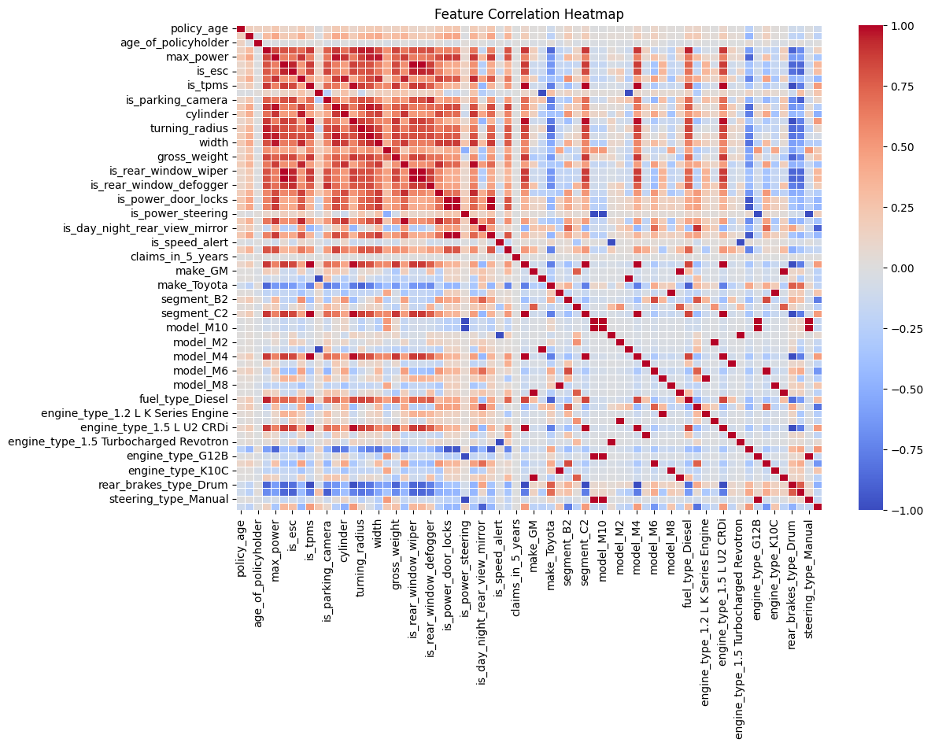
Exploratory Data Analysis
Heatmap of Correlation Matrix
Identified strong relationships between variables like Customer Demographic, Displacement of Car, and claims.
Also seen multi-collinearity among other features which can be seen in dark in heatmap, this shows that a simple Linear Regression Model is not a great choice for the data

Slide 5
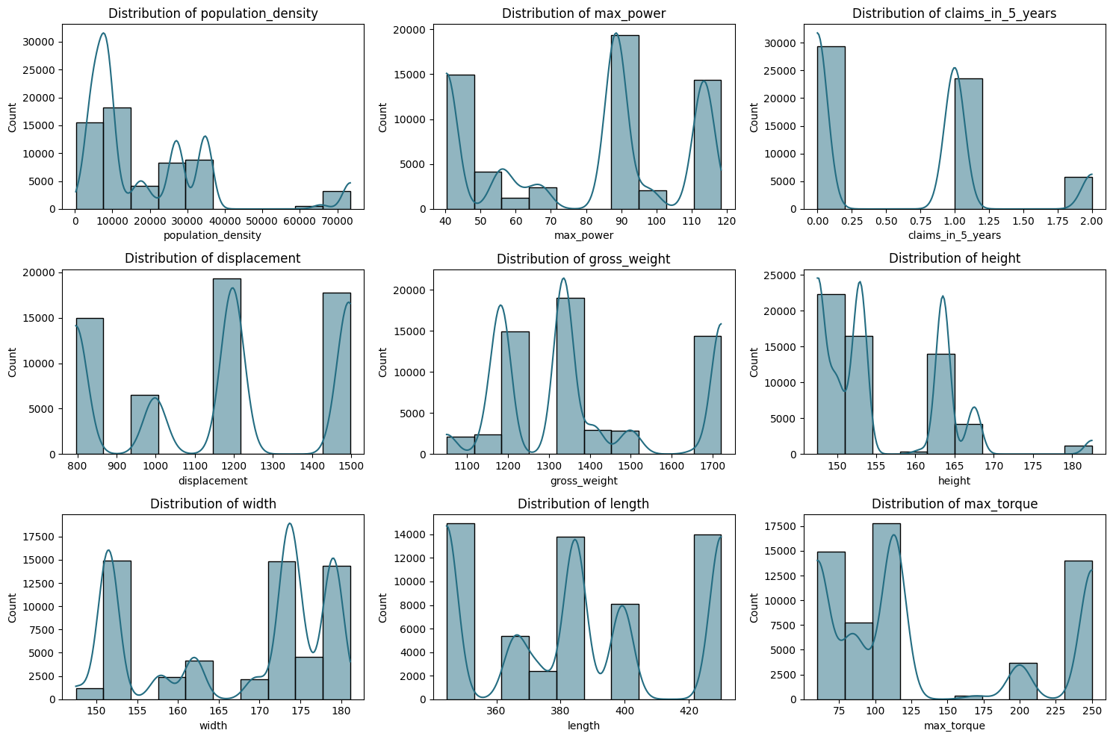
Visualization of Data
ROI​
Niche markets
Number of Claims in 5 years for each customer are one of 0,1,2 or 3, but considering only these are the only values possible, will create a bias in the model
Most of the numerical features can be standardized
We can see 3 categories in Length, vehicle is either small, mid or long
Envision multimedia-based expertise and cross-media growth strategies​ Visualize quality intellectual capital​ Engage worldwide methodologies with web-enabled technologies​ ​
Pursue scalable customer service through sustainable strategies​ Engage top-line web services with cutting-edge deliverables​

Slide 6
Transformations on Data
Variable | Transformation Applied | Reason | Effect
max_torque | Extract numeric values till "N", then standardization | The column contained "Nm" units, making it non-numeric | Enables numerical computation & brings it to a common scale for better model training
max_power | Extract numeric values till "b", then log transformation | The column contained "bhp" units, making it non-numeric & had a skewed distribution | Enables numerical computation, reduces skewness, and improves normality
length, width, height | Extract numeric values till "c", then standardization | The columns contained "cm" units, making them non-numeric | Enables numerical computation & prevents larger values from dominating the model
displacement | Extract numeric values till "c", then log transformation | The column contained "cc" units & had a right-skewed distribution | Converts it to a numerical format & stabilizes variance for better predictions
gross_weight | Standardization | The variable had a large range, requiring scaling | Prevents scale differences from affecting model training
is_esc, is_tpms, etc. | Convert "Yes"/"No" to 1/0 | The column was categorical (binary) but should be numeric | Enables model to understand binary categorical variables
area, make, segment, etc. | One-Hot Encoding | The column was categorical with multiple levels | Prevents incorrect ordinal interpretation & allows better categorical representation

Slide 7
Important Features
1. Age of Policyholder
Younger drivers tend to have higher accident risks due to inexperience.
Older policyholders might have slower reaction times, affecting claim likelihood.
2. Age of Car
Older vehicles may have higher maintenance issues, leading to more claims.
Newer cars with advanced safety features might have fewer severe claims.
3. Claims in 5 Years
A history of frequent claims suggests a higher likelihood of future claims.
Past claim behavior is a strong predictor of risk profile.

Slide 8
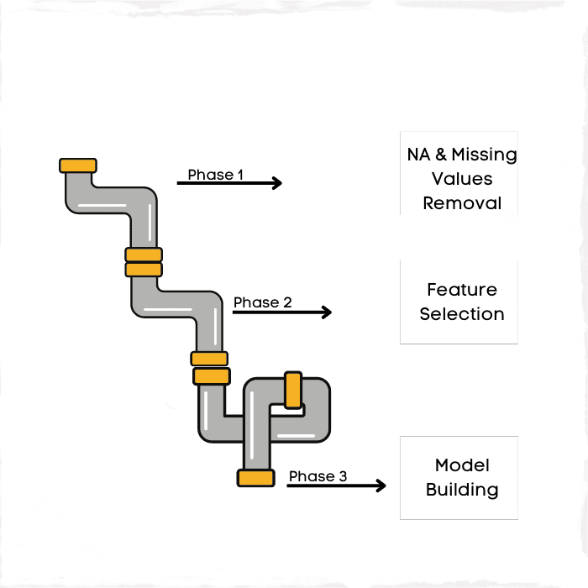
Model Building
Selected Machine Learning Models
Linear Regression (Baseline Model)
Random Forest Regressor (Captures non-linearity)
Gradient Boosting Regressor (Boosted ensemble for improved accuracy)
Support Vector Regressor (SVR) (Handles complex relationships)
XGBoost Regressor (Optimized tree-based model)

Slide 9
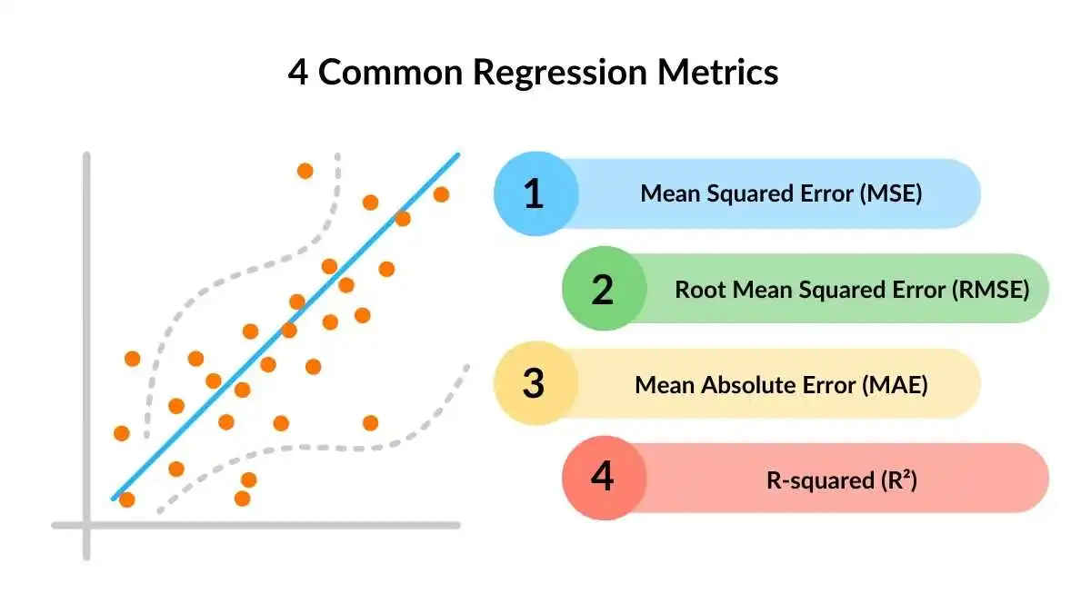
Model Evaluation Metrics
Metrics Used for Performance Evaluation:
Mean Squared Error (MSE) – Measures average squared error.
Mean Absolute Error (MAE) – Shows absolute deviation from actual claims
Root Mean Squared Error (RMSE) – Penalizes large errors more than MSE
R-squared (R²) – Explains variance captured by the model

Slide 10
Model Evaluation Result
 | MSE | RMSE | MAE | R² Score
Linear Regression | 0.069293 | 0.263235 | 0.207078 | 1
Random Forest | 1.031695 | 1.015724 | 0.25302 | 1
Gradient Boosting | 20682.22 | 143.8131 | 104.5614 | 0.993324
Support Vector Regressor | 3929821 | 1982.378 | 1224.092 | -0.26846
XGBoost | 1379.906 | 37.14708 | 10.5019 | 0.999555

Slide 11
Visualization of Results
We evaluate models based on MSE, RMSE, MAE, and R² Score:
Linear Regression: Lowest MSE and RMSE (0.07, 0.26), R² = 1.00
Random Forest: Higher MSE and RMSE (1.03, 1.02), R² = 1.00
Gradient Boosting: Very high MSE (20,682), but R² = 0.993
Support Vector Regressor (SVR): Poor performance, negative R² (-0.268) → Not suitable
XGBoost: Very strong performance (MSE = 1379, RMSE = 37.14, MAE = 10.50, R² = 0.9996)
**SVR Removed from chart because of very high RMSE, MSE and Negative R²

Slide 12
Visualization of Results
We evaluate models based on MSE, RMSE, MAE, and R² Score:
Linear Regression: Lowest MSE and RMSE (0.07, 0.26), R² = 1.00
Random Forest: Higher MSE and RMSE (1.03, 1.02), R² = 1.00
Gradient Boosting: Very high MSE (20,682), but R² = 0.993
Support Vector Regressor (SVR): Poor performance, negative R² (-0.268) → Not suitable
XGBoost: Very strong performance (MSE = 1379, RMSE = 37.14, MAE = 10.50, R² = 0.9996)
**SVR Removed from chart because of very high RMSE, MSE and Negative R²

Slide 13
Why Choose XGBoost?
High Accuracy & Low Error
R² Score: 0.9996, indicating a near-perfect fit while avoiding complete overfitting.
MSE: 1379, RMSE: 37.14, MAE: 10.50, showing significantly lower prediction errors compared to Gradient Boosting and SVR.
Better Generalization
While Linear Regression has an R² of 1.00, its extremely low errors (MSE = 0.07) suggest overfitting or data leakage.
XGBoost balances accuracy while maintaining robust generalization.
Handles Complex Data Relationships
XGBoost captures non-linear patterns better than Linear Regression and SVR.
Unlike Random Forest, it reduces variance and avoids overfitting through boosting techniques.
Efficient & Scalable
XGBoost is optimized for speed and efficiency, making it suitable for large datasets.
It uses regularization (L1/L2) to prevent overfitting.

Slide 14
Key Insights from the Model
Policyholder and Vehicle Factors Matter
Older policyholders & vehicles → Higher claim severity
Frequent past claims → Strong indicator of future claim severity
Heavy and high-powered vehicles → More expensive claims due to repair costs
Top Features Driving Claim Severity
Age of Policyholder & Age of Car: Older individuals and vehicles correlate with higher claims.
Claims in Last 5 Years: Strong predictor of future claims, highlighting the importance of claim history in risk assessment.
Vehicle Weight & Dimensions: Heavier, larger vehicles incur higher repair costs.
NCAP Safety Rating: Lower safety ratings link to higher claim amounts due to severe damage/injuries.

Slide 15
How This Supports Pricing & Risk Management
Refined Premium Pricing
Identify policyholders prone to high claims before issuing policies.
Adjust coverage plans for high-risk vehicles.
Better Underwriting Decisions
Identify policyholders prone to high claims before issuing policies.
Adjust coverage plans for high-risk vehicles.
Risk Mitigation Strategies
Offer incentives for safer vehicles (higher NCAP rating).
Encourage responsible driving behavior through dynamic pricing (e.g., usage-based insurance).

Slide 16
Limitations & Future Improvements
Missing Key Behavioral Data
Driving habits (mileage, speeding, accident history) not included.
Future improvement: Integrate telematics data.
External Factors Not Considered
Weather, road conditions, economic factors could refine predictions.
Solution: Incorporating external datasets for a holistic approach.
Explore Advanced Models
Generalized Linear Models (GLM) or deep learning can be used to enhance prediction accuracy.

Slide 17
Thank you
Anant Kumar Verma
Christ University
+91 7453 015 236
anant.kumar@arts.christuniversity.in

