Slide 1
Previous Summary & New Framework
Old method
New Method

Slide 2
Old Method
Literally Just Rules
Too much rules, absolutely overfitting
Even a little denoising filtering on the input signal could change the result a lot.
The code is piled together, and not purely m file, horrible and even impossible to maintain and modify.

Slide 3
A lot of surveys, tries and failures.
PVCoder (to improve frequency resolution)
Upsample (same as above)
Wavelet
Miscellaneous ACC methods

Slide 4
New Method(not perfect currently)
Based on the wavelet transform
I observe roughly 100 frames, the peak of hr won't be minimized, and if the hr don't have peak, it would get a new peak.

Slide 5
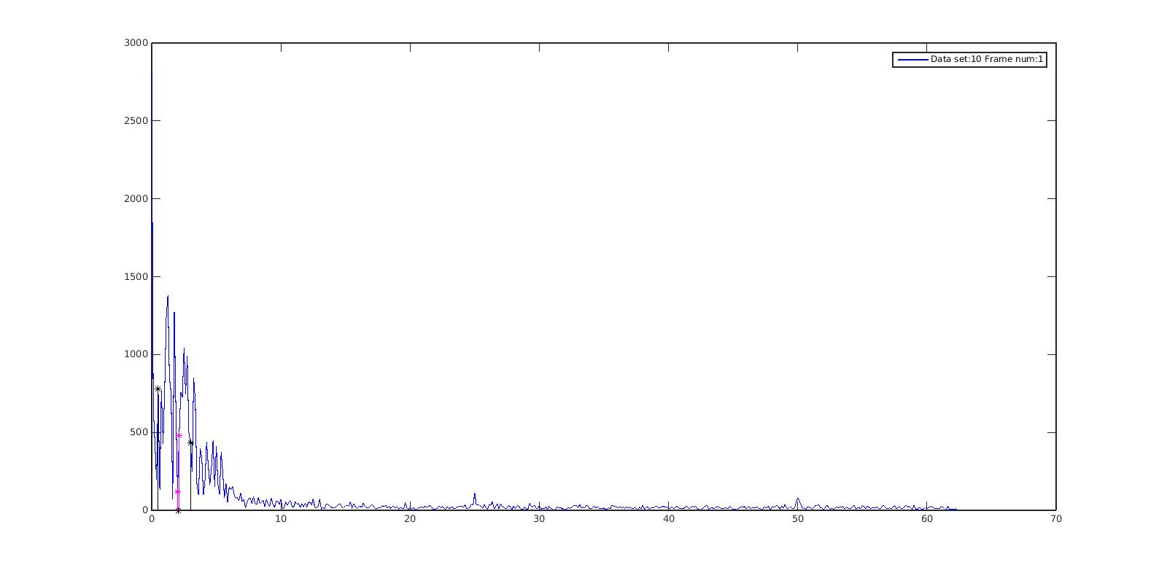
For Example before

Slide 6
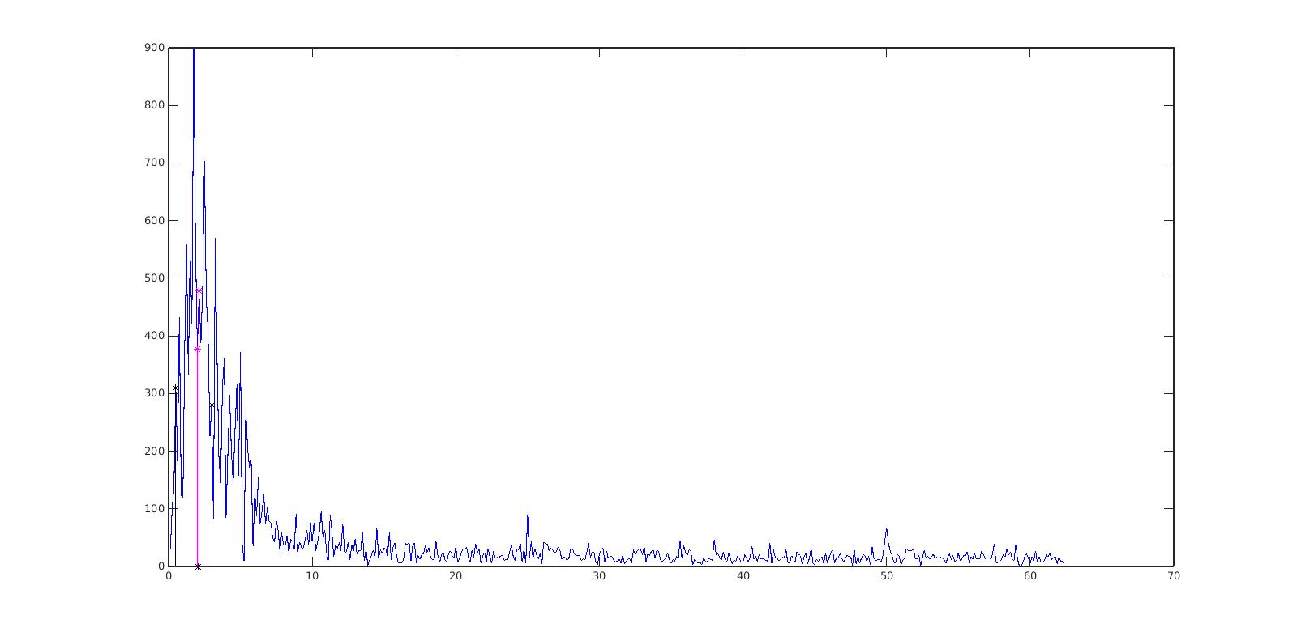
For Example, after

Slide 7
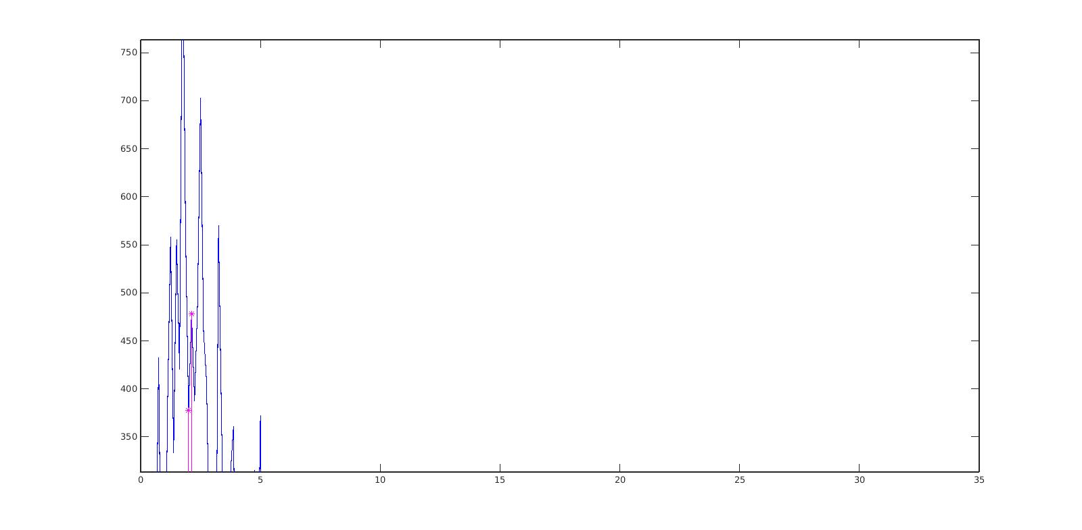
For Example, after

Slide 8
In detail
Apply level 7 haar wavelet transform
Set level 0 to all zeros (very low frequency)
Threshold each level into mean(each level)*R
Suppress MA!
R is the parameter that needed to tweak.

Slide 9
More
When use different R, different frequency domain status could be observed
Could observe the process that the small hr peak being generated!
Examples Next

Slide 10
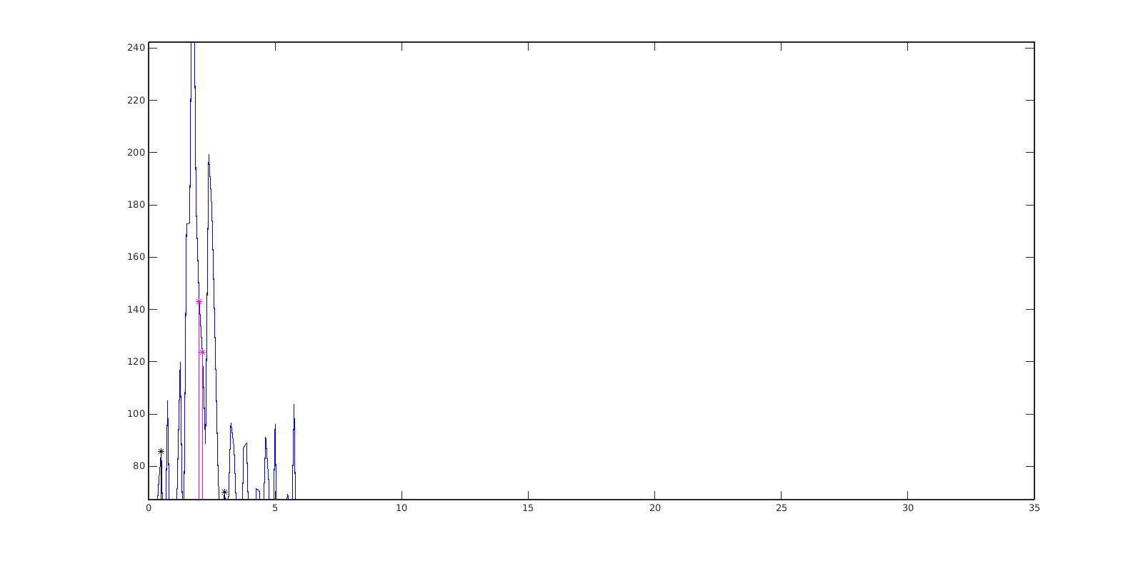
R = 0.3

Slide 11
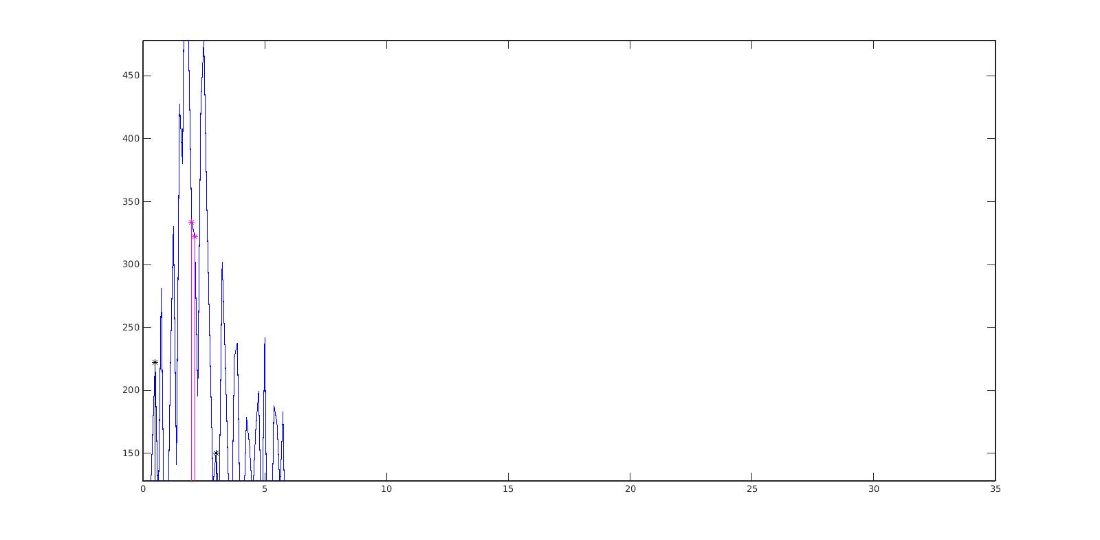
R = 0.8

Slide 12
R = 1.5

Slide 13
How to pick that new but small Peak
Apply different r
Observe changes of peaks
Peak the special one

Slide 14
Version One Already!
Only Simple Rules
Magnitude Unit
Peak the larger one
Memory Unit
find the peaks that not so far from the previous estimation
Not find all peaks from 0.5 to 3.0
Simple rule: 0.8*current + 0.2* previous
Wavelet Unit
Find the Special peak as above
Have higher priority than the memory unit.

Slide 15
Version One Already!
For the first peak
Magnitude Unit
Wavelet Unit
For the next peak
Memory Unit
Magnitude Unit

Slide 16
Version One Already!
The Code is very Clean and Modular
Provide a lot of utilities for easy debug and test.

Slide 17
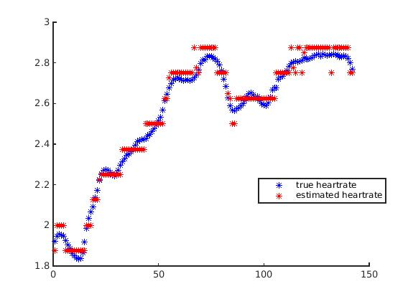
Result one
Error: 1.5% Dataset: 11

Slide 18
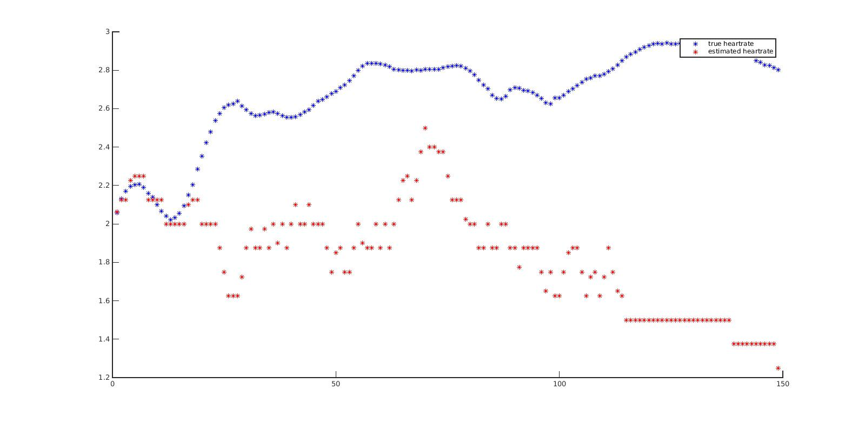
Result two (this one is bad)
Data Set: 10

Slide 19
Analysis --- not perfect but
Though it goes wrong in dataset 10, but the first frame is very accurate which no way we could do before
Still need more Rules or other information to help it !
For the rest frames, I only use Mem & Mag Unit,
should try Wavelet Unit as well.

Slide 20
Also Try other techniques
ANC
Won't work at all
Some methods will totally ruin the ppg signal
other won't make any good changes
Maybe our PPG too dirty or totally different signal collection methods
ICA
If ICA don't converge, it would hurt a lot
If ICA converge, hard to say it's good or not.

Slide 21
The End

Slide 22
Also Try other techniques
Upsampling
Won't work
Pvcoder
Already written
maybe would work, haven't integrated into this method
Improve old method rules
It's hard
But we should see the result of old method is not bad, it could be our baseline and provide some inspirations on rules

Slide 23
Also Try other techniques
ANC
Won't work at all
Some methods will totally ruin the ppg signal
other won't make any good changes
Maybe our PPG too dirty or totally different signal collection methods
ICA
If ICA don't converge, it would hurt a lot
If ICA converge, hard to say it's good or not.

