Slide 2

Python Complete Course
Ananta Asim Joy
Dept of EEE, RU
Email: anantajoy007@gmail.com
GitHub: https://github.com/AnantaJoy

Slide 3
Topics will be covers
History of Programming and Python
Compiled vs Interpreted
Programming Paradigm
Python Installation
Code Editor Selection
Version Control With Git and GitHub
Command Line Interface (CLI)

Slide 4
Earlier history of Languages
1GL
2GL
3GL or High Level
Machine Language
Assembly Language
Fortran(Formula Translation)
Around 1900s
Around 1950s
In 1957 By John Backus
0 and 1 s, Hexadecimal
i.e: http://www.eecs.umich.edu/courses/eecs284/example1.htm
https://github.com/XlogicX/m2elf/blob/master/hello_world.m
Human Readable
Used in hardware
Bridge between Machine and High Level
i.e. https://montcs.bloomu.edu/Information/LowLevel/Assembly/hello-asm.html
High Level, Compiled
Using Numeric, Scientific, Egineering
i.e https://fortran-lang.org/learn/quickstart/hello_world
https://ourcodingclub.github.io/tutorials/fortran-intro/

Slide 5
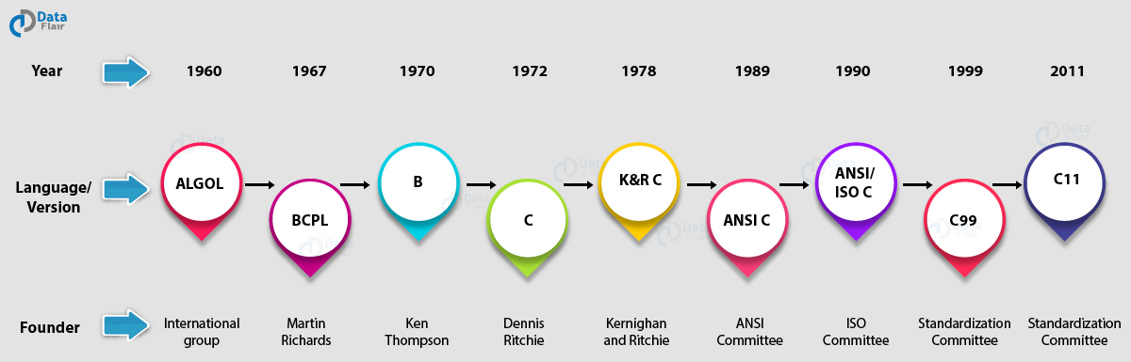
History of Modern Languages
MATLAB(1978)
C++(1983)
Objective-C(1983)
Perl(1987)
Python(1991)
Go(2009)
C#(2000)
PHP(1995)
JavaScript(1995)
Java(1995)
R(1993)
Notes:
https://www.tiobe.com/tiobe-index/

Slide 6
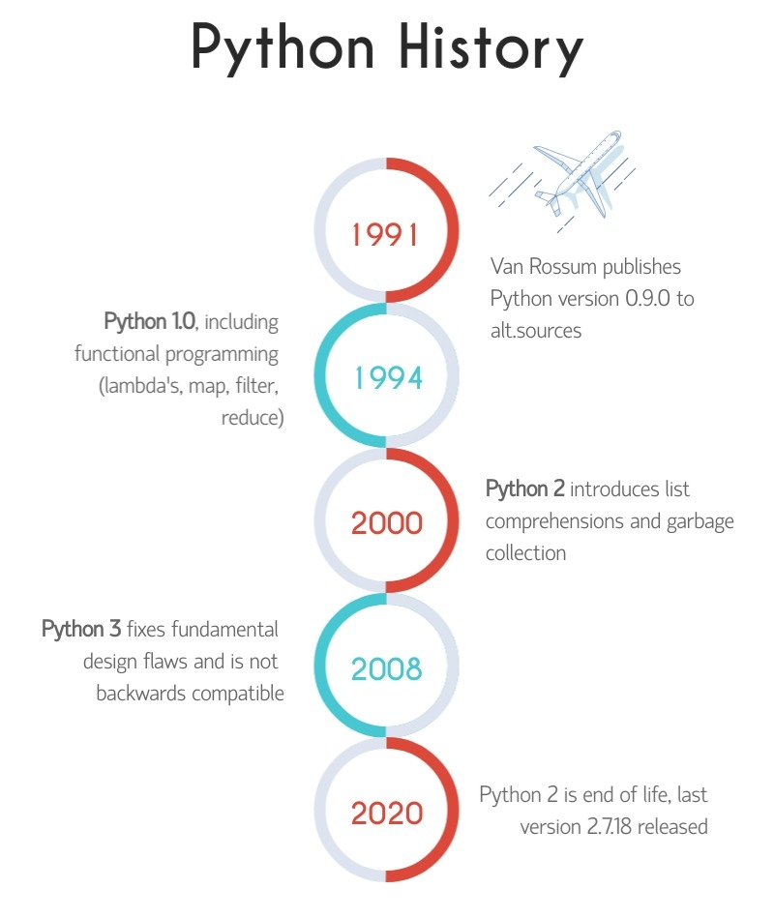




History of Python
Guido van Rossum
Monty Python's Flying Circus

Slide 7
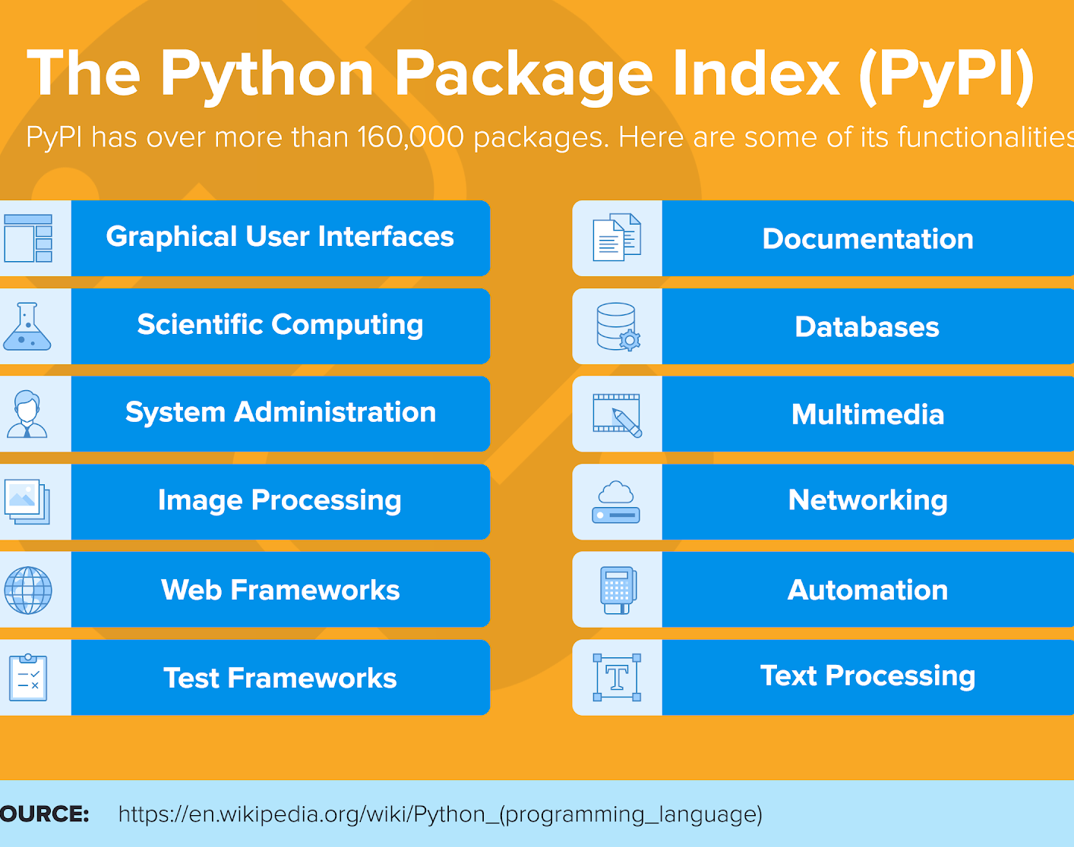
Why Learning Python
Beginner friendly
Easy to learn, high level
Large community Support
Free Learning Resources
Good Career and Salary
https://www.tiobe.com/tiobe-index/(Tiobe Index)
https://www.indeed.com/career/python-developer/salaries(Salary)
https://www.payscale.com/research/US/Job=Python_Developer/Salary(Salary)

Slide 8

Installation and IDEs
Python Interpreter
Download Interpreter https://www.python.org/downloads/
Open cmd/terminal and type py/python
Type print(‘Hello World’)
IDE/Text Editor Selection
IDE Selection Priority
Multilanguage Support
Integrated Terminal
Auto correction
Color Theme
Customized Settings
Version Control
Visual Studio Code https://code.visualstudio.com/
PyCharm https://www.jetbrains.com/pycharm/
Atom https://atom.io/
Sublime Text https://www.sublimetext.com/download
Geany https://www.geany.org/download/releases/

Slide 9

How to Get PyCharm Professional Version using your University Mail
Free Educational Licenses By Jet Brains
Step1: Go to https://www.jetbrains.com/shop/eform/students
Step2: Fill Up the form and Use your institutional email(i.e. example@ru.ac.bd)
Step3: Wait and get confirmation. Enjoy

Slide 10
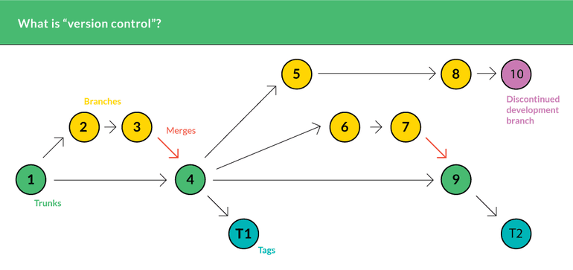
Version Control With Git
Saving the record(history) of the a folder/path
Source code management
Manage larger code management easier
VCS tools(Local) > git https://git-scm.com/download/win > Subversion > Mercurial
Remote VCS > GitHub https://github.com/ > Bit Bucket > Git Lad

Slide 11
Git Pro and Education Pack
Steps1: Create a GitHub Account https://github.com/signup
Steps2: Apply for Individuals Pro Students account https://education.github.com/benefits?type=student
Steps3: Wait and get Confirmation ☺
Why GitHub account is so important
No tension about crashing your computer and loose code
Showcase your code(work) to others and share
Be part of the world largest programming community
Learn and contribute about opensource projects
Create free portfolio website
Private repository

Slide 12
Basic Git Command
Steps1:
Steps2:
$ git config --global user.name "John Doe"
$ git config --global user.email johndoe@example.com
Create a GitHub repository
Steps3:
Follow the documentation for the rest part : https://docs.github.com/en/github/importing-your-projects-to-github/importing-source-code-to-github/adding-an-existing-project-to-github-using-the-command-line

Slide 13
Home Work
Lists
Work
Download Python Interpreter
Download a text editor
Download git
Create a GitHub account
Upload first line of code
Send me the GitHub code link.
Question : Why do you want to learn programming?

