Slide 1

COEP Technological University
A Unitary Public University of Govt. of Maharashtra
Formerly College of Engineering Pune
Hostel Management
System
~Hacksparrows

Slide 2
COEP Technological University
A Unitary Public University of Govt. of Maharashtra
Formerly College of Engineering Pune
Contributors
112105030 Swarnim Kamble
112103009 Ananta Hatwar
112103039 Gaurish Dodke
112103014 Aryan Thakre
112103022 Shreya Bhatkhande
112103006 Aishwarya Koli

Slide 3
COEP Technological University
A Unitary Public University of Govt. of Maharashtra
Formerly College of Engineering Pune
Problem Statement:
Develop a hostel management system allowing administrators to manage room allocations, check-ins, check-outs, and student records. The system should provide functionalities for faculties/guests to view available rooms, make reservation requests, and track their stay history. Additionally, administrators should be able to generate reports on occupancy rates, maintenance requests, and billing records for hostel fees

Slide 4
COEP Technological University
A Unitary Public University of Govt. of Maharashtra
Formerly College of Engineering Pune
Technology Stack
Frontend(Client) Backend(Server) Framework: React Framework Express.js
Routing React: Router-Dom Database MongoDB
HTTP Client: Axios Database MongoDB
State Management: Redux Toolkit Authentication JSON Web
Framework Express.js
Tokens Security Bcrypt.js
Middleware Cookie-parser

Slide 5
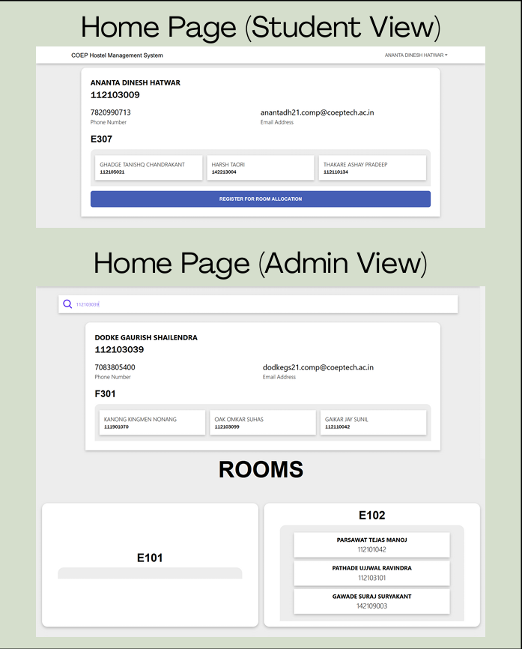
COEP Technological University
A Unitary Public University of Govt. of Maharashtra
Formerly College of Engineering Pune
Prototype Images

Slide 6
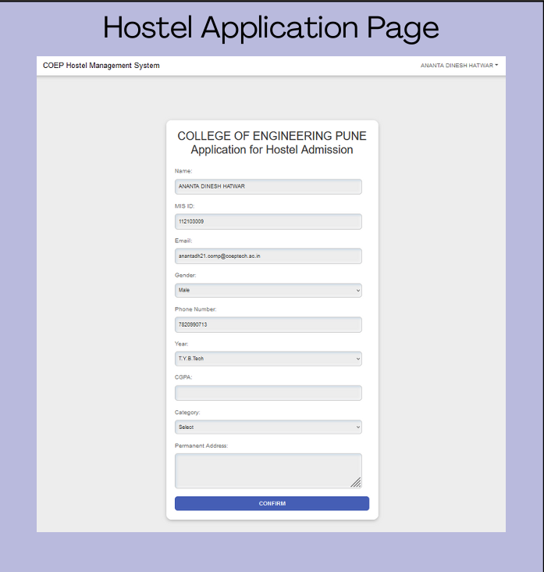
COEP Technological University
A Unitary Public University of Govt. of Maharashtra
Formerly College of Engineering Pune

Slide 7
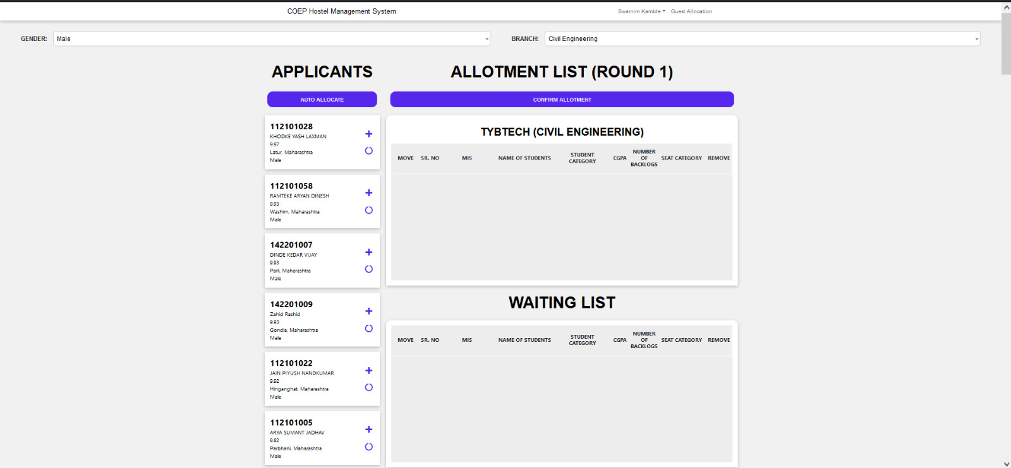
COEP Technological University
A Unitary Public University of Govt. of Maharashtra
Formerly College of Engineering Pune

Slide 8
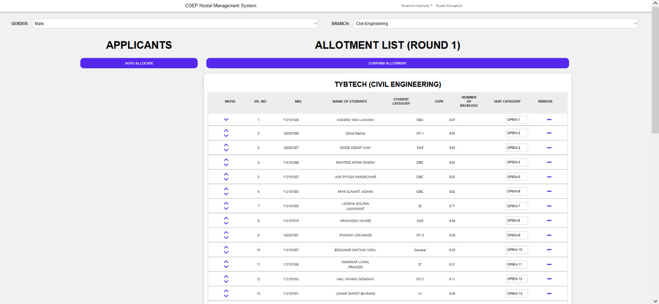
COEP Technological University
A Unitary Public University of Govt. of Maharashtra
Formerly College of Engineering Pune

Slide 9
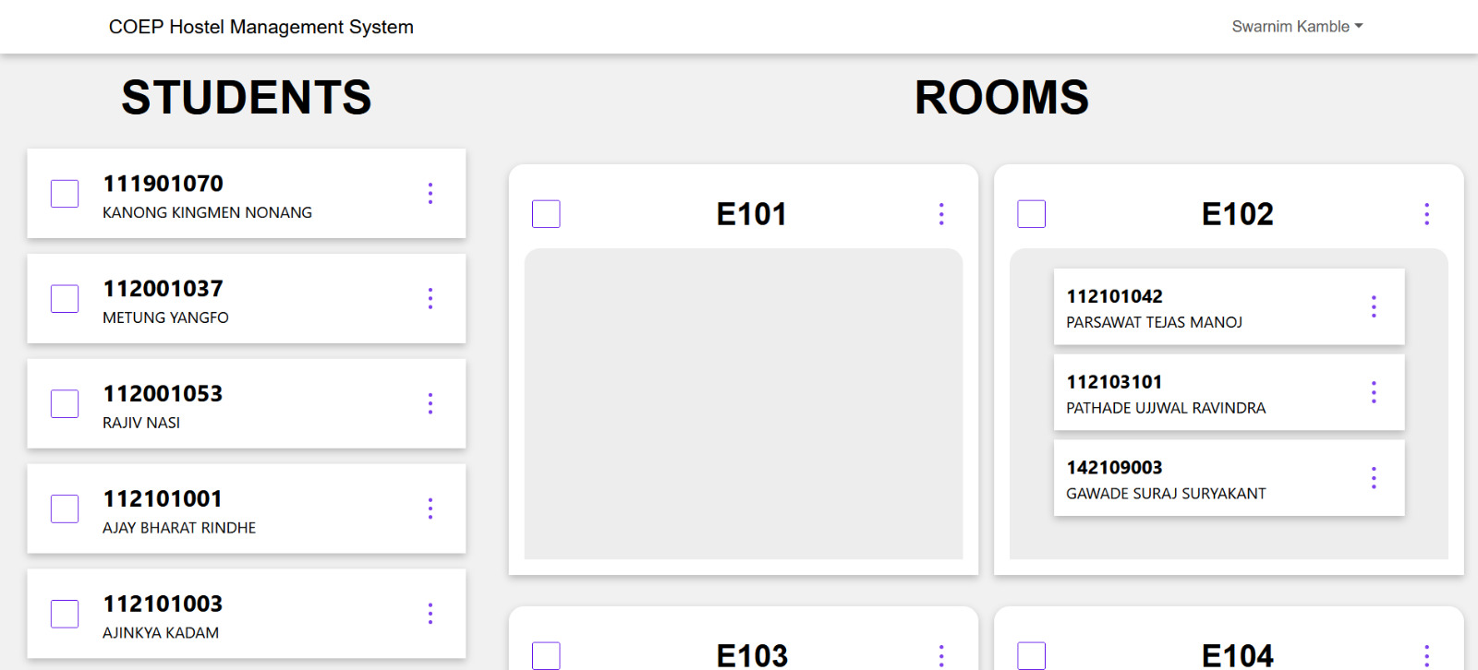
COEP Technological University
A Unitary Public University of Govt. of Maharashtra
Formerly College of Engineering Pune

Slide 10
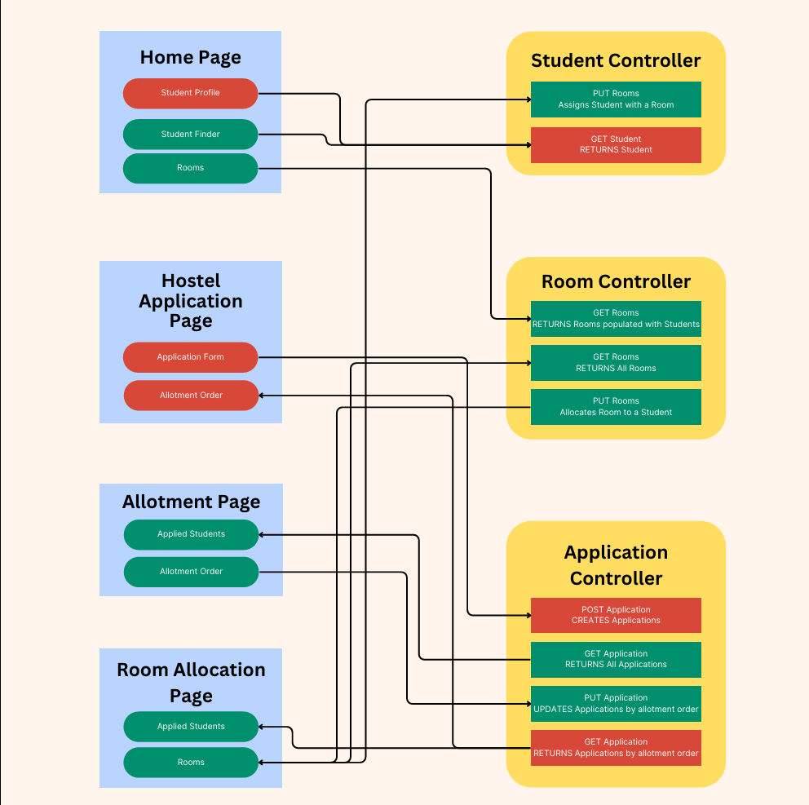
COEP Technological University
A Unitary Public University of Govt. of Maharashtra
Formerly College of Engineering Pune
Architecture
Diagram:

Slide 11
COEP Technological University
A Unitary Public University of Govt. of Maharashtra
Formerly College of Engineering Pune
Future Scope
Mess Billing and No Due Certificates The mess staff can add or clear bills in the system, and notifications will be sent to each student on their profiles. Once all bills are settled by the mess staff and hostel administrators, a digital no-due certificate will be automatically generated for hostel allocation
Automatic Allotment System Once the administration has assigned students their allotment, the students can then submit their preferred room choices in order of priority. The application will assign rooms automatically according to the allotment sequence, pending approval by the administrators

Slide 12
COEP Technological University
A Unitary Public University of Govt. of Maharashtra
Formerly College of Engineering Pune
THANK YOU

