Slide 1


SHREE VIDYADHIRAJ POLYTECHNIC , KUMTA
COLLEGE MANAGEMENT SYSTEM
Guided By
Presented By
Dinesh Balgi
Anant Bhat
Anusha Achari
Navya Hebbar
Suhas Shetti
HOD – CS Department
COMPUTER SCIENCE DEPARTMENT

Slide 2

SHREE VIDYADHIRAJ POLYTECHNIC , KUMTA
CONTENTS
Problem Statement
Objectives
Description
Deliverables
Key Milestones
Constraints
Work Breakdown Structure
Time-line Schedule
Cost Breakdown Structure
Risk Analysis
Identification of Methodology
COMPUTER SCIENCE DEPARTMENT

Slide 3



SHREE VIDYADHIRAJ POLYTECHNIC , KUMTA
PROBLEM STATEMENT
Design and develop a COLLEGE MANAGEMENT SYSTEM which allows staff members to maintain student marks , attendance & personal information
COMPUTER SCIENCE DEPARTMENT

Slide 4
SHREE VIDYADHIRAJ POLYTECHNIC , KUMTA
OBJECTIVES
The goal of the College Management System is to create a centralized, user-friendly, where staff members can easily access , update , delete & maintain records.
This platform aims to maintain student, staff’s, course, department details in online.
Centralized Record Management: Develop a centralized database to store and manage student, staff, course, and department details in a structured and organized manner, ensure efficient retrieval of information for authorized users.
Access Control and Security: Implement access control mechanisms to ensure that only authorized staff members can access, update, and delete records. Incorporate robust security measures to protect sensitive data.
Record Maintenance: Enable staff members to easily update and maintain records through a simple and efficient interface. Provide functionalities for adding new records, updating existing information, and deleting outdated records.
COMPUTER SCIENCE DEPARTMENT

Slide 5
SHREE VIDYADHIRAJ POLYTECHNIC , KUMTA
DESCRIPTION
The College Management System aims to develop a comprehensive College Management System that enables users to maintain student marks , attendance & personal information.
It consists of a website that allows users to browse through different department information as per their availability.
Once the student record is inserted , the staff members have the option to update and delete.
COMPUTER SCIENCE DEPARTMENT

Slide 6
SHREE VIDYADHIRAJ POLYTECHNIC , KUMTA
DELIVERABLES
The College Management System project deliverables include a fully functional software application with features such as maintaining student marks, attendance, student personal information ,staff details, course details & department information.
For Maintenance and support documentation will be included
COMPUTER SCIENCE DEPARTMENT

Slide 7
SHREE VIDYADHIRAJ POLYTECHNIC , KUMTA
KEY MILESTONES
Design and Development
Requirements gathering & analysis
Project initiation and planning
Maintenance , Support & Monitoring
Deployment and Implementation
Testing and Quality Assurance
COMPUTER SCIENCE DEPARTMENT

Slide 8
SHREE VIDYADHIRAJ POLYTECHNIC , KUMTA
CONSTRAINTS
Limited time
Limited resources
Financial constraints
Payment Processing Challenges
Security and Privacy Concerns
COMPUTER SCIENCE DEPARTMENT

Slide 9
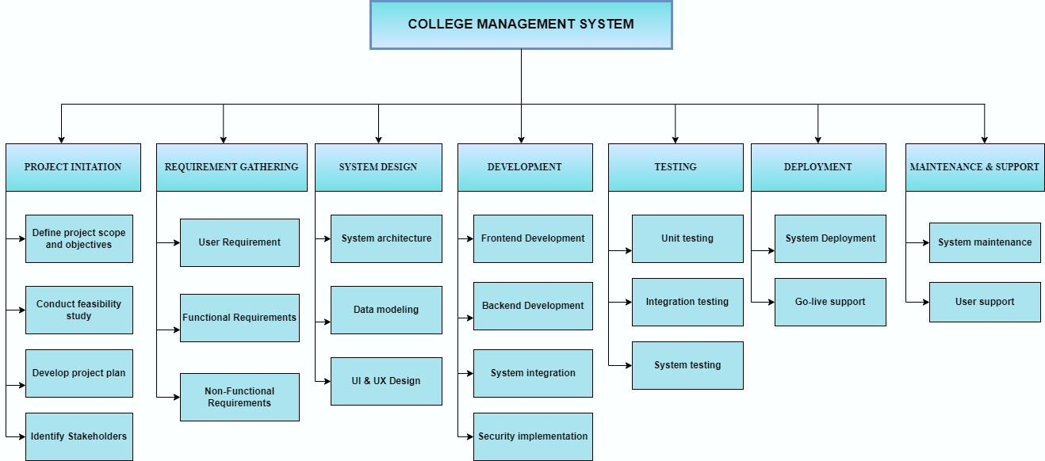
SHREE VIDYADHIRAJ POLYTECHNIC , KUMTA
WORKBREAKDOWN STRUCTURE
COMPUTER SCIENCE DEPARTMENT

