Slide 1

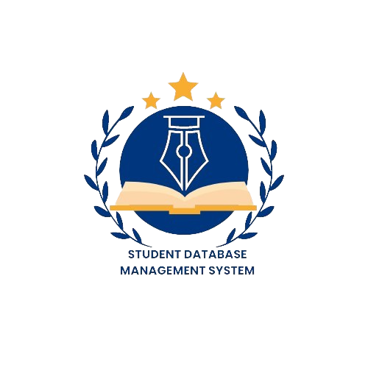
SHREE VIDYADHIRAJ POLYTECHNIC , KUMTA
STUDENT DATABASE MANAGEMENT SYSTEM
Guided By
Presented By
Dinesh Balgi
Anant Bhat
Anusha Achari
Navya Hebbar
Suhas Shetti
HOD – CS Department
COMPUTER SCIENCE DEPARTMENT

Slide 2
SHREE VIDYADHIRAJ POLYTECHNIC , KUMTA
CONTENTS
Problem Statement
Objectives
Description
Deliverables
Key Milestones
Constraints
Work Breakdown Structure
Time-line Schedule
Cost Breakdown Structure
Risk Analysis
Identification of Methodology
COMPUTER SCIENCE DEPARTMENT

Slide 3





SHREE VIDYADHIRAJ POLYTECHNIC , KUMTA
PROBLEM STATEMENT
Design and develop a STUDENT DATABASE MANAGEMENT SYSTEM which allows staff members to maintain student marks , attendance & personal information
COMPUTER SCIENCE DEPARTMENT

Slide 4
SHREE VIDYADHIRAJ POLYTECHNIC , KUMTA
OBJECTIVES
The goal of the Student Database Management System is to create a centralized, user-friendly, where staff members can easily access , update , delete & maintain records.
This platform aims to maintain student, staff’s, course, department details in online.
Centralized Record Management: Develop a centralized database to store and manage student, staff, course, and department details in a structured and organized manner, ensure efficient retrieval of information for authorized users.
Access Control and Security: Implement access control mechanisms to ensure that only authorized staff members can access, update, and delete records. Incorporate robust security measures to protect sensitive data.
Record Maintenance: Enable staff members to easily update and maintain records through a simple and efficient interface. Provide functionalities for adding new records, updating existing information, and deleting outdated records.
COMPUTER SCIENCE DEPARTMENT

Slide 5
SHREE VIDYADHIRAJ POLYTECHNIC , KUMTA
DESCRIPTION
The Student Database Management System aims to develop a comprehensive Student Management System that enables users to maintain student marks , attendance & personal information.
It consists of a website that allows users to browse through different department information as per their availability.
Once the student record is inserted , the staff members have the option to update and delete.
COMPUTER SCIENCE DEPARTMENT

Slide 6
SHREE VIDYADHIRAJ POLYTECHNIC , KUMTA
DELIVERABLES
The Student Database Management System project deliverables include a fully functional software application with features such as maintaining student marks, attendance, student personal information ,staff details, course details & department information.
For Maintenance and support documentation will be included
COMPUTER SCIENCE DEPARTMENT

Slide 7
SHREE VIDYADHIRAJ POLYTECHNIC , KUMTA
KEY MILESTONES
Design and Development
Requirements gathering & analysis
Project initiation and planning
Maintenance , Support & Monitoring
Deployment and Implementation
Testing and Quality Assurance
COMPUTER SCIENCE DEPARTMENT

Slide 8
SHREE VIDYADHIRAJ POLYTECHNIC , KUMTA
CONSTRAINTS
Limited time
Limited resources
Financial constraints
Payment Processing Challenges
Security and Privacy Concerns
COMPUTER SCIENCE DEPARTMENT

Slide 9
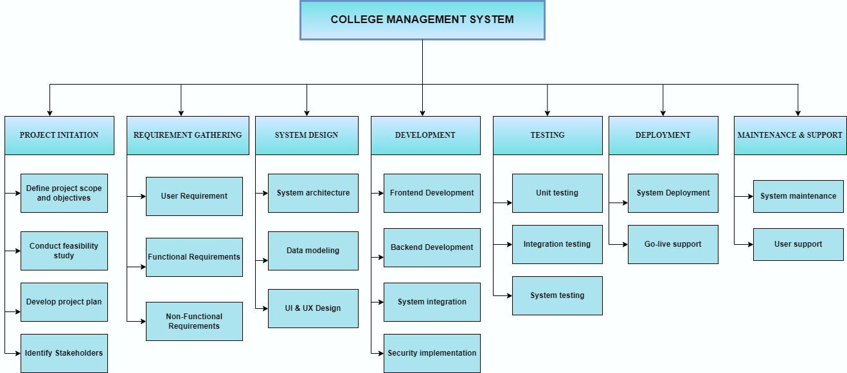
SHREE VIDYADHIRAJ POLYTECHNIC , KUMTA
WORKBREAKDOWN STRUCTURE
COMPUTER SCIENCE DEPARTMENT

Slide 10
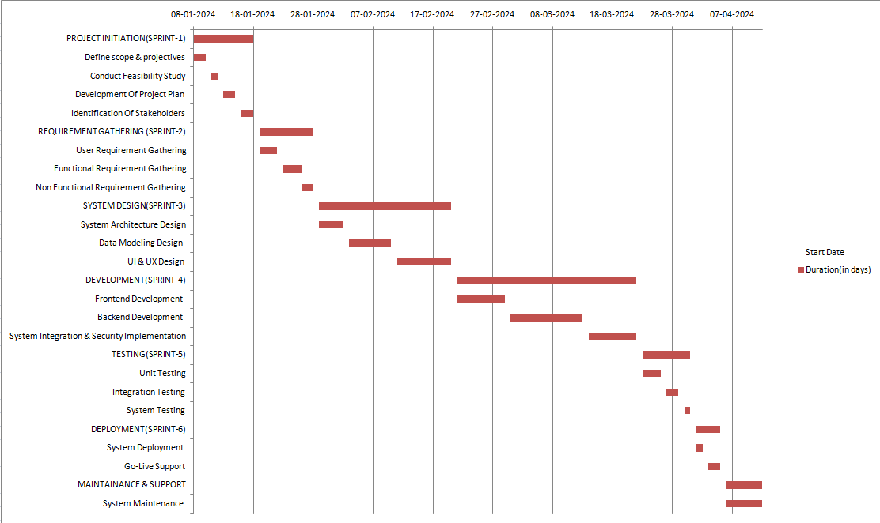
SHREE VIDYADHIRAJ POLYTECHNIC , KUMTA
TIME-LINE SCHEDULE
COMPUTER SCIENCE DEPARTMENT

Slide 11
SHREE VIDYADHIRAJ POLYTECHNIC , KUMTA
COST BREAKDOWN STRUCTURE
Total Developer:4
Duration of Project:4 Months
Total labour cost = 1,20,000/INR
Estimated Cost of Material=12,000/INR
Contigency Amount=24,000/INR
Final Check:
Subtotal = Salary + Material Cost + Contingency Amount
= 1,56,000/INR
Total cost with company profit:
1,56,000+ 30% = 2,02,800/INR
COMPUTER SCIENCE DEPARTMENT

Slide 12
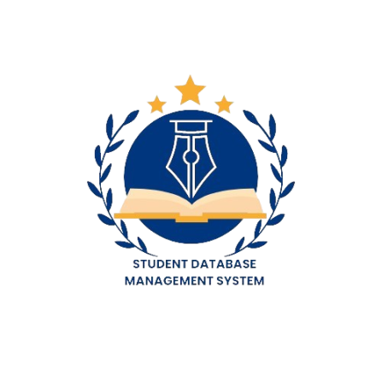
SHREE VIDYADHIRAJ POLYTECHNIC , KUMTA
RISK ANALYSIS
Technical Risks:
Implementation Risks:
Data Security: Unauthorized access, data breaches, and system vulnerabilities could compromise sensitive student and staff information.
System Integration: Challenges in integrating the College Management System with existing systems, leading to data inconsistencies and operational disruptions.
Project Delays: Budget overruns, resource limitations, and technical challenges could delay implementation and impact operational timelines.
User Resistance: Difficulty adapting to the new system and lack of proper training could lead to user resistance and decreased adoption.
COMPUTER SCIENCE DEPARTMENT

Slide 13
SHREE VIDYADHIRAJ POLYTECHNIC , KUMTA
RISK ANALYSIS
Data-Related Risks:
Financial &Resource Risks:
Data Accuracy & Integrity: Inaccurate or incomplete data entry, system errors, and inadequate data migration practices could compromise data accuracy and reliability.
Data Privacy: Improper data collection, storage, and usage practices could violate student and staff privacy rights and attract regulatory scrutiny.
Budget Overruns: Implementation costs exceeding initial estimates due to unforeseen challenges or changes in requirements.
Resource Scarcity: Insufficient personnel or skills within the college to properly manage and maintain the College Management System.
COMPUTER SCIENCE DEPARTMENT

Slide 14
SHREE VIDYADHIRAJ POLYTECHNIC , KUMTA
RISK ANALYSIS
Operational & Process Risks:
Stakeholder & Reputational Risks:
Workflow Disruption: The new system disrupting existing workflows and operational processes, leading to inefficiency and confusion.
Loss of Institutional Knowledge: System migration leading to the loss of historical data and institutional knowledge.
Student &Staff Dissatisfaction: Negative user experience with the new system could damage student and staff morale and negatively impact the college's reputation.
Negative Publicity: Data breaches, system outages, or privacy violations could lead to negative press coverage and damage the college's reputation.
COMPUTER SCIENCE DEPARTMENT

Slide 15
SHREE VIDYADHIRAJ POLYTECHNIC , KUMTA
IDENTIFICATION OF METHODOLOGY
Sprint Planning:
Agile methodology is an iterative and incremental project management approach that is widely used for software development projects. The agile methodology involves breaking down the project into small and manageable parts, known as sprints. Each sprint has a defined duration and is focused on delivering a specific set of features. The agile methodology used for the student management system project involved the following steps:
The first step in the agile methodology was to plan the sprint. A sprint is a fixed duration of time during which a set of features is developed. The sprint planning involved identifying the features to be developed during the sprint, defining the scope, and estimating the effort required to complete the features.
COMPUTER SCIENCE DEPARTMENT

Slide 16
SHREE VIDYADHIRAJ POLYTECHNIC , KUMTA
IDENTIFICATION OF METHODOLOGY
Daily Stand-Up Meetings:
Sprint Execution:
The second step in the agile methodology was to execute the sprint. The sprint execution involved developing the features identified during the sprint planning. The development was done using the Java full stack development, which involves using Spring Boot, Thymeleaf, MySQL, Amazon EC2.
The third step in the agile methodology was to hold daily stand-up meetings. These meetings were used to discuss the progress made during the sprint, identify any roadblocks, and plan the tasks for the next day. The daily stand-up meetings ensured that the development team was on track and any issues could be addressed promptly.
COMPUTER SCIENCE DEPARTMENT

Slide 17
SHREE VIDYADHIRAJ POLYTECHNIC , KUMTA
IDENTIFICATION OF METHODOLOGY
Sprint Retrospective:
Sprint Review:
The fourth step in the agile methodology was to conduct a sprint review. The sprint review involved reviewing the features developed during the sprint and seeking feedback from stakeholders. The feedback obtained during the sprint review was used to refine the features developed during the sprint and ensure that the project was on track.
The final step in the agile methodology was to conduct a sprint retrospective. The sprint retrospective involved reflecting on the sprint and identifying areas for improvement. The feedback obtained during the sprint retrospective was used to improve the development process for the next sprint.
COMPUTER SCIENCE DEPARTMENT

Slide 18
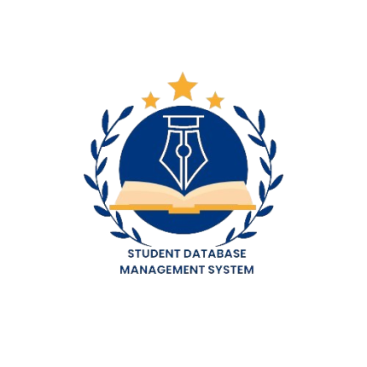
SHREE VIDYADHIRAJ POLYTECHNIC , KUMTA
IDENTIFICATION OF METHODOLOGY
Advantages Of Methodology:
The use of agile methodology for the Student Management System project provided several advantages. These advantages include:
Flexibility: The agile methodology allowed the development team to be flexible and adapt to changes during the development process.
Collaboration: The daily stand-up meetings and sprint review allowed for better collaboration between the development team and stakeholders.
Faster Time-to-Market: The iterative and incremental development approach enabled the development team to deliver features faster, resulting in a faster time-to-market.
Continuous Improvement: The sprint retrospective allowed for continuous improvement of the development process, resulting in a more efficient and effective development process.
Customer Satisfaction: Continuous customer involvement throughout the development process ensures that the final product meets customer expectations.
COMPUTER SCIENCE DEPARTMENT

