Slide 1

A computational investigation of water adsorption in silica
INTERNSHIP PRESENTATION
DEPARTMENT OF CHEMICAL ENGINEERING
LamMps - GUI software

Slide 2

LAMMPS (Large-scale Atomic Molecular Massively Parallel Simulator)
An open-source molecular dynamics (MD) simulator developed by Sandia National Laboratories.
Feature:
Parallelized for large-scale simulator.
Highly flexible for various interaction potentials (i.e., force field) and simulation types.
Able to Handle millions of particles efficiently.
Support simulations in materials science, biology, and condensed matter field

Slide 3
Understand LAMMPS Basic
LAMMPS uses input script file and control simulations
Input script file name: filename.in or in.filename
Important part of an input script file:
Initialization: Define units, dimensions, and boundary conditions
Atom Definition: Define system’s atomic structure (e.g., solid, liquid, gas) using lattice, region
Interaction Potentials: Define how atoms interact using pair styles command

Slide 4
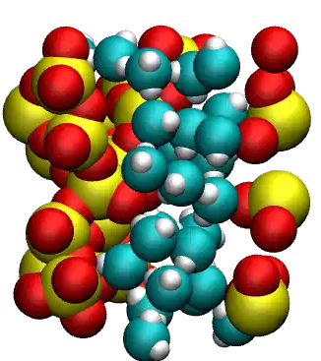
Generation of the silica block
Introduction The simulation of water adsorption in silica using LAMMPS software. Adsorption is the process where molecules from a gas or liquid stick to a surface
The main objective of this simulation was to model and study how water molecules interact with a silica surface.

Slide 5
What is the Vashishta Potential?
The Vashishta potential is an empirical three-body potential developed by Priya Vashishta and co-workers. It is particularly designed for silicon, oxygen, and their compounds (e.g., amorphous silica, SiO₂), where bond angles and directional bonding are important.

Slide 6
LAMMPS Syntax
In LAMMPS, the pair_style command sets the force field style. Here's how you use it:
This tells LAMMPS to use the Vashishta potential.
Then you use:
This line links the atom types in your system to the actual potential file (in this case, SiO.1990.vashishta) and assigns atom labels (e.g., Si and O) correctly.
#lmp
pair_style vashishta
#lmp
pair_coeff * * SiO.1990.vashishta Si O

Slide 7
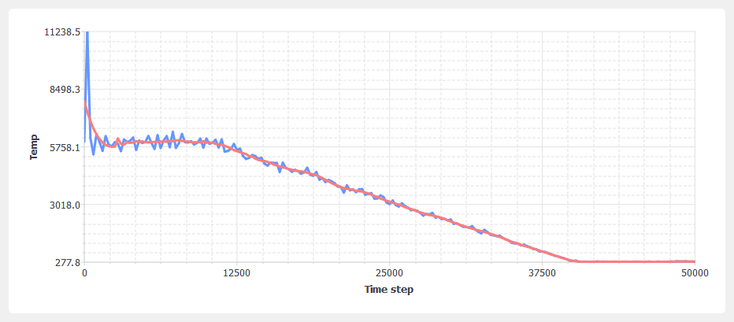

Slide 8
Phase | Temperature | Ensemble Used | Purpose
Melting | 6000 K | NVT | Break structure, create liquid state
Cooling (Anneal) | 6000 K → 300 K | NVT | Relaxation into amorphous phase
Equilibration | 300 K | NPT (anisotropic) | Final equilibration under realistic T/P

Slide 9
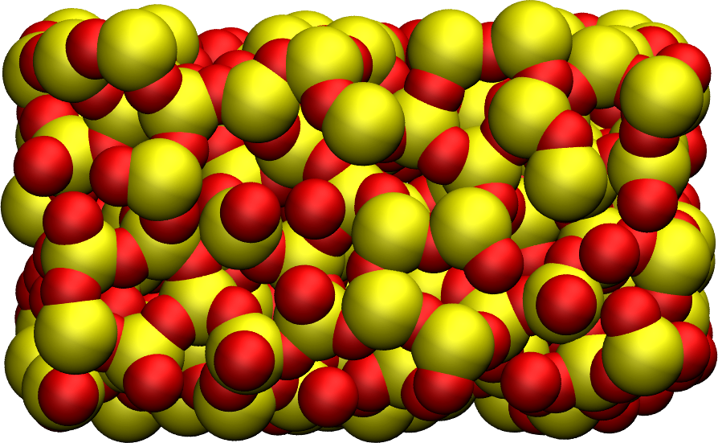
Amorphous silica (SiO2). Silicon atoms are represented in yellow, and oxygen atoms in red.

Slide 10
Cracking is the intentional breaking of bonds in the silica structure by stretching or deforming the simulation box using the fix deform command.
It simulates the formation of a crack or pore, which creates space inside the otherwise dense amorphous silica block.
This crack serves as a nanoporous region into which water molecules can later be adsorbed.
CRACKING THE SILICA

Slide 11
How is it Done in LAMMPS?
Here's the key command:
lmp
fix mydef all deform 1 x erate 0.005
fix deform : Dynamically changes the shape/size of the simulation box.
x erate 0.005: Stretches the box in the x-direction at a constant engineering strain rate of 0.005 (per timestep).
Over time, this causes stress buildup and eventual breaking of Si–O bonds, forming a crack.
The full cracking simulation typically includes:
lmp
fix nvt1 all nvt temp 300 300 0.1 fix mydef all deform 1 x erate 0.005 run 50000
This deforms the silica while maintaining temperature using an NVT thermostat.
lmp
fix mydef all deform 1 x erate 0.005
lmp
fix nvt1 all nvt temp 300 300 0.1 fix mydef all deform 1 x erate 0.005 run 50000

Slide 12
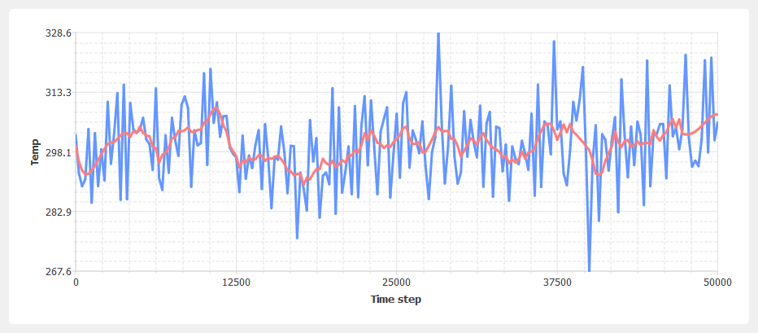

Slide 13
The temperature vs. time graph confirms that the system remains thermally stable at 300 K during the simulation.
The average temperature (red line) stays close to the target value, while small fluctuations (blue line) are due to the dynamic movement of atoms.
This behavior is expected when using the NVT ensemble, as applied in the script with fix nvt, and indicates that the thermostat is functioning correctly throughout the 50,000 time steps.

Slide 14
The gap in the middle of the box is a crack or fracture zone
This crack appears to have formed due to the applied uniaxial deformation:
#lammps
fix mydef all deform 1 x erate 0.005
→ This stretches the simulation box along the x-direction (left ↔ right)
#lammps
fix mydef all deform 1 x erate 0.005
The system was initially one compact block
As the simulation progressed and the box stretched, the atomic bonds broke, forming a crack in the center
This is a simulated fracture behavior, commonly used to study material failure, brittleness, or crack propagation in glasses and ceramics

Slide 15
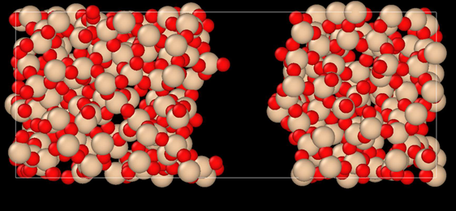

Slide 16
Adding water
Before going further, we need to make a few changes to our data file.
Currently,the generated cracking.data, and name the duplicate cracking-mod.data. Make the following ccracking.data file includes only two atom types, but we require four.
Copy the previously hanges to the beginning of cracking-mod.data to ensure it matches the following format (with 4 atom types, 1 bond type, 1 angle type, the proper type labels, and four masses):

Slide 17
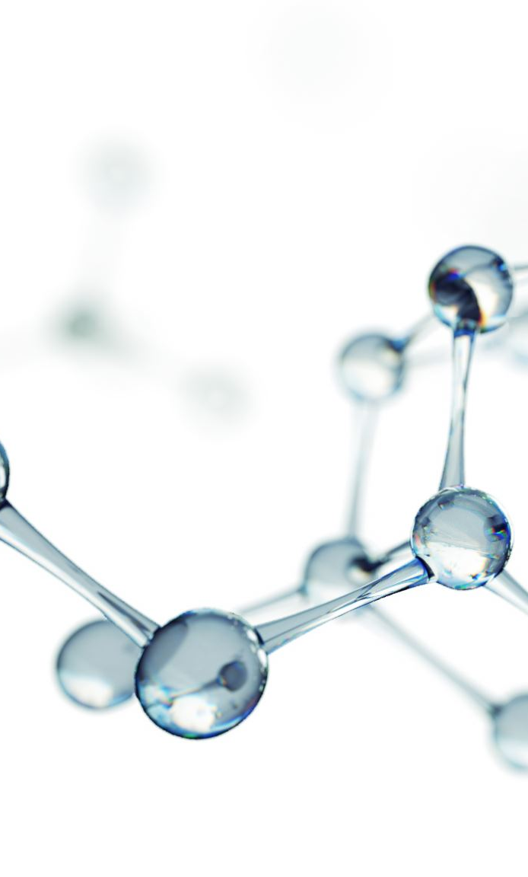
To add the water molecules to the silica, we will employ the Monte Carlo method in the grand canonical ensemble (GCMC). In short, the system is placed into contact with a virtual reservoir of a given chemical potential μ, and multiple attempts to insert water molecules at random positions are made. Each attempt is either accepted or rejected based on energy considerations.

Slide 18
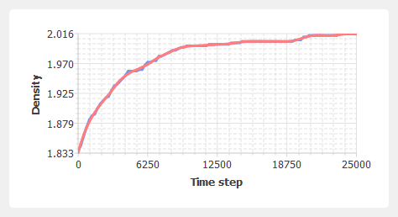

Slide 19
The graph shows how the density of the amorphous silica system evolves during a 25,000-step molecular dynamics simulation.
Initially, the atoms are loosely packed, resulting in a lower density of around 1.83 g/cm³
As the system evolves at 300 K under an NVT ensemble, the atoms re-arrange and the structure densifies.
The density gradually increases and stabilizes at approximately 2.016 g/cm³, indicating the system has reached an equilibrated amorphous state.
This confirms the effectiveness of the relaxation process in generating a realistic amorphous silica structure.

Slide 20
Term | Meaning
Vashishta potential | Used only for Si and O atoms in solid silica
TIP4P (lj/cut/tip4p/long) | Used for modeling water molecules and their interactions
OW / HW | TIP4P water atom types: Oxygen Water / Hydrogen Water
NULL in pair_coeff | Excludes OW and HW from Vashishta potential
Fluid-fluid interaction | Water–water interactions (OW–OW, HW–HW)
Fluid-solid interaction | Water–silica interactions (e.g., OW–Si)
bond_coeff and angle_coeff | Define water’s internal structure (bond length 0.9572 Å, angle ~104.52°)

Slide 21
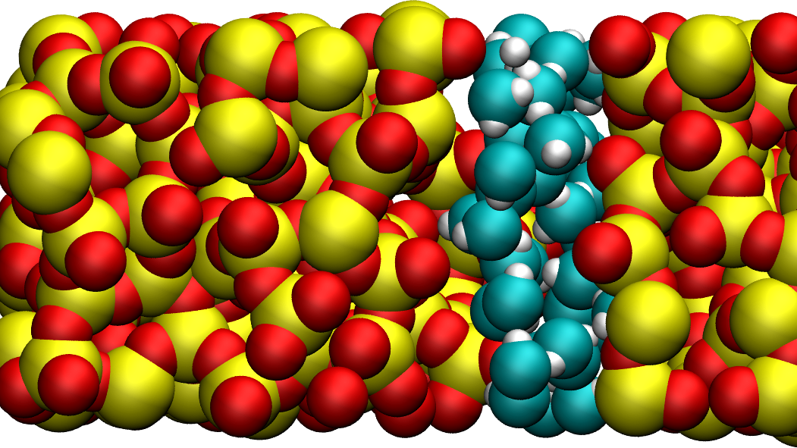
This mimics water adsorption behavior in porous silica — which is important for applications like:
Catalysis
Water purification
Sensor technology

Slide 22
Relevance to Chemical Engineering :
a) Molecular Simulation in Process Design
b) Adsorption Technology
c) Catalysis
d) Environmental Applications
e) Nanomaterials and Surface Engineering
f) Thermodynamic Understanding

Slide 23
Applications in Chemical Engineering
Adsorption Units | Designing silica-based adsorbents for dehydration processes
Catalysis | Evaluating hydrothermal stability of silica supports
Membranes | Moisture behavior in silica membranes for water purification
Pharmaceuticals | Water interaction in silica-based drug carriers
Energy Storage | Silica in fuel cells and battery components
Sensors | Development of humidity sensors based on silica’s adsorption capacity

Slide 24

Conclusion :
This method is a powerful simulation-based tool that allows chemical engineers
Analyze material performance before real experiments,
Reduce time and cost in R&D of porous adsorbents,
Improve the design of unit operations involving adsorption, diffusion, or reaction,
Innovate new applications using nanoporous silica in diverse chemical processes.

Slide 25
THANK YOU!!!

