Slide 1

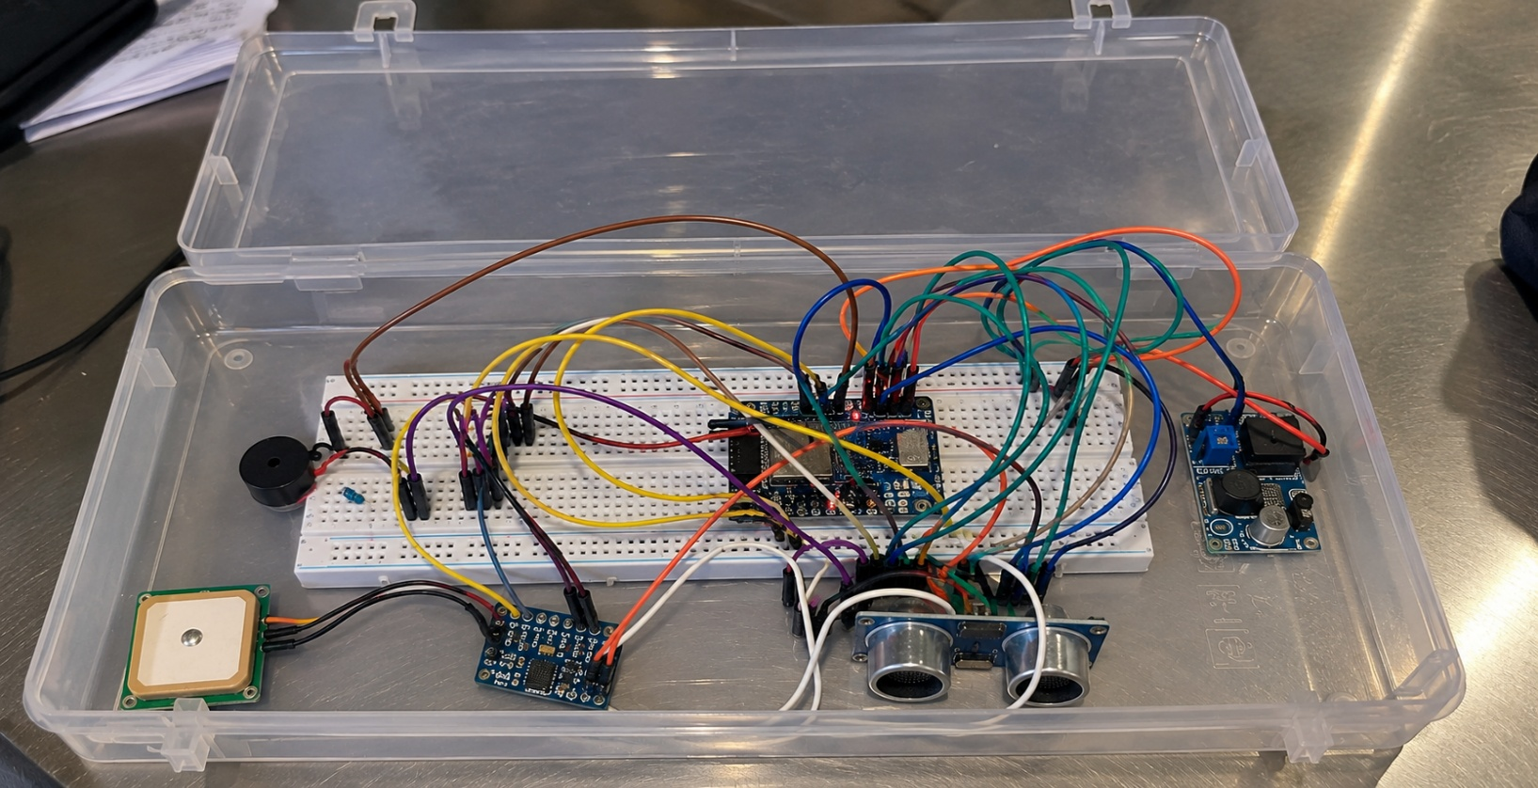
MVGR College Of Engineering(Autonomous)
Department Of Electronics And Communications Engineering
Community Project On
IoT Based Road Pothole And Anomaly
Detection System

Slide 2

TEAM INTRODUCTION
BATCH NO - 2
Registration No | NAME | ROLE
24331A0406 | A. Rama Chandini | Hardware Implementation
24331A0426 | B. Ananth Kumar | Software & System Implementation
24331A0439 | CH. John Sumanth | Documentation and testing
24331A0456 | G. Chanikya | Data collection &Research
UNDER THE GUIDANCE OF
DR .K.S.N Raju
MTECH.PhD
ASSOCIATE PROFESSOR(ECE)

Slide 3
Abstract
The aim of this project is to develop an IoT-based road pothole and anomaly detection system that detects road irregularities while a vehicle is moving and provides timely alerts to improve road safety and monitoring.
The system uses an ESP32 microcontroller, a pothole detection sensor(MPU6050), and a GPS module(Neo 6M) to detect road anomalies and obtain their location. The detected information is transmitted through Wi-Fi using a Telegram Bot instead of GSM/SMS. The main objective is to achieve simple, low-cost, real-time detection and location-based reporting of road potholes and anomalies.

Slide 4
INTRODUCTION
Reviw1:Survey Analysis
Conducted a survey to understand common road and pothole-related problems.
Analyzed responses to identify major issues faced by road users.
Survey results helped us understand the need for an effective pothole detection system.
Review2:Protype Deploment
Developed an initial prototype for IoT-Based Road Pothole and anomaly Detection.
The prototype detects potholes and sends the information through Telegram for quick notification.

Slide 5
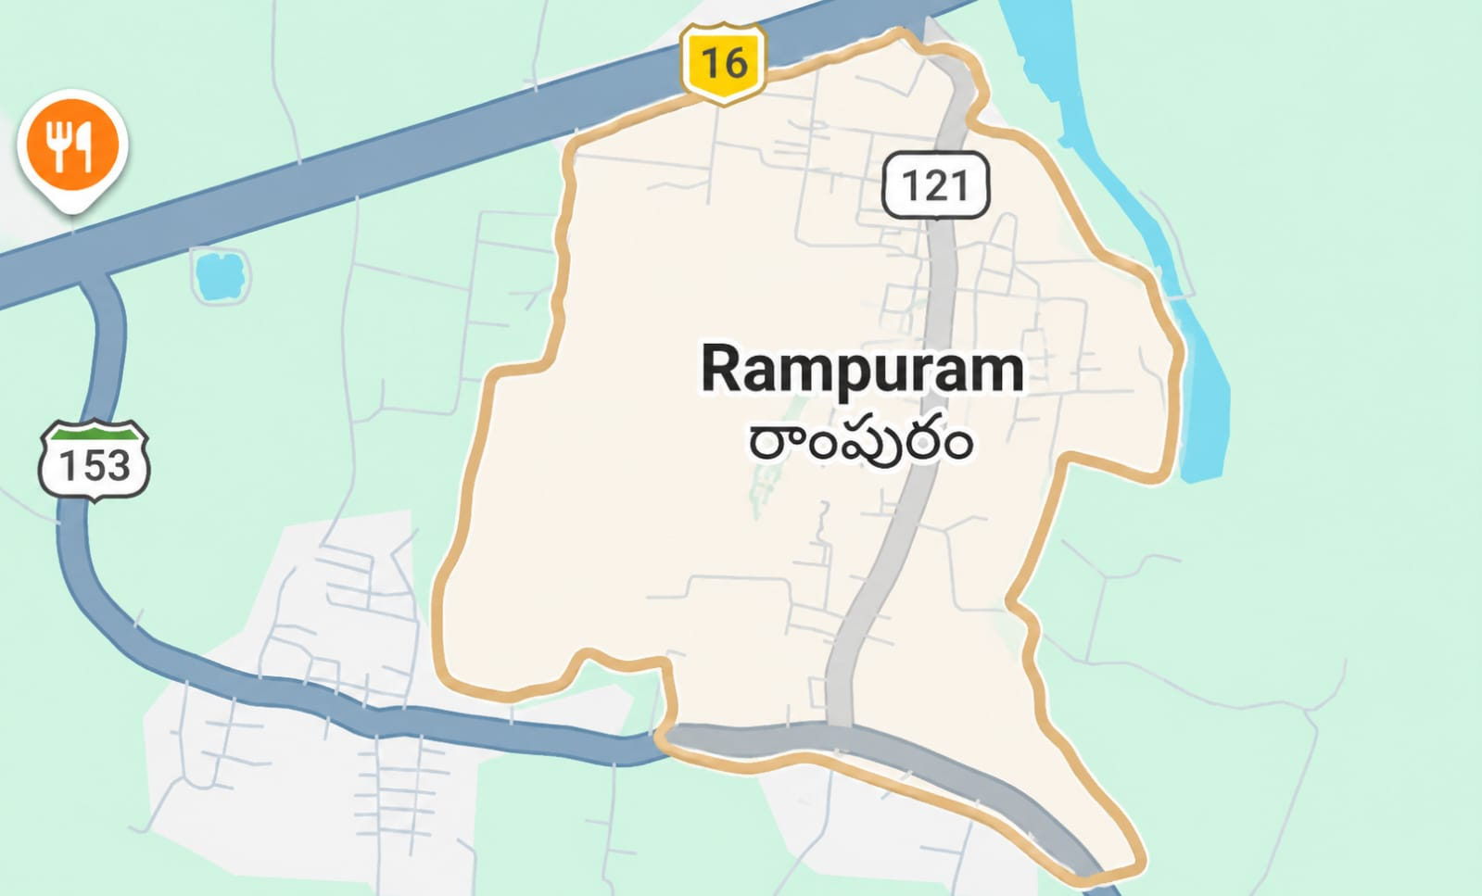
TARGETED AREA
Village name : Rampuram
Population : 3536
Density : /Km2 (4300 sq.m)
Location :Rampuram Pendurthi mandal-531173(AP)
Area : 518 hectares
Primary Economic :Farming

Slide 6

Objectives
To study road conditions in the selected community.
To identify pothole-prone areas.
To understand the causes of potholes.
To study their effect on road users.
To collect feedback from the community.
To propose an anomaly detection system
For identifying road defects.
To create awareness about road safety.

Slide 7

survey location
Selected Location : Rama puram
District : Visakhapatnam
Population : 1657
No of people interacted with : 10
Date of Survey :
Type of Road sections Observed : Mostly
Problems in Village : Roads , water

Slide 8






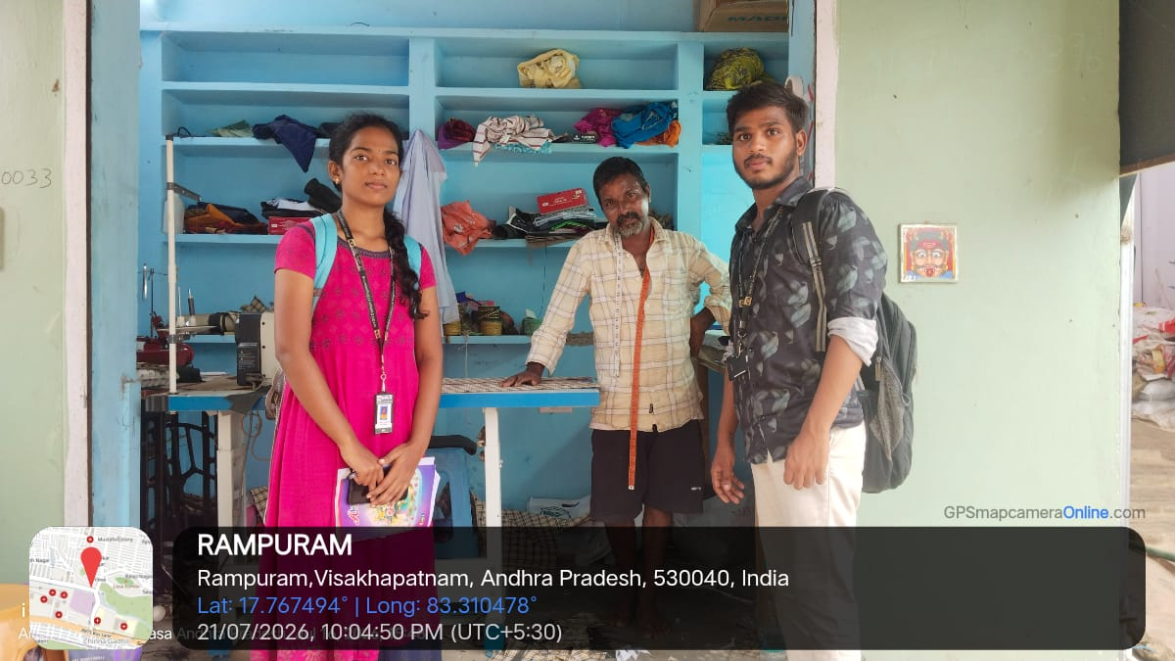
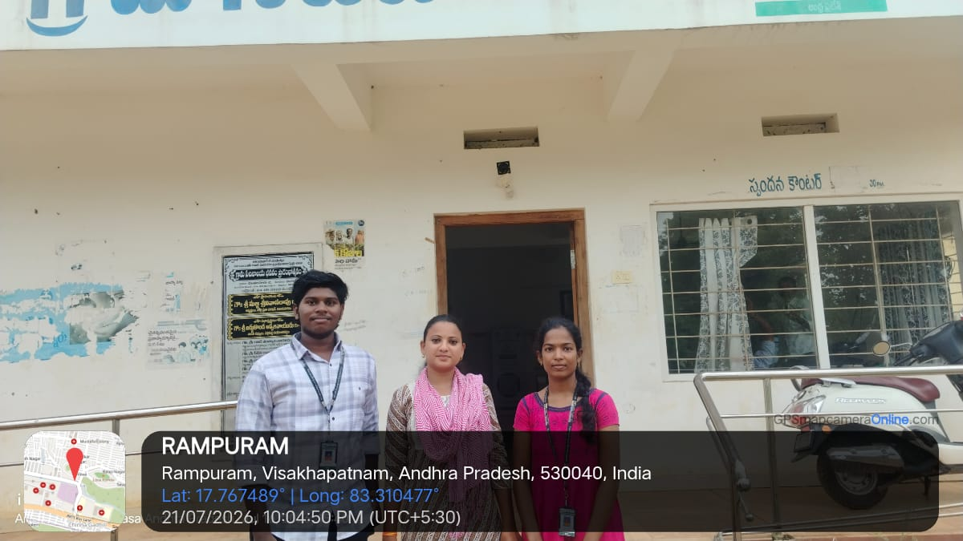
Survey Gallery

Slide 9
Survey Questions
How frequently do you encounter potholes while travelling on the roads in your village?
How much do potholes affect your daily travel, especially while riding a two-wheeler?
Do you find it difficult to identify potholes during night-time due to poor visibility?
What do you think is the main cause of potholes in your village roads?

Slide 10
Data & observations
Survey conducted among local residents and road users.
Major problems reported: potholes, uneven roads, waterlogging, traffic congestion, and poor road maintenance.
Many respondents reported that road problems cause travel inconvenience and safety concerns.
Residents felt that quick identification and reporting of road problems would be helpful.
The survey showed a need for a smart, automated road monitoring system.

Slide 11
Causes of Potholes
Water Infiltration: Rainwater seeps through surface cracks and weakens the lower layers of the road base
Heavy Traffic: Overloaded trucks and cars put excessive stress on the pavement, creating fatigue cracks.
Poor Drainage: Inadequate drainage systems trap standing water on the road, speeding up surface breakdown.
Substandard Materials: Cheap construction materials and poor maintenance lead to premature road failure.

Slide 12
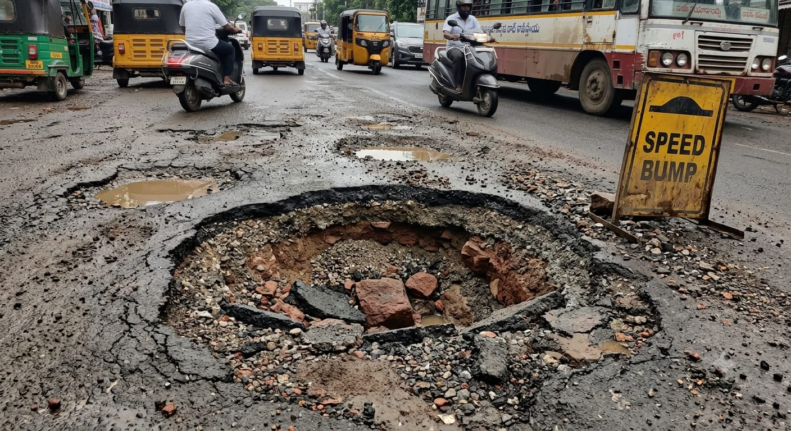
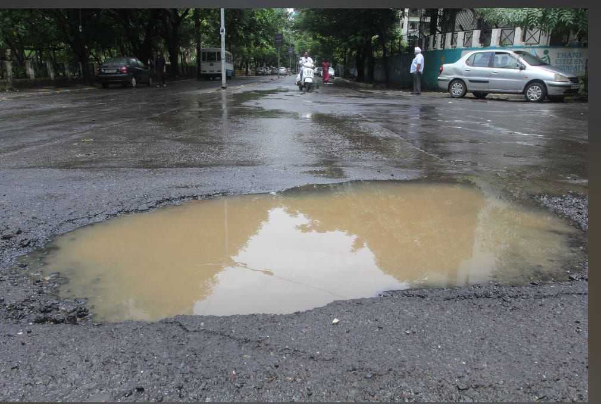
Reason for choosing Smart Road Pothole Detection:
Road potholes were the most frequently reported problem during the survey.
They pose a serious risk to road users and can lead to accidents.
Potholes cause vehicle damage and increase maintenance costs.
Existing reporting methods are slow and mostly manual.
A smart detection system can identify potholes quickly and help authorities take faster action.
The project is practical, cost-effective, and beneficial to the community.

Slide 13
Components used:
Hardware :
ESP 32 CAM Module,
MPU6050 Accelerometer
GPS Module (Neo-6M),
Buzzer
Breadboard
Jumper Wires
Software:
Aurdino IDE
YOLO V8

Slide 14
Working of Pothole System
The ESP32 controls all the components in the system.
The Accelerometer detects sudden vibrations when the vehicle passes over a pothole.
The GPS module captures the exact location of the pothole.
The pothole information is stored in the cloud(Telegram) for future reference.
Authorities can access the cloud data, view pothole locations, and take necessary action.

Slide 15
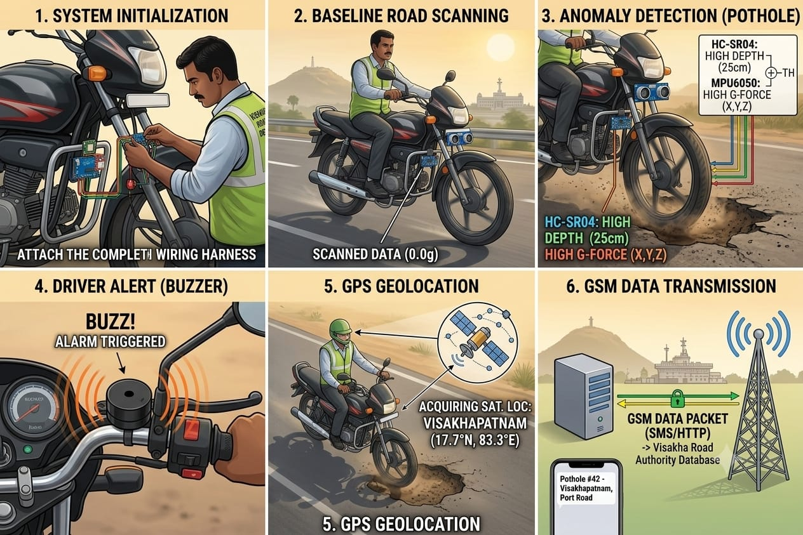

Slide 16
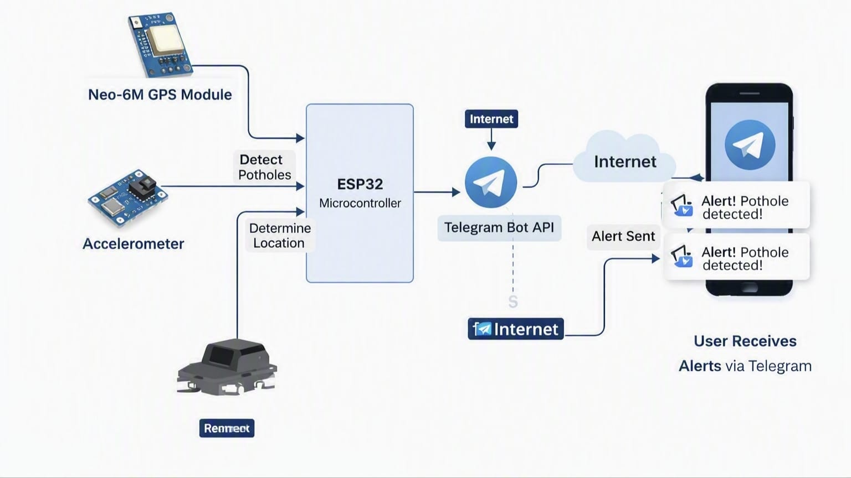
System Architecture:

Slide 17
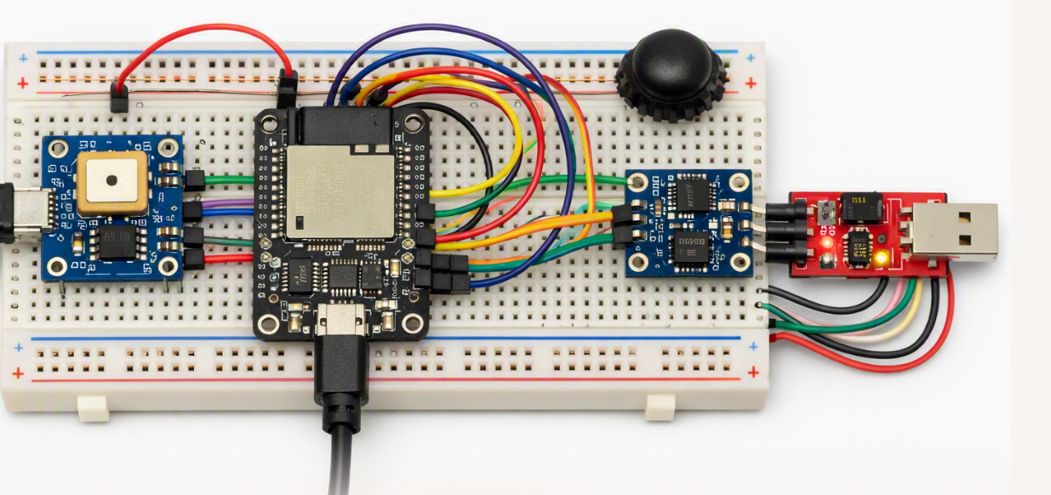
Circuit Diagram:

Slide 18
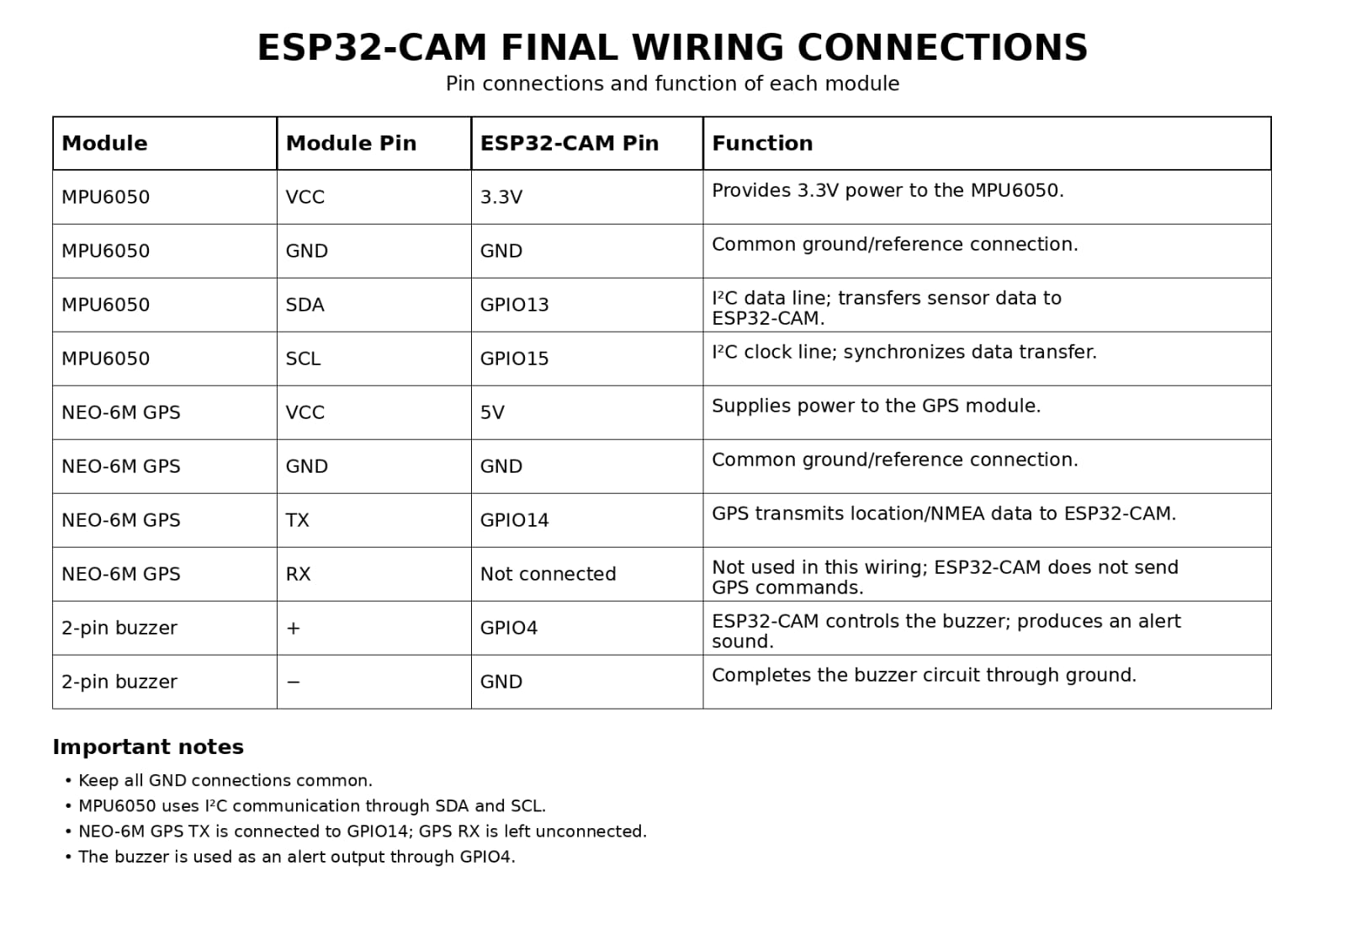

Slide 19
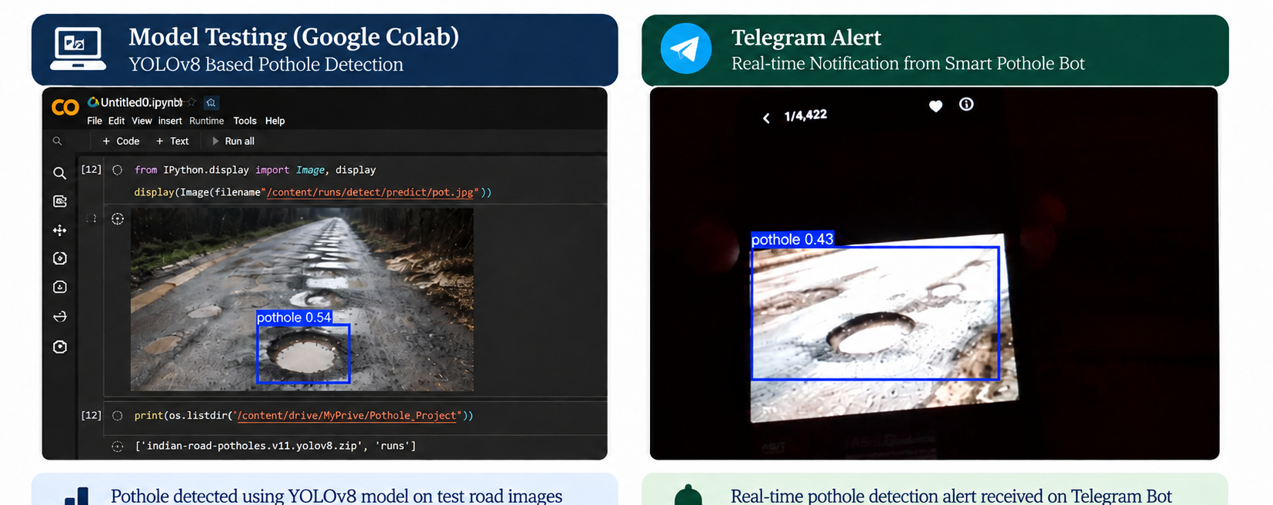
Prototype results and Actions:

Slide 20
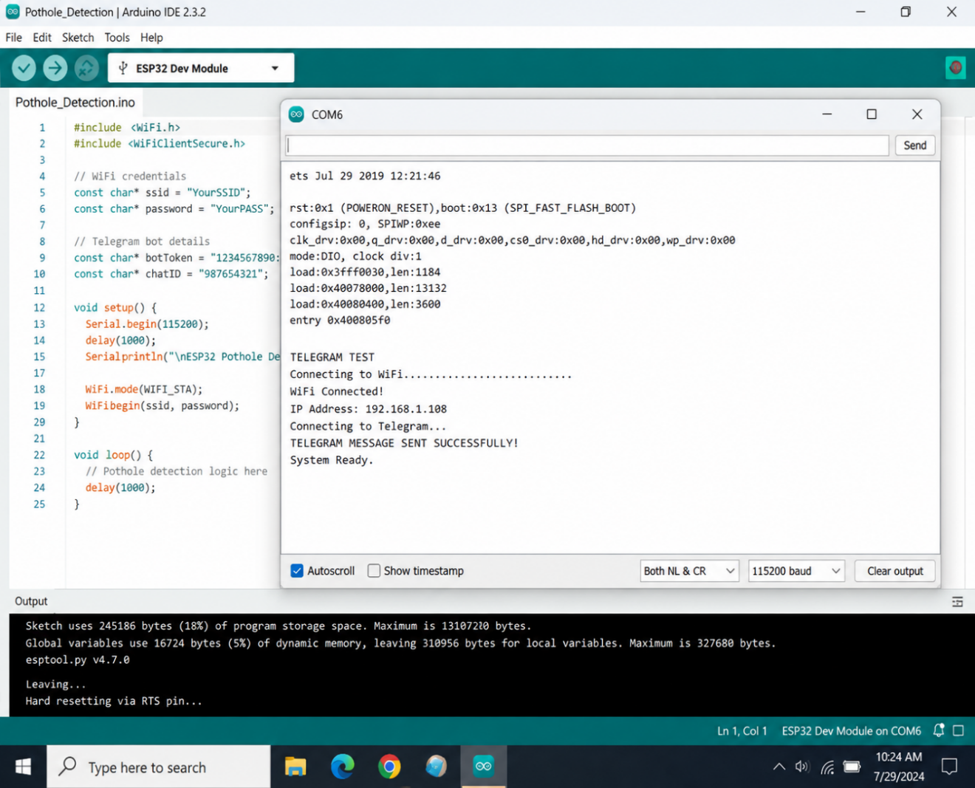
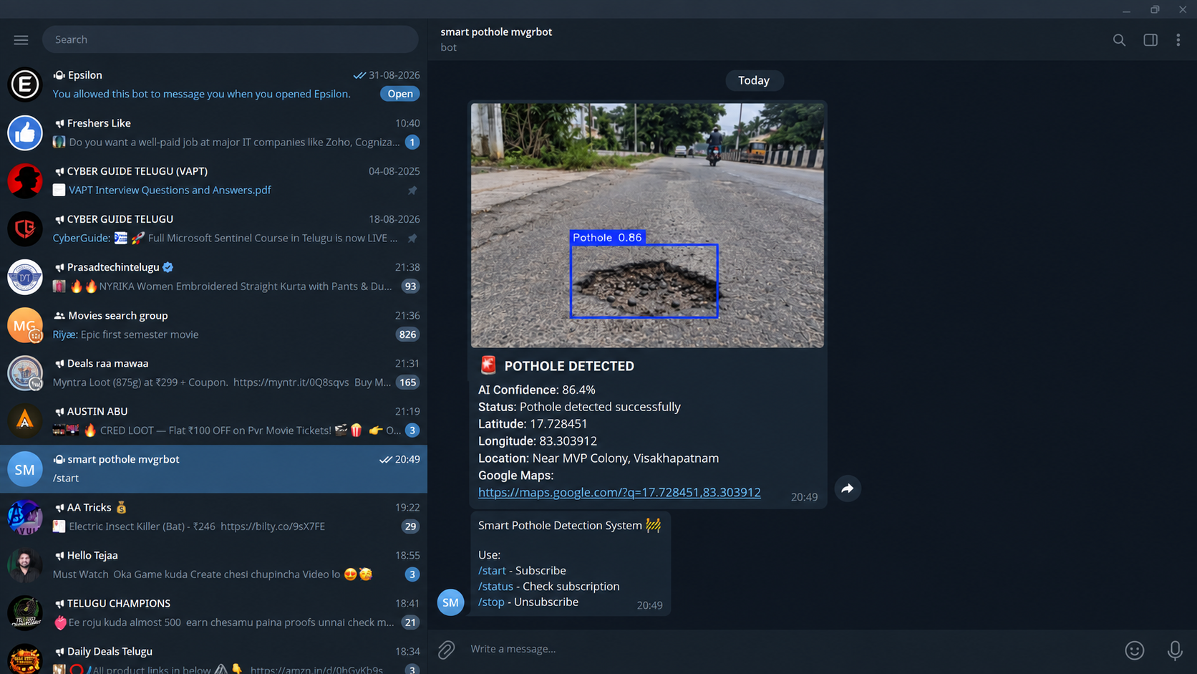

Slide 21
Advantages
Real-time detection of potholes and road abnormalities.
Instant Telegram notifications to provide timely information.
Helps identify the location of road problems using GPS.
Reduces the need for manual road inspection.
Can help improve road safety and maintenance.
Simple and cost-effective prototype.
Can be expanded to monitor multiple types of road problems.
Limitations
Detection accuracy depends on road conditions, lighting, camera quality, and the trained YOLO dataset.
MPU6050 may sometimes classify speed breakers, sudden braking, or strong vehicle vibrations as road anomalies.
The current prototype is developed and tested on a small scale and requires further real-road testing for reliable deployment.
Telegram alerts require an active Wi-Fi/Internet connection; alerts cannot be delivered when the network is unavailable.

Slide 22
Conclusion
The IoT pothole detection system using ESP32, GPS, and accelerometer provides a low‑cost, real‑time solution for road monitoring. By sending alerts through the Telegram Bot API, the system ensures that public officers and road maintenance authorities receive immediate notifications with location data. This direct communication enables faster response times, better prioritization of repairs, and improved road safety. Despite challenges like Wi‑Fi dependency and GPS accuracy, the design offers a scalable foundation for smart city infrastructure and strengthens collaboration between citizens and the public sector.

Slide 23
Future Scope:
AI-Based Damage Classification
Integrate Artificial Intelligence to automatically classify potholes and estimate their severity.
Smart City Integration
Connect the system with smart city infrastructure for centralized road monitoring and maintenance.
Develop a mobile app that provides real-time pothole alerts and suggests safer routes.
Predictive Road Maintenance
Drone and Camera Integration
Combine IoT sensors with drones and computer vision to improve road inspection accuracy and cover larger areas efficiently.

Slide 24
References
[1] P. Singh, R. Wijethunga, and A. Sadhu,
“Expert Evaluation System for Pothole Defect Detection,”
Expert Systems with Applications, 2025. — ScienceDirect
[2] C. Chellaswamy, H. Famitha, T. Anusuya, and M. A. Coumar,
“IoT Based Humps and Pothole Detection on Roads and Information Sharing,”
ICCPEIC, IEEE, 2018, pp. 291–297. — IEEE Xplore
[3] J. C. Wang, C. L. Hsieh, M. H. Lee, and C. H. Sun,
“Monitoring Road Surface Anomalies Using an IoT-Based Automatic Detection System,”
IEEE Transactions on Intelligent Transportation Systems, 2024. — IEEE Xplore
[4] H. Bello-Salau, A. J. Onumanyi, R. F. Adebiyi, et al.,
“A Critical Appraisal of Various Implementation Approaches for Real-Time Pothole Anomaly Detection,”
Sensors, vol. 23, no. 18, 2023. — MDPI
[5] K. Bansal, K. Mittal, G. Ahuja, and A. Singh,
“DeepBus: Machine Learning Based Real-Time Pothole Detection System for Smart Transportation Using IoT,”
Internet Technology Letters, vol. 3, no. 6, 2020. — Wiley

Slide 25
THANK YOU

