Slide 1


Explorative data analysis on

Slide 2
TEAM INFO
Name :Anantha Sai.K
Batch : 239
Qualification : B.Tech(Mechanical)
Name: Sreeja.G
Batch : 239
Qualification : B.Tech (ECE)
Name:Sirisha
Batch : 239
Qualification : B.Tech (ECE)

Slide 3
AGENDA
Business Problem and use case domain understanding
Objective of the project
Web Scraping
Data Summary
Exploratory Data Analysis
Data cleaning
Data manipulation
Data Summary
Uni-Variate analysis steps
Bi-Variate analysis steps
Multi-Variate analysis steps
Key-business questions
Conclusions
Q & A
Experience and challenges working on web scrapping

Slide 4
Objectives
Number of categories in Cars24.
Number of cities in Cars24.
Most discounted cars
Price comparison in between cities
Discount % based on cars age availability in different cities

Slide 5
Data Collection
Website Name : cars24.com
Link : https://www.cars24.com/buy-used-maruti-cars-hyderabad/
Libraries Used :
Beautiful soup from BS4
Requests
Regular Expressions
Pandas
Numpy
Matplotlib
Seaborn

Slide 6
Process of Data Collection
Data Extraction : Data extraction process of retrieving relevant information from websites, or files using programming techniques and tools. It involves extracting specific data points or patterns for further analysis or processing.
Data Parsing : We have used Beautiful soup to navigate and extract data from HTML documents.
Data Cleaning : Data cleaning involves identifying and correcting or removing inaccurate data in order to improve data quality for modeling purposes. It includes tasks such as handling missing values, removing duplicates, correcting data inconsistencies.
By using the above techniques we have created DATAFRAME

Slide 7
Data Cleaning & Manipulation
Data cleaning
Handling missing data
Removing duplicates
Data normalization and standardization
Data Manipulation
Filtering
Sorting
Transforming

Slide 8
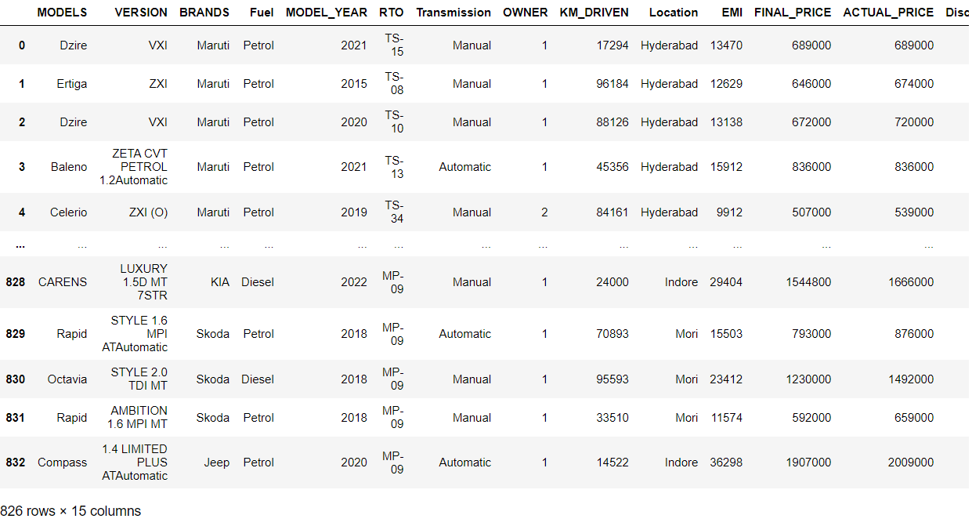

Data Frame

Slide 9
Data Set Info
Models : It shows the name of the car model.
versions : It represents the version of the car.
Brands : It shows the car from which brand.
Fuel : It shows the type of Fuel.
Model Year : It shows the Model year of the car.
RTO : It shows the number of car.
Transmission : It shows the weather the car is manual or auto .
Owner : It shows the weather the car 1st or 2nd or 3rd handed.
KM Driven : It shows how many kms the car has travelled.
Location : It shows the location of the car.
EMI : It shows the monthly EMI amount.
Final Price : This is the final price after discount.
Actual Price : This is the actual price without discount.
Discount Amount : It shows the discount amount .
Cars Age : It shows age of the car.

Slide 10
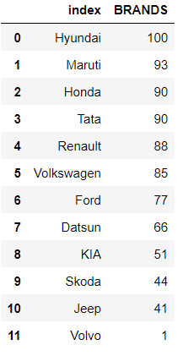
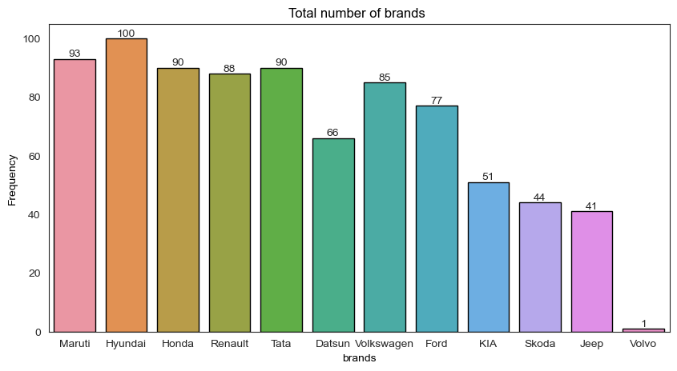
Number of categories in BRANDS
This Graph shows the number of each brand from all the cities

Slide 11
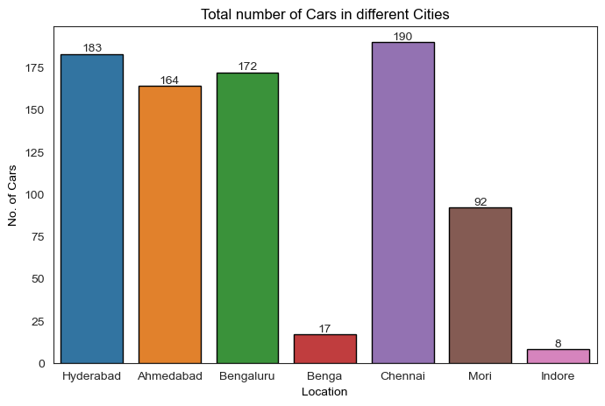
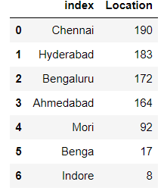
Number of categories in BRANDS
This Graph shows the number of all modes from all brands in all the cities

Slide 12
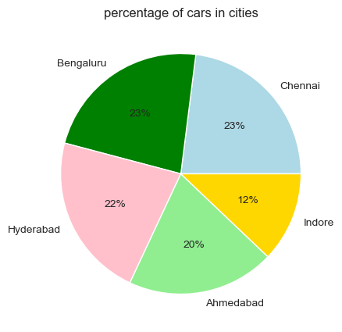
Percentage of cars in cities
This Graph shows the percentage of cars from each city

Slide 13
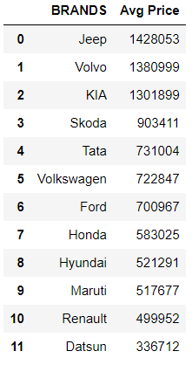
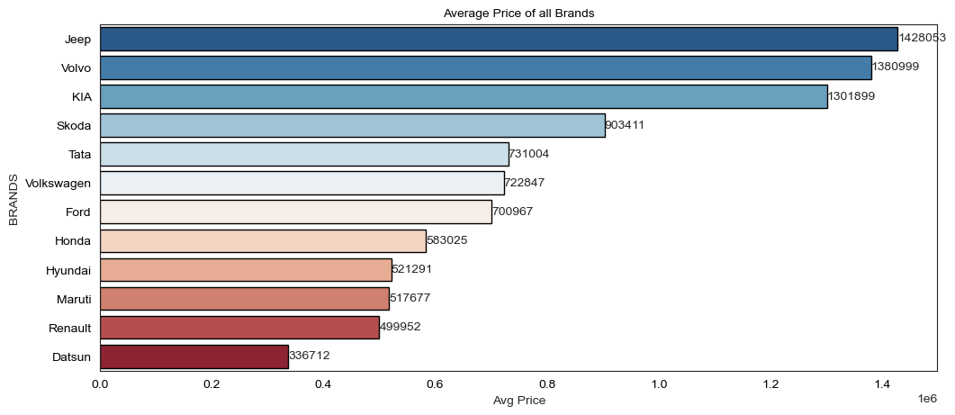
Average price of all Brands
This Graph shows the average price of cars from all cities

Slide 14

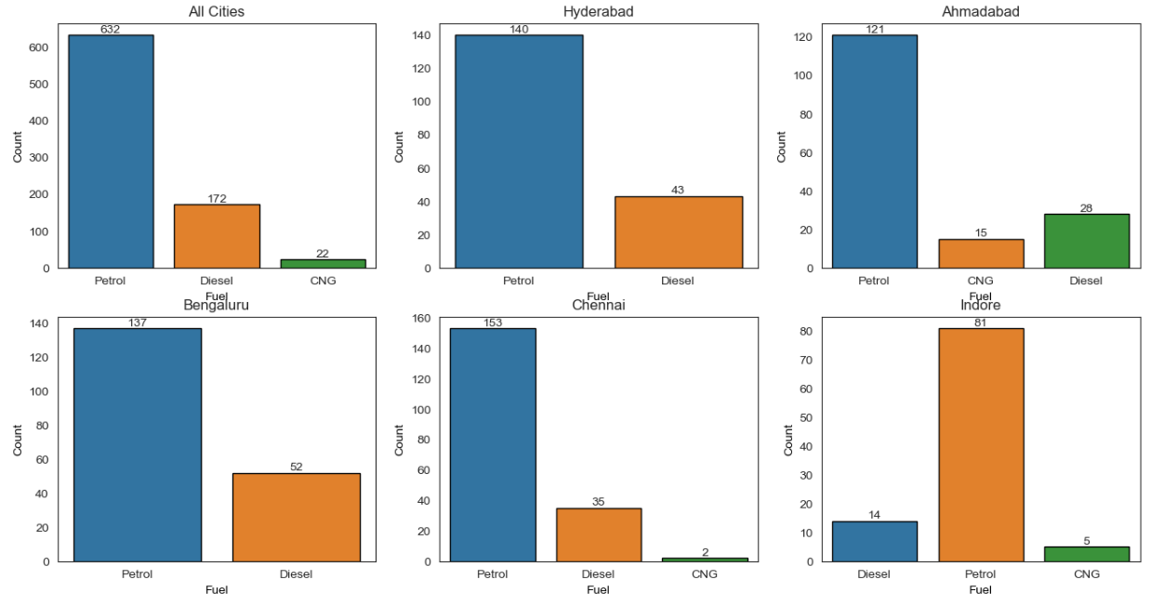
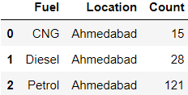

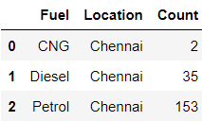
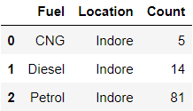
Fuel types
This Graph shows the types fuel cars from all cities

Slide 15
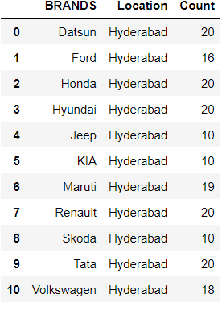
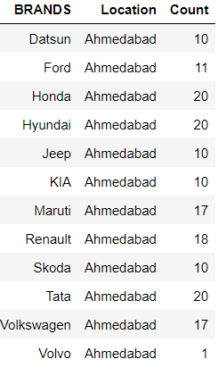
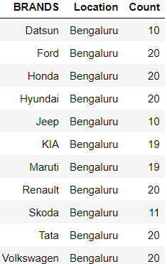
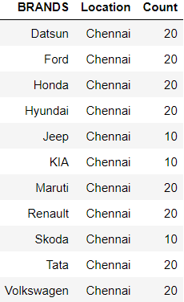
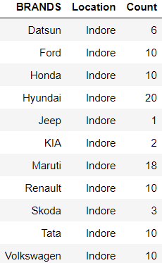
Number of Brands in all cities
This Tables shows the number of Brands from all cities

Slide 16
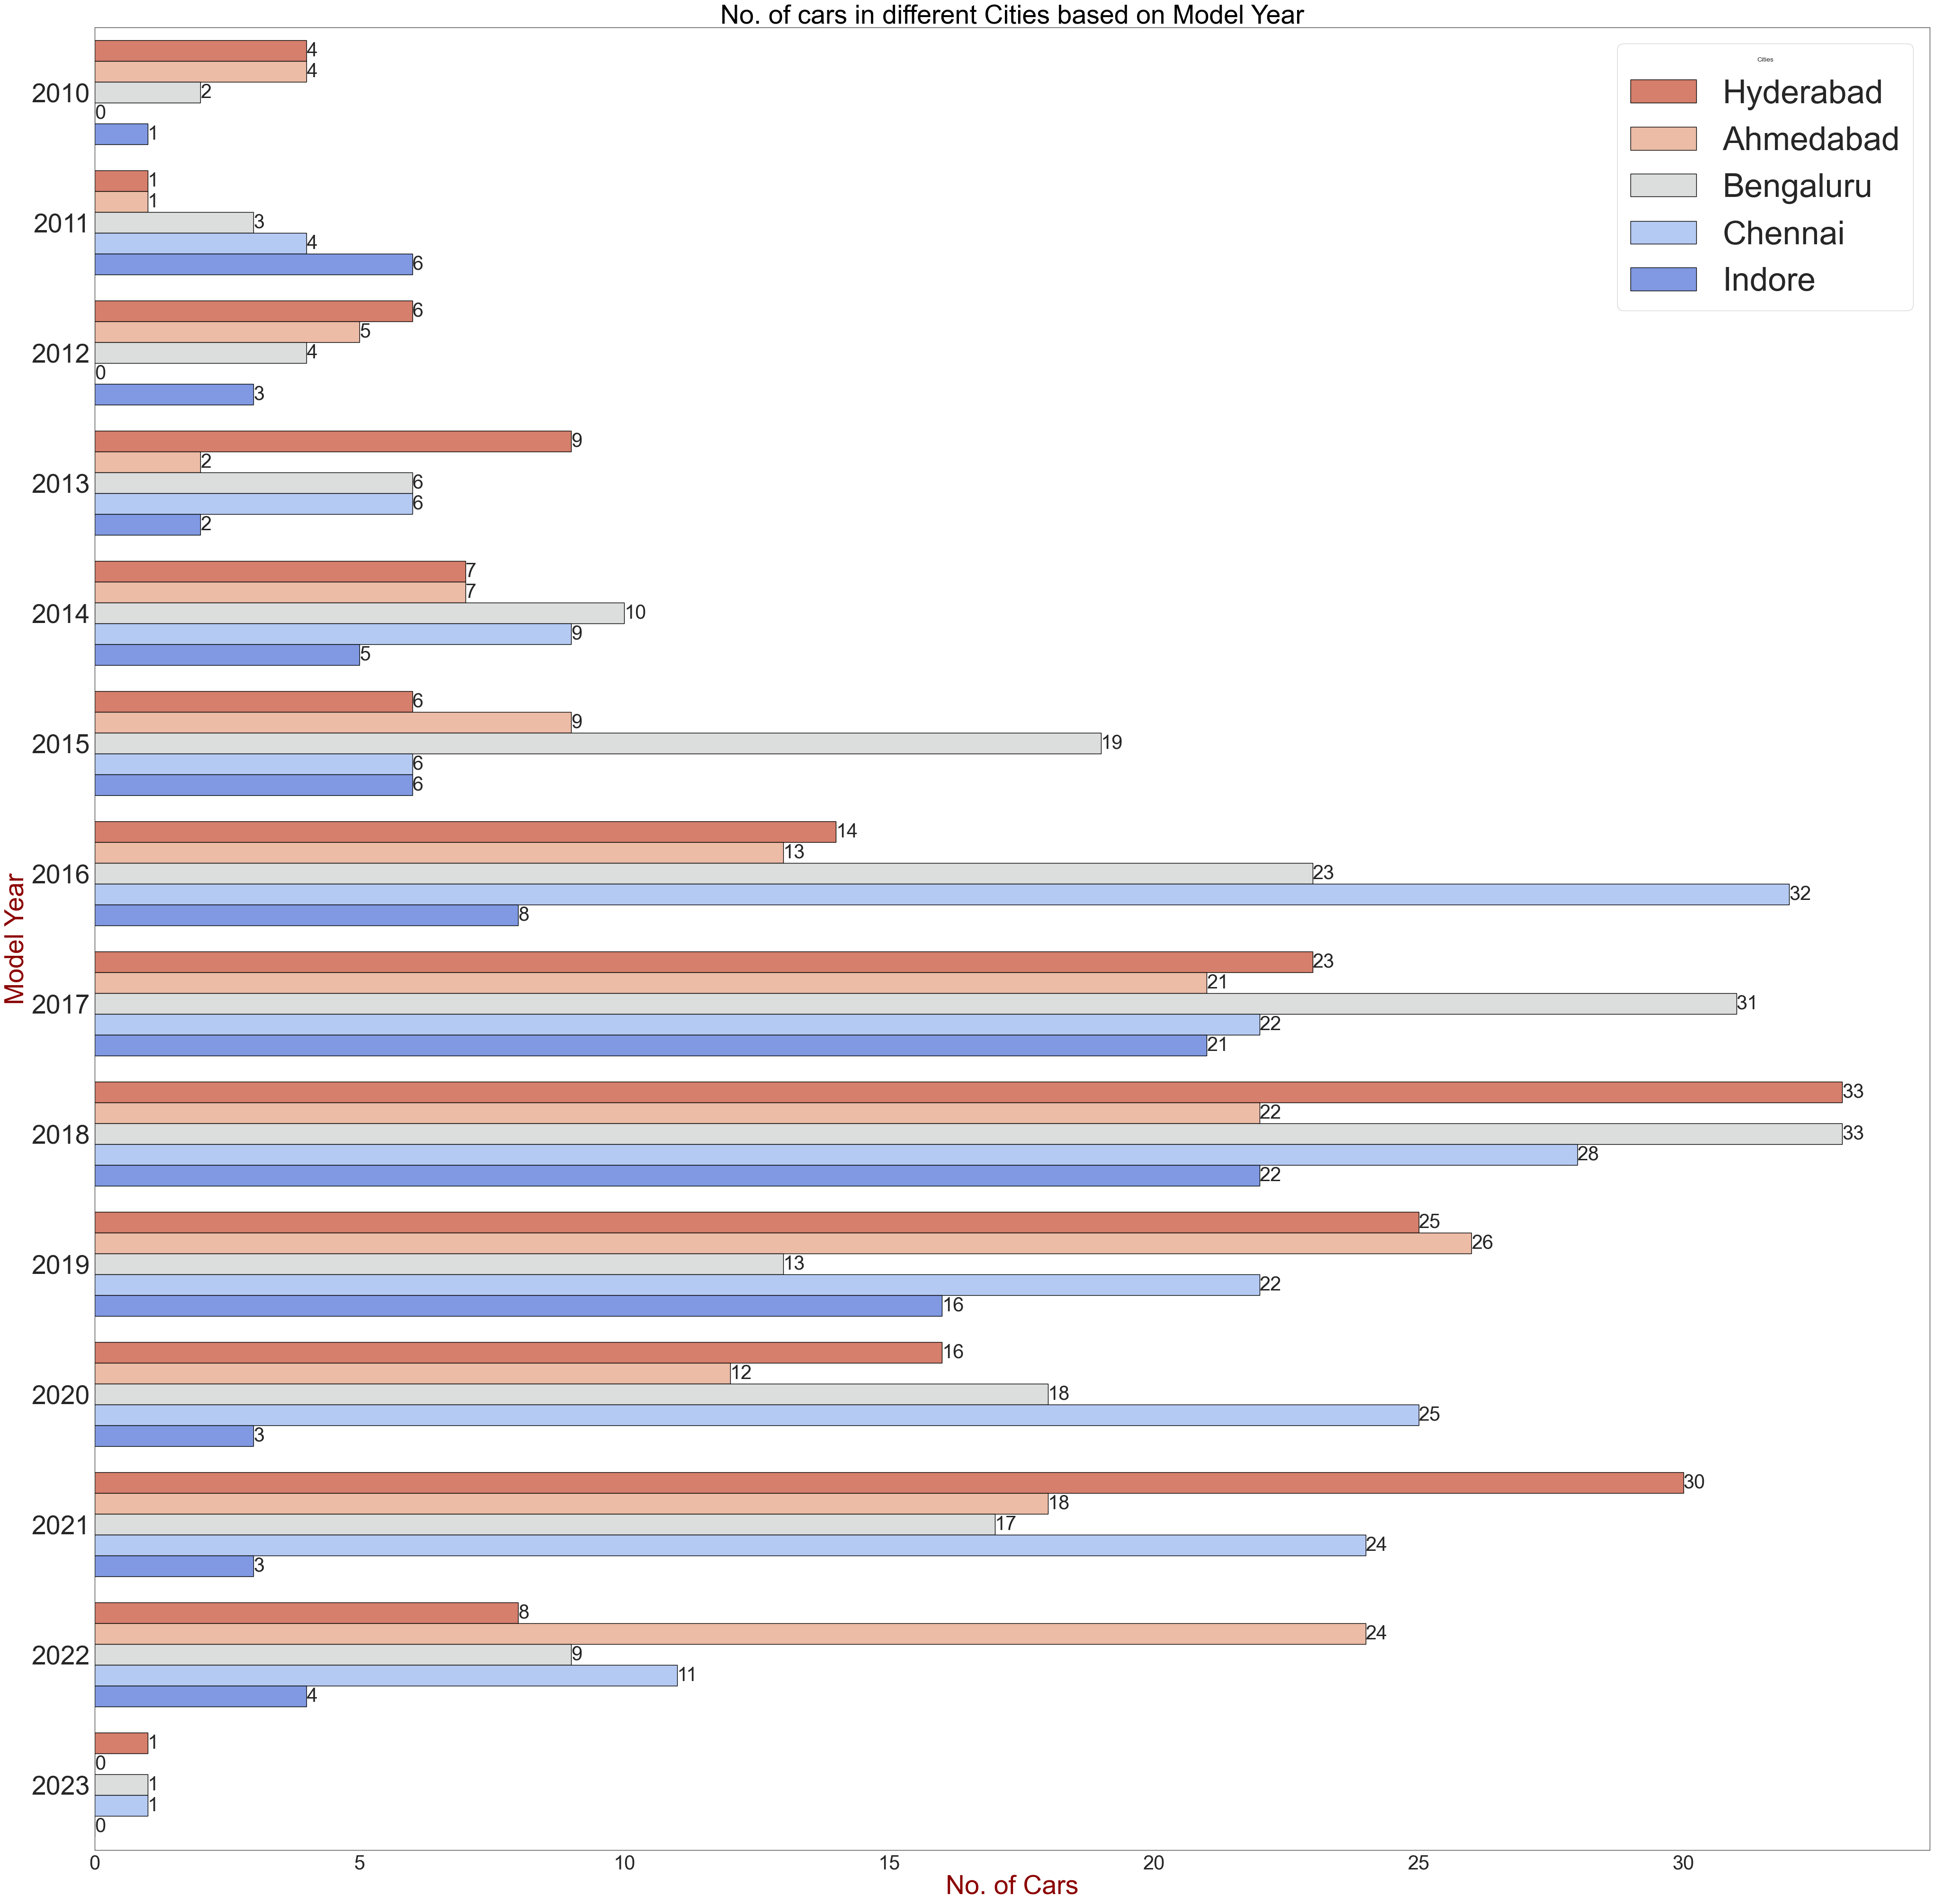
Number of cars based on model year
This Graph shows the number of cars from all cities

Slide 17
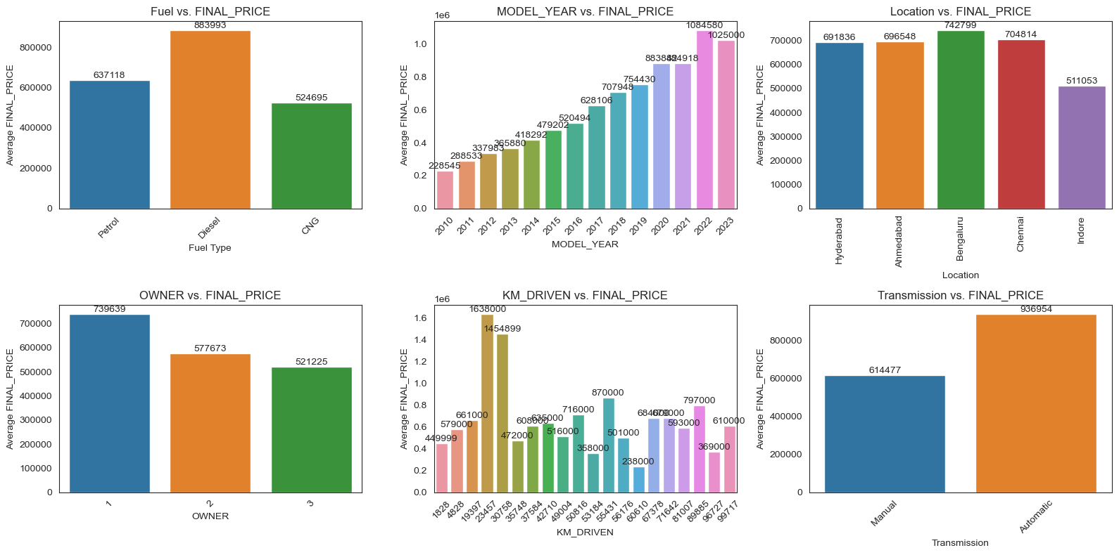
Average price of cars based on different cases
1.Fuel vs. FINAL_PRICE
2. MODEL_YEAR vs. FINAL_PRICE
3. Location vs. FINAL_PRICE
4. OWNER vs. FINAL_PRICE
5. KM_DRIVEN vs. FINAL_PRICE
6. Transmission vs. FINAL_PRICE

Slide 18
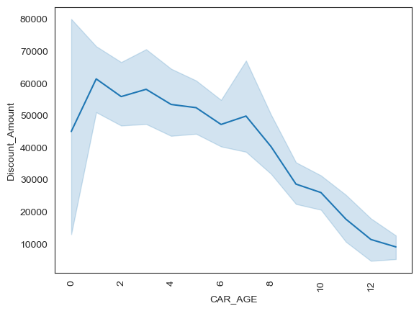
Price Drop based on age

Slide 19
Challenges
Reading data from a dynamic website is challenging , Though it is changing continuously
Scraping the data from the website is bit more complicated

Slide 20
Key Business Questions

Slide 21
Conclusion
Cars24 Offers highest discounts on
Recent released segment.
The main target of cars24 is to provide best
Cars to attract more Coustomers.

Slide 22
Thank you

