Slide 1
Data Visualization, Mid term Exam Ananth Kumar sseetham@kent.edu
Assumptions and Stacked Bar Graph for Establishment Survey(CES)

Slide 2
Assumptions: CES Revised Survey and Published Survey
Assuming few of the non-farm entities are not considered in the previously published.
Assuming that there might be multiple records for an employee, if employee working multiple jobs when initial survey was conducted.
Assuming that, it also reflects adjustments for net international migration, updated vital statistics, and estimation methodology improvements.
As the deadline for collecting the data for month-month analysis is 12^{th,} Given this short collection cycle for the first preliminary estimates, many establishments are not able to provide their payroll information in time to be included in these estimates.
The establishment survey revises published estimates to improve its data series by incorporating additional information that was not available at the time of the initial publication of the estimates. The establishment survey revises its initial monthly estimates twice, in the immediately succeeding 2 months, to incorporate additional sample receipts from respondents in the survey and recalculated seasonal adjustment factors.
People are also counted as employed if they were temporarily absent from their jobs because of illness, bad weather, vacation, labor-management disputes, or personal reasons.
Some of the employee might have quit the company during published survey but was an employee when the revised survey was conducted.
Story:
Identifying and understanding the assumptions for the gap between revised survey data and previously published survey.

Slide 3
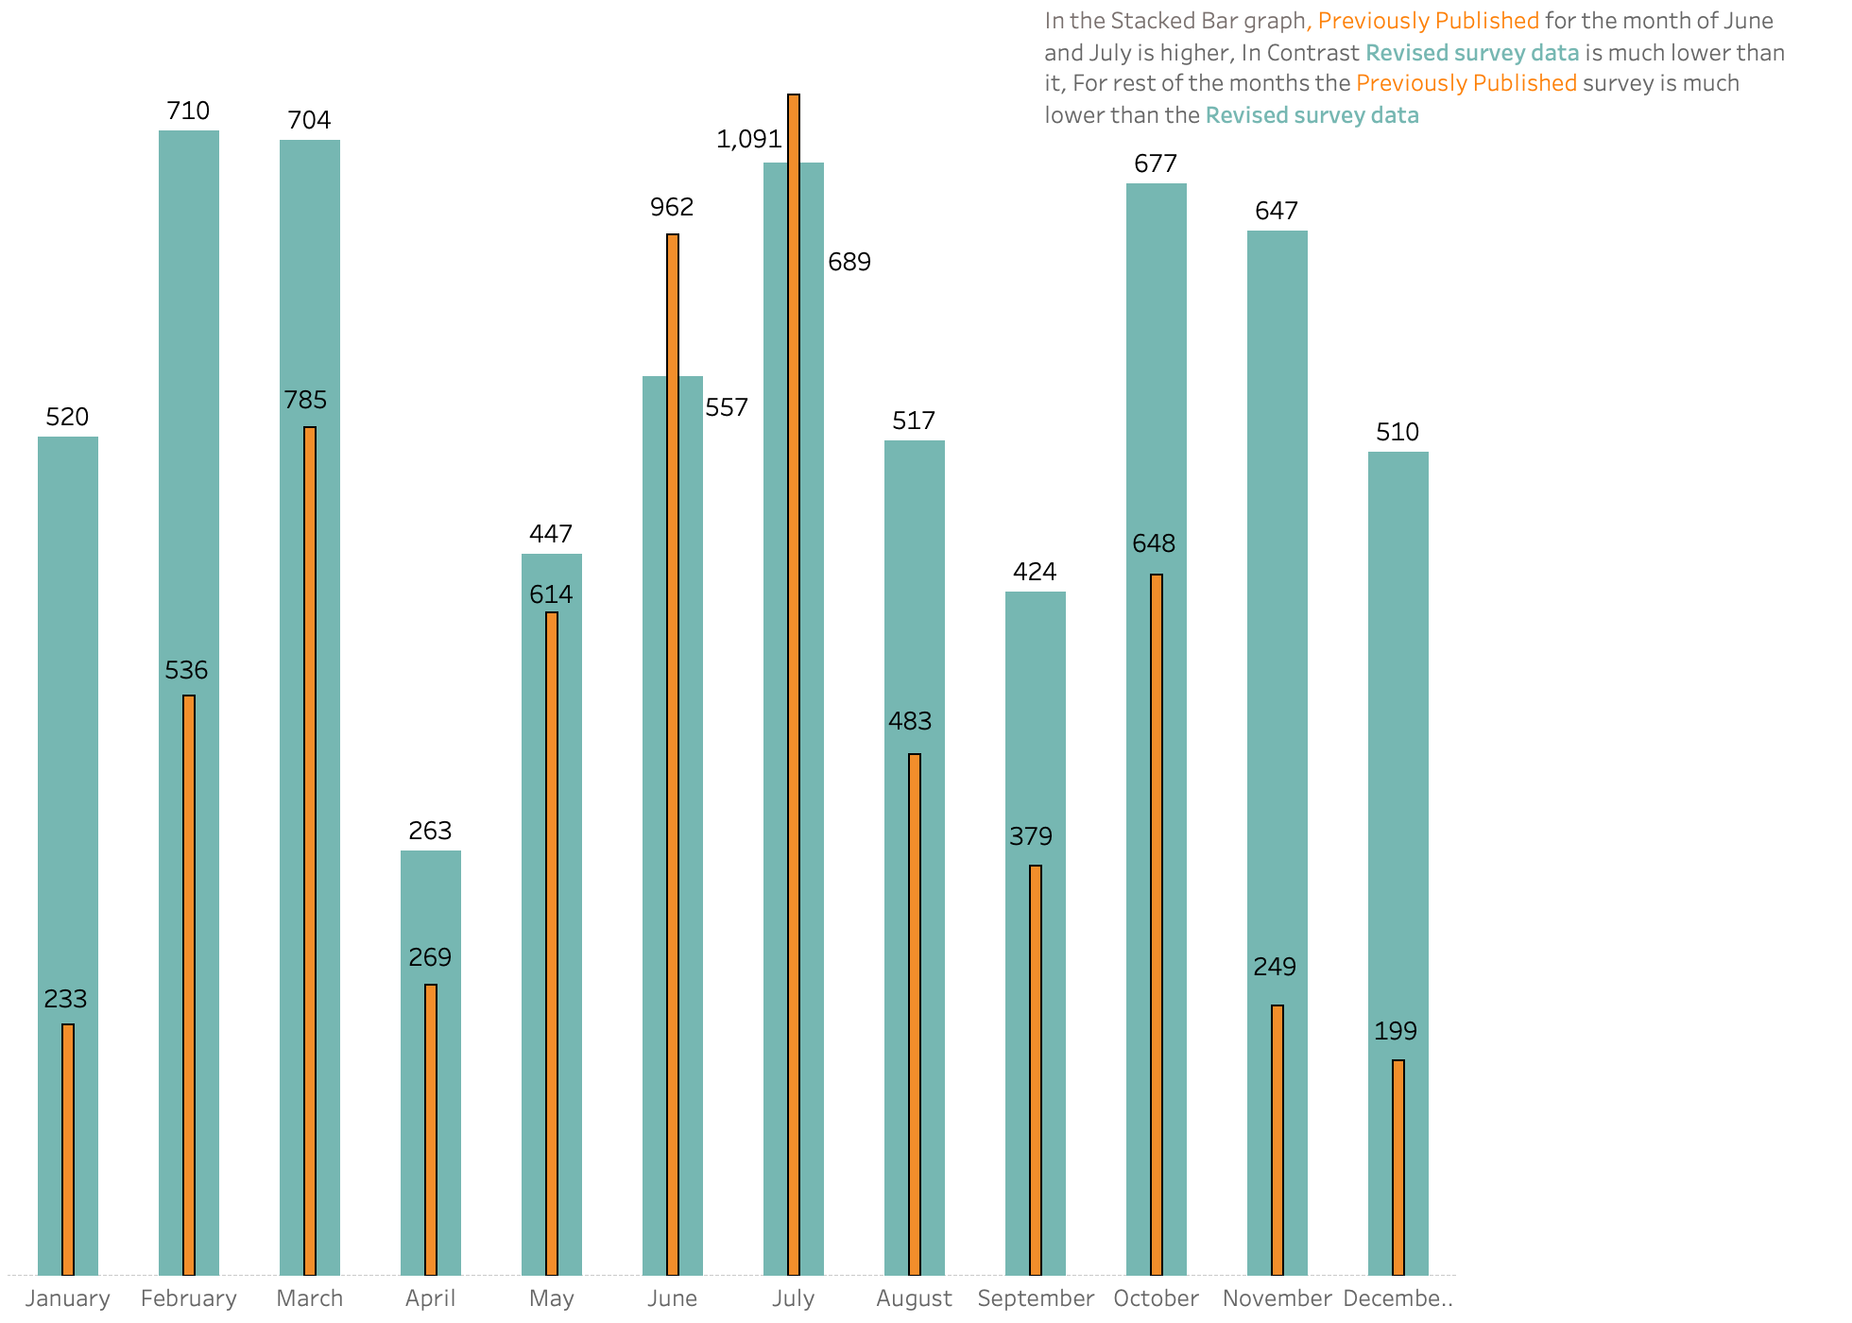
2021(Monthly)CES Survey Previously Published Vs Revised
*Numbers in thousands

