Slide 1
Adidas Case Study
By Ananth Rao

Slide 2
Data Quality Measures
Standardize datetime format – need to ensure it is complete/ follow strict format.
Remove unwanted/junk characters from text fields.
Add unique identifier key for the data.

Slide 3
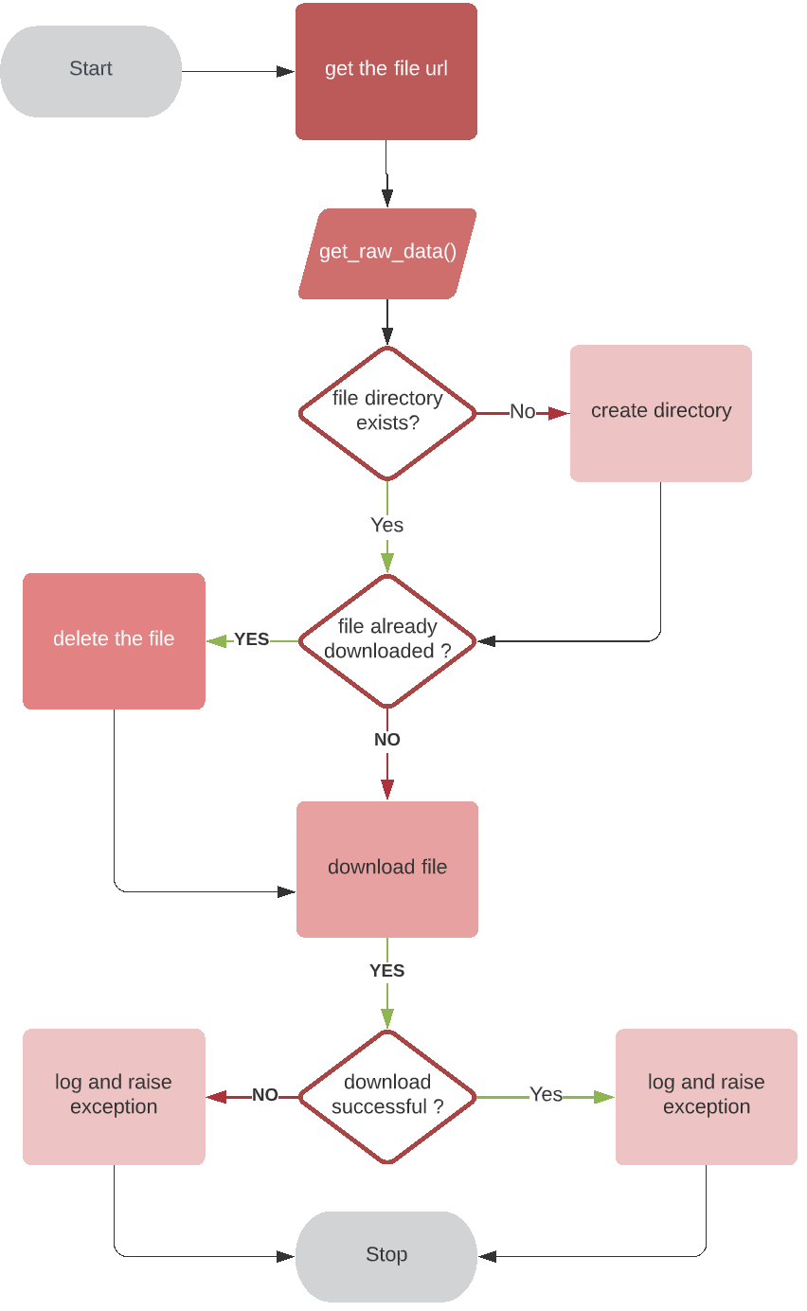
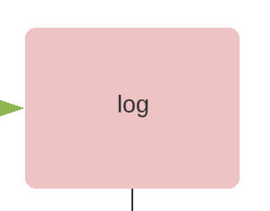
get_raw_data
Flow diagram:

Slide 4
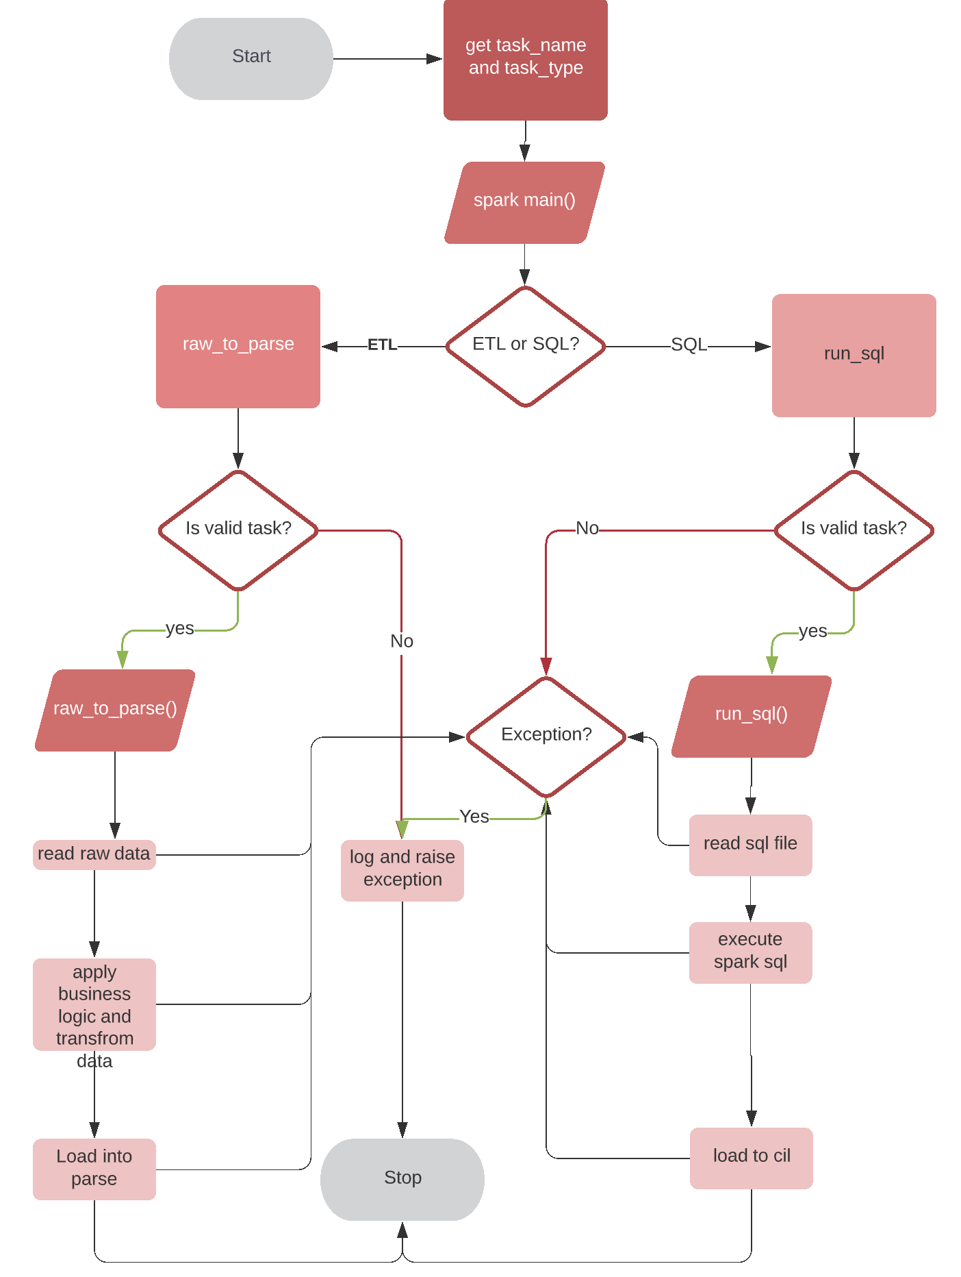
Spark Application
Flow Diagram:

Slide 5
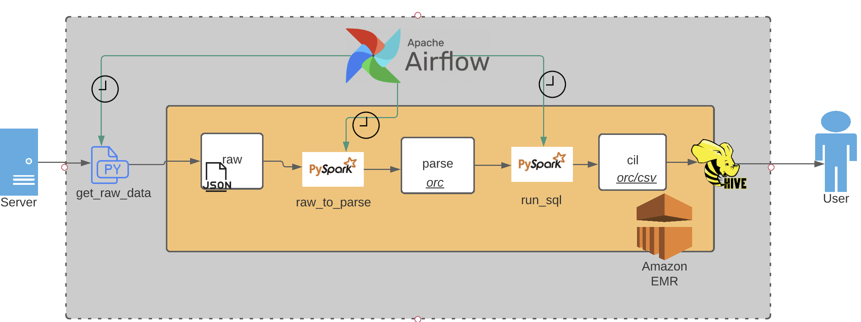
Current Architecture Design

Slide 6
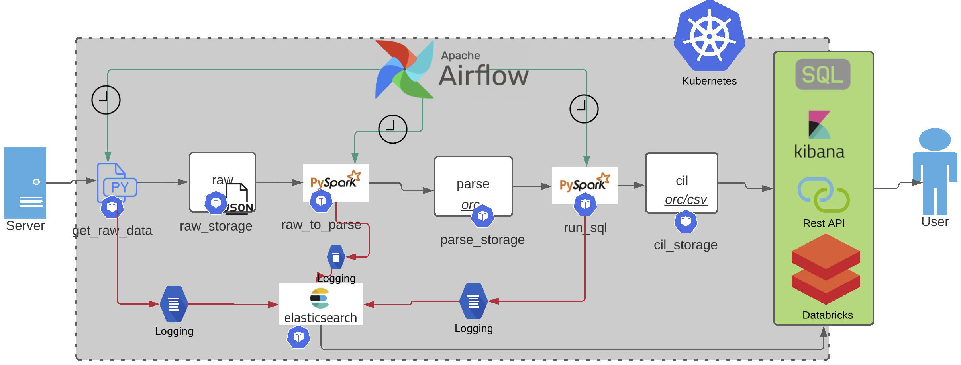
Future Architecture Design

Slide 7
Alerting and Monitoring
Use Combination of Telegraph+InfluxDb+ Chronograph+Kapacitor
Every kub pod will be paired with telegraph agent which is configured to send events to influx db-time series db.
Chronograph can be used to visualize on influx db.
Kapacitor can be used for real time processing of data into chronograph

Slide 8
Error Monitoring
We can use Senty (https://sentry.io/welcome/) for application and error monitoring.
Sentry event collector pod will always be running k8s.
Our application code needs to be configured to put error events into sentry.
This can be done by embedding the custom class in every class design pattern.

