Slide 1
INTERNAL COMPONENTS OF A
SYSTEM-ON-CHIP (SOC)
UNIT- 2
Chapter- 2
23-06-2020
1

Slide 2
Serial Communication
Data from the MCU can be sent or received in serial form through specific
protocol.
One important peripheral is the UART (Universal Asynchronous Receiver
Transmitter)
All MCU’s have a UART module inside.
A dedicated hardware for serial communication is based on RS232C protocol.
The pins TxD and RxD are the serial transmit and receive pins.
Many external modules like GSM(Global System for Mobile Communications) and GPS(Global Positioning System) use the UART pins for interfacing an MCU.
Simpler data transfer protocols like I2C(Inter Integrated Circuit)and SPI(Serial Peripheral Interface)are also available as peripherals in most MCUs.
23-06-2020
PRASHANTH KAMBLI, DEPT. OF ISE, RIT
2

Slide 3
Direct Memory Access
Basically, in a system when a data is to be moved between memory and external devices, it is channelled through the CPU registers. (For Normal Case)
But, if a lot of data is involved, it is a waste of time and effort to use the CPU as an intermediator.
DMA is the scenario when the transfer of data is directly done between an I/O device and memory i.e the connection to the CPU is blocked when DMA is being used.
Many MCUs have the DMA controllers inside it and this unit is responsible for initiating and controlling DMA operations.
When there is a need for DMA, this unit gives a ‘DMA request’ to the CPU, which responds by a ‘DMA Acknowledge’ signal.
23-06-2020
PRASHANTH KAMBLI, DEPT. OF ISE, RIT
3

Slide 4
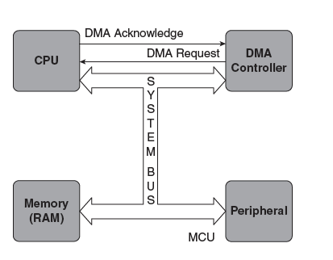
Then it release its control of the system bus. The DMA controller is now the bus master and it will specify the starting address of the required data block in memory and the number of bytes to be transferred.
Then data transfer between memory and I/O proceeds, and when it is done ,the system bus control is returned to the cpu.
23-06-2020
PRASHANTH KAMBLI, DEPT. OF ISE, RIT
4

Slide 5
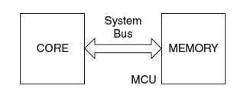
Semiconductor Memory
Lets see the other component of an MCU, Memory.
The code and data need to be stored in memory and it is the prime activity in any computing system.
Accessing data from memory by the core is termed as Reading/Writing.
When data is written into the memory is called as ‘Store’
Whereas the data reading from it is called ‘Load’.
23-06-2020
PRASHANTH KAMBLI, DEPT. OF ISE, RIT
5

Slide 6
These operations take a certain amount of time depending on the type of
technology used for memory.
The value of the 'access times' tells that a memory is either fast or slow, and this
depends on the technology used.
So, in this section, let us discuss the different types of memory devices which are used in embedded applications.
Inside the memory hardware, each address stores one byte of data. It means that memory is generally 'byte oriented‘
So if a 32-bit word is stored in memory, it occupies four bytes space and four addresses are used for it.
23-06-2020
PRASHANTH KAMBLI, DEPT. OF ISE, RIT
6

Slide 7
For eg: let us consider an MCU in which 32 bits are allowed for the address bus.
So there can 2³² bytes or 4 GB of memory at a maximum.
This maximum capacity may not be fully realized inside the chip, because for many applications it may not be necessary and also because it takes chip area and increases the price of the chip.
This memory is realized by many types of memory components.
There will be RAM (Random Access memory) as well as ROM (Read Only memory).
ROM is used to store code
RAM is used as an intermediate area for computations.
In MCUs, memory is usually inside the chip, but if more memory is needed, it is possible to have off-chip memory as well.
23-06-2020
PRASHANTH KAMBLI, DEPT. OF ISE, RIT
7

Slide 8
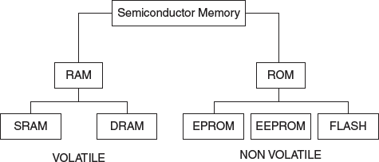
Different types of semiconductor memories which are useful for embedded systems
23-06-2020
PRASHANTH KAMBLI, DEPT. OF ISE, RIT
8

Slide 9
Random access memory (RAM)
Following are the distinct characteristics of RAM:
It is volatile, that is the contents are lost when power is switched off.
It can be read from and written to by program instructions, so it’s Read/Write memory.
The memory access time is the same irrespective of the location of the data we want to access — that is why it is called 'random access' in contrast to serial access in magnetic memory.
23-06-2020
PRASHANTH KAMBLI, DEPT. OF ISE, RIT
9

Slide 10
RAM technology
RAM is realized by different technologies.
The fastest type is SRAM which stands for Static RAM.
In this type, storage is in the form of a voltage.
So the content remains stable or static, as long as power supply is maintained.
23-06-2020
PRASHANTH KAMBLI, DEPT. OF ISE, RIT
10

Slide 11
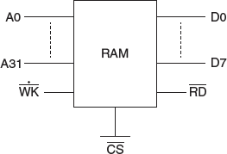
Static RAM chip
SRAM chip with a 32-bit address bus and an 8-bit data bus and the control signals for reading and writing.
There is also a CS (Chip Select) signal which ensures that this chip is accessed only after it is selected.
23-06-2020
PRASHANTH KAMBLI, DEPT. OF ISE, RIT
11

Slide 12
Memory read cycle
The reading cycle of one byte of data from this SRAM chip has the following steps:
The address of the location whose content is to be read, is placed on the address bus.
The chip is selected by making CS low.
The RD signal is activated.
The data appears on the data bus after a minimum time.
23-06-2020
PRASHANTH KAMBLI, DEPT. OF ISE, RIT
12

Slide 13
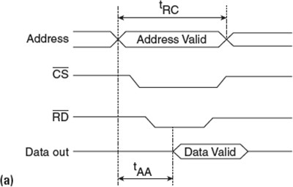
Asynchronous read
t_{AA}, the read access time. This is defined as the time taken for the data to appear on the data bus, after the address is placed on the address bus.
t_{RC}, the read cycle is the minimum time that must elapse before the next read operation can be started.
23-06-2020
PRASHANTH KAMBLI, DEPT. OF ISE, RIT
13

Slide 14
Memory write cycle
Writing has similar steps as reading:
1.On the address bus, the relevant address is placed. 2.The CS signal is activated.
3.The data for writing is placed on the data bus. 4.The WR signal is activated.
5.The data is considered valid and is written in the addressed location.
23-06-2020
PRASHANTH KAMBLI, DEPT. OF ISE, RIT
14

Slide 15
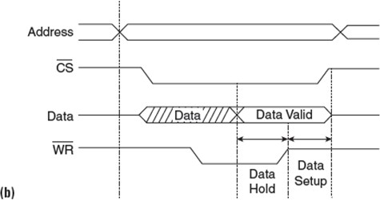
Asynchronous Write
In this diagram, we find that the operations of reading and writing are not timed by any clock, and hence are 'asynchronous'.
SRAMs are timed by the clock signals of the system they are part of 'Synchronous SRAMs'.
23-06-2020
PRASHANTH KAMBLI, DEPT. OF ISE, RIT
15

Slide 16
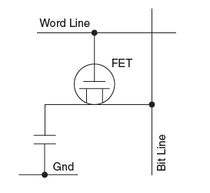

Dynamic RAM (DRAM)
DRAM is used as primary (main) memory in PCs and also as RAM in many embedded boards. It is named 'Dynamic RAM’
Because data is stored as voltage in a capacitor which leaks away with time, and thus is dynamic or changing with time.
It consists of a single field effect transistor (FET) and a capacitor, which is the storage element.
The amount of charge in the capacitor decides the cell logic of either a '1' or '0'.
A capacitor does not retain the charge it contains unless it is recharge continuously.
This action of recharging the capacitor is referred to as 'refreshing' and is done at regular intervals.
The frequency of refreshing depends on the design of cell and the technology used.
Refreshing is done by performing a read or write into the cells at regular intervals.
23-06-2020
PRASHANTH KAMBLI, DEPT. OF ISE, RIT
16

Slide 17
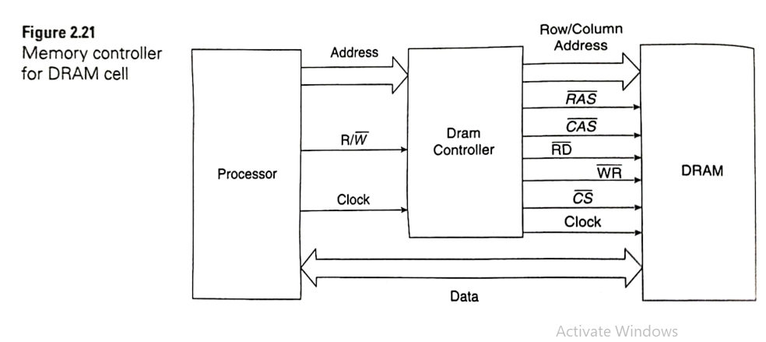
THE READ Cycle of DRAM:
The memory controller associated with DRAM has the function of splitting the address into two, as rows and columns. The address supplied by the processor is split into two and is given to the DRAM address lines in time multiplexed form, as row and column address. The DRAM controller generates the control signals for reading and writing to the DRAM.

Slide 18
Read cycle of DRAM
The steps involved in the Read cycle:
The row address is placed on the rows
The row address strobe RAS signal is then activated.
The address latch inside the chip saves the row address.
Next, the column address is placed on the same address.
The column address strobe CAS signal is then activated.
The address latch inside the chip saves the column address also.
The CAS pin also serves as the output enable.
With this, the data in the selected address is available at the output buffers of
the chip, and it is transferred to the data bus of the processor.
CAS and RAS return to their previous state to complete the read cycle.
23-06-2020
PRASHANTH KAMBLI, DEPT. OF ISE, RIT
17

Slide 19
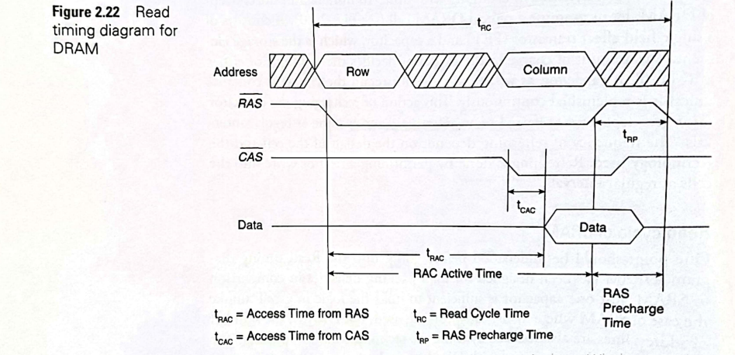

Slide 20
SDRAM
This is 'Synchronous' DRAM —
DRAM whose operations are synchronized by a clock.
This is the DRAM which is actually used now.
SRAM technology is the same as DRAM but because of being synchronous with the system clock and controlled by a 'finite state machine',
Many attributes pertaining to memory operations can be finely tuned.
23-06-2020
PRASHANTH KAMBLI, DEPT. OF ISE, RIT
18

Slide 21
DDRAM
This is an SDRAM which has 'Double Data Rate'.
The 'double data rate occurs because it transfers data at both the rising and falling edges of the
clock.
DDR-2 and DDR-3 are just faster versions of DDR SDRAMs and use special techniques for speed.
23-06-2020
PRASHANTH KAMBLI, DEPT. OF ISE, RIT
19

Slide 22
Read only memory (ROM)
This is 'Read Only Memory' which means that once written to, the contents remain unchanged until we deliberately change it by special means of erasing and re-writing into it.
ROM is used for keeping information 'firmly'.
The only operation we can do on ROM is reading its contents.
We use the word `firmware' when we refer to the contents of ROM.
23-06-2020
PRASHANTH KAMBLI, DEPT. OF ISE, RIT
20

Slide 23
Where does ROM find application in embedded systems?
In embedded systems, once the application code is tested and found to be working, it is stored in ROM.
Thus, ROM is the memory area where code is stored.
In advanced embedded systems, operating systems are also stored in ROM.
ROM is also used as a storage for data.
Think of the data we store in our USB sticks, memory cards of mobile phones, cameras etc.
All these are instances of ROM storage.
23-06-2020
PRASHANTH KAMBLI, DEPT. OF ISE, RIT
21

Slide 24
EPROM
This stands for Erasable Programmable ROM (E-PROM)
Which data can be burned or erased, by using a device called PROM programmer.
To erase the contents, it is exposed to ultraviolet light.
All this needs the chip to be removed from its circuit.
For UV light exposure, there is a window on the chip.
23-06-2020
PRASHANTH KAMBLI, DEPT. OF ISE, RIT
22

Slide 25
OTP ROM
If the same information is to be burned into many ROM chips and these chips are part of a consumer product, the need for 're-programming' is absent.
In such a case, a set of ROMs are taken to a factory and programmed once(en masse) i.e refers to Mask ROM programming.
No facility is given to re-program them and such ROMs are called OTP (One Time Programmable) ROMs.
23-06-2020
PRASHANTH KAMBLI, DEPT. OF ISE, RIT
23

Slide 26
EEPROM
This is 'Electrically Erasable programmable ROM'.
The difference in this is that erasing and writing data can be done while the chip is in a circuit,
but 'higher than normal voltages' are needed for erasing and re-writing.
EEPROMs are constructed like EPROMS, but allow the erasing of individual bytes or the entire memory without UV light.
The problem with EEPROM is that only one byte at a time can be erased and re-written, so the whole process is too slow for large amounts of data.
So, EEPROMs are used in systems which need to store small amounts of information which may be required to be rarely changed, like calibration tables, configuration information etc.
Many MCUs (PIC, for example) have a small amount of EEPROM inside them.
23-06-2020
PRASHANTH KAMBLI, DEPT. OF ISE, RIT
24

Slide 27
Flash ROM
This is the type of ROM which is erasable and re-writable with normal circuit voltages and also at high speeds.
Dr Fujio Masuko of Toshiba is credited to be the inventor of Flash memory.
We all are used to Flash devices.
For EEPROMs erasure could be done only one byte at a time.
Here a large chunk(called a block) of around 512 bytes can be erased in a flash.
23-06-2020
PRASHANTH KAMBLI, DEPT. OF ISE, RIT
25

Slide 28
Flash ROM
There are two types of flash, namely NOR and NAND.
In NOR flash, words can be read from any random location (see Fig. 2.25(a)). It is called NOR flash because it exhibits NOR logic. I .e if one of the word lines is taken high, the corresponding gate transistor pulls the output bit line to a low.
In NAND flash, the transistors are connected in series. Only if all word lines are pulled high, the output bit line is pulled low. This is essentially NAND logic, and hence the name (see Fig. 2.25(b)).
23-06-2020
PRASHANTH KAMBLI, DEPT. OF ISE, RIT
25

Slide 29
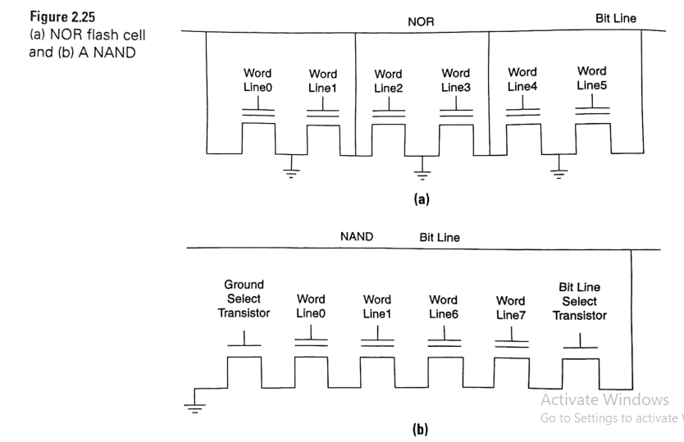
23-06-2020
PRASHANTH KAMBLI, DEPT. OF ISE, RIT
25

Slide 30
Flash ROM
The application are as of NAND and NOR logic are different.
NOR flash can be read randomly, it is used for storing BIOS in PCs, operating systems in mobile phones, tablets, and boot code in general embedded systems, etc.
NAND flash is used where serial reading and retrieval is sufficient and is used for storage in USB sticks, cameras, mobile phones, etc.
23-06-2020
PRASHANTH KAMBLI, DEPT. OF ISE, RIT
25

Slide 31
SD(Secure Digital) card
These are flash memory cards with security features added to it.
The security features include cryptographic protection for copyrighted data.
SD cards are widely used for storage in many of our hand-held devices, and are available in various storage and physical sizes.
23-06-2020
PRASHANTH KAMBLI, DEPT. OF ISE, RIT
26

Slide 32
Cache
This is a memory concept meant for speeding up memory accesses.
Caches are always used in general purpose computing systems, but in the embedded domain, only high-end MCUs use it.
The cache is a type of memory which is placed close to the processing engine, and is fast in
response and low in volume.
It is used to store a copy of important data and code which needs to be accessed at a rapid rate.
When the required information is found in the cache is called a hit. Otherwise it is a cache miss.
It is not possible to guarantee that a required item will be found in cache when it is needed.
Caches are not preferred for time critical applications where delays cannot be tolerated.
In such systems ,a Tightly Coupled Memory(TCM) is considered to be a better option.
23-06-2020
PRASHANTH KAMBLI, DEPT. OF ISE, RIT
27

Slide 33
Cache
In TCM’s critical information(which is pre decided) is stored and used without the indeterminancy of caches.
Cache storage is dynamic.
It stores information that is likely to be frequently needed.
Thus, the content of cache is continuously changed according to the decisions of what is considered important.
TCMs contain static information that is predetermined to be very important .
Critical procedures, interrupt routines etc are usually TCM hold.
23-06-2020
PRASHANTH KAMBLI, DEPT. OF ISE, RIT
27

Slide 34
Designing Low Power Systems
In our current world, everyone talks on the need for 'low power design'.
The requirement of high performance (which means computation at high speed) has been modified to 'performance per watt'
which means that only if the power dissipation is low, does high performance become acceptable.
23-06-2020
PRASHANTH KAMBLI, DEPT. OF ISE, RIT
28

Slide 35
How do we quantify the power requirements of any system or component?
The term 'Thermal Design Power' (TDP) is used to compare different systems in terms of power.
TDP is defined as the maximum amount of power (in watts), the cooling system must be able to dissipate.
It does not mean the maximum wattage, but is meant to give an idea of how much power would be necessary to run applications for which a system is designed for.
There is a TDP value for a processor, as well as TDP values for systems.
23-06-2020
PRASHANTH KAMBLI, DEPT. OF ISE, RIT
29

Slide 36
What is the Thermal Design Power systems we see around us?
A smart phone has a typical value of 4-5 W
A tablet may have up to around 12 W
Low power embedded systems are expected to maintain a value below 4 W(Hand held devices).
TDP rating is very important.
While starting a design for which power specifications are stringent, it is important to verify and make sure that the processor has low TDP (like Displays, Sensors etc.. Should belong to ‘Low Power Dissipating’ category).
For any systems ,there are 2 aspects in keeping low power dissipation :
Design stage & Power management usage.
23-06-2020
PRASHANTH KAMBLI, DEPT. OF ISE, RIT
30

Slide 37
Design stage
Processor Design:
In the IC design itself, many techniques are being used.
Use of extremely low power supply voltages
Adopting techniques for low static and leakage currents,
insertion of sleep transistors and many other methods to lower the TDP of the processor are adopted.
23-06-2020
PRASHANTH KAMBLI, DEPT. OF ISE, RIT
31

Slide 38
2.13.1 Design stage
System Design:
Here the designer needs to choose low power I/O devices, and of low complexity hardware.
The clock frequency used is a matter of importance as high clock speeds directly translate to higher power.
Unless there is a real requirement for high speed, refraining from using high clock frequencies is a rule to be adhered to.
Higher bus widths also contribute to higher power.
It is up to the hardware designer to take care of these matters, while the software designer should write optimum code which uses the hardware efficiently.
23-06-2020
PRASHANTH KAMBLI, DEPT. OF ISE, RIT
32

Slide 39
2.13.2 Power management
Many embedded systems are in inactive states until they are called upon for some work.
Think of mobile phones and many other handheld devices.
All these devices are in either the idle state or deep sleep states.
These sleep states have been implemented in the processor design itself, but it requires a protocol to ensure that it works as required.
In this context, there is a power management strategy named ACPI (Advanced Configuration and Power Interface) which has been formalized for computing devices — PCs as well as embedded devices.
This protocol is embedded into the Operating System such that it becomes operational during the time the device is being used.
Voltages and frequencies are dynamically controlled and modulated to get performance in tune with the requirements of low power.
23-06-2020 PRASHANTH KAMBLI, DEPT. OF ISE, RIT
33

Slide 40
What does ACPI do?
It defines a number of states from active to sleep and off states, for various levels of performance and requirements for PCs, phones, tablets etc.
23-06-2020
PRASHANTH KAMBLI, DEPT. OF ISE, RIT
34

Slide 41
2.14 BUS ARCHITECTURE
A bus is a group of wires that transfers information within a computer or between computers.
The information may be an address, data or signals.
When information travels over a bus, it uses and follows a protocol.
A protocol is a set of rules associated with the transfer of
information over a specific bus.
A bus may be classified as internal or external.
some control
23-06-2020
PRASHANTH KAMBLI, DEPT. OF ISE, RIT
35

Slide 42
External buses are those that transfer the information between a system and components outside the system. For example, the USB (Universal Serial Bus) is an external bus.
Buses that communicate between components on the same board are referred to as on-board buses or internal bus.
In this section, we will discuss two popular on-board buses — the controllers for such buses are present in all MCUs, and that makes it necessary for a brief discussion on two of them.
23-06-2020
PRASHANTH KAMBLI, DEPT. OF ISE, RIT
36

Slide 43
Inter integrated circuit bus (12C)
This is a two-wire bus, developed by Philips and is generally used for communication between ICs on the board.
For example, an MCU may communicate with other ICs like a temperature monitor, EEPROM, ADC etc, if they also have I2C controllers inside.
Figure shows the conceptual view of an I2C bus.
It is a serial, synchronous, byte-oriented bus, which uses only two wires (hence, the name `Two wire Protocol').
The operation is timed by a clock, data is sent/received serially and after each byte is received, there is an indication to that effect.
23-06-2020
PRASHANTH KAMBLI, DEPT. OF ISE, RIT
37

Slide 44
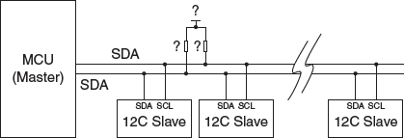
The I2C Bus with One Master and Many Slaves
Figure 2.26 shows that there are only two wires for the bus, namely the SCL (serial clock) and serial data (SDA). Each wire has a resistor connected to the supply voltage. This is a 'wired AND connection' for the bus that indicates an open collector or open drain connection depending on whether a bipolar transistor or FET is used.
23-06-2020
PRASHANTH KAMBLI, DEPT. OF ISE, RIT
38

Slide 45
2.14.1.1 Open drain/collector connection
Open drain/Open collector refers to a type of output which can either pull the bus down to (ground, in most cases), or "release" the bus and let it be pulled up by a pull-up resistor.
When the bus is released by the master or a slave, the pull-up resistor (R) on the line is responsible for pulling the bus voltage up to the power supply voltage.
The necessity of such a "wired AND" connection is that if any device on the line wants to communicate
It will pull the line down and no other device can use it, until this device releases the bus. This is an important concept to realize when dealing with I2C devices
23-06-2020
PRASHANTH KAMBLI, DEPT. OF ISE, RIT
39

Slide 46
2.14.1.2 Steps in I2C protocol
Let us list out the steps in the 12C protocol
START and STOP signals: The master sends the START signal by pulling the SDA line low, while the SCL line is high. At the end of data transfer the master sends the STOP signal, which is a HIGH state of the SDA signal, while the SCL line is high.
Data Transfer: This starts after the START signal. The master sends an address (MSB first). This is the address (7 or 10 bit) of the device to which it intends to communicate.
The next is R/W signal. If the master wants to get a data from a slave, it is READ operation, otherwise it is WRITE.
23-06-2020
PRASHANTH KAMBLI, DEPT. OF ISE, RIT
40

Slide 47
4. The slave whose address has been received will respond with an ACK (Acknowledge) ) signal.
After this, the actual data transfer occurs. Data is sent one byte (MSB first) at a time. After each byte is sent, the receiver returns an acknowledge signal ACK.
Each byte of data (including the address byte) is followed by one ACK bit from the receiver. The ACK bit allows the receiver to communicate to the transmitter that the byte was successfully received and another byte may be sent. After the data transfer is fully over, and the final acknowledge signal is received, the master sends the STOP signal. Before the receiver can send an ACK, the transmitter must release the SDA line. To send an ACK bit, the receiver shall pull down the SDA line.
23-06-2020
PRASHANTH KAMBLI, DEPT. OF ISE, RIT
41

Slide 48
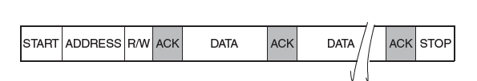

The steps are summarized as follows
1.Send the start signal. This is done by master.
2.Send the slave address.
3.Send the Read/Write signal.
4.Wait for send an acknowledge bit(ACK).
5.Send/Receive the data byte(8 bits)(DATA).
6.Expect/Send acknowledge bit(ACK).
7.Send the Stop Bit.
23-06-2020
PRASHANTH KAMBLI, DEPT. OF ISE, RIT
41

Slide 49
The positive aspects of this protocol are follows:
I2C requires only two pins to perform serial data transfer.
The ACK signal ensures good synchronization between the transmitter and receiver.
Earlier version of I2C had only a speed 100KHZ,but now the I2C specifications supports up to 3.4 MHZ clock speed.
This protocol can be used in a muti master environment.
23-06-2020
PRASHANTH KAMBLI, DEPT. OF ISE, RIT
41

Slide 50
2.14.2 Serial Peripheral Interface
The Serial Peripheral Interface (SPI) is another on-board protocol. It has three signals and is also a master slave protocol.
An SPI bus has only one master.
It can have more than one slave.
There is a slave Select signal in the master using which a slave can be selected.
The data transmission between the master and one slave occurs through two signals:
MOSI — Master Out Slave In
MISO — Master In Slave Out
There is also a clock signal that synchronizes the data transmission.
23-06-2020
PRASHANTH KAMBLI, DEPT. OF ISE, RIT
42

Slide 51
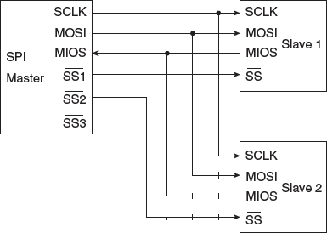

23-06-2020
PRASHANTH KAMBLI, DEPT. OF ISE, RIT
43

Slide 52
Data is sent serially on the MOSI and MISO pins with the LSB first.
Fig 2.32 shows the MISO and MOSI signals active for sending data in both the directions.
Each SPI transfer is full duplex meaning the data is sent from the master to the slave and from slave to the master at the same time.
Because the SPI transactions occur through a shift register arrangement shown in fig 2.32
If the master is sending data to a slave, the slave cannot stop sending data back to the master at the same time.
This happens because in protocols like SPI, data transfer happens simultaneously in both directions whenever the clock runs
It will then send dummy bytes with all 0’s or all 1’s as data.

Slide 53
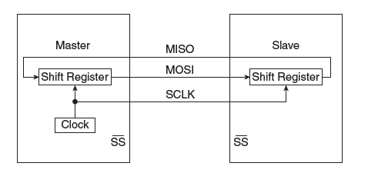

Even if the slave does not have useful data to send, it must still transmit something.
So the slave sends dummy data such as:
All 0’s (00000000) or
All 1’s (11111111).
Transmission is in one direction only.
If the master is reading data in for a slave, the slave will know to ignore the data being sent by the master.

Slide 54
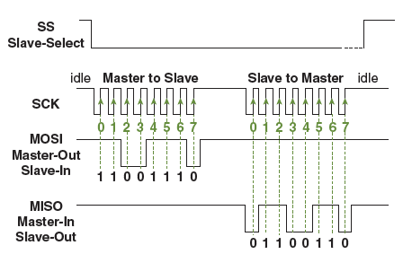

Fig 2.33 shows a sample communication in an SPI environment. When the slave select(SS) signal is low, data transfer occurs between a slave and a master.
The figure shows data being sent on both the MOSI and MISO pins.

Slide 55
Chapter-3
Embedded systems- The software

Slide 56
3.1 ENDIAN-NESS
Data is stored in memory, each address corresponds to a storage of only one byte
we say that memory is 'byte oriented'.
When a word of 16 bits is stored, it occupies two byte spaces in memory, and it is stored in ADDRESS, and ADDRESS+1.
The order in which the data bytes are to be stored.

Slide 57
There are two ways of addressing the matter
Little Endian
Big Endian
This applies to 16-bit, 32-bit and 64-bit data.

Slide 58
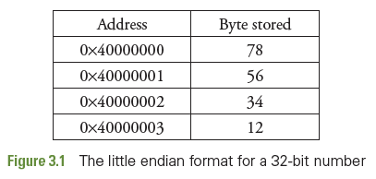
1. Little Endian
In this format, the lower byte of the multi-byte word is always stored in the lower address.
Consider the case of the 32-bit word Ox12345678.
Let us store it in address 0x40000000.
This format is used in Intel architecture.
78 | 56 | 34 | 12

Slide 59
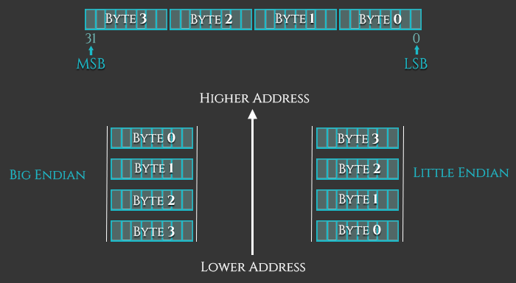

Slide 60
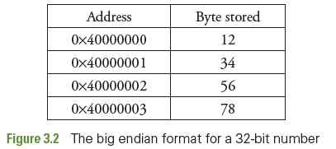
2. Big Endian
Consider the case of the 32-bit word Ox12345678.
Let us store it in address 0x40000000.
Here the lowest byte is stored in the highest address.
Motorola processors follow this scheme.
12 | 34 | 56 | 78

Slide 61
ARM processors can use any of the two formats.
There is a bit in a control register of the processor, using which, one of the formats may be chosen.
In either case, when a 32-bit number is to be read from memory, only one address needs to be specified in the program — that is, the starting address.
In the examples shown, the address 0x40000000 will be specified in the pro- gram, but the required four locations will be accessed to get the full 32-bit data.
This applies for the case of 'writing' also.

Slide 62
3.6 FLAGS
All processors have status flags to indicate something about the result of an operation.
Each flag is a flip flop which is either set or reset.
The one or zero state of flags may be needed before a conditional execution.
The flag bits are generally seen in some status register of the processor.
In 8051, flags bits are available in a register called the Processor Status Word.
In ARM, there is a register called CPSR (Current Program Status Register), which holds the flag bits.

Slide 63
3.6.1 Carry Flag (C)
Carry Flag ( C ) gets set if there is a carry out from the most significant bit during
calculations.
When an 8-bit addition causes the result to be greater than 8 bits, tee is a carry out from the MSB (D7) that causes the flag to be set.
For 16-bit operations, the carry will be from D15, and CF will be set.
For 32-bit processors, it is set when the result is greater than 32 bits.
The C flag will also be set in the case of a ‘Borrow’ during subtraction.

Slide 64
3.6.1 Carry Flag (C)
11111111 (255)
+ 00000001 (1)
-----------
1 00000000
C = 1 (carry generated)
Z = 1 (result is zero)

Slide 65
3.6.2 Zero Flag (Z)
When the results of an arithmetic or logic operation is zero, the zero flag gets set
if we keep on decrementing the contents of a register, it will finally become zero.
At this instant, the zero flag gets set, that is, Z= 1.
Also when two numbers are compared.
Comparison is achieved by subtraction.
If the numbers compared are equal, the zero flag is set (Z=1) including equality of the operands.

Slide 66
3.6.2 Zero Flag (Z)
00000101 (5)
- 00000101 (5)
-----------
00000000
Z = 1
Result = 0

Slide 67
3.6.3 Negative Flag (N)
After an arithmetic or logic operations, if the result contains a negative number.
The N flag is set.
It contains the MSB of the result,
Which can be interpreted as the sign bit in signed arithmetic operations.

Slide 68
3.6.3 Negative Flag (N)
00000101 (5)
- 00001010 (10)
-----------
11111011 (-5 in 2’s complement)
N = 1 (MSB is 1 → negative)
MOV R0,#5
MOV R1,#10
SUBS R2,R0,R1

Slide 69
3.6.4 Overflow Flag (V)
This flag is set under one of the following conditions
There is an overflow into the MSB from the bit of lower significance, but no carry out from the MSB.
There is a carry out from the MSB, but no carry into the MSB.

Slide 70
Overflow Flag (V)
To understand the overflow flag, let use an example. We declare that the numbers we use are 'signed'. We add +5 and +4 using four-bit word length.
The addition is 0101
+ 0100
1001
The sum shows the MSB to be '1'. There has been an overflow into the MSB. The V flag will be set.

Slide 71
3.6.4 Overflow Flag (V)
01111111 (+127)
+ 00000001 (+1)
-----------
10000000
V = 1 (overflow)
MOV R0,#127
MOV R1,#1
ADDS R2,R0,R1

Slide 72


Overflow Flag (V)
10000000 (-128)
+ 10000000 (-128)
-----------
1 00000000 (-256)
V = 1
C = 1
Z = 1

