Slide 1
Unit -3
Chapter-4
THE ARCHITECTURE OF ARM 7

Slide 2
INTRODUCTION
In the current world of embedded systems
ARM processor has made its mark in almost all high-end devices
It might be mobile phone, automotive hardware, factories or aircrafts
The first popular one in this series is ARM7 which was used extensively in Apple IPods, PDAs (Personal Digital Assistant) and many other applications.

Slide 3
ARM AS A RISC PROCESSOR
This powerful processor is designated as a RISC processor.
RISC stands for Reduced Instruction Set Computer.
A RISC architecture has only simple instructions realized in hardware.
Complex operations are made possible by writing programs using these simple instructions.

Slide 4
To elaborate, think of the 'divide' operation.
RISC processors do not have an instruction for division
A program that does repeated subtraction is a method of getting division done.

Slide 5
The advantage is that the absence of a dedicated division unit reduces the complexity of the processor, and also leads to less power dissipation.
The disadvantage is that division in RISC is not as fast as in CISC (Complex Instruction Set Computer).
ARM design started as a pure RISC architecture.

Slide 6
1. SIMD (Single Instruction Multiple Data) instructions
Some of the features added to later generations, for making it a truly computationally intensive processor are
Floating Point Support
Specialized DSP (Digital Signal Processing) instructions

Slide 7
The main features of RISC are
This holds for most of the instructions
Instructions have the same size of 32 bits.
Each instruction takes one cycle to complete. 3.It is a 'load store' architecture.
The end result of the RISC approach made the processor to be a low power dissipating one and that became the reason why it easily conquered the growing embedded market, where hand held and battery operated devices are the major constituents.

Slide 8
ADDITIONAL FEATURES
As ARM was accepted in the embedded market, more features were added to it.
ARM design was modular in structure so it was easy to add new features.
The flexibility on account of the business model of ARM, made the addition of new and special features optional.
Knowing these features will let us understand the early naming conventions of the different ARM chips.

Slide 9
1.THUMB SET
The ARM Instruction Set Architecture has only 32-bit instructions
This means that each and every instruction has to be of 32 bits.
For simple applications, such a powerful set of instructions are not needed.
Thus, a new set of instructions, named THUMB, which are of 16 bits length was added.
This is helpful in reducing the amount of code memory needed.

Slide 10
The amount of the code in unit area of memory, that is, the code density, is more, when THUMB is used.
Thumb code takes 40% less space in comparison to regular 32-bit ARM code but is slightly less efficient.
There is also the facility to mix ARM and THUMB code and this is called ARM-THUMB interworking.

Slide 11
Cache
This is a memory concept meant for speeding up memory accesses.
Caches are always used in general purpose computing systems, but in the embedded domain, only high-end MCUs use it.
The cache is a type of memory which is placed close to the processing engine, and is fast in
response and low in volume.
It is used to store a copy of important data and code which needs to be accessed at a rapid rate.
When the required information is found in the cache is called a hit. Otherwise, it is a cache miss.
It is not possible to guarantee that a required item will be found in cache when it is needed.
Caches are not preferred for time critical applications where delays cannot be tolerated.
In such systems ,a Tightly Coupled Memory(TCM) is considered to be a better option.
23-06-2020
PRASHANTH KAMBLI, DEPT. OF ISE, RIT
27

Slide 12
Cache
In TCM’s critical information(which is pre decided) is stored and used without the indeterminacy of caches.
Cache storage is dynamic.
It stores information that is likely to be frequently needed.
Thus, the content of cache is continuously changed according to the decisions of what is considered important.
TCMs contain static information that is predetermined to be very important .
Critical procedures, interrupt routines etc are usually TCM hold.
23-06-2020
PRASHANTH KAMBLI, DEPT. OF ISE, RIT
27

Slide 13
2.CACHE
All modern processors have caches, though some have only TCMs (Tightly Coupled Memories)
ARM7 has 8 KB cache in which both instructions and data are allowed.

Slide 14
3.LONG MULTIPLIER
Even though fast multiplication is a complex instruction, many ARM variants have such multipliers.

Slide 15
4.DEBUG UNIT
Inside the chip, there is a dedicated unit which provides the necessary support for testing and debugging.
This unit is designed based on the specifications of JTAG (Joint Test Action Group).
A 'boundary scan architecture' is defined which makes it easy to test the chip.

Slide 16
5.EMBEDDED ICE MACRO CELL
All ARM processors need not have this feature.
This is also a separate 'cell' to facilitate advanced debugging.

Slide 17
6.SYNTHESIZABLE
When the ARM IP is sold to the licensee in the form of an HDL (Hardware Definition Language)code, the buyer can flash this code to an FPGA (Field Programmable Gate Array), add peripherals, make changes etc.
Such ARM cores are said to be synthesizable'. Some FPGAs can also have this ARM design as a 'soft core' in it.

Slide 18
7.JAZELLE
In the early days of ARM, it was common for some ARM processors to execute Java bytecode in hardware as a third execution state along with the existing ARM and Thumb mode.
This is useful to increase the execution speed of Java Micro Edition games and applications.
Such an extension is now not in use.

Slide 19
8. ENHANCED DSP INSTRUCTIONS
ARM to make useful in advanced signal processing applications, It was necessary to add advanced signal processing instructions in the processor.
Such processors would have DSP instructions,which meant that specialized DSP hardware is available in them.

Slide 20
9. VECTOR FLOATING POINT UNIT
Specialized hardware implies support for single and double precision arithmetic which enables floating point computations.

Slide 21
NAMING CONVENTIONS
Naming convention is associated with the processor.
The most popular ARM processor is ARM7 TDMI (Thumb Debug Multiplier In circuit Emulator)
Which means an ARM7 processor with Thumb extension (T), Debug interface (D), long multiplier (M) and an ICE macro cell.(I). ARM7TDMI-E means that DSP extensions are available, and ARM7TDMI-S means that it is in synthesizable form.
These naming conventions are not used for the new ARM processors, but many ARM7 processor capabilities can be gauged by this convention.

Slide 22
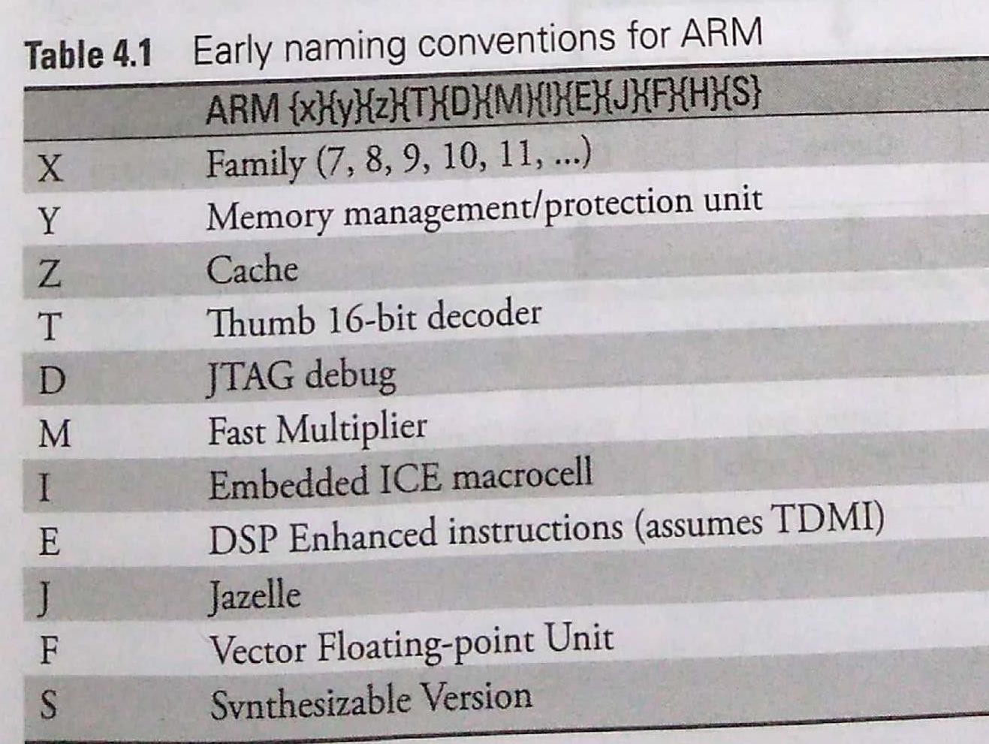

Slide 23
ARM Instruction Set Architecture Variants
The first Instruction Set Architecture of ARM7 was called ARMv4.
With a Thumb extension, it came to be called ARMv4T.
The next ISA was ARMv5 and used for ARM9 and it implied the Thumb set inherent in it.
With DSP instructions added to it, the ISA became ARMv5E.
The next ISA series was ARMv6 and ARMv7 and used for ARM 11 as well as for the Cortex series.
The latest ISA for 64 bit ARM is ARMv8.

Slide 24
4.2 ARM7 ARCHITECTURE
We have seen the basic aspects of the ARM architecture
Typical ARM7 processor as shown in the block diagram
Note that it is an ARM7TDMI CPU.
We start with the programmers model.
A programmer model is the view of the processor in terms of its registers and its instruction set.
It can operate in ARM and THUMB states.

Slide 25
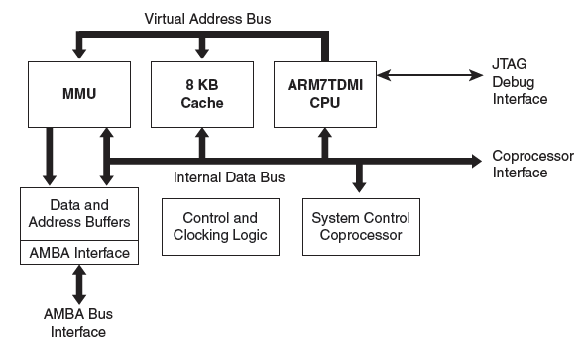
BLOCK DIAGRAM OF A TYPICAL ARM7 PROCESSOR

Slide 26
MMU- Memory Management Unit
8KB Cache - TCMs (Tightly Coupled Memories)
ARM7TDMI CPU- The most popular ARM processor is ARM7 TDMI (Thumb Debug Multiplier In circuit Emulator)
Data and Address Buffers
AMBA Interface- Advanced Microcontroller Bus Architecture
Control and Clocking Logic
System Control Co-Processor

Slide 27
PROGRAMMERS MODEL
A programmers model is the view of the processor, in terms of its registers and its instruction set.
Since the CPU is ARM7 TDMI, we know that it can operate in the ARM and THUMB states.
The ARM state is one in which it executes 32-bit, word-aligned ARM instructions.
The THUMB state is one in which it operates with 16-bit, half word-aligned THUMB Instructions.
The data format in memory can be big endian or little endian
This is selected by a bit named ‘bigend’ bit in the Control Register.
It supports byte (8-bit), halfword (16-bit) and word (32-bit) data types.
Words must be aligned to 4-byte boundaries and half words to 2-byte boundaries.

Slide 28
MODES OF OPERATIONS
There are seven modes of operation as follows:
User: Unprivileged mode under which most tasks run.
FIQ (Fast Interrupt mode): Entered when a high priority (fast) interrupt is raised.
IRQ (Interrupt Request): Entered when a low priority (normal) interrupt is raised.
Supervisor: Entered on reset and when a Software Interrupt instruction is executed.
Abort: Entered when memory access violations occur.
Undef: Entered when an undefined instruction occurs.
System: Privileged mode of operation.

Slide 29
MODES OF OPERATIONS
Mode | Type | Example Use
User (USR) | Non-privileged | Running application code
FIQ | Interrupt | High-speed sensor handling
IRQ | Interrupt | Timer/keyboard interrupt
Supervisor (SVC) | Privileged | OS system call
Abort (ABT) | Exception | Invalid memory access
Undefined (UND) | Exception | Unknown instruction
System (SYS) | Privileged | OS kernel tasks

Slide 30
WHAT IS THE IMPORTANCE OF THESE MODES?
All application programs run in the user mode.
The other modes, which are called 'exception modes' are entered for processing interrupts or for accessing protected resources.
Mode changing may be done under 'software control' (by bit settings in registers) or by external interrupts or exceptions due to specific conditions or errors.
Following Table indicates the specific exception through which each of the exception modes are entered.

Slide 31
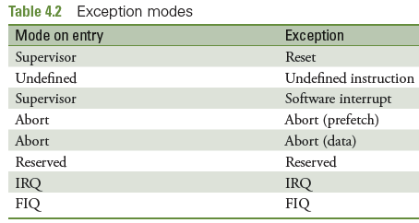

Slide 32
REGISTER SET
ARM7 has a total of 37 registers
31 general-purpose 32-bit registers
Six status registers
All these registers cannot be seen at the same time.
Some are available only in certain modes and states.

Slide 33
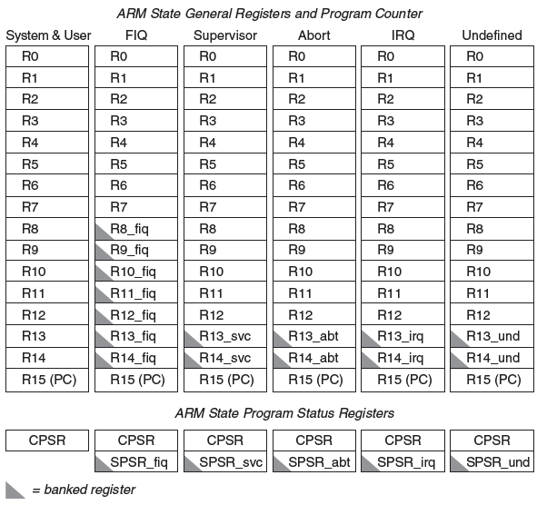
ARM REGISTER SET

Slide 34
The upper part of figure shows the general purpose registers and the Program counter.
The same set of registers are used in the System and User modes.
Certain registers are indicated as being 'banked'.
The general registers in the FIQ mode R8 to R14 are notated as R8_fiq,…, R14-fiq.
When a mode switch occurs from the user mode to the FIQ mode, the registers R8 to R14 of the user mode are replaced with a new set notated as R8_fiq, R9_fiq,.., R14_fiq.

Slide 35
FIQ is a mode that is entered for a high priority 'fast interrupt request'.
To enable fast response, no time is spent in 'saving the context' of the registers R8 to R14, there is no need to save the content of these registers and their content remains intact.
The FIQ mode does not use these registers as it has an entirely new set of registers R8 to R14 to be used in this mode.
In the other modes, only R13 and R14 are banked. Note that R13 and R14 are the 'Stack pointer register (SP)' and 'Link register (LR)' respectively of each mode.

Slide 36
The Uses of The Link Register:
The link register is one that is not seen in most other processors.
Its incorporation into ARM is meant to speed up branching during procedure calls and interrupt processing.
Generally, in most processors, when a call or interrupt occurs, the 'return address' is saved in the stack which is in memory.
This involves memory access which causes a certain amount of delay.
In ARM, this delay is avoided by having this link register to save the return address.
Since all registers are inside the CPU, no memory access is necessary and thus an additional element of speed is obtained.

Slide 37
THE PROGRAM COUNTER REGISTER (PC)
There is only one PC in any processor.
The Program Counter is the register which sequences the instructions as they are being fetched and executed.
In ARM, the value in the Program counter is the address of the current instruction being 'fetched' (rather than the address of the instruction being executed, as in other processors).

Slide 38
PROGRAM STATUS REGISTERS(PSR)
The lower part of figure shows One CPSR (Current Program Status Register) and Banked SPSRs (Saved Program Status Register) for each mode.
CPSR is the register which has the status bits and control bits for the `current' time
The bit configuration of the CPSR is shown in fig 4.3
Bits 8-27 are 'reserved' which means they are undefined for ARM7.
The upper five bits store the flag bits and are generally used to understand the result of a data processing instruction.

Slide 39
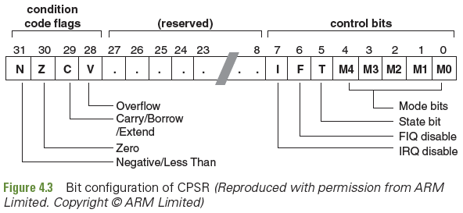

Slide 40
The lower eight bits of the CPSR are collectively known as the control bits.
These change when an exception arises.
If the processor is operating in a privileged mode, they can also be manipulated by the software.
The I and F bits, when set, are used for disabling the IRQ and FIQ interrupt modes.
The T bit indicates the state of operation. If T = 1, the processor is in the Thumb state, otherwise, it is in the ARM state.

Slide 41
The MO—M4 bits are used to indicate the mode of
operation.
Note that only seven modes are possible here, and any other number in the mode bits will cause an error from which an exit is possible only by a reset.

Slide 42
SAVED PROGRAM STATUS REGISTERS(SPSR)
There are five 'Saved Program Status Registers (SPSRs)', that is, one for each of the 'exception' modes of operation.
These SPSRs are shown as banked registers
When a mode switching occurs, the corresponding SPSR saves the current CPSR value into it.
The system mode and user modes do not have SPSRs because they are not entered through exception mechanisms.

Slide 43
THE THUMB STATE REGISTERS
The register set when the processor is in the Thumb state.
This state involves 16-bit instructions
It will still handle 32-bit data, but since low complexity applications are assumed for this state of operation, the number of registers used in this state is less.
The THUMB state register set is a subset of the ARM state set.
The programmer has direct access to eight general purpose registers, R0—R7, the Program Counter (PC), a stack pointer register (SP), a link register (LR), and the CPSR.
There are banked Stack Pointers, Link Registers and SPSRs for each exception mode.

Slide 44
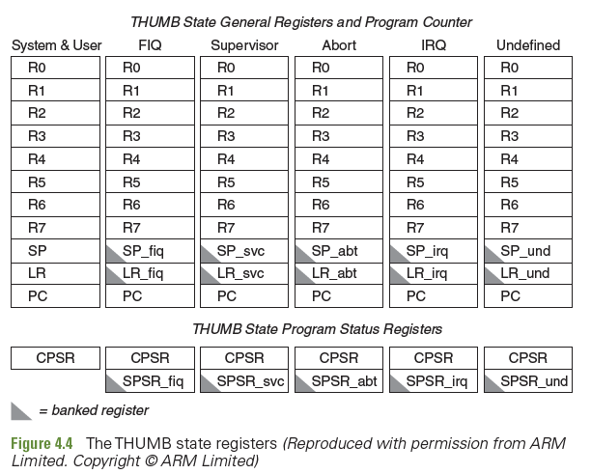

Slide 45
THE RELATIONSHIP BETWEEN ARM AND THUMB STATE REGISTERS
The THUMB state registers relate to the ARM state registers in the following way:
THUMB state RO—R7 and ARM state RO—R7 are identical.
THUMB state CPSR and SPSRs and ARM state CPSR and SPSRs are identical.
THUMB state SP maps onto ARM state R13. 4.THUMB state LR maps onto ARM state R14.
5.The THUMB state Program Counter maps onto the ARM state Program Counter (R15).

Slide 46
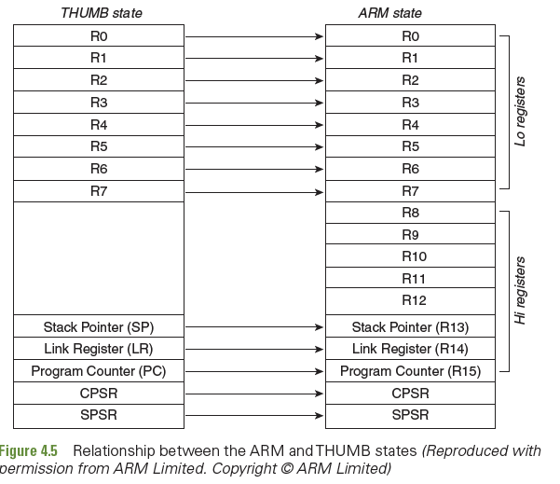

Slide 47
4.3 INTERRUPTS AND EXCEPTIONS
Exceptions/Interrupts are events that change the context of the processor
They change the normal flow of the program
The event may be triggered by software, a fault condition, a system call or an interrupt from a peripheral.
The first thing to do when an exception occurs is to save the context of the processor
Means that all working register contents must be saved
The current content of the PC must also be saved

Slide 48
THE PROCESSOR HANDLES AN EXCEPTION
The 'return address' which corresponds to the current PC value +8 is copied to the Link Register. The addition of 8 to PC is because the PC always contains the address of the instruction that is being fetched. Because of the three stage pipeline, the address of the instruction that is currently being executed is PC+8.
The content of CPSR is copied to the appropriate SPSR
The mode bits in the CPSR are changed to the mode of the exception mode to which switching has occurred.
The new PC value is the vector of the exception(table4.4)

Slide 49
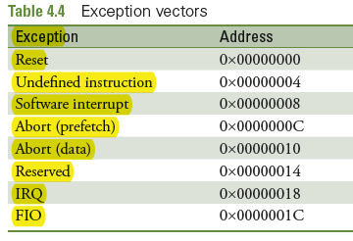

Slide 50
On Completion of the exception handler (ISR)
The following steps must be taken to return to the context of the interrupted program.
The link register contents are used to get back the PC value.
The SPSR is copied back to the CPSR.
The interrupt disable flags, if they were set on entry, are cleared.

Slide 51
EXCEPTION/INTERRUPT VECTORS
Each exception (interrupt) has a specific address to which control branches to.
This address is called the 'vector' of the exception.
Interrupts which have predefined and fixed vectors, are generally designated as 'vectored interrupts'. Table shows the vectors of the exceptions defined for ARM7.

Slide 53
EXCEPTION/INTERRUPT HANDLERS
What are the sources for interrupts?
The current program running in the processor may be interrupted by an external device which requires service.
A second case is when an interrupt occurs due to a software instruction.
Another case is when an error occurs, like data abort or undefined instruction.
In the first two cases, the new program that comes into play (called ISR or interrupt/ exception handler) performs the service for the peripheral or acts upon the interrupting instruction.

Slide 54
EXCEPTION IS GENERATED ON AN ERROR:
Here also control branches to the vector of the exception.
The handler of the exception should contain the code which performs the necessary action to override the effect of the error.
Thus, the system is prevented from crashing or going into a reset state before being able to save the current context.
The ISRs of error-generated exceptions may be referred to as error handlers or fault handlers.
These handlers allow the processor to exit gracefully from the error state without causing havoc to the system
The different types of interrupts/Exceptions are

Slide 55
1.RESET
When the processor is switched on it is in the Reset condition.
All the hardware is initialized with a 'reset pulse'.
The mode that is entered on reset is the `Supervisor' mode.
The first instruction that is to be executed then is taken from the address Ox0000000.
During the operation of the processors, reset may happen due to various reasons and then the system operation starts again from the reset vector.

Slide 56
2.UNDEFINED INSTRUCTION
If an instruction is fetched and found to be a binary number which is not listed as one of the opcodes of the processor
This exception is generated.
The interrupt handler at the corresponding vector is to take appropriate action to exit gracefully from the error state.

Slide 57
3. SOFTWARE INTERRUPT
The software interrupt instruction (SWI) [now changed to SVC- supervisor call] is used for entering Supervisor mode
Usually to request a particular supervisor function.
This is used by the OS to request access to protected resources.

Slide 58
4. ABORT
An abort indicates that the current memory access cannot be completed.
There are two types of abort:
Prefetch abort occurs during an instruction prefetch.
Data abort occurs during a data access (R/W), when data at an invalid address is attempted to be accessed.

Slide 59
5. PREFETCH ABORT
It occurs when the processor prefetches code (could be a case of branching) which is at an invalid address.
It may be that this address is in a protected memory area,
This address is a peripheral address which has not been mapped to a peripheral.
If a prefetch abort occurs, the prefetched instruction is marked as invalid, but the exception will not happen until the instruction reaches the execution unit of the pipeline.

Slide 60
6. RESERVED
Table 4.4 shows a vector for an exception that is not used for ARM7 but may be used for later processors.

Slide 61
7. IRQ
The Interrupt Request (IRQ) exception is a normal interrupt caused by a LOW level on the IRQ pin.
It is generally used by peripherals to get service.

Slide 62
8. FAST INTERRUPT REQUEST
This is used for very important actions and is designed to be very fast.
When this interrupt occurs, the processor goes to the FIQ mode, where a new set of registers are used, so as to avoid the delay for context saving.
In practical situations, the applications which use the FIQ exception are coded in assembly to bring in an additional level of speed.

Slide 63
4.3.3 PRIORITY OF EXCEPTIONS
When multiple exceptions arise at the same time, there is a priority prefixed to determine the order in which they are handled.
The order is as follows:
Reset (Highest priority)
Data abort
FIQ
IRQ
Prefetch abort
Undefined Instruction, Software interrupt (Lowest priority)

Slide 64
All Exceptions cannot occur at the same time
Undefined instructions and software interrupts are mutually exclusive.
If an instruction is decoded and found to be an SWI(software interrupt instruction ),it cannot be an undefined instruction.
A data abort exception occurs at the same time as an FIQ.
The processor first enters the data abort handler and then immediately after that proceeds to the FIQ vector.
A normal return from FIQ will cause the data abort handler to resume execution.
It is necessary to place the data abort exception at a higher priority than FIQ to ensure that the data transfer error does not escape detection.

Slide 65
4.4 ARM7 PIPELINE
The idea of pipelining is well known in computer architecture.
The simplest is a three-stage pipeline to overlap the basic operations of fetch, decode and execute.
ARM 1 used a three-stage pipeline and this has been continued for ARM7.
ARM9 uses a five-stage pipeline and ARM 10 uses a six-stage pipeline.

Slide 66
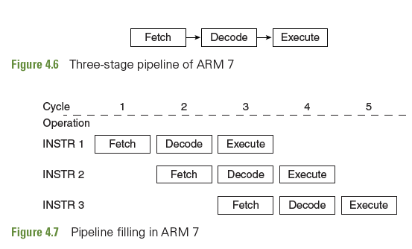
FIGURES SHOW THE THREE-STAGE PIPELINE OF ARM7.

Slide 67
ARM9 and ARM10
ARM9 processor is a 5 stage (five clock cycle) ARM state pipeline is used, consisting of FETCH, DECODE, EXECUTE, MEMORY and WRITE BACK stages.
ARM10 processor is a 6 stage consisting of FETCH ,ISSUE, DECODE,EXECUTE, MEMORY ,WRITE stages.

Slide 68
4.5 ADVANCED FEATURES

Slide 69
4.5.1 AMBA
AMBA is associated with ARM and it is a widely used interconnection standard for System on Chip (SoC) design.
AMBA stands for Advanced Microcontroller Bus Architecture.
In 1996 it was developed as a standard bus to facilitate the concept of modularity when adding on-chip functional blocks like memory and peripherals.
The AMBA specification has become a well-accepted de-facto standard for the semiconductor industry
used by 95% of ARM's partners and a number of IP providers.

Slide 70
AMBA Contd…
The AMBA interface is a processor and technology independent, and so the reusability of peripheral and system components is ensured across a wide range of applications.
The AMBA specification defines three buses
Advanced System Bus (ASB)
Advanced High-performance Bus (AHB)
Advanced Peripheral Bus (APB).
Figure shows that the high-performance modules are on the AHB/ ASB bus. There is a bridge which converts this standard to a lower speed peripheral bus.

Slide 71
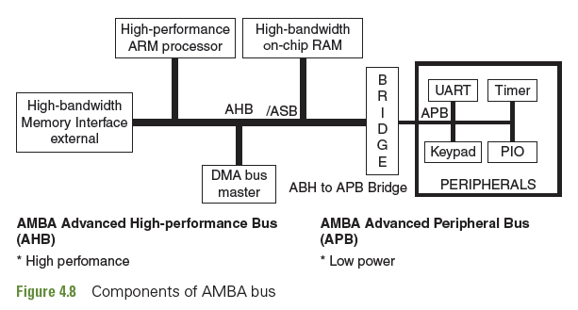
COMPONENTS OF AMBA BUS

Slide 72
These Buses are used in
The AHB is the backbone of the system and is designed specifically for high performance, high-frequency components. This includes the connections of processors, on-chip memories, and memory interfaces among others.
AHB is able to sustain the external memory bandwidth, on which the CPU, on-chip memory and other Direct Memory Access (DMA) devices reside. This part has to be a high-speed bus.
The ASB is an alternative to the AHB where some high-performance features are not needed.

Slide 73
Contd…
The APB is a simplified interface designed for low bandwidth peripherals that do not require the high performance of the AHB or the ASB.
APB is the part which is used by the on-chip peripherals and operates at a lower speed.
These include components like a UART, low-frequency GPIO, and timers.

Slide 74
In 2003, ARM introduced the 3rd generation, AMBA 3,
AMBA revision 3.0 introduced the AXI(Advanced eXtensible Interface) protocol to reach even higher performance interconnect and the Advanced Trace Bus (ATB) as part of the Core Sight on-chip debug and trace solution.
This is used in Cortex processors, not on ARM7.

Slide 75
4.5.2 COPROCESSORS
For ARM7 to ARM 11, additional and sometimes optional functions were obtained by the concept of coprocessors
A coprocessor is an additional functional block which has its own instruction set
When some function needs to be done, which is not supported by the general ARM core, a coprocessor is brought in to do it
For example, the ARM core is not capable of high-end floating point arithmetic processing.

Slide 76
When the need of such processing is needed, an arithmetic
coprocessor is used, which operates together at the same time with the main core.
Similar to this, there are coprocessors for the control of MMU, cache, DSP etc.
A licensee of ARM, when designing a chip, has the option to add the coprocessor modules that is needed for his design.

Slide 77
Each coprocessor has its own functional hardware with its instructions.
Up to 16 coprocessors (CPO to C15) have been defined in the ARM cores.
Some of the important architectures. All of them are not present in all core coprocessors of ARM7 are as follows:
CP10: Vector Floating Point unit
CP11: SIMD hardware and software named NEON
CP14: Debug unit
CP15: System control coprocessor for memory and cache management (including TCM)
The Cortex series does not use the concept of coprocessor.

Slide 78
4.5.3 MEMORY MANAGEMENT AND MEMORY PROTECTION
Many ARM cores have only a memory protection unit (MPU).
More advanced ARM chips have a memory management unit which includes protection features as well.
Here the MMU of a typical ARM7 chip. ARM710T is one such processor.
The MMU performs two primary functions:
Translation of virtual addresses to physical addresses
Provision of protection to memory by stipulating 'access permissions'

Slide 79
The MMU has the following dedicated hardware to perform these functions: 1.Translation Lookaside memory (TLB)
2.Access control Logic 3.Translation table walking logic
ARM7 memory sizes are designated as either sections or pages.
Sections are 1 MB blocks of memory. Pages may be small of size 4 KB, or large of size 64KB

Slide 80
Within the small page, there can be tiny pages (sub-pages)of size 1KB.
Within a large page, there can be 16KB sub-pages.
The sub Pages are meant to control access permission within a memory area which is smaller than the specified page.
The MMU also supports the concept of domains — which are areas of memory that can be defined to possess individual access rights.
The domain Access Control Register is used to specify access rights for up to 16 separate domains.

Slide 81
4.5.3.1 USING THE Translation Lookaside Buffer
A Translation Lookaside Buffer stores a certain number of translations of logical addresses to physical addresses.
For the ARM7 MMU, 64 translated entries are saved in the TLB.
If the required translation is available in the TLB, the 'access control logic‘ performs a permission check to verify if access is to be allowed.
If access is permitted, the MMU outputs the appropriate physical address corresponding to the virtual address.
If access is not permitted, the MMU signals the CPU to go to the abort mode through the abort exception.

Slide 82
4.5.3.1 USING THE TLB
If the TLB does not contain the physical address corresponding to the generated virtual address, the ‘Address Translation Logic’ which is referred to as ‘translation table walk hardware’ takes over.
This action calculates the physical address corresponding to the given logical(virtual)address.
Memory calculation is done after the physical address is calculated.
The results of address calculation is also placed in the TLB, overwriting an existing value there in.

Slide 83
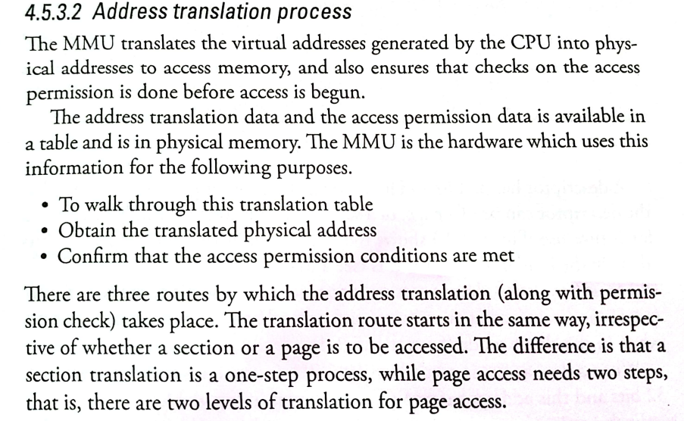
4.5.3.2 Address Translation Process

